Slide 1
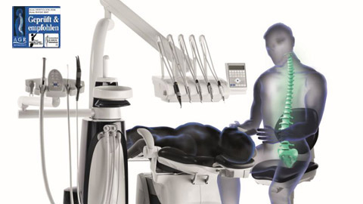

DENTAL ERGONOMICS
Dr. Meet Dedania

Slide 2
Definition-
Ergonomics- “ergon” means work and “omics” means law. It is the science of fitting the job settings conducive to the worker.
ERGONOMICS is a way to work smarter-not harder, by designing tools, equipment, work stations and tasks to fit the job to the worker-NOT the worker to the job.

Slide 3
Importance of ergonomics-
Proper ergonomic design is necessary to prevent repetitive strain injuries, which can develop over time and can lead to long-term disability.
The most prevalent regions for pain in dentists have been shown to be the back (36.3-60.1%) and neck (19.8-85%), while the hand and wrist regions were the most prevalent regions for dental hygienists (60-69.5%).

Slide 4
Ergonomic Design Goals:
Improve job process by eliminating unnecessary tasks, steps & effort.
Reduce potential for overexertion injury.
Minimize mental/physical fatigue potential.
Workers ’skills/knowledge of their jobs to increase their satisfaction, comfort and fulfillment.

Slide 5
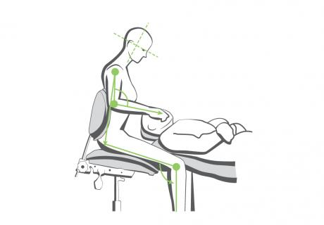
Operator Chair Position is that position the operator sits or stands in, thus giving him maximum accessibility and ease of operation in the patient’s mouth.
But, while treating a patient, three important factors are to be taken into consideration.
Operator Chair Position
Patient Chair Position
Chair Height.

Slide 6
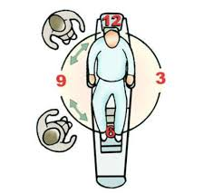
Operator chair positions-
The chair positions of an operator are represented by the clock for easy explanation.
The position of the operator is decided on the basis of the factors of visibility, accessibility and ease of operation as per the treatment required.

Slide 7
zones
The area around the patient’s chair is divided into four different zones
RIGHT HANDED CLINICIAN
LEFT HANDED CLINICIAN
The first zone is the Operator’s Zone- 7 o’clock to 12 o’clock.
The next one is called the Static Zone- 12 o’clock to 2 o’clock.
The third zone is the Assistant Zone- 2 o’clock to 4 o’clock.
The last or the fourth zone is the Transfer Zone- 4 o’clock to 7 o’clock.
12 o’clock to 5 o’clock - Operator’s Zone.
10 o’clock to 12 o’clock - Static Zone.
8 o’clock to 10 o’clock - Assistant Zone.
5 o’clock to 8 o’clock - Transfer Zone.

Slide 8
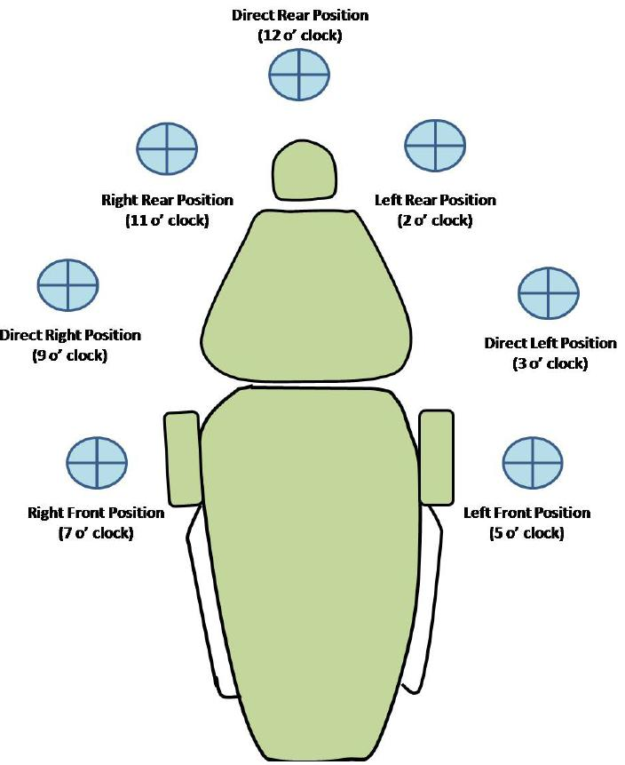

Slide 9
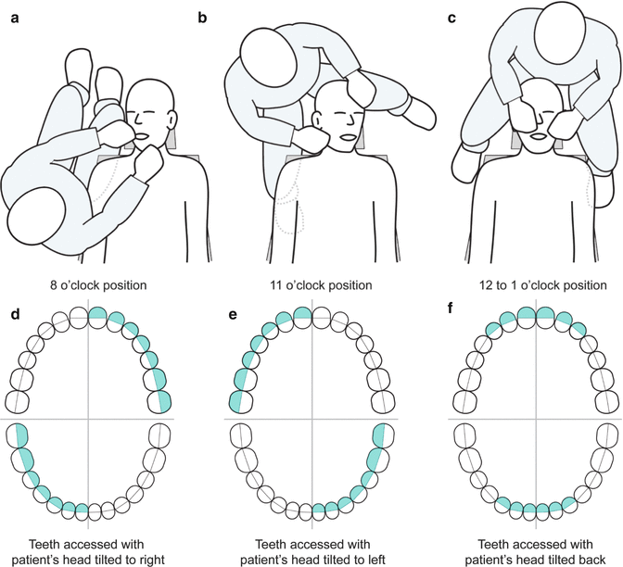
Operator zone-
This is the zone where the operator operates from.
It is further divided as follows:
8 o’clock position is called the Right Front Position.
9 o’clock or Direct Right Position.
11 o’clock or Right Rear Position.
12 o’clock or Direct Rear Position.

Slide 10
Patient chair position-
Two important points are to be considered while deciding the chair position of the patient.
The visibility and accessibility of the field required.
Comfort of the patient.
The patient should mostly be in Supine position.

Slide 11
Patient’s Body:
For Maxillary Teeth: The back of the chair should be at a 45 degree angle from the floor.
For Mandibular Teeth: The back of the chair should be almost parallel to the floor.
Chin Position:
For Maxillary Teeth: Chin up position.
For Mandibular Teeth: Chin down position.

Slide 12
Chair height-
For Maxillary Teeth:
The chair height should be 3 inches or 8 cm below the elbow of the operator.
For Mandibular Teeth:
The chair height should be 6 inches or 16 cm below the level of operator’s elbow.

Slide 13
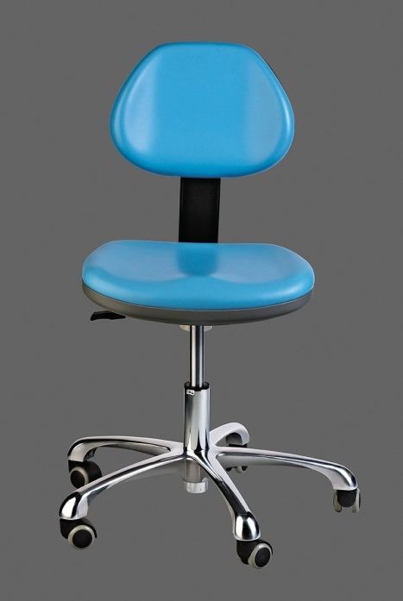
Operator stools:
The design of the stool is important.
It should be well balanced to prevent tipping/gliding away from dental chair

Slide 14
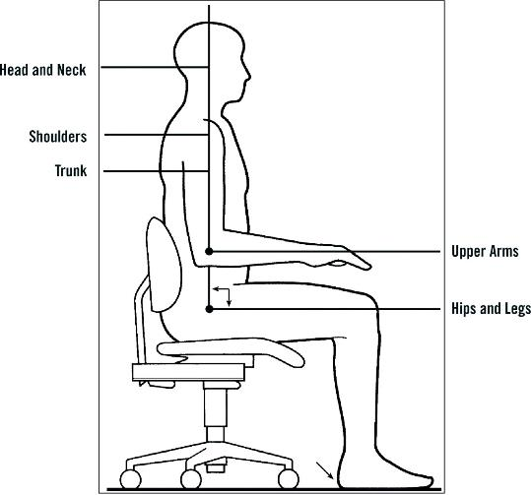
Clinician’s posture-
Forearms and thighs parallel to the floor.
Hip angle of 90 degrees.
Seat height positioned low enough so that the heels of the feet rest flat on the floor.
Back of the operator should always be straight.
Head should not bend or droop.

Slide 15
Ailments-
The following bodily disorders may occur if a proper posture is not maintained throughout one’s practice:
Carpal Tunnel Syndrome.
Thoracic Outlet Syndrome.
Rotator Cuff Tendonitis.
Tension Neck Syndrome
Lower back pain

Slide 16
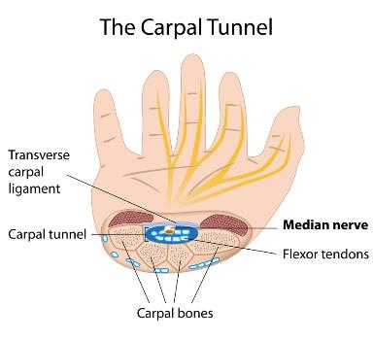
Carpal tunnel syndrome-
Hand or finger numbness, pain, tingling, burning, clumsiness
Eventual muscle weakness and atrophy
Pain or tingling that awakens the patient at night with relief via shaking/massaging the hand is considered a hallmark symptom for diagnosis
Possible causes: compressed median nerve in wrist via trauma, forceful exertion, repetitive and awkward movements that deviate from near-neutral positions

Slide 17
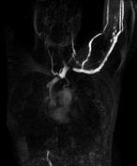
Thoracic outlet syndrome-
Pain in the shoulder, arm or hand (can be all three)
Numbness, tingling of fingers
Muscle weakness/fatigue
Cold arm or hand
Possible causes: compressed nerves or blood vessels passing into arms; trauma; forward or dropping shoulders

Slide 18
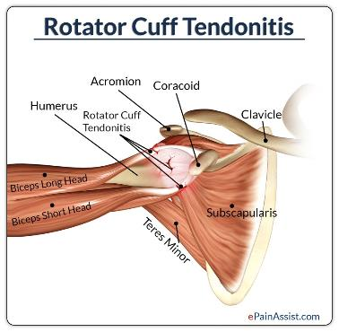
Rotator cuff tendonitis-
Pain and stiffness in the shoulder associated with backward and upward arm movements
Weakness of rotator cuff muscles
Possible causes: swelling or tearing of rotator cuff soft tissue; shoulder joint abnormalities; poor shoulder posture

Slide 19
Tension neck syndrome-
When the head is held in an awkward, unbalanced working position, the vertebrae cannot support the spine, which causes the shoulders stabilising muscles to quickly get fatigued.
When the other muscles, such as levator & trapezius , try to compensate & hold the neck & shoulders in a stabilized position ,they too get fatigued because they are performing the tasks for which they are not designed which leads to tension neck syndrome.
Chronic neck pain.
Headaches
Shoulder pain
Pain radiated to arms.
IN SEVERE CASE- Leads to cervical disc degeneration & Spondylosis.

Slide 20
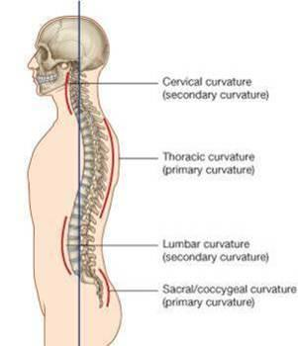
Lower back pain-
due to the tendency to come forward that makes muscle fatigue.
By eliminating the need to sacrifice ideal posture in order to gain visiblity & accessibility magnifying devices help dental professionals in maintaining the ideal posture i.e. maintaining the lumbar & cervical curvatures in harmony with the thoracic & sacral curvatures.

Slide 21
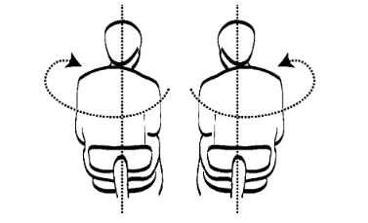
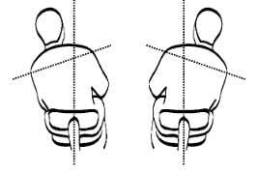
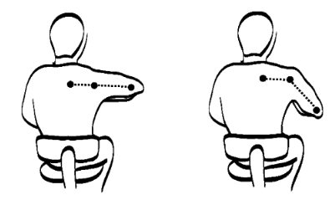
Following patterns associated with increased risk of Musculoskeletal symptoms
Torso twist
Tipped shoulder
Elbow raised during operation

Slide 22
Risk factors contribute to MSDs:
Repetitive motions
Excessive Force (e.g. tooth extraction).
Static neck, back, and shoulder postures.
Grasping small instruments for prolonged period
Prolonged use of vibrating hand tools.

Slide 23
general considerations:
The patient’s head should be rotated according to need of operator without hesitation
During working maxillary occlusal surfaces should be perpendicular to the floor and for mandibular occlusal surface should be 45 degrees
The operator should maintain space between the patient as like reading a book
There should be reduced contact with that of patient
The operator should never rest his hand on patient’s face
The chest of patient should never be used as trays to keep instruments
The left hand should be kept free to retract using the mouth mirror

Slide 24
Some wrong Postures In Dental Office

Slide 25
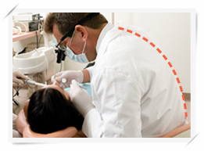
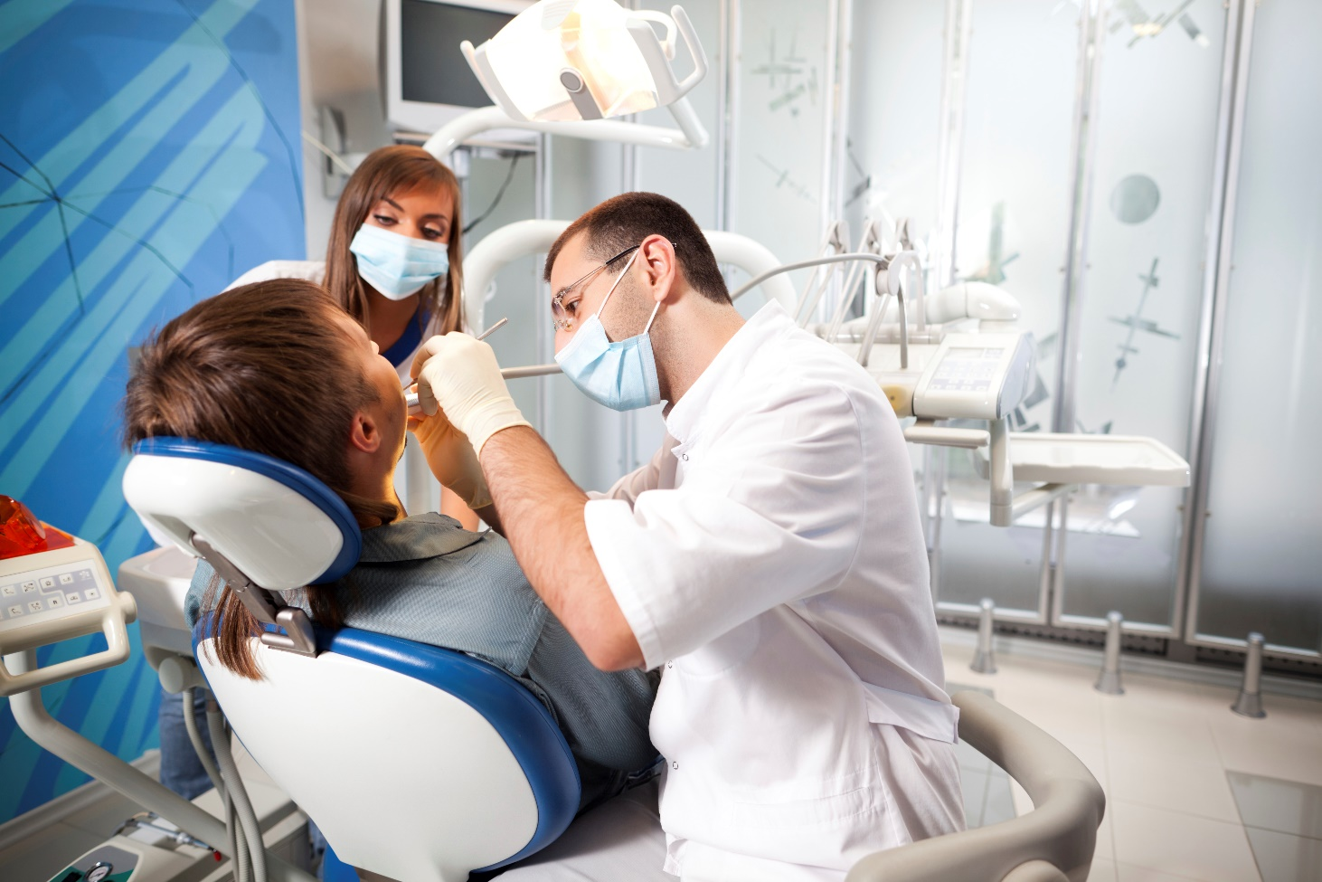
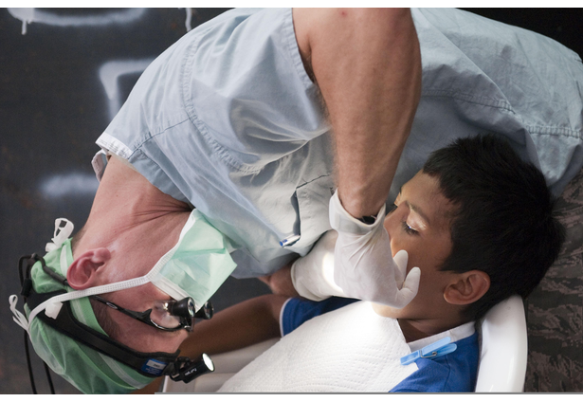
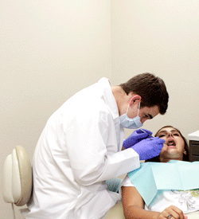
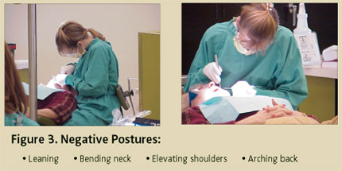

Slide 26
Application of Ergonomics in Dentistry
Instruments
Equipments
Work postures
Hand
instruments
Vibrating handpieces
Patient
position
Dentist
position
Lighting
magnification
Operator and patient chair

Slide 27
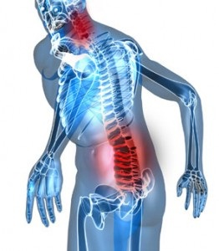
How to avoid all this pain!!!!
SCHEDULING

Slide 28
Scheduling
Recommendations when scheduling include:
• Incorporate brief “stretch break” periods between patients.
• Develop a patient difficulty rating scale to ensure difficult treatment sessions are not performed consecutively.
• Increase treatment time for more difficult patients.
• Alternate heavy and light calculus patients throughout the day.
• Alternate procedures performed.

Slide 29
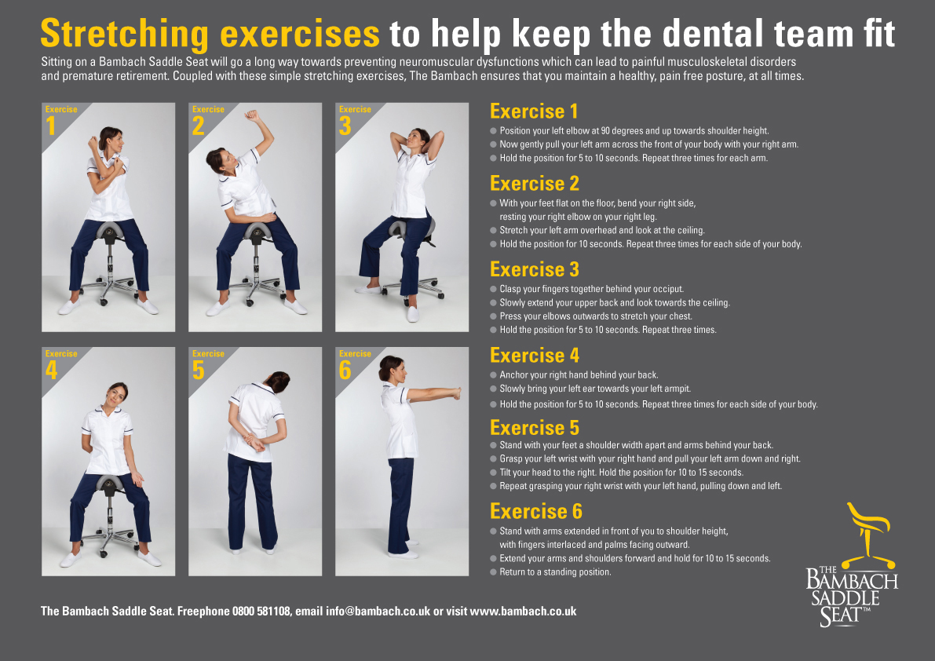

Slide 30
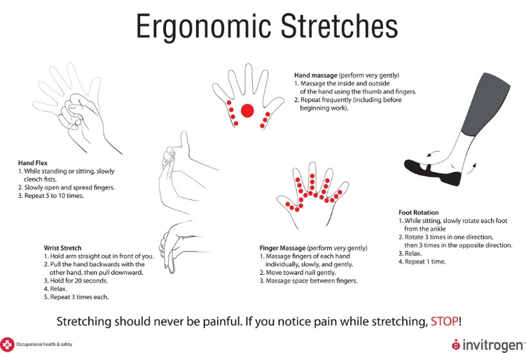

Slide 31
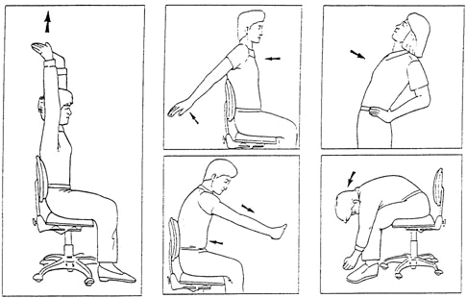
LOWER BACK STRETCH EXCERCISE

Slide 32
Prevalence of Work Related Musculoskeletal Disorders Among Physicians, Surgeons and Dentists: A Comparative Study
Ann Med Health Sci Res. 2014 Jul-Aug; 4(4): 578–582.
Aim:
The objective of this study was to evaluate MSDs in terms of perception of pain experienced by physicians, surgeons and dental surgeons during professional work.
Subjects and Methods:
The study was conducted with 100 physicians practicing either modern or alternative medicine, 100 surgeons of various specialties and 100 dental surgeons. Self-reporting work related questionnaire on MSDs were distributed, including information on the location of MSD symptoms in the past 12 months and the pain experienced.
Results:
Musculoskeletal pain was most prevalent among dentists 61% (61/100), followed by surgeons 37% (37/100) and physicians 20% (20/100).
Conclusion:
Within the limitations of the study, there is a higher prevalence of MSDs experienced by dental surgeons than physicians and surgeons.

Slide 33
MCQs
1. In right handed clinician assistant zone is from...
a. 2 to 4o’clock
b. 12 to 4o’clock
c. 4 to 7o’clock
d. 10 to 8o’clock

Slide 34
2. For manibular teeth the chair height should be ------ from the operators elbow
a. 6 cm
b. 5 cm
c. 8 cm
d. 16 cm

Slide 35
3. Carpel Tunnel syndrome ifs due to compression of??
a. Radial nerve
B. Median nerve
c. Ulnar nerve
d. Sciatic nere

Slide 36
4. Forearms and hips should always be
a. 30 degree to floor
b. 90 degree to floor
c. 120 degree to floor
d. 0 degree to floor

Slide 37
5. In left handed clinician the operators zone is …..
a. 7 to 12o’clock
b. 12 to 5o’clock
c. 4 to 2o’clock
d. 6 to 7o’clock

Slide 38

