Slide 1
Biomechanics of Thorax
Dr. Parth Devmurari

Slide 2
Objectives
At the end of the lecture students will be able to,
  Describe anatomy of thorax and musculature
  Describe biomechanics of thorax
  Describe the patho-mechanics of thorax

Slide 3
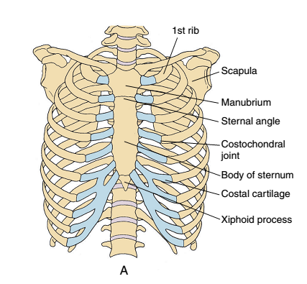

Slide 4
Introduction
The thorax, consisting of the thoracic vertebrae, the ribs,
and the sternum has several important
functions.
It provides a base for the muscle attachment
of the upper extremities,
the head and neck, the vertebral
column, and the pelvis.
The thorax also provides protection for the heart, lungs, and viscera.

Slide 5
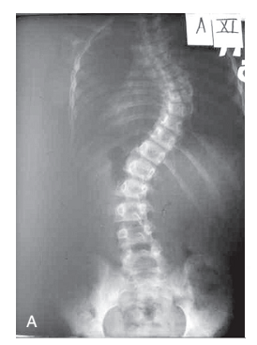

Slide 6
Due to pathology
Function, especially ventilatory function, can be affected when pathology interferes with the structure of the bony thorax. For example, scoliosis is a pathological lateral curvature of the spine frequently associated with rotation of the vertebrae.
right thoracic scoliosis (named for the convex side of the thoracic curve) results in left lateral flexion of the thoracic spine. The coupled rotation in a typical right thoracic scoliosis causes the bodies of the vertebrae to rotate to the right and the spinous processes to rotate to the left.
The right transverse processes of the vertebrae rotate posteriorly, carrying the ribs with them. This is the mechanism that causes the classic posterior rib hump of scoliosis. On the concave side of the scoliotic curve, the effects are just the opposite. The transverse processes of the vertebrae move anteriorly, bringing the articulated ribs forward. The rib distortion that results from the vertebral rotation is evident bilaterally.
These musculoskeletal abnormalities limit the range of motion of the rib cage and the spine and, therefore, decrease ventilatory abilities.

Slide 7
Function
It provides a base for the muscle attachment of the upper extremities, the head and neck, the vertebral column, and the pelvis. The thorax also provides protection for the heart, lungs, and viscera. Therefore, there needs to be a certain amount of inherent stability to the thorax. The structure of the rib cage significantly increases the stability of the thoracic spine in flexion/extension, lateral bending, and rotation.

Slide 8
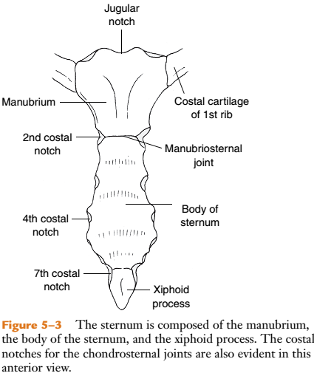
Sternum
The sternum is an osseous protective plate for the heart and is composed of the manubrium, body, and
xiphoid process

Slide 9
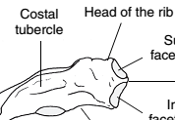
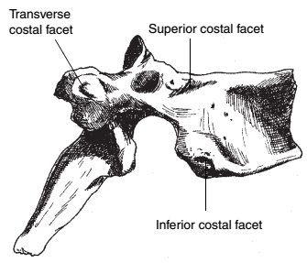
Vertebrae
There are 12 thoracic vertebrae that make up the posterior aspect of the rib cage
Vertebral body and transverse processes have total of 6 costal articulating surfaces.
4 on the body (a superior and an inferior costal facet,
or demifacet, on each side)
1 costal facet on each transverse process

Slide 10
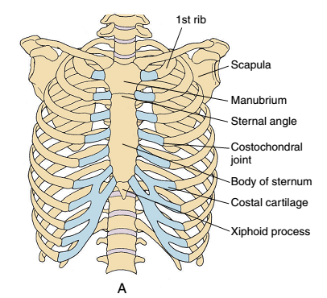
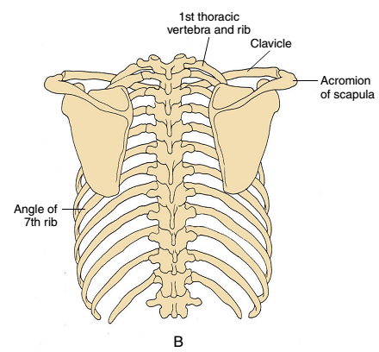
Rib cage

Slide 11
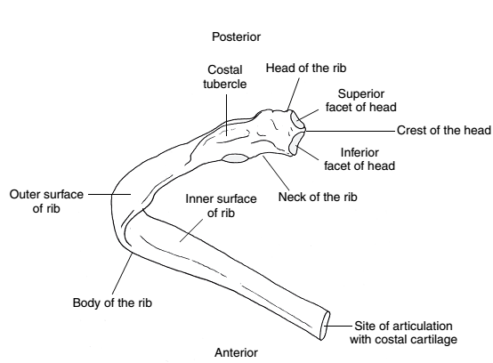
Ribs
The rib cage also includes
12 pairs of ribs. The ribs are curved flat bones
The posteriorly located head of each rib articulates with contiguous thoracic vertebral bodies.
Posteriorly, head of the rib articulates with contiguous thoracic bodies. The costal tubercles of ribs 1 to 10 also articulate with the transverse processes of thoracic vertebrae.
Anteriorly, ribs 1 to 10 are joined either
directly or indirectly to the sternum through their costal
cartilages

Slide 12
True ribs
Ribs 1 through 7 are classified as vertebrosternal (or “true”) ribs because each rib, through its costo-cartilage, attaches directly to the sternum.

Slide 13
False ribs
The costo-cartilage of ribs 8 through 10 articulates with the costocartilage of the superior rib, indirectly articulating with the sternum via rib 7. These ribs are classified as vertebrochondral (or “false”) ribs.
The 11th and 12th ribs are called vertebral (or “floating”) ribs because they have no anterior attachment to the sternum

Slide 14
Articulations of the Rib Cage
The articulations that join the bones of the rib cage include
the
manubriosternal,
xiphisternal,
costovertebral,
costotransverse,
costochondral,
chondrosternal, and
interchondral joints

Slide 15
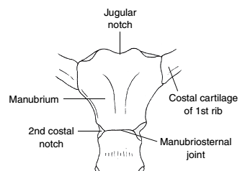

Manubriosternal and Xiphisternal Joints
The manubrium and the body of the sternum articulate at the manubriosternal joint.
Also known as the sternal angle or the angle of Louis and is readily palpable as a horizontal ridge at the level of the
second ribs’ anterior attachments.
The manubriosternal joint is a synchondrosis.
Ossifies at older adult’s age
The xiphoid process joins the inferior aspect of the sternal body at the xiphisternal joint. Ossifes at 40-50 years

Slide 16
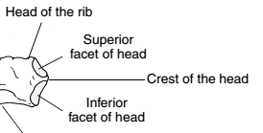
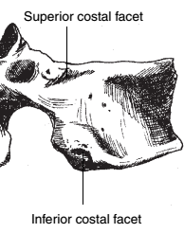
Costovertebral Joints
The typical costovertebral joint is a synovial joint formed by the head of the rib, two adjacent vertebral bodies, and the interposed intervertebral disc.
Ribs 2 through 9 have typical costovertebral joints
Each rib’s superior facet articulates with the inferior facet of the vertebrae above it. Each rib’s inferior facet articulates with the superior facet of its own numbered vertebrae
Ribs 1, 10, 11, and 12 are atypical ribs because they articulate with only one vertebral body and are numbered by that body.

Slide 17
Ligaments
Costovertebral joint is divided into two cavities by intra-articular ligament, it attaches to annular fibrosus of the inter vertebral disc.
The radiate ligament is located within the capsule, with firm attachments to the anterolateral portion of the capsule.
the superior band, which attaches to the superior vertebra; the intermediate band, which attaches to the intervertebral disc; and the inferior band which attaches to inferior vertebra.
A fibrous capsule surrounds the entire articulation of each costovertebral joint.
The atypical costovertebral joints of ribs 1, 10, 11, and 12 are more mobile than the other. The interosseous ligament is absent in these joints

Slide 18
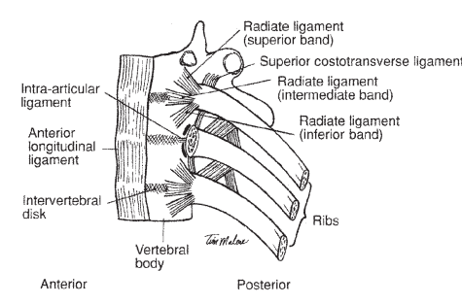

Slide 19
Costotransverse Joints
The costotransverse joint is a synovial joint formed by the articulation of the costal tubercle of the rib with a costal facet on the transverse process of the corresponding vertebra.
At these joints T1 through approximately T6 costal facets have slightly concave facets on the transverse process of vertebra and ribs have convex costal tubercle therefore it allows rotation of ribs

Slide 20
Ligaments
The costotransverse joint is surrounded by a thin, fibrous capsule.
These are the lateral costotransverse ligament,
  short, stout band located between the lateral portion of the costal tubercle and the tip of the corresponding transverse process
Costotransverse ligament,
  Costotransverse foramen between the neck of the rib posteriorly and the transverse process at the same level.
Superior costotransverse ligament
  Runs from the crest of the neck of the rib to the inferior border of the cranial transverse process.

Slide 21
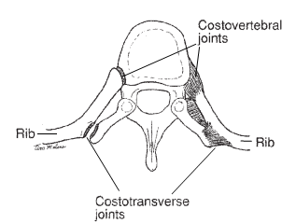

Slide 22
Costochondral and Chondrosternal Joints
The costochondral joints are formed by the articulation of the 1st through 10th ribs antero-laterally with the costal cartilages.
This joint is synchondrosis and has no ligament support.
The chondrosternal joints are formed by the articulation of the costal cartilages of ribs 1 through 7 anteriorly with the sternum

Slide 23
Costochondral and Chondrosternal Joints
Rib 1 attaches to the lateral facet of the manubrium, rib 2 is attached via two demifacets at the manubriosternal junction, and ribs 3 through 7 articulate with the lateral facets of the sternal body.
The chondrosternal joints of ribs 1, 6, and 7 are synchondroses.
The chondrosternal joints of ribs 2 through 5 are synovial joints.
The chondrosternal joints of ribs 1 through 7 have capsules.

Slide 24
Ligaments
Ligamentous support for the capsule includes anterior and posterior radiate costosternal ligaments.
The sternocostal ligament is an intra-articular ligament, similar to the intra-articular ligament of the costovertebral joint, that divides the two demifacets of the second chondrosternal joint.
The costoxiphoid ligament connects the anterior and posterior surfaces of the seventh costal cartilage to the front and back of the xiphoid process.

Slide 25
Interchondral Joints
The costal cartilages of ribs 7 through 10 each articulate with the cartilage immediately above them to form the interchondral joints.
The interchondral joints are synovial joints and are supported by a capsule and interchondral ligaments.

Slide 26
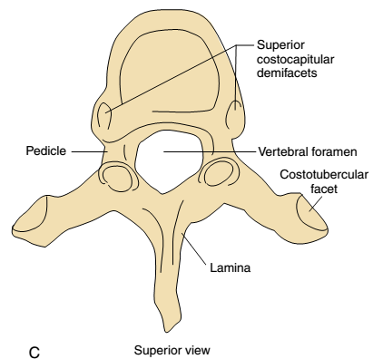
Thoracic vertebrae

Slide 27
Kinematics of the ribs and manubrio-sternum
Movement of the thorax is possible by
  Types and angles of articulation
  Movement of the manubrio-sternum
  The elasticity of the costal cartilages

Slide 28
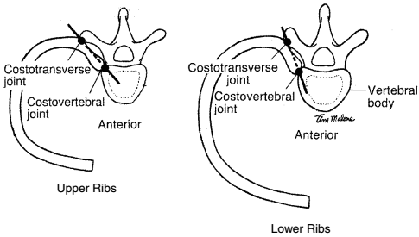
Ribs
The costovertebral and costotransverse joints are mechanically linked, with a single axis of motion for elevation and depression passing through the centres of both joints.
During inspiration, the costovertebral joint moves superiorly and posteriorly, elevating the first rib.

Slide 29
Ribs
1st rib thick large attachment with manubrio-sternum.
During inspiration
Ribs 2 through 7, which are attached to the body of the sternum, increase in length and mobility the more caudal the rib.
The costal cartilage rotates upward, becoming more horizontal with inspiration.
The movement of the ribs pushes the sternum ventrally and superiorly
The greatest effect of the motion of the upper ribs and sternum is the increase in the anteroposterior (A-P) diameter of the thorax. This combined rib and sternal motion that occurs in a predominantly sagittal plane has been termed the “pump-handle” motion of the thorax.

Slide 30
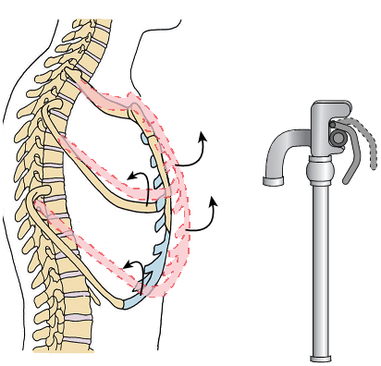

Slide 31
Ribs
Elevation of ribs 8 through 10 occurs about an axis of motion lying more towards the sagittal plane.
The lower ribs have a more angled shape and an indirect attachment anteriorly to the sternum.
It allow the lower ribs more motion at the lateral aspect of the rib cage.
The greatest effect of the elevation of the lower ribs is the increase in the transverse diameter of the lower thorax. This motion that occurs in a more frontal plane has been termed the “bucket-handle” motion of the thorax

Slide 32
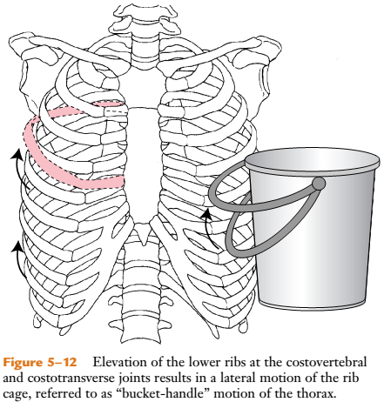

Slide 33
Ventilator Muscles
The ventilator muscles are striated skeletal muscles that differ from
other skeletal muscles in a number of ways:
(1) They have increased fatigue resistance and greater oxidative
capacity;
(2) They contract rhythmically throughout life rather than episodically;
(3) They work primarily against the elastic properties of the lungs and airway resistance rather than against gravitational forces;
(4) Neurological control of these muscles is both voluntary and involuntary; and
(5) The actions of these muscles are life sustaining.

Slide 34
The ventilatory muscles are classified as either primary or accessory muscles of ventilation.
Any muscles which are attached to chest wall can contribute to ventilation
The recruitment of muscles for ventilation is related to the type of breathing being performed.
In quiet breathing that occurs at rest, only the primary inspiratory muscles are needed for ventilation.
During active or forced breathing that occurs with, for example, increased activity or pulmonary pathologies, accessory muscles of both inspiration and expiration are recruited to help meet the increased demand for ventilation.

Slide 35
Primary or accessory muscles of ventilation
Inspiration
Primary muscles
Diaphragm, scalene, parasternal
Accessory muscles
SCM, Upper trepezius, pectoralis major and minor
External intercostals
Zone of apposition: the vertical fibers of the diaphragm which lie close to the inner wall of the lower rib cage- during tidal breathing it contracts

Slide 36
Primary Muscles of Ventilation
The diaphragm,
The intercostal muscles (particularly the parasternal muscles), and
The scalene muscles.
There are no primary muscles for expiration because expiration at rest is passive.

Slide 37
Diaphragm
The diaphragm is the primary muscle of ventilation, accounting for approximately 70% to 80% of inspiration force during quiet breathing.
The fibers travel cephalad (superiorly) from their origin to insert into a central tendon.
Functionally, the muscular portion of the diaphragm is divided into dorsal(posterior) and ventral(anterior) segments. The ventral segment, called the costal fibers, arises from the sternum and ribs. The dorsal segment of the diaphragm, termed the crural fibers, arises from the vertebral bodies.

Slide 38
Costal part
The costal fibers of the diaphragm originate from the posterior aspect of the xiphoid process, the inner surfaces of the lower six ribs, and the costal cartilages of those ribs.
The costal fibers of the diaphragm run vertically from their origin, in close apposition to the rib cage, and then curve to become more horizontal before inserting into the central tendon. The vertically traveling costal fibers of the diaphragm, which lie close to the inner wall of the lower rib cage, form a functional unit called the zone of apposition

Slide 39
Crural part
The crural fibers of the diaphragm originate from two tendonous structures, called the right and left crus, and from the aponeurotic arcuate ligaments (Medial & Lateral). The right and left crus are tendons that arise from the L1 to L3 vertebrae.
The tendons pass ventrally and medially, joining together to form an arch just ventral to the aorta. The medial arcuate ligament arches over the upper anterior part of the psoas muscles. The lateral arcuate ligament covers the quadratus lumborum muscles.

Slide 40
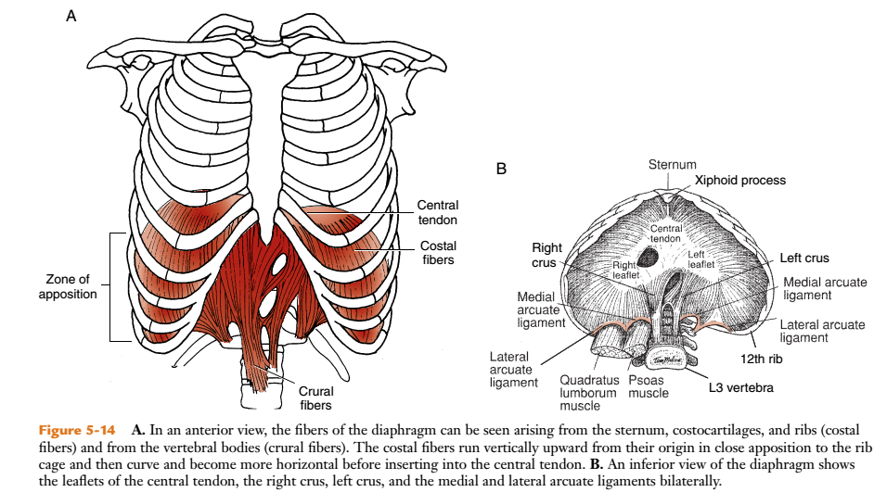

Slide 41
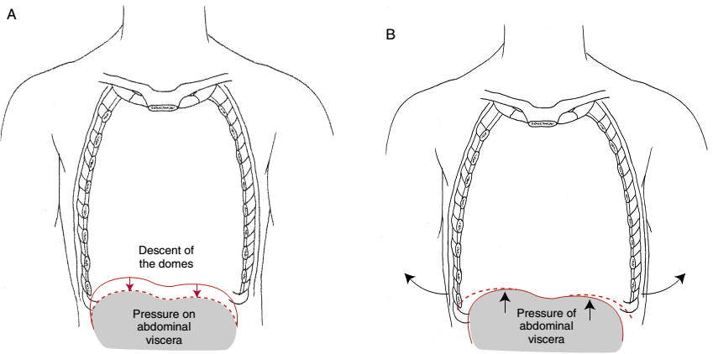

Slide 42
During tidal breathing
During tidal breathing, the fibers of the zone of apposition of the diaphragm contract, causing a descent (but only a slight change in contour) of the dome of the diaphragm.
As the dome descends, the abdominal contents are compressed, increasing intra-abdominal pressure.
With a deeper inhalation, the abdomen, now compressed, acts to stabilize the central tendon of the diaphragm.
With a continued contraction of the costal fibers of the diaphragm against the stabilized central tendon, the lower ribs are now lifted and rotated outwardly in the bucket-handle motion

Slide 43
During tidal breathing
The action of the crural fibers of the diaphragm results in a descending of the central tendon, increasing intra-abdominal pressure. This increased pressure is transmitted across the apposed diaphragm to help the costal fibers of the diaphragm expand the lower rib cage.

Slide 44
Normal Breathing Mechanism
The thoracoabdominal movement during quiet inspiration is a result of the pressures that are generated by the contraction of the diaphragm. When the diaphragm contracts and the central tendon descends, there is an increase in thoracic size and a resultant decreased intrapulmonary pressure that is responsible for inspiration. There is also an increase in abdominal pressure, which causes the abdominal contents to be displaced anteriorly and laterally.
When muscle contraction of the diaphragm ceases (stops), the domes returns to their resting position within the thorax. The thoracic volume decreases, intrapulmonary pressure increases, and exhalation occurs. The abdominal contents return to their starting position.

Slide 45
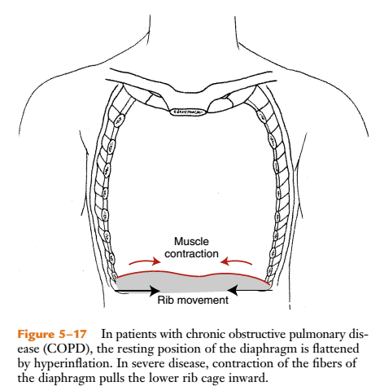
Pathophysiology Of COPD

Slide 46
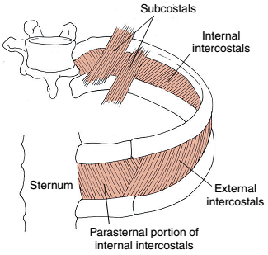
Intercostal Muscles

Slide 47
Intercostal Muscles
Internal intercostals
External intercostals
However, only the parasternal muscles (immediately adjacent to the sternum) are considered primary muscles of ventilation.
The internal intercostal muscles arise from a ridge on the inner surfaces of ribs 1 through 11 and insert into the superior border of the rib below. It runs caudally and posteriorly.
The external intercostal muscles originate on the inferior borders of ribs 1 through 11 and insert into the superior border of the rib below. The fibers run caudally and anteriorly.
The subcostal muscles originate at the rib angles and may span more than one intercostal space before inserting into the inner surface of a caudal rib. Generally present in the lower ribs.

Slide 48
Functions of intercostals in respiration
Funcitons of muscles is controversial.
In 1749, Hamberger proposed an oversimplified theory that the external intercostal muscles tend to raise the lower rib up to the higher rib, which is an inspiratory motion, and the internal intercostal muscles tend to lower the higher rib onto the lower rib, which is an expiratory motion. Later EMG studies proved it right.
During deep inhalation only lower intercostals appears to work.
The parasternal muscles, internal intercostal muscles, are considered primary inspiratory muscles during quiet breathing.

Slide 49
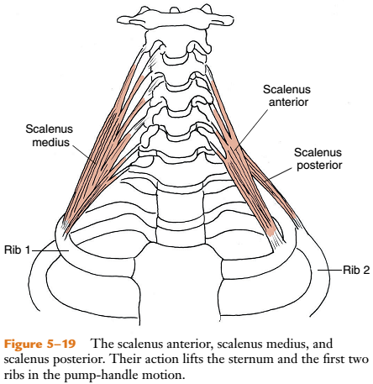
Scalene Muscles

Slide 50
Scalene Muscles
The scalene muscles are also primary muscles of quiet ventilation.
It lifts the first two ribs, and therefore the sternum, in the pump -handle motion of the upper rib cage.
also acts as stabilizers of the rib cage.
Origin | Insertion
Transverse processes of C3 to C7 | upper borders of the first rib (scalenus anterior and scalenus medius) and second rib (scalenus posterior).

Slide 51
Accessory Muscles of Ventilation
INSPIRATORY MUSCLES | EXPIRATORY MUSCLES
Sernocleidomastoid | Pectoralis major (clavicular head) when arms below clavicle
Pectoralis major (sternocostal ), pectoralis minor | Abdominal muscles
Upper trepezius | Internal intercostals
External intercostals
Subclavius

Slide 52
Accessory Muscles of Ventilation
The muscles that attach the rib cage to the shoulder girdle, head, vertebral column, or pelvis may be classified as accessory muscles of ventilation. These muscles assist with inspiration or expiration in situations of stress, such as increased activity or disease.

Slide 53

Accessory Muscles of Ventilation
Why is it called Accessory Muscles?
It moves vertebral column,
Arm, and
Head or pelvis on the trunk
The accessory muscles of inspiration increase the thoracic diameter by moving the rib cage upward and outward. The accessory muscles of expiration move the diaphragm upward and the thorax downward and inward.

Slide 54
Sternocledomastoid
flexion of the cervical spine.
(when head is stabilized with trapezius)Pull the rib cage superiorly, expanding the upper rib cage in the pump-handle motion.

Slide 55
Pectoralis major (sternal head & clavicular head)
(Sternal head)can elevate the upper rib cage when the shoulders are stabilized.
(Clavicular head) according the position of the humerus it acts as either inspiratory or expiratory.
The pectoralis minor can help elevate the third, fourth, and fifth ribs during active inspiration.
The subclavius, a muscle between the clavicle and the first rib, can also assist in raising the upper chest for inspiration.

Slide 56
The abdominals
The abdominal muscles (transversus abdominis, internal oblique abdominis, external oblique abdominis, and
rectus abdominis) are trunk flexors and rotators.
The major function of the abdominal muscles in ventilation is to assist with forced expiration. The muscle fibers pull the ribs and costal cartilages caudally, into a motion of exhalation.
By increasing intra-abdominal pressure, the abdominal muscles can force the diaphragm upward into the thoracic cage, increasing both the volume and speed of exhalation.

Slide 57
The transversus thoracis
The transversus thoracis (triangularis sterni) muscles are a flat layer of muscle that runs deep to the parasternal muscles.
It recruits along with abdominals to pull rib cage caudally during active exhalation e.g coughing, laughing or talking.

Slide 58
COPD
Damage to the airways and alveolar walls destruction occurs
- elastic recoil property of the lung- diminished
More air is now housned [trapped] with the lungs at the end of exhalation
Passive exhalation that depends upon elastic recoil of the lung becomes ineffective in removing air from the thorax.
Air trapping and hyperinflation occurs.

Slide 59
The static position for the thorax changes.
Hyperinflation not only effects the bony components but also
Muscles of the chest wall- diaphragm flattened
The angle of pull of the diaphragm changes and so that strength and range of contraction also.

Slide 60
COPD
In severe cases of hyperinflation, the fibers of the diaphragm aligned horizontally, contraction of the lower rib cage inward.
Majority of the inspiration is now performed by accessory muscles.
SCM will be now in shorten position because of the barrel chest.
The upper rib cage is pulled upward and outward.

Slide 61
COPD
May be thoracoabdominal breathing pattern ( paradoxical breathing) present
Increased demand of ventilation for COPD patients
More work is required for less effective system

Slide 62
Restrictive lung disease
Compliance is a measurement of the distansibility of a structure or system.
During diaphragm contraction, the abdomen becomes the fulcrum for lateral expansion of the rib cage.
Therefore compliance of the abdomen is a factor in the inspiratory movement of the thorax.
Compliance = change in volume per unit of pressure

Slide 63
SCOLIOSIS
Scoliosis is an abnormal lateral curvature of spine.
In scoliosis- the thoracic vertebrae not only laterally deviate but also rotate, altering the alignment of costovertebral and costotransverse articulating surfaces.
Alteration in the thoracic curve affect ventilation more than alterations in lumbar or cervical spine.
Bodies of the thoracic vertebrae rotate.
On the side of convexity :
- Transverse process move posterior with the their ribs (posterior rib hump).
- Intercostal spaces widen

Slide 64
SCOLIOSIS
On the side of concavity:
Transverse process move anterior with their ribs.
Intercostal spaces narrow
If the deformity is severe- axis of rotation will shift and reduced the efficiency of the intercostals and reduced rib cage compliance.
This will lead to decreased lung volumes and capacities.

Slide 65
P : COPD
I : Pursed lip breathing
c : No treatment
O : FEV1, IC, MIF at 50% of VC, and peak expiratory flow.

Slide 66
Pursed lip breathing improves inspiratory capacity in COPD
Objective: The purpose of this study was to measure the effect of PLB on inspiratory parameters.
Methods : 35 patients with stable COPD and a forced expiratory volume (FEV1) < 50% of the predicted value were tested following primary parameters before and immediately after PLB , and 5 min later: forced IVC, IC, FEV1 AT 50% of VC.

Slide 67
RESULTS: of all primary parameters only IC improved significantly.
Conclusion:
- Improved IC after PLB Indicate less hyperinflation in patients with severe COPD; there was no effect on parameter of flow.

Slide 68
MCQ
1. Menubriosternal joint type is _____________.
Synchondrosis
Synovial
.

Slide 69
2. True or false
True ribs which are indirectly attached with the sternum
TRUE
FLASE

Slide 70
3. True or false
Atypical costovertebral joints are indirectly attaches with one corresponding thoracic vertebrae.
TRUE
FALSE

Slide 71
4. How many demicostal facets present at thoracic vertebral body?
4
2

Slide 72
5. Ribs are increased in length from.
1st rib to 12th rib
12th rib to 1st rib

Slide 73
6. _____ is one of the attachment for the diaphragmatic fibers.
Crural portion
Intebertebral disc
Thoracic spinous process

Slide 74
7. True or false
In COPD patients diaphragm becomes flattened.
TRUE
FALSE

Slide 75
MCQ
8. TRUE or FALSE
The abdominal muscles are used during forced inspiration
TRUE
FLASE

Slide 76
9. Hyperinflation of the lungs seen in
COPD
Scoliosis

Slide 77
10. True or false
In COPD patients work of breathing and demand of ventilation increased.
TRUE
FALSE

