Slide 1
Biomechanics of Lumbar Spine
22/04/2016

Slide 2
Typical Lumbar Vertebrae
Body
It is massive, with a transverse diameter that is greater than the anterior diameter and height.
The size and shape reflect the need to support great compressive loads caused by body weight, ground reaction forces, and muscle contraction.

Slide 3
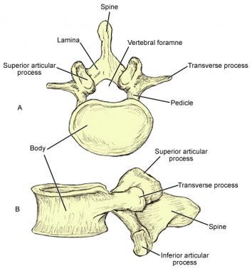

Slide 4
Arches
Pedicles- They are short and thick and project posterolaterally.
Laminae are short and broad.
Zygapophyseal Articular Processes (facets) both the superior and inferior facets vary considerably in shape and orientation.
Inferior zygapophyseal facets are vertical and convex and face slightly anteriorly and laterally

Slide 5
Transverse Process is long and slender and extends horizontally.
Spinous Process is broad and thick and extends horizontally.
Vertebral Foramen is triangular and larger than the thoracic vertebral foramen but smaller than the cervical vertebral foramen.
The fifth lumbar vertebra is a transitional vertebra and differs from the rest of the lumbar vertebrae in that it has a wedge-shaped body wherein the anterior portion of the body is of greater height than the posterior portion.
The L5/S1 lumbosacral disk also is wedge shaped.

Slide 6
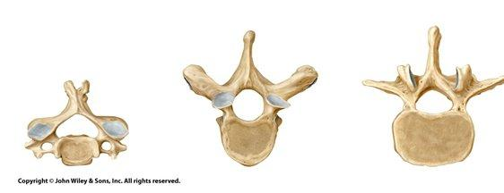
Difference in Regional Vertebras

Slide 7
Lumbo sacral articulation
Lumbo sacral angle.
The size of the angle varies with the position of the pelvis and affects the superimposed lumbar curvature.
An increase in this angle will result in an increase in lordosis of the lumbar curve and will increase the amount of shearing stress at the lumbosacral joint.

Slide 8
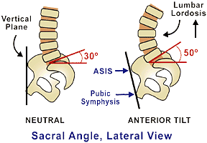
Lumbo Sacral Angle

Slide 9
Intervertebral Disc
The intervertebral discs of the lumbar region are the largest in the body, differs from the disks of the cervical region in that the collagen fibers of the anulus fibrosus are arranged in sheets called lamellae.

Slide 10
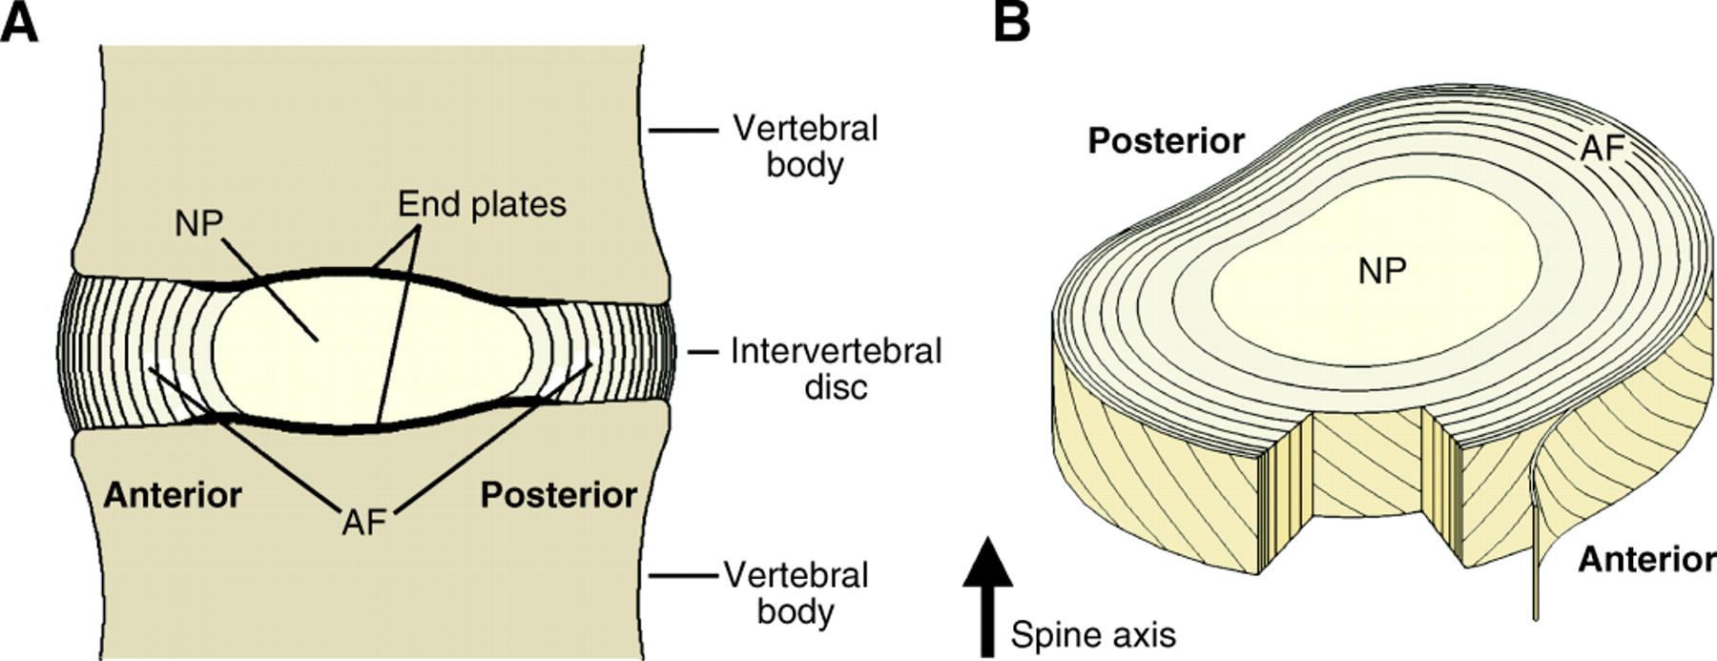

Slide 11
The lamellae are arranged in concentric rings that surround the nucleus.
Collagen fibers in adjacent rings are oriented in opposite directions at 120˚ to each other.
This provides a greater cross-sectional area of anulus fibrosus posteriorly and hence increased ability to resist the tension that occurs here with forward bending.

Slide 12
Articulations
The interbody joints of the lumbar region are capable of translations and tilts in all directions.
Zygapophyseal joints of the lumbar region, like all others, are true synovial joints and contain fibroadipose meniscoid structures.

Slide 13
Ligaments and Fascia
The majority of the ligaments associated with the lumbar region are the ligamentum flavum, PLL, anterior longitudinal ligament, inter spinous and supra spinous ligaments, and joint capsules.
Iliolumbar Ligaments : extends from the tips and borders of the transverse processes of L4 and L5 to attach bilaterally on the iliac crests of the pelvis.
The iliolumbar ligaments as a whole are very strong and play a significant role in stabilizing the fifth lumbar vertebra (preventing the vertebra from anterior displacement) and in resisting flexion, extension, axial rotation, and lateral bending of L5 on S1.

Slide 14
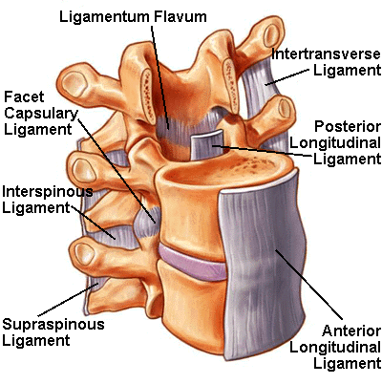

Slide 15
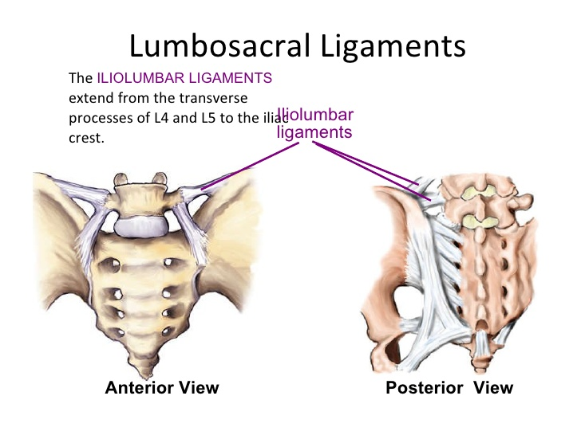

Slide 16
Kinematics
The lumbar region is capable of movement in flexion, extension, lateral flexion, and rotation.
The lumbar zygapophyseal facets favor flexion and extension, because of the predominant sagittal plane orientation.
Amount of flexion varies at each interspace of the lumbar vertebrae, but most of the flexion takes place at the lumbosacral joint.
During flexion and extension, the greatest mobility of the spine occurs between L4 and S1, which is also the area that must support the most weight.

Slide 17
Rotation in this region is more limited because of the shape of the zygapophyseal joints.
Coupled motions always occur with lateral flexion and axial rotation.
With lateral flexion, pronounced flexion and slight ipsilateral rotation occurs.
With axial rotation, however, substantial lateral flexion in a contralateral direction occurs, but only a slight amount of flexion occurs.

Slide 18
Lateral flexion and rotation are most free in the upper lumbar region and progressively diminish in the lower region.
The largest lateral flexion ROM and axial rotation occurs between L2 and L3.
Little or no lateral flexion or rotation is possible at the lumbosacral joint.
The posterior anulus fibrosus and the PLL seem to play an important role in limiting axial rotation when the spine is flexed.

Slide 19
The zygapophyseal joint capsules limit rotation in both the neutral and extended positions of the spine.

Slide 20
Lumbar-Pelvic Rhythm
Cailliet described a specific instance of coordinated, simultaneous activity of lumbar flexion and anterior tilting of the pelvis in the sagittal plane during trunk flexion and extension. He called the combined lumbar and pelvic motion lumbar-pelvic rhythm.
The activity of bending over to touch one’s toes with knees straight depends on lumbar-pelvic rhythm. According to Cailliet, the first part of bending forward consists of lumbar flexion, followed next by anterior tilting of the pelvis at the hip joints .
A return to the erect posture is initiated by posterior tilting of the pelvis at the hips, followed by extension of the lumbar spine.

Slide 21
A restriction of motion at either the lumbar spine or at the hip joints may disturb the rhythm and prevent a person from reaching the toes.
Restriction of motion at one segment also may result in hypermobility of the unrestricted segment.

Slide 22
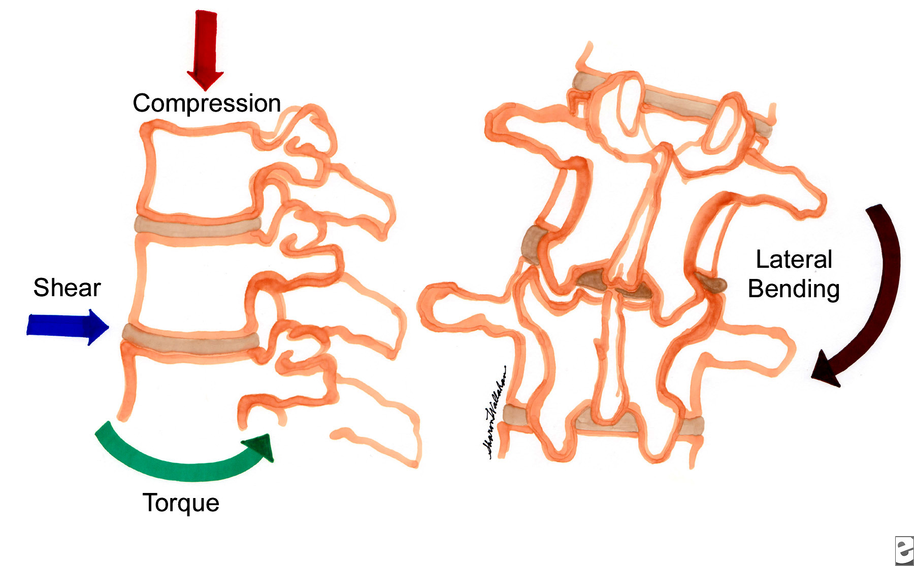
Forces at Lumbar Vertebra

Slide 23
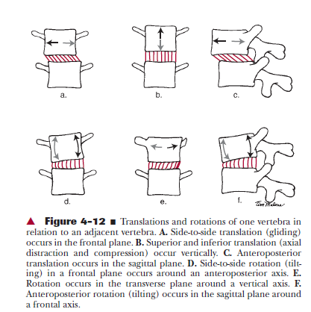
Translations and Rotations at Lumbar Spine

Slide 24
Kinetics
Compression
One of the primary functions of the lumbar region is to provide support for the weight of the upper part of the body in static as well as in dynamic situations. increased size of the lumbar vertebral bodies and disks in comparison with their counterparts helps the lumbar structures support the additional weight.
Lumbar region must also withstand the tremendous compressive loads produced by muscle contraction.
With increased extension or lordosis along with degeneration of the intervertebral disk, the zygapophyseal joints will assume more of the compressive load.

Slide 25
Shear
In the upright standing position, the lumbar segments are subjected to anterior shear forces cause by the lordotic position, the body weight, and ground reaction forces.
This anterior shear or translation of the vertebra is resisted by direct impaction of the inferior zygapophyseal facets of the superior vertebra against the superior zygapophyseal facets of the adjacent vertebra below.
The effectiveness of the zygapophyseal joint in providing resistance to anterior translation during flexion depends on the extent to which the inferior vertebra’s superior facets lie in the frontal plane and face posteriorly.

Slide 26
The more that the superior zygapophyseal facets of an adjacent inferior vertebra face posteriorly, the greater the resistance they are able to provide to forward displacement because the posteriorly facing facets lock against the inferior facets of the adjacent superior vertebra.

Slide 27
Thoracolumbar Fascia
Thoracolumbar fascia gives rise to the latissimus dorsi, the gluteus maximus, the internal and external abdominal oblique, and the transversus abdominis.
The fascia surrounds the erector spinae and the multifidus muscles of the lumbar region.
The attachments are significant as tensile forces can be exerted on the thoracolumbar fascia through muscle contraction of the above muscles.
Tension on the thoracolumbar fascia will produce a force that exerts compression of the abdominal contents which is similar to that of an external corset.

Slide 28
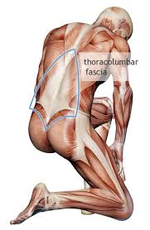
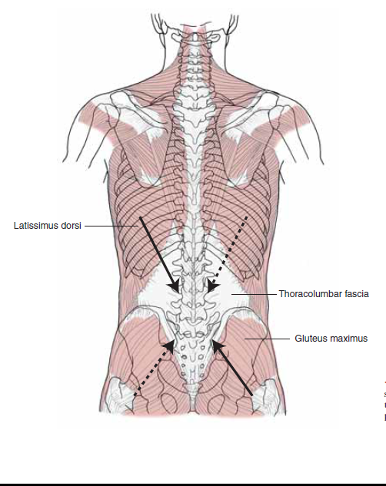
The coupled action of the latissimus dorsi, contralateral gluteus maximus, and tension through the thoracolumbar fascia will compress the lumbosacral region and impart stability.

Slide 29
Posterior Muscles of the Trunk
Posterior Muscle : (Superficial Layer)
Trapezius, latissimus dorsi, rhomboids, levator scapula, serratus anterior
(Intermediate Layer)
Serratus posterior superior
Serratus posterior inferior
(Deep Layer)
Three groups:
1. Erector spinae group (spinalis, longissimus, iliocostalis)
2. Transversospinal group (semispinalis muscles, multifidi, rotators)
3. Short segmental group (interspinalis muscles, intertransversarius muscles)

Slide 30
Anterior Group of Muscles:
Rectus abdominis
Obliquus internus abdominis
Obliquus externus abdominis
Transversus abdominis

Slide 31
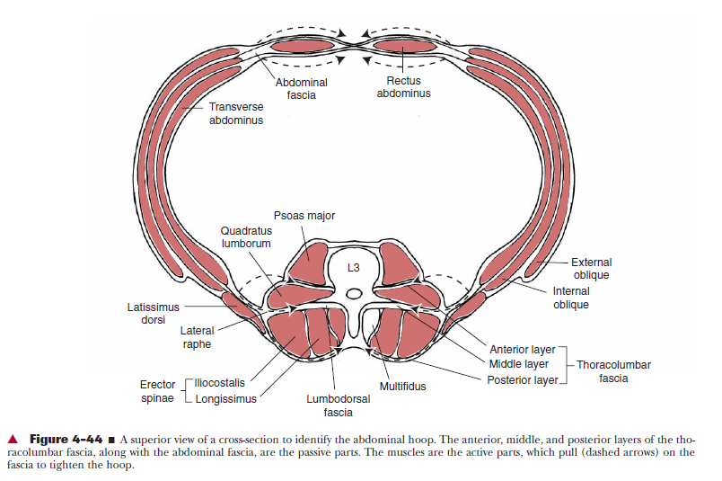
Cross Section of the Back through L3 vertebra

Slide 32
Posterior Muscles
The erector spinae consist of the longissimus and iliocostalis muscle groups. In general, these muscles are identified as extensors of the trunk.

Slide 33
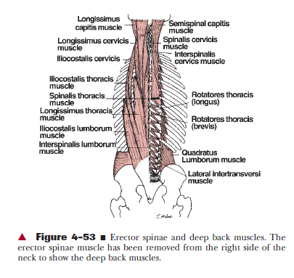

Slide 34
The superficial layer runs from the ribs and thoracic transverse processes to form muscle bellies that are laterally located in the thoracic region.
The muscles have long tendons that join together to form the ESA, which inserts into the spinous processes of the lower lumbar spine, sacrum, and iliac crest.
This superficial layer, with its long moment arm and excellent line of pull, produces extension of the thoracic and lumbar regions when acting bilaterally.
These muscles are considered to be the primary extensors of the trunk.

Slide 35
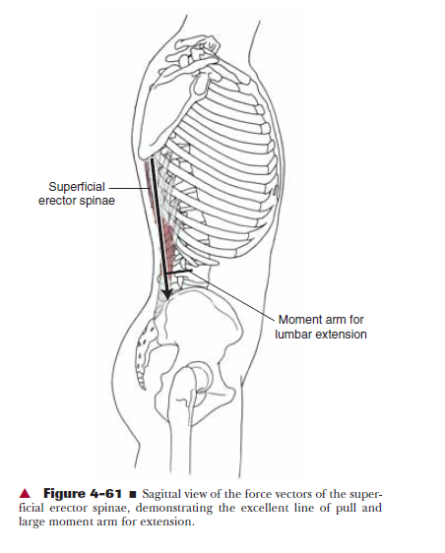

Slide 36
Acting unilaterally, they are able to laterally flex the trunk and contribute to rotation.
During trunk flexion from a standing position, the erector spinae are responsible for contracting eccentrically to control the motion.
The gravitational moment will produce forward flexion, but the extent and rate of flexion are controlled partially by eccentric contractions of the extensors with the ESA and partially by the thoracolumbar fascia and posterior ligamentous system.
The erector spinae act eccentrically until approximately two thirds of maximal flexion has been attained, at which point they become electrically silent.

Slide 37
The posterior ligaments (supraspinous and interspinous ligaments) have longer moment arms than do the extensor muscles and thus have a mechanical advantage over the extensors.
Latissimus dorsi run generally from the dorsal sacrum and the ilium in the region of the PSIS to the spinous processes of the lumbar vertebrae.

Slide 38
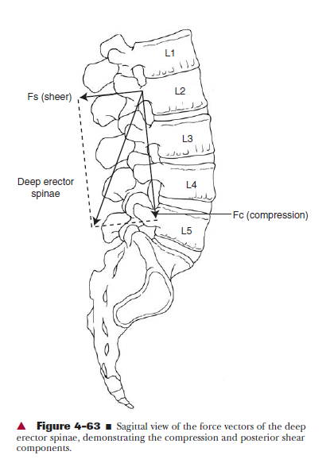

Slide 39
The fibers of the lumbar multifidus muscles become increasingly more vertical in a caudal direction.
The line of action will produce extension by increasing the lumbar lordosis.
Thus the fibers will add compressive loads to the posterior aspect of the interbody joints.
The role of the lumbar multifidus muscles in rotation is to work in synergy with the abdominal muscles.

Slide 40
Lateral Muscles:
The quadratus lumborum, when acting bilaterally, serves as an important frontal plane stabilizer and also serves an important role in stabilization in the horizontal plane.
When acting unilaterally, the quadratus lumborum can laterally flex the spine and attachments to the lumbar transverse processes, allowing it to control rotational motion as well.
If lateral flexion occurs from erect standing, the force of gravity will continue the motion, and the contralateral quadratus lumborum will control the movement by contracting eccentrically.
If the pelvis is free to move, the quadratus lumborum will “hike the hip” or laterally tilt the pelvis in the frontal plane.

Slide 41
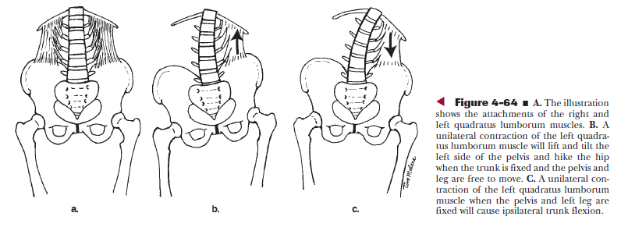

Slide 42
Anterior Muscles
The rectus abdominis is the prime flexor of the trunk.
It is contained within the abdominal fascia, which separates the rectus abdominis into sections and attaches the rectus abdominis to the aponeurosis of the abdominal wall.
The abdominal wall consists of the external oblique, the internal oblique, and the transversus abdominis muscles.
These muscles together form the “hoop” around the entire abdomen with the abdominal wall as the anterior aspect and the thoracolumbar fascia and its muscle attachments as the posterior aspect.
This hoop plays an important role in stability of the lumbopelvic region.

Slide 43
The psoas major runs from the lumbar transverse processes, the anterolateral vertebral bodies of T12 to L4, and the lumbar intervertebral disks to the lesser trochanter of the femur.
The primary role of the psoas major is flexion of the hip alongwith iliacus.
The iliacus runs from the iliac crest over the pubic ramus to the lesser trochanter with the tendon of the psoas major.
The psoas major also provides stability to the lumbar spine during hip flexion activities by providing great amounts of lumbar compression during activation.

Slide 44
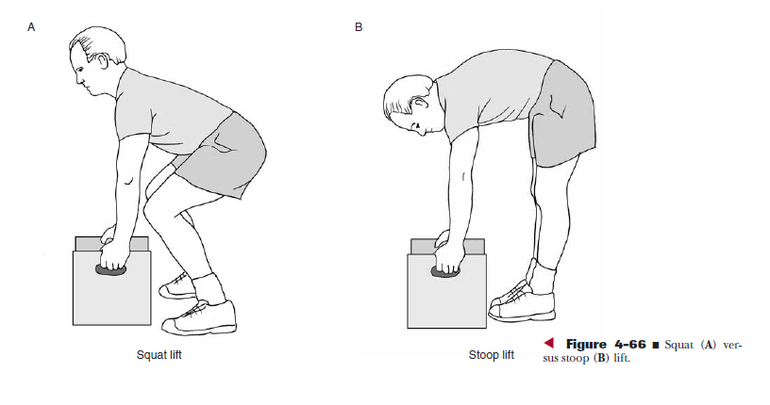
Squat Lift Vs. Stoop Lift

Slide 45
Injury Prevention with Lifting Tasks
Squat Lift versus Stoop Lift
During a stoop lift, trunk flexion is achieved primarily by thoracolumbar flexion, and there is little to no knee flexion.
During a squat lift, the spine remains as erect as possible and trunk flexion is achieved primarily by hip and knee flexion.
The extensor muscles are at a disadvantage in the fully flexed position of the spine because of shortened moment arms in this position, a change in the line of pull, and the possibility of passive insufficiency resulting from the elongated state of the muscles.

Slide 46
In a neutral lumbar spine posture, the deep layer of the erector spinae is capable of producing posterior shear, which will help to offset the tremendous amounts of anterior shear that occur with trunk flexion, particularly if the person is carrying an additional load.
The diminished capacity of the extensors to generate torque and to counteract the anterior shear forces in the forward flexed position are important reasons why stoop lifting is discouraged.
Another factor involved is intradiskal pressures.
Intervertebral disk pressures were substantially higher when a load was held in a stooped position than in a squat position.
Damaging shear forces were two to four times higher for the stoop lift than for the squat lift.

Slide 47
Patho-mechanics

Slide 48
How are the Lumbar Facets alinged?
In Sagital Plane
In Frontal Plane
In Horizontal Plane
None of the Above

Slide 49
Which Ligaments supports the Lumbar Vertebra ?
Anterior Longitudinal Ligament
Posterior Longitudinal Ligament
Ligamentum Flavum
All of the above

Slide 50
Which movements occurs at Proximal Lumbar Spine?
Lateral Flexion and Rotation
Forward Flexion and Extension
Rotation and Forward Flexion
Lateral Flexion and Extension

Slide 51
Which Movement occurs first for touching the toes from erect standing position?
Rotation
Anterior Pelvic tilting
Forward flexion
Extension

Slide 52
Which Muscle belongs to the Anterior group of Muscles?
Latissimus Dorsi
Erector Spinae
Trapezius
Rectus Abdominis

Slide 53
Study title: the effects of repetitive motion on lumbar flexion and erector spinae muscle activity in rowers
Jillian Caldwell
Peter McNair
Clinical biomechanics, October 2003

Slide 54
PICO
P: rowers
I: lumbar flexion, erector spinae muscle activity
C: -
O: electromyography of erector spinae, lumbar flexion range

Slide 55
Method: 16 young adult rowers participated in the study. Changes in lumbar flexion and muscle activity were recorded at three stages of an ergometer based rowing trial. Lumbar flexion was analyzed with computerized motion analysis and muscle activity by electromyography.

Slide 56
Result: lumbar flexion increased significantly during rowing trial as did the magnitude of the electromyographic activity.
Conclusion: rowers attain relatively higher level of lumbar flexion and indirect evidence of muscle fatigue was also apparent. Excessive lumbar flexion may influence the potential for injury to spinal structures.

