Slide 1
FORCE, COMPONENTS OF FORCE, COMPOSITE EFFECT OF TWO OR MORE FORCES (FORCE COUPLES)
DR PURVI PATEL

Slide 2
FORCE
A force is a push or a pull exerted by one object or substance on another. Any time two objects make contact they will either push on each other or pull on each other with some magnitude of force
Human body is acted upon by various forces. Through muscular contraction, body generates a force on its own which it uses either to balance or overcome external forces.
Force is described in terms of its
  Magnitude
  Direction
  Point of its application

Slide 3
Magnitude:
magnitude of muscular force is direct proportion to the number and size of the fibres in the muscle which is contracting.
Point of application:
it is assumed to be at centre of the muscle attachment. Usually corresponds to muscle insertion or distal attachment.
Direction:
direction of muscular force is represented by angle which is bounded by muscle’s line of pull and portion of mechanical axis that lies between the point of application and fulcrum.

Slide 4
Components of force:
a muscle’s angle of pull changes with every degree of joint motion. Size of angle determines the effectiveness of muscle’s pull in moving bony lever.
Force is said to have two components:
  rotatory component
  non –rotatory component
these component are at right angle to each other.

Slide 5
Rotatory component (vertical component)
it is a component of muscular force that acts perpendicular to long axis of bone (lever).
When the line of muscular force is at 90 degrees to bone on which it attaches, all of the muscular force is rotatory force (100% of force is contributing to movement).
All of force is being used to rotate the lever about it axis. The closer the angle of pull to 90 degrees, the greater the rotatory component.
At all other degrees of angle of pull, one of the other two components of force are operating in addition to rotatory component.

Slide 6
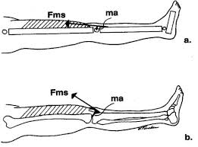

Slide 7
Non-rotatory component (horizontal component)
it is either a stabilizing component or a dislocating component, depending on whether the angle of pull is less than or greater than 90 degrees.
If angle is less than 90 degrees, the force is a stabilizing force because its pull directs the bone towards the joint axis.
If angle is greater than 90 degrees, the force is dislocating due to it’s pull directing the bone away from the joint axis.
When angle of pull is 90 degrees the force is completely rotatory. When it is 45 degrees the rotatory and stabilizing components are equal.
Since the angle of pull usually remains less than 45 degrees, more of the muscle’s force serves to stabilize the joint than to move the lever.
There are some muscles whose angle of pulls are always so small that their contribution to motion is negligible like coracobrachialis and subclavius.

Slide 8
Composite effect of two or more forces (force couple)
in mechanics the term “couple” or “ force couple” refers to a pair of equal parallel forces acting in opposite direction. The effect of such action is rotation.
Force couples occur when two or more forces are pulling in different directions on an object, causing the object to rotate about its axis.
Coupling of muscular forces together in the body caN result in a more efficient movement.
Force couple examples
hands acting as a force couple while steering a wheel
upper fibres of trapezius and serratus anterior act as a force couple for upward rotation of scapula.

Slide 9
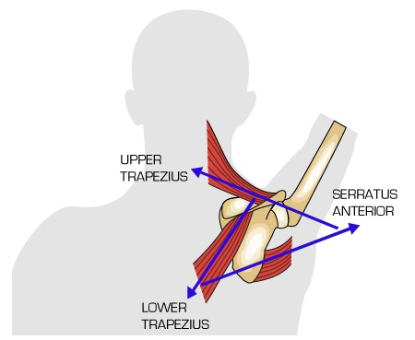
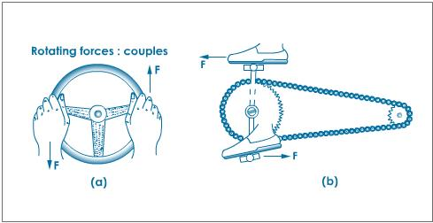

Slide 10
Force and work

Slide 11
Moving one’s own body when it is supported by the ground or similar surface

Slide 12
Movement of the body as a whole
Locomotion is a form of translatory motion produced by angular motions of the extremity.
To propel itself, it must be able to push against a resistant surface.
Accord the law of action and reaction

Slide 13
Principles for walking on the ground
The efficacy of locomotion depends upon counter pressure and friction.
A body at rest will remain at rest unless acted upon by a force.
A body in motion will remain in motion unless acted upon by a force. Specially for trunk. Forward limb acts as a check on the momentum.
Force applied diagonally have two component
Vertical
horizontal

Slide 14
The speed of the gait is directly related to the magnitude of the pushing force and to the direction and frequency of its application: by extensor muscles
The economy of the gait is related to its timing with reference to the length of the limbs. Most economy is timed to permit pendulum like motion of L.L.
Walking has been described as an alternating loss and recovery of the balance.

Slide 15
New base of support is every step.
Stability is directly related to the size of the base of support.
Too narrow
Too broad
optimum

Slide 16
Moving one’s own body when it is supported by water

Slide 17
In water, body is concerned with buoyancy rather than a force of gravity.
The substance against which is pushes affords less resistance
The medium through which it moves affords more resistance
It is customary to maintain a horizontal than a vertical position.

Slide 18
Immersed body have a center of buoyancy. This is a center of balance in water.
Swimming is a matter of coordination and not a buoyancy.
In aquatic locomotion, water is both a supportive medium as well as the source of resistance.
In swimming, hands and feet depend upon the counter pressure of the water and transmitted to the body. Yet the same time water will offer resistance to the body to overcome it.

Slide 19
Mechanics of the swimming are the minimizing of resistance and the advantageous application of force.
Principles:
The body will move in the opposite direction from that in which the force is applied.
A rapidly moving body in the water leaves a low pressure area immediately behind it. This creates a suction effect and tends to pull the body back.

Slide 20
The more streamlined the body, the less the resistance to progress through the water.
Carrying the head so that the water level is somewhere between the hairline and just below eyes.
Carrying a body parallel with the surface of water.
Carrying the buttocks just below the surface of the water.
Keeping legs, ankles and feet close together,

Slide 21
Moving one’s own body when it is in the air, free of support

Slide 22
The unsupported body eventually drawn to the earth by the force of gravity.
The direction usually being horizontally forward, vertically upward or in between these two.
Diving and high jumping
Broad jumping

Slide 23
When the body is unsupported, momentum of the body cant be developed. This means that its center of gravity cant be displaced from its path of motion.
Nothing the diver can do will alter the pathway of his CoG, once he has left the diving board.
The only total movement which can be initiated in the unsupported body is rotation around its CoG.

Slide 24
Principles of moving one’s own body when it is suspended
Hanging, swinging and other suspension activities like at the circus, high boom, ropes etc.
The movement of pendulum is produced by the force gravity.
The upward movement of a pendulum is effected by the momentum developed in the downward movement.

Slide 25
The amplitude of the pendulum depends upon the height from which its movement is initiated.
The time taken by the pendulum to make a single round trip excursion is related to the length of the pendulum.
The period of the pendulum is not influenced by its weight.
As the pendulum swings downwards, the speed increases and vice versa.

Slide 26
The swinging body moves through an arc, first in one direction and then in reverse direction.
When a pendulum reaches the end of its arc, just before it reverses its direction, it reaches a zero point in velocity. At this moment, force of gravity is neutralized by the upward momentum.
All the characteristics of circular motion apply. If the body does break loose, there is a danger of injury.

