Slide 1
SUMANDEEP VIDYAPEETH
DEPARTMENT OF MANAGEMENT
MBA IN HEALTHCARE MANAGEMENT
HUMAN RESOURCE MANAGEMENT
ANALYSING WORK AND DESIGNING JOBS
Dr. Subhasish Chatterjee

Slide 2
INDEX
1. NATURE OF JOB ANALYSIS.
2. BENEFITS OF ORGANIZATION AND COMPETATIVE ADVANTAGE.
2. THE PROCESS OF JOB ANALYSIS.
3. METHODS OF COLLECTING DATA.
4. POTENTIAL PROBLEM WITH JOB ANALYSIS.
5. JOB DESIGN.
6. FACTORS AFFECTING JOB DESCRIPTION.
7. JOB DESIGN APPROACHES.
8. CONTENPORARY ISSUES IN JOB DESIGN.

Slide 3
1. NATURE OF JOB ANALYSIS
Job is bundle of related task.
Job analysis is the process of collect information about job. The process of job analysis results in two set of data:
Job description
Job specification

Slide 4
Job analysis A process of obtaining all pertinent job facts
Job description Job title. Location. Job summary. Duties. Machine, tools and equipments. Material and from use. Supervision given or received. Hazards. | Job specification Education. Experience. Training. Judgement. Initiative. Physical effort. Physical skills. Responsibilities. Communication skills. Emotional skills. Unusal sensory demands such as sight, smell, hearing.

Slide 5
2. Benefits of organization & Competitive advantage
Laying the foundation for human resource planning.
Laying the foundation for employee hiring.
Laying the foundation for training and developing.
Laying the foundation for performance appraisal.
Laying the foundation for salary and wage fixation.
Laying the foundation for safety and health.

Slide 6
3. THE PROCESS OF JOB ANALYSIS
Job Analysis Is Useful For Several Purposes, Such as Personnel Planning, Performance Appraisal And The Like.
The process of job analysis is here.

Slide 7
STRATEGIC CHOICE
JOB DISCRIPTION
JOB SPECIFICATION
GATHER INFORMATION
PROCESS INFORMATION
Uses of job description and job specification:
Personnel planning
Performance appraisal
Hiring
Training and development
Job evaluation and compensation
Health and safety
Employees disciplines
Work scheduling
Career planning

Slide 8
A. STRATEGIC CHOICES.
With the regard to job analysis, an organization is required to make at least five choices:
The extent of employee involvement in job analysis.
The level of detail of the analysis.
Timing and frequency of analysis.
Past-oriented versus future-oriented job analysis.
Sources of job data.

Slide 9
Employee involvement.
To what extent employees need to be involve is a debatable point. Too much involvement may result in bias in favour of a job, as the employee is likely to inflate the duties and responsibilities of his jobs, just to make it appear more important than it actually is. On the other hand, if employees are not involve or only minimally involved, they tend to become suspicious about the motives behind the job analysis. Behind, lack of involvement from employees may lead to inaccurate and incomplete information. The extent to which employees are involved depends upon the need of both the organization and the employees.
An organization expects accurate information about the jobs being analyzed. How-ever, the organization may also be concerned about the employees. Reactions to having their job analyzed. In order to prevent employee dissatisfaction, uncertainty and anxiety, firms should communicate the reasons for conducting the job analysis and keep the employees informed about the job-analysis process.

Slide 10
THE LEVEL OF DETAILS
The level of analysis may vary from detailed, as in time and motion studies, to broad as in analysis jobs based on general duties. The level of analysis is affect the data collection.
If the job analysis is being done to add clarification to the rules and responsibilities of job holders, a less-detailed job analysis may be detailed.
Reason is the job analyzed conducted when;
Organization newly established
A new job created the established the job.
Organization work on new plan
The employees believe inequality between their growth and their job demand.
Past oriented Vs Future Oriented:
In the organization are adopt the rapidly change that time to give the training to the worker and tell the new worker there past worker working process and also told them new process.

Slide 11
Source of job data:
From non-human source
The person
HR manager.
Job analyst who are uses the job incumbents and supervisors as a source of information should make sure that these individuals have had an adequate opportunity to perform the job, or observe the job being perform.

Slide 12
B. Information Gathering
The methods are here;
1. observation
2. Interview
3. Questionnaires
4. checklists.
5. Technical conference
6. Dairy methods.
The regards to employees to data collection
Supervisor
Job holder
Trained analyst

Slide 13
C. Information processing
Once the job information has been collected. It needs to be processed, so that it would be useful in various personnel function. Specifically, job-related data would be useful tp preparejob description and job specification.

Slide 14
D. Job Description
Job description implies objective listing of the job title, tasks, duties and responsibilities involved in the job.
E. Job Specification
A statement of employee characteristics and qualification required for the satisfactory performance of defined duties and tasks comprising a specific job or function.

Slide 15
HRP
Recruitment and selection
Job description
Training and development
Job analysis
Job evaluation
remuneration
Job specification
purposes
Performance appraisal
Personal information
Safety and health

Slide 16
4. Methods of collecting data
Job data
interviews
questionnaire
checklist
observation
dairy
Technical conference

Slide 17
JOB ANALYSIS AND TOTAL QUALITY MANAGEMENT
ESSENTIAL FEATURES OF TQM ARE:
1. CREATION OF A COMMON COMPANY THEME
2. CREATION OF CUSTOMER CENTRIC MENTALITY
3. IMPROVEMENT BECOMING PART OF JOB
4.EACH FUNCTION TO REASSESS ITS PURPOSE
5. IMPROVEMENT BECOMING A CONTINUOUS PROCESS
6.COMMUNICATION TO IMPROVE
7.BUREAUCRACY TO BE REDUCED

Slide 18
4. POTENTIAL PROBLEMS OF JOB ANALYSIS
CERTAIN PROBLEMS CROP UP WHILE CONDUCTING JOB ANALYSIS. THE MAJOR ONES ARE,
1. SUPPORT FROM TOP MANAGEMENT:-
IN MOST OF CASES, TOP MANAGEMENT IS MISSING. THE TOP MANAGEMENT SHOULD MAKE IT CLEAR TO ALL EMPLOYEES THAT THEIR FULL AND HONEST PARTICIPATION IS EXTREMELLY IMPORTANT FOR THE PROCESS.
2. SINGLE MEANS AND SOURCE:-
THIS RELATED TO DETECT IN THE PROCESS OF JOB ANALYSIS. THERE ARE MANY PROVEN METHOD AND SOURCE OF COLLECTIONG DATA. ALL TOO OFTEN, ANALYSIS RELY ON ONLY ONE OF THE METHODS WHEN A COMBINATION OF TWO METHODS MIGHT PROVIDE A BETTER DATA.

Slide 19
3. NO TRAINING AND MOTIVATION:-
THIS ALSO REALTES TO THE DEFECT IN THE JOB ANALYSIS PROCESS. JOB HOLDERS ARE A GREAT SOURCE OF INFORMATION ABOUT THE JOB. BUT THEY ARE NOT TRAINED OR MOTIVATED TO GENERATE QUALITY DATA FOR JOB ANALYSIS. FURTHER, JOB HOLDERS ARE RERELY MADE AWARE OF THE IMPORTANCE OF THE DATA, AND NEVER REWARDED FOR IMPROVING ACCURATE DATA.
4. ACTIVITIES MAY BE DISTORTED:-
WHERE TRAINING ARE PREPAREDNESS DO NOT EXIST, JOB HOLDERS TEND TO SUBMIT DISTORTED DATA, EITHER INTENTIONALLY OR INADVERTENTLY.
FOR EXAMPLE, EMPLOYEES ARE LIKELY TO SPEED UP, IF THEY KNOW THEY ARE BEING WATCHED.

Slide 20
5. REQUISITES FOR JOB ANALYSIS
JOB ANALYSIS SHOULD BE SO DESIGNED THAT DERIVATION OF JOB DESCRIPTIONS AND JOB SPECIFICATIONS BECOMES EASY.
MANAGER SHOULD BE COMMUNICATE ALL RELEVANT INFORMATION TO EMPLOYEES CONCERNING THE JOB ANALYSIS TO PREVENT UNNECCESSARY UNCERTAINLY AND ANXIETY.
WHEN MAJOR ORGANIZATIONAL CHANGES TAKE PLACE, JOB ANALYSIS SHOULD BE UNDERTAKEN.
THE PURPOSE OF JOB ANALYSIS, THE EXTENT OF EMPLOYEES INVOLVEMENT, THE TYPE OF INFORMATION REQUIRED AND THE LEVELS OF DETAILS REQUIRED SHOULD BE SPECIFIED.

Slide 21
COMPETENCY BASED JOB ANALYSIS
WHERE THE FOCUS IS ON THE INDIVIDUAL, BUT NOT ON THE JOB, THE PROCESS BECOMES COMPETENCY BASED JOB ANALYSIS.
JOB ANALYSIS HERE SEEKS TO COLLECT COMPETENCIES OF EMPLOYEES RATHER THAN JOB DUTIES. COMPETENCIES INCLUDE MEASURABLE AND OBSERVABLE BEHAVIOUR COMPETENCIES THAT AN EMPLOYEE MUST EXHIBIT TO DO THE JOB WELL.
JOB DESCRIPTIONS PREPARED ON CBJA WILL CENTRE AROUND COMPETENCIES OF INDIVIDUALS, NO MATTER JOBS THEY OCCUPY.

Slide 22
TYPICAL COMPETENCIES INCLUDED IN THE COMPETENCY BASED JOB ANALYSIS INCLUDED THE FOLLOWING:
SELF CONTROL
SELF DEVELOPMENT
PERSONAL ORGANIZATION
POSITIVE APPROACH
DELIVERING RESULTS
PROVIDING SOLUTIONS
SYSTEMIC THINKING
ATTENTION TO DETAIL
CREATING CUSTOMER SERVICE
DELIVERING CUSTOMER SERVICE
CONTINUOUS IMPROVEMENT
DEVELOPING PEOPLE
WORKING WITH OTHERS
INFLUENCING
LEADING
DELIVERING THE VISION
CHANGE AND CREATIVITY

Slide 23
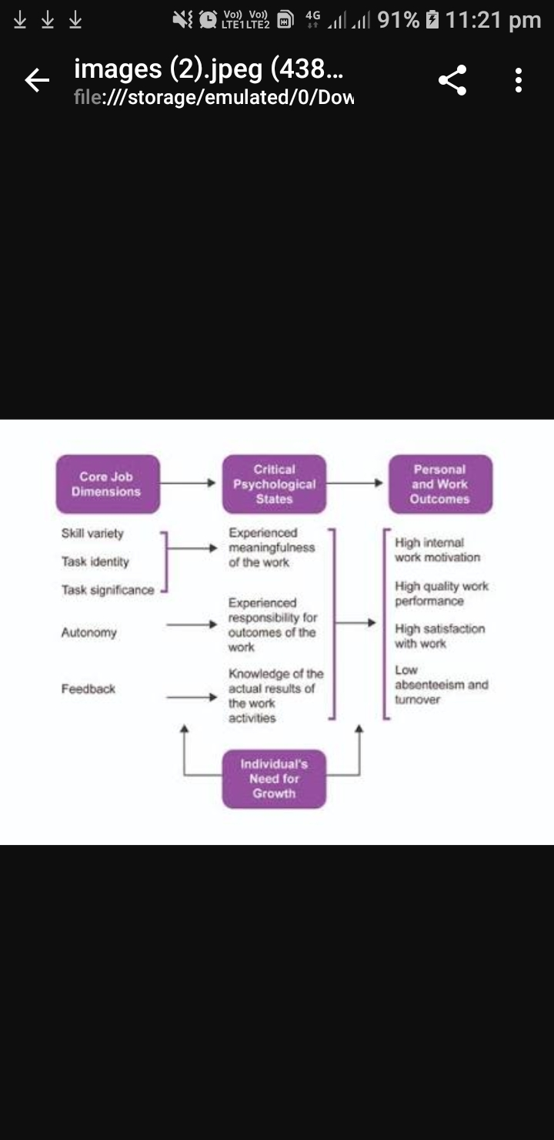
JOB CHARACTERISTICS MODEL

Slide 24
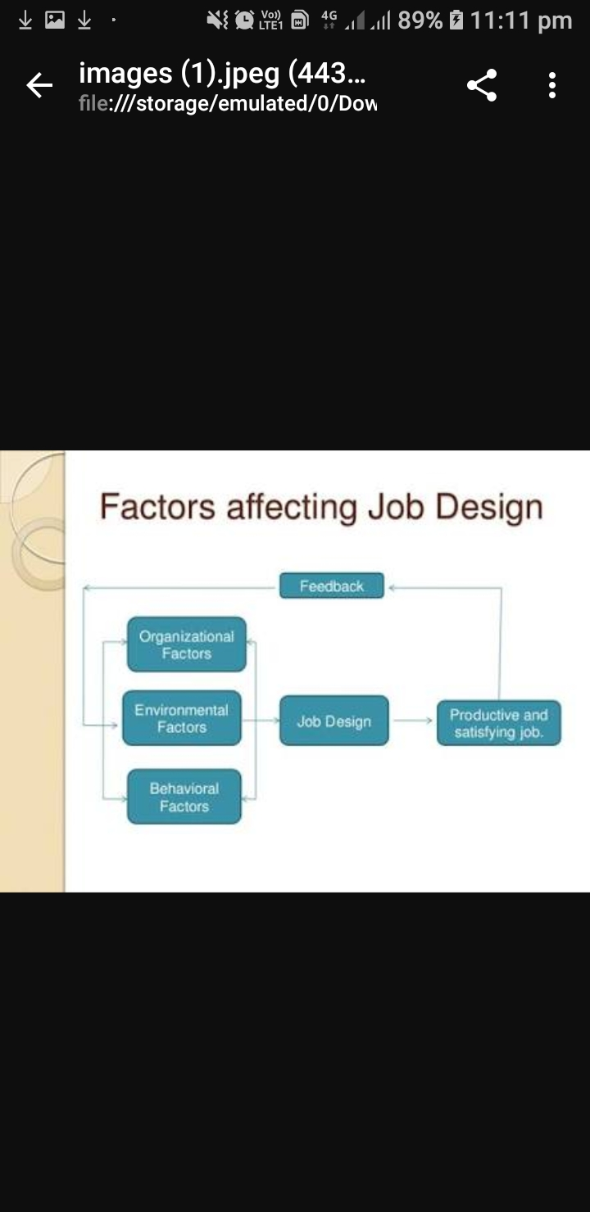
6. FACTORS AFFECTING JOB DESIGN

Slide 25
ORGANISATIONAL FACTORS
CHARACTERISTICS OF TASK
WORK FLOW
ERGONOMICS
WORK PRACTICE

Slide 26
ENVIRONMENTAL FACTORS
EMPLOYEE ABILITIES AND AVAILABILITY
SOCIAL AND CULTURAL EXPECTATIONS

Slide 27
BEHAVIOURAL FACTORS
FEEDBACK
AUTONOMY
USE OF ABILITY
VARIETY

Slide 28
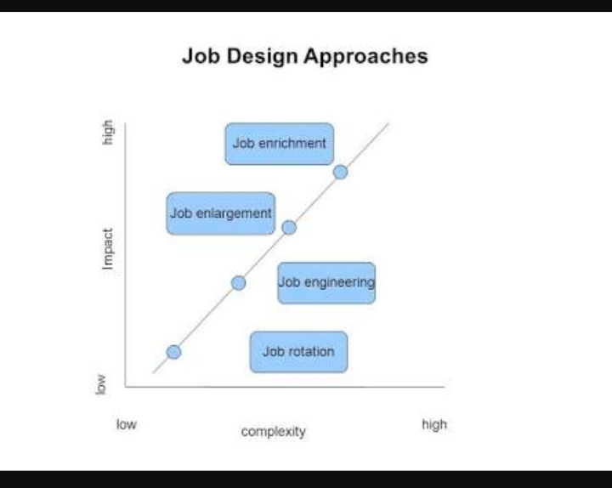
7. JOB DESIGN APPROACHES

Slide 29
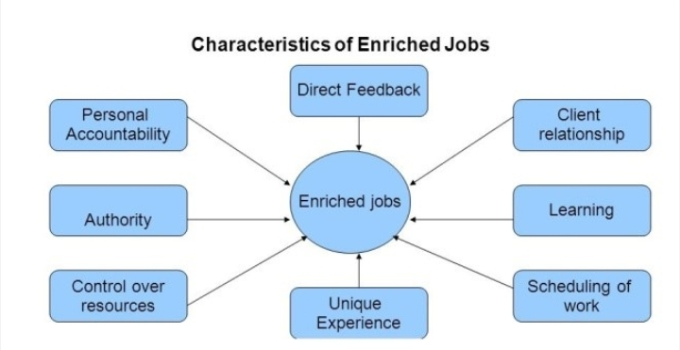
CHARACTERISTICS OF AN ENRICHED JOB

Slide 30
8. CONTEMPORARY ISSUES IN JOB DESIGN
-: TELECOMMUTING :-
REFERS TO THE USE OF MICROCOMPUTERS, NETWORKS AND OTHER COMMUNICATION TECHNOLOGY SUCH AS FAX MACHINE TO DO WORK FROM HOME, WHICH WAS TRADITIONALLY DONE IN THE WORK PLACE.
-: ALTERNATIVE WORK PATTERN:-
JOB SHARING IS AN EXAMPLE OF ALTERNATIVE WORK PATTERN. IT INVOLVES TWO PEOPLE SHARING A FULL TIME JOB. IT CAN BE IMPLEMENTED IN SEVERAL WAYS:
EACH WORKING A HALF DAY, FIVE DAYS A WEEK.
EACH WORKING TWO OR THREE FULL DAYS A WEEK
EACH WORKING EVERY OTHER WEEK
EACH WORKING ATTERNATE MONTHES OR SEASONS

Slide 31
-: TECHNOSTRESS :-
IT IS A STRESS CAUSED BY NEW AND ADVANCING TECHNOLOGIES IN THE WORK PLACE,MOSTLY BY INFORMATION TECHNOLOGY.
ADVANCED INFORMATION TECHNOLOGIES ENABLE ORGANISATIONS TO MONITOR EMPLOYEE PERFORMANCE, EVEN WHEN THE WORKER IS NOT AWARE OF SUCH ARRENGEMENT.
THESE NEW TECHNOLOGIES ALSO ALLOW ORGANISATIONS TO TIE PAY TO PERFORMANCE BECAUSE PERFORMANCE IS ELECTRINICALLY MONITORED.

Slide 32
-: TASK REVISION :-
A NEW CONCEPT IN THE DESIGN OF WORK IS TASK REVISION. IT IS AN INNOVATIVE WAY TO MODIFY AN INCORRECTLY SPECIFIED ROLE OR JOB. IT IS ASSUMES THAT ORGANISATIONAL ROLES AND JOB EXPECTATIONS MAY HAVE BEEN CORRECTLY OR INCORRECTLY DEFINED. WHERE THE ROLE IS CORRECTLY DEFINED,BEHAVIOUR OF THE EMPLOYEE FITS THE ROLE AND PERFORMANCE TENDS TO HIGH. PERFORMANCE SUFFERS BECAUSE OF DEVIANT BEHAVIOURS WHICH RESULT FROM INCORRECTLY DEFINED JOBS. TASK REVISION HELPS CORRECT SUCH INCORRECTLY DEFINED JOBS.

Slide 33
-:KNOWLEDGE WORK:-
THE EMERGENCE OF KNOWLEDGE WORK HAS TRANSFORMED THE WAYS OF DESIGNING WORKS.
AS OF NOW, WORK IS NO LONGER ABOUT THE MASS PRODUCTION OF TANGIBLE COMMODITIES BUT IS CONCERNED WITH THE FIRM’S INTANGIBLE ASSETS – HUMAN BRAINS.
THE NATURE OF KNOWLEDGE WORK IS FUNDAMENTALLY DIFFERENT FROM WHAT WE HAVE TRADITIONALLY ASSOCIATE WITH THE ‘MACHINE AGE’ AND MASS PRODUCTION AND MARKETING.

Slide 34
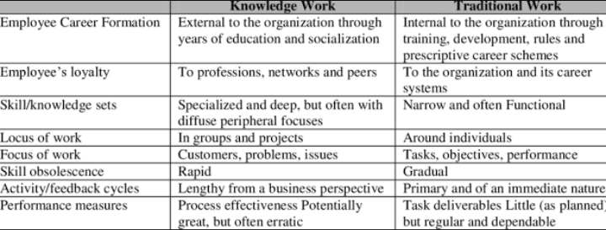
THE SHIFT FROM TRADITIONAL WORK TO KNOWLEDGE WORK HAS LED MANAGERS TO CHANGE STRATEGIES, PATTERNS OF INTERACTION, ROLE OF INDIVIDUAL, HR AND ORGANISATIONAL STRUCTURES.

Slide 35
THANK YOU

