Slide 1
APPRAISING AND MANAGING PERFORMANCE
Dr..Subhasish Chatterjee

Slide 2
PERFORMANCE APPRAISAL
Is an objective assessment of an individual’s performance against well defined benchmarks.
Also called as Employee rating , Employee evaluation ,Performance review

Slide 3
Performance Appraising are done for:
Administering Wages and Salaries
Performance feedback
Indentify employee strength and weakness
Improving previous or poor performance

Slide 4
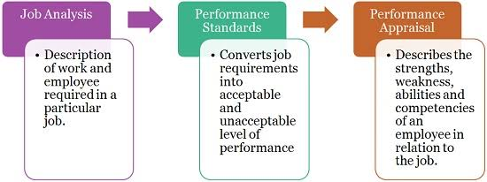
Relationship of Performance Appraisal and job Analysis

Slide 5
OBJECTIVES OF PERFORMANCE APPRAISAL
To effect promotions based on competence and performance
To assess the training and development needs of employees
To decide upon a pay raise where regular pay scales have not been fixed
To improve communication
Finally, can be used to determine whether HR programmes such as selection, training, have been effective or not.

Slide 6
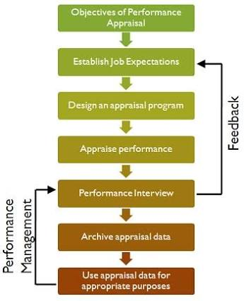
APPRAISAL PROCESS

Slide 7
OBJECTIVES OF APPRAISAL
Includes effecting promotions and transfers, assessing training, needs, awarding pay increases
These objectives are appropriate as long as the approach in appraisal is individual
ESTABLISH JOB EXPECTATIONS
Includes informing the employee what is expected of him or her on the job

Slide 8
DESIGN APPRAISAL PROGRAMME
Includes
Formal v/s informal appraisal
Whose performance is to be assessed ?
Who are the raters ?
What problems are encountered?
How to solve the problem?
What should be evaluated ?
When to evaluate?

Slide 9
APPRAISE THE PERFORMANCE
Included while measuring employee performance
Quantity of output
Quality of output
Timeliness of output
Presence /attendance of the job
Efficiency of work completed
Effectiveness of work completed

Slide 10
PERFORMANCE MANAGEMENT
Provides feedback about employee job performance
Getting feedback is not enough ,three more activities need to be undertaken to complete the process
Performance interview
Achieving performance data
Use of appraisal data

Slide 11
ARCHIVING PERFORMANCE DATA
Organizations need to archive or store the appraisal data so that at any point in future ,the information can be revealed and used.
USE OF APPRAISAL DATA
Is the use of evaluation data
It may be recollected that the most significant rewards employers offer to the employee are:
Monet to purchase goods and services
Opportunities to interact with other people in a favourable working environment
Opportunities to learn ,grow ,and make full use of their potential

Slide 12
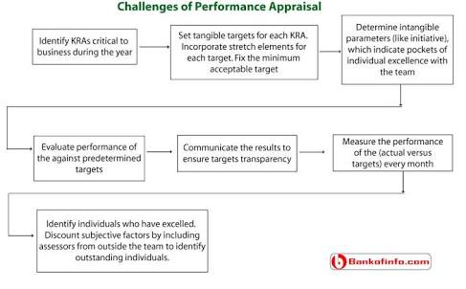
CHALLENGES OF PERFORMANCE APPRAISAL

Slide 13
Create a culture of excellence that inspires every employee to improve and lend himself or herself to the assessed.
Align organizational objectives to individual aspiration.
Clear growth paths for talented individuals.
Embed teamwork in all operational process.
Empower employees to make decision without the fear of falling.

Slide 14
LEGAL ISSUES
LEGALLY DETENSIBLE APPRAISAL PROCEDURE
All specific performance standards should be formally communicated to employee
All employees should be able to review their appraisal results.
LEGALLY DEFENSIABLE APPRAISAL CONTENT
Any performance appraised content should be based on a job analysis
All personnel decisions should be based on a formal standardised performance appraised system.
Appraisals based on traits should be avoided
Specific job related performance dimensions should be used rather than global measures.

Slide 15
LEGALLY DEFENSIBLE DOCUMENTATION OF APPRAISAL RESULTS
Written documentation for extreme ratings should be required and they must be consistent with the numerical ratings.
LEGALLY DEFENSIBLE RATERS
The raters should be trained in ‘how to use an appraisal system’
Documentation requirements should be consistent among the raters
The raters must have the opportunity to observe the ratee first-hand or to review important ratee performance product.

Slide 16
JOB EVALUATION

Slide 17
DEFINATION
Job Evaluation is the process of analyzing and assessing the various jobs systemically to ascertain their relative worth in an organization.
Jobs are evaluated on the basis of their content and are placed in the order of their importance.
It is to be noted that in a job evaluation programme, the jobs are ranked and not the job holders, they are rated through performance appraisal.

Slide 18
Difference btw Job Evaluation & Performance Appraisal.
The job is rated, keeping in view such factors as responsibility, qualification, experience, working conditions etc required for performance.
A job is rated before the employee is appointed to occupy it.
It is not compulsory, Many organization carry on without it. It is mainly for lower level jobs.
Employee is rated on the basis of his or her performance.
Evaluation takes place after the employee has been hired and placed on a job.
Compulsory. It is done on regularly for all jobs.

Slide 19
Job Evaluation Process
The job evaluation process starts with defining objectives of evaluation and ends with establishing wage and salary differentials.
The main objective of job evaluation, is to establish satisfactory wage and salary differentials. Job analysis should precede the actual programme of evaluation . Job analysis provides job related data which would be useful in drafting job description and job specification.

Slide 20
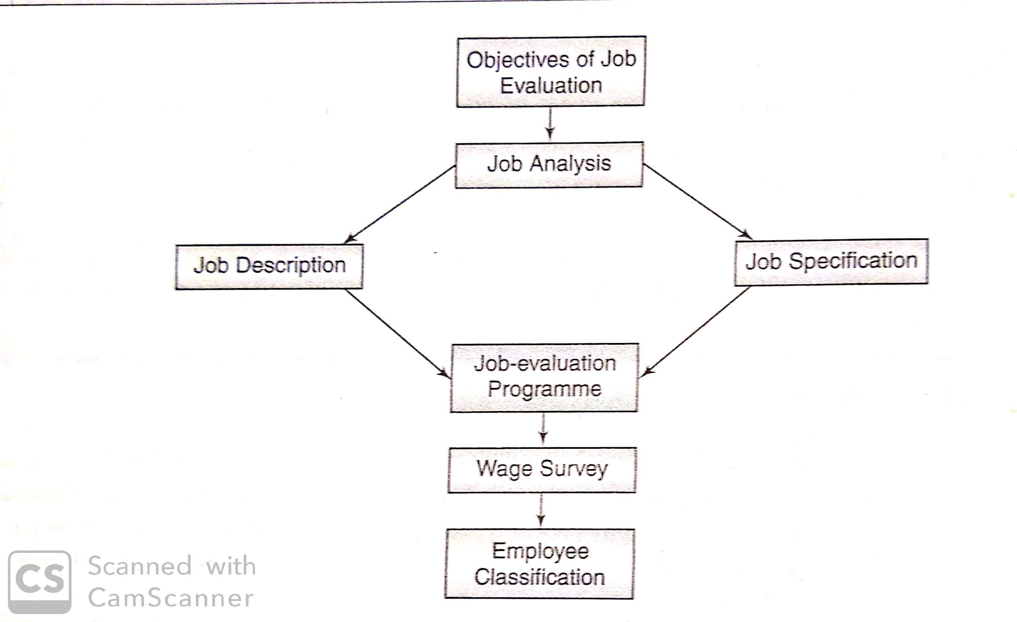
Which jobs are to be evaluated?

Slide 21
Staffing the evaluation exercise.
Job evaluation is done by a committee which consist of heads of various departments, representatives of employee unions and specialist drawn from the National Productivity Council.
Responsibility for the overall co-ordination of the job evaluation programme should be in the hands of a senior executive who can the and report its progress to the board and advise it on ensuring wage and salary development.

Slide 22
Training for the committee.
Members of the job evaluation committee should be trained in its procedure so as to make the programme successful. Training is given through series of meetings in which the following issues are generally discussed and doubts cleared.
What is job evaluation?
Why does this company need job evaluation?
How will it work?
How does it affect promotion policy?
Does job evaluation mean that everyone whose job is in the same grade gets the same rate of pay?

Slide 23
Time factor:-
Job evaluation should not be conducted in rush. Any rushing through will lead to appeals against the grading of jobs.
The quality of evaluation tends to drop and more time has to be spend later in checking and assessing the validity of the grading.
Enough time should be allowed for re-evaluation, if necessary.
Isolating Job-Evaluation Criteria:-
The heart of job evaluation is the determination of the criteria for evaluation. Most job evaluation use responsibility, skill, effort and working conditions as major criteria.

Slide 24
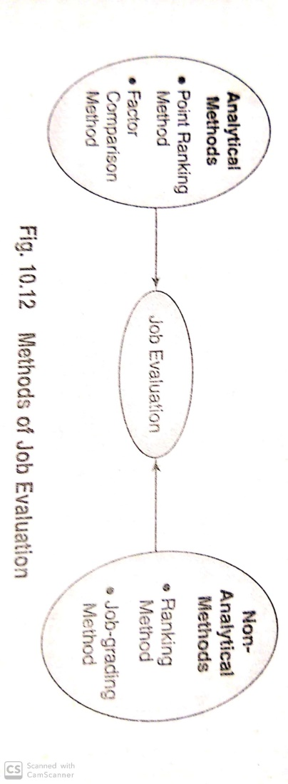
METHODS OF JOB EVALUATION

Slide 25
ANALYTICAL METHODS
Point Ranking Method:- The system starts with the selection of job factors, construction of degrees for each factor and assignment of points to each degree. Different factors are selected for different jobs, with accompanying differences in degrees and points.
The advantages of point system are:-
A job is split into no of factors. The worth of each job is determined on the basis of its factors and not by considering the job as a whole.
The procedure adopted is systematic and can easily be explained to the employees.
The method is simple to understand and easy to administer.

Slide 26
Factor-Comparison Method:- it is another approach for job evaluation.
Under this, 5 selection of factors are taken-mental requirements, skill requirements, physical exertion, responsibility, and job conditions.
Factors are assumed to be constant and are ranked individually with other jobs.
An advantage of the factor-comparison method is that jobs of unlike nature may be evaluated with the same set of factors.

Slide 27
NON- ANALYTICAL METHODS
Ranking method:-
This is the simplest, the most inexpensive and the most expedient method of evaluation.
The evaluation committee assesses the worth of each job on the basis of its title or on its contents, if the latter is available.
But the job is not broken down into elements or factors. Each job is compared with others and its place is determined.
The method has several drawbacks. Job evaluation may be subjective as the jobs are not broken into factors. It is hard to measure whole jobs.

Slide 28
Job-Grading Method:-
As in the ranking method, the job-grading method (or job classification method) does not call for a detailed or quantitive analysis of job factors. It is based on the job as a whole.
Under the classification method, the number of grades is first decided upon, and the factors corresponding to these grades are then determined. Facts about jobs are collected and are matched with the grades which have been established.
Advantage-
includes simplicity and inexpensiveness. Also o organizations where number of jobs is small, this method yeilds satisfactory results.

Slide 29
Disadvantage :-
Job grade description are vague and are not qualified
Difficulty in convincing employees about the inclusion of a job in a particular grade because of vagueness of grade descriptions
More jobs classifications schedules need to be prepared because the same schedule cannot be used for all types of jobs.

Slide 30
ALTERNATIVE TO JOB EVALUATION
In today’s environment, firms need to encourage employees to think differently about their jobs and to get their work done in innovative ways.
Employees need to be encouraged to make independent decisions and execute them instead of waiting for instructions from supervisors.
The DECISION BANK METHOD (DBM) propounded by Thomas T. Paterson in the 1970s – the value of a job depends on its decision making requirements.
The DBM differs from the traditional evaluation systems as it focuses on decision making scope as the primary criterion for determining the relative worth of jobs.

Slide 31
THANK YOU

