Slide 1
Pain Modulation
By: Dr. Pooja Patel (PT)

Slide 2
Pain is defined as an unpleasant sensory and emotional experience that is associated with actual or potential tissue damage or described in terms of such damage.*
*International association for the study of pain

Slide 3
The input from the periphery is modified in the nervous system at various levels and has sensory, cognitive, emotional and autonomic components.
Pain is a protective Mechanism, It occurs whenever any tissue is damaged and causes the individual to respond to remove the Pain stimulus. Eg. Prolonged sitting on the ischium.
Notes:
The perception of pain in turn prevents potential damage by making us respond with an alteration of posture or weight shift.
Loss of pain perception can cause and increase tissue damage (e.g. pressure sores)

Slide 4
Pain has been classified into:
Fast pain
Slow pain

Slide 5
1) Fast pain
It occurs within 0.1 second after the pain stimulus is applied, such as
Sharp pain
Prickling pain
Acute pain
Electric pain
Notes:
This type of pain felt when a needle is stuck into the skin or when the skin is cut with a knife. It is felt only by superficial tissues of body.

Slide 6
2) Slow Pain
It begins only after a second or more and then increase slowly over many seconds and sometimes even minutes, such as:
Burning pain
Aching pain
Throbbing pain
Nervous pain
Chronic Pain
Notes:
Slow pain is associated with tissue destruction. It can occur both in the skin and almost any deep tissue or organ.

Slide 7
Other types of pain:
Acute pain
Chronic pain
Somatogenic pain
Neurogenic pain
Psychogenic pain

Slide 8
Pain receptors:
Nociceptor:
A delta receptors respond to strong mechanical stimulation and to damaging heat, i.e. above 45 degree above.
When these fibers are stimulated they cause a pricking or stinging sensation known as first pain or fast pain.
A delta receptors are present as discrete sensitive spots in the skin all over the body surface and small numbers in joints and muscles.

Slide 9
Their impulses are carried by small myelinated fibers at speeds around 15m/sec.
Fast pain helps the body to avoid tissue damage since it provokes an immediate reflex and evoke rapid well localized conscious awareness.
Fast pain not felt in most deep tissue, it’s well localized

Slide 10
The C fibers receptors appear to be sensitive to many kinds of stimuli such as mechanical, chemical and heat.
They are sensitive to chemical released from the damaged tissue by any stimulus. This includes inflammatory changes leading to release of different chemicals.
Such stimulation gives rise to a dull aching pain.
Notes:
Inflammatory: chemicals like hydrogen ions, hitamine, serotonin, lactic acid etc.

Slide 11
Slow pain transmitted by unmyelinated C fibers at a speed of about 1m/sec.
Their free nerve ending are found in all innervated body tissue.
Slow pain is felt both in the superficial and deep tissue, its poorly localized.
Notes:
Free nerve ending: except the central nervous system

Slide 12
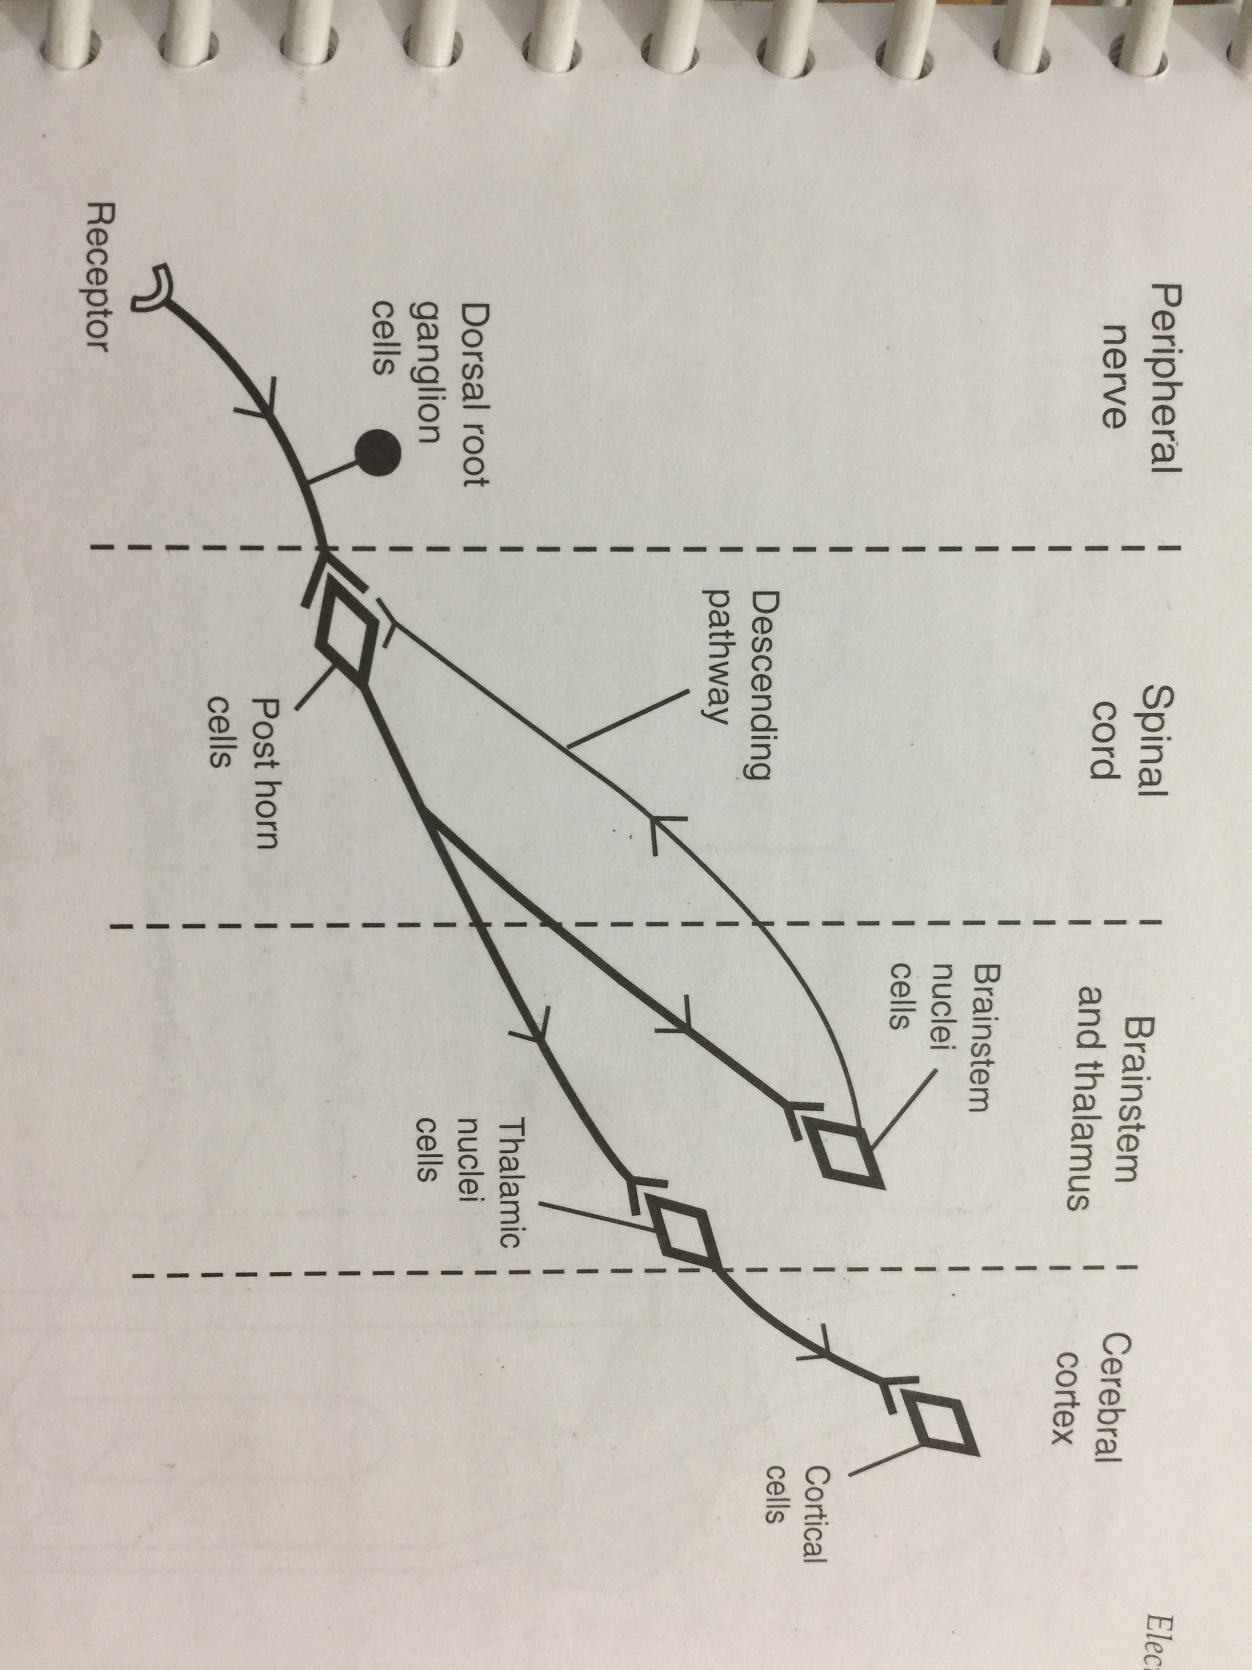
Pain pathway:

Slide 13
Nerve impulse travel in four regions of nervous system, in each of which they can be modulated:
Peripheral nervous system
Spinal cord
Brainstem and thalamus
Cerebral cortex
Notes:
Cell bodies of the A delta and C fibers are found in the dorsal root ganglion and their central connections enter the spinal cord via dorsal root except some of the 30% fibers which returns to the peripheral nerve and go to ventral root. They synapse with central nocciceptive transmission cells. In lamina 1 of SC. Wide dynamic range cells are chiefly in lamina 5. and receive input from nociceptors and large diameter A beta fibers. 1st order neuron. Direct pathway by spinathalamic tract through thalamus or indirectly from reticulspinal tract. From thalamus, the information transmitted to somatosensory cortex and other regions of the brain.

Slide 14
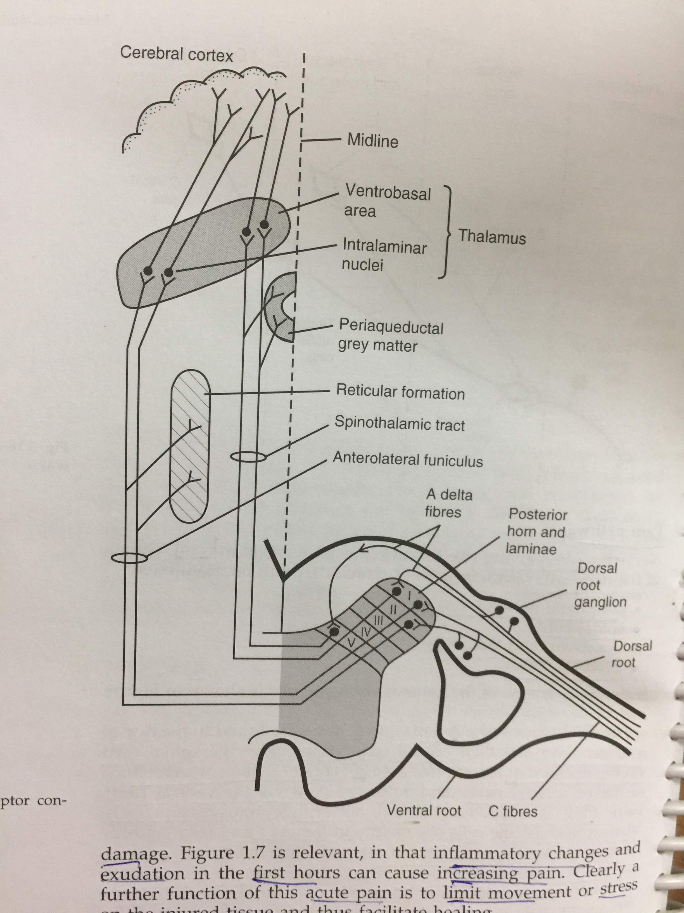

Slide 15
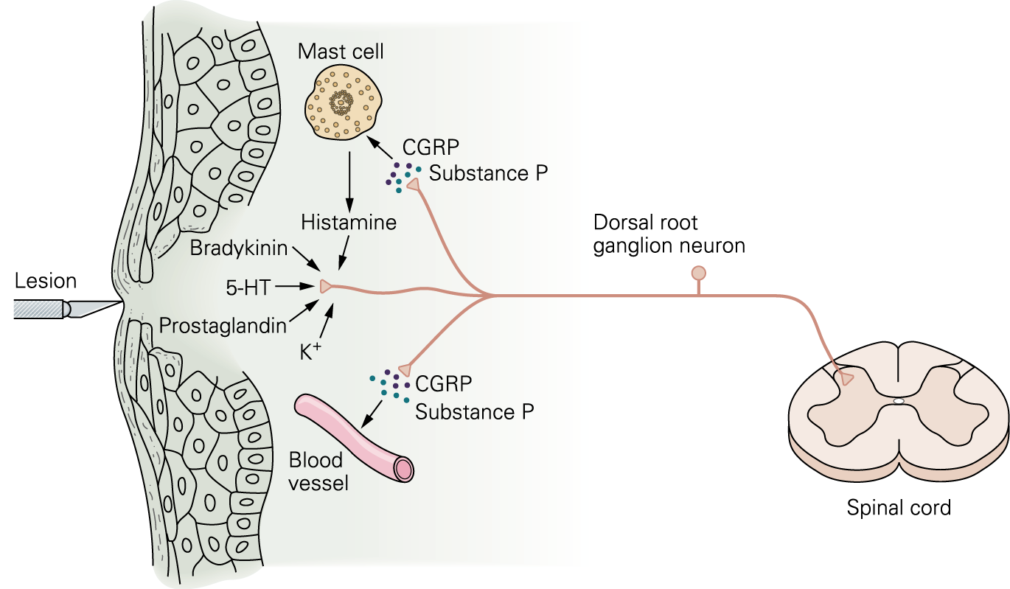
Periphral pain modulation:
Notes:
Any tissue injury causes the release of inflammatory mediators like histamine, serotonin (5 HT), bradykinin, prostaglandins, substance-p; sensitivity of nociceptors increased with the release of above chemicals, pain transmits to the spinal cord. Mediator
Action
Bradykinins Directly stimulates nociceptors.
Prostaglandin Sensitization of the nerve fibres.
Substance P Neurotransmitter.
Histamine Released by mast cells to directly
stimulate nociceptors.
The Role of Substance P:
Substance P is a neurotransmitter that is thought to be involved in the transmission of neuropathic and inflammatory pain.
It has been shown to excite pain transmitting neurons in the dorsal horn of the spinal cord and to be involved in nociceptive processing at spinal cord level.
Substance P release and receptor activation is thought to be a response to tissue injury and stress.
Involved in the sensitization of pain transmitting neurons & development of hyperalgesia.
Mode of action: Substance P may facilitate/excitation of afferent pain fibers by activating the neurokinin-1 receptor in the spinal cord.
When released in to the periphery, Substance P increases the production of inflammatory mediator prostaglandin E2 and the release of cytokines from macrophages and neutrophils. Both prostaglandins and cytokines sensitize primary afferent nociceptors.

Slide 16
Any tissue injury causes the release of inflammatory mediators like histamine, serotonin (5 HT), bradykinin, prostaglandins, substance-p; sensitivity of nociceptors increased with the release of above chemicals, pain transmits to the spinal cord.

Slide 17
Spinal cord level modulation:
The Role of GABA:
The Role of Glutamate:
Notes:
Two main amino acids, GABA (gamma amino butyric acid) and Glycine are important inhibitory neurotransmitters.
Both cause IPSPs by opening cl⁻ channels.
Although GABA is amino acid it is not incorporated in to proteins, instead it is only found in brain. As many as one-third of all brain synapses use GABA.
Glutamate
Several amino acids like glutamate (glutamic acid) and aspartate (aspartic acid) have powerful excitatory effects.
Nearly all excitatory neurons in the CNS and perhaps half of the synapses in the brain communicate with glutamate.
The process of inactivation of glutamate is different from that of Ach.
Soon after release from synaptic vesicles, it is actively transported back into the synaptic end bulb and into neighboring neuroglia by specific glutamate transporters.

Slide 18
INFLUENCE OF ENDOGENOUS OPIATES:
Endogenous – produced by the body
Opiates – produce analgesia by direct action on the CNS
Endorphin/Enkephalin – reduce or inhibit the transmission of pain. Both are found in heavy concentrations in the CNS
Notes:
The endogenous opiates consist of naturally occurring opioids and their receptors.
Opioids- are morphine-like substances synthesized in many regions of the CNS (including pituitary gland).Example: endorphines, enkephalins, dynorphin

Slide 19
Supra spinal level modulation/Descending pain modulation:
Pain can be decreased by descending pain path via peri aquaduct gray matter of mid brain and raphe magnus nucleus of medulla oblongata release endorphins and encephalin and also pain can blocked at substantia gelatinosa of dorsal gray horn cell of spinal cord release endorphins, encephalin so that pain can be blocked pre synaptically.

Slide 20
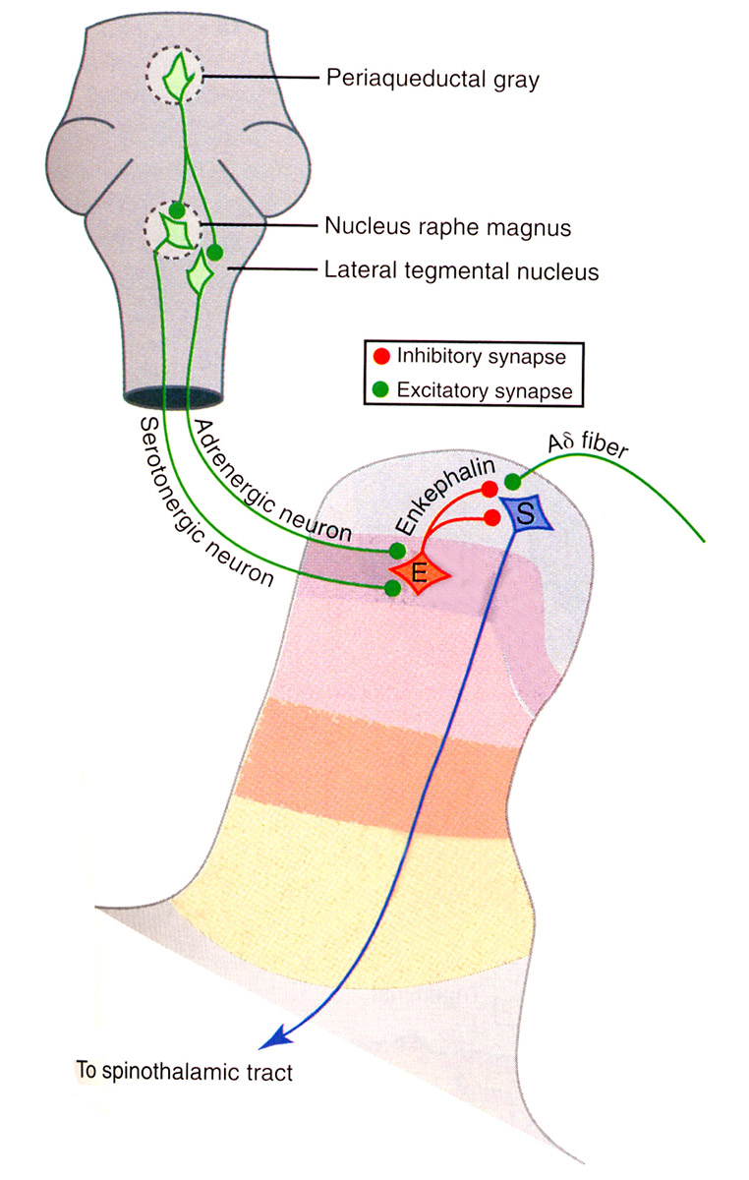
Brainstem
(PAG of mid brain)
(nRM)
Encephalin
SG of dorsal gray horn of spinal cord
To spino thalamic tract

Slide 21
Gate Control Theory of Pain:
Postulated by Melzack & Wall, 1965.
Dorsal horn of spinal cord act like a gate that can increase or decrease the flow of nerve impulses, from peripheral fibers to spinal cord cells that project to the brain.

Slide 22
Mechanoreceptors (Deep pressure like massage, High TENS, Manual therapy)
Stimulation of A β fibers
Presynaptic inhibition of pain from Aδ and C fibers at SG of darsal grey horn cell of SC
Suppression of pain from Aδ and C fibers (Nociceptors)

Slide 23
Interneuronal inhibition of pain/Endorphin and Encephalin theory of pain:
Low TENS
Stimulation of A δ fiber
Activation of Interneuron
Release of Encephalin and Endorphins from Substantia Gelatinosa
Presynaptic inhibition of C fiber pain

Slide 24
Descending Inhibition of pain:
Low TENS/Brief Intense TENS
Stimulation of A δ fiber
Pain reaches to brain via ascending pathway
Descending pain pathway via PAG and nRM
Release of Encephalin and Endorphins from Substantia Gelatinosa
Presynaptic inhibition of C fiber pain

Slide 25
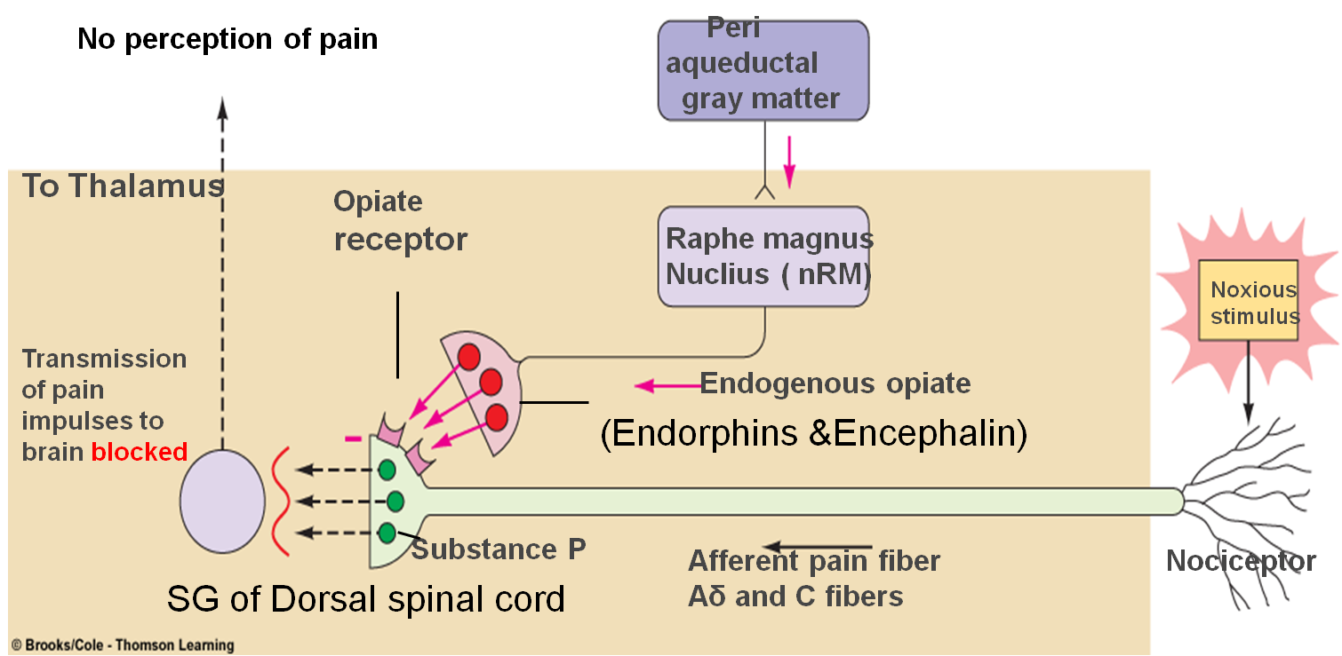

Slide 26
Thank you…

