Slide 1
TENS
(TRANSCUTANEOUS (ELECTRICAL) NERVE STIMULATION)
Dr.Dhwani Chanpura

Slide 2
DEFINITION
It is a stimulation device used for pain control which delivers pulses of low intensity for sensory nerve stimulation which is based on gate control theory.

Slide 3
PARAMETERS
Manheamer and Hampe in 1984 gave the existing TENS parameters
Pulse shape(waveform):
Mainly rectangular
They are of 3 types-
1). Monophasic
2). Biphasic – Symmetrical
Asymmetrical-
i. Balanced
ii. Unbalanced

Slide 4
Balanced -
Shapes are different but charges are equal
Chemical formation takes place
Unbalanced –
Two different shapes with unequal charges
Decreased chemical formation
Used therapeutically
3). Polyphasic

Slide 5
Pulse frequency –
2-600HZ
Commonest used frequency is 150HZ
Pulse width(duration) –
Generally 50-300µs are used but mainly 100µs
Intensity –
100 mAmp, but mainly 60 mAmp is used
A satisfactory intensity is till tingling sensation
By this we can get- Sensory level stimulation
Motor level stimulation
Noxious (pain) level stimulation

Slide 6
ELECTRODE PLACEMENT
At a site of pain
At the dermatome level -
At one particular site of dermatome
Within dermatome (long axis)
Covering the ant and post aspect
Over trigger (acupuncture) point –
This point has least resistance so have good conduction areas
They have αß afferents
Over the peripheral nerve
It bypasses the receptors which have the property of accommodation so decreases the chances of accommodation

Slide 7
Paravertebral area
It stimulates nerve root when placed over concerned nerve root segment.
6) Contra lateral homologus electrode placement- if patient feels pain in right side then put electrodes on left side but location should be same.
7) Stimulation of a remote site-if pain is distal, then put electrode anywhere.

Slide 8
PLACEMENT OF ELECTRODE
SINGLE CHANNEL PLACEMENT:
Two electrodes which can be placed as above.
DUAL CHANNEL PLACEMENT:
There are four electrode.
Bracket method
Criss cross method

Slide 9
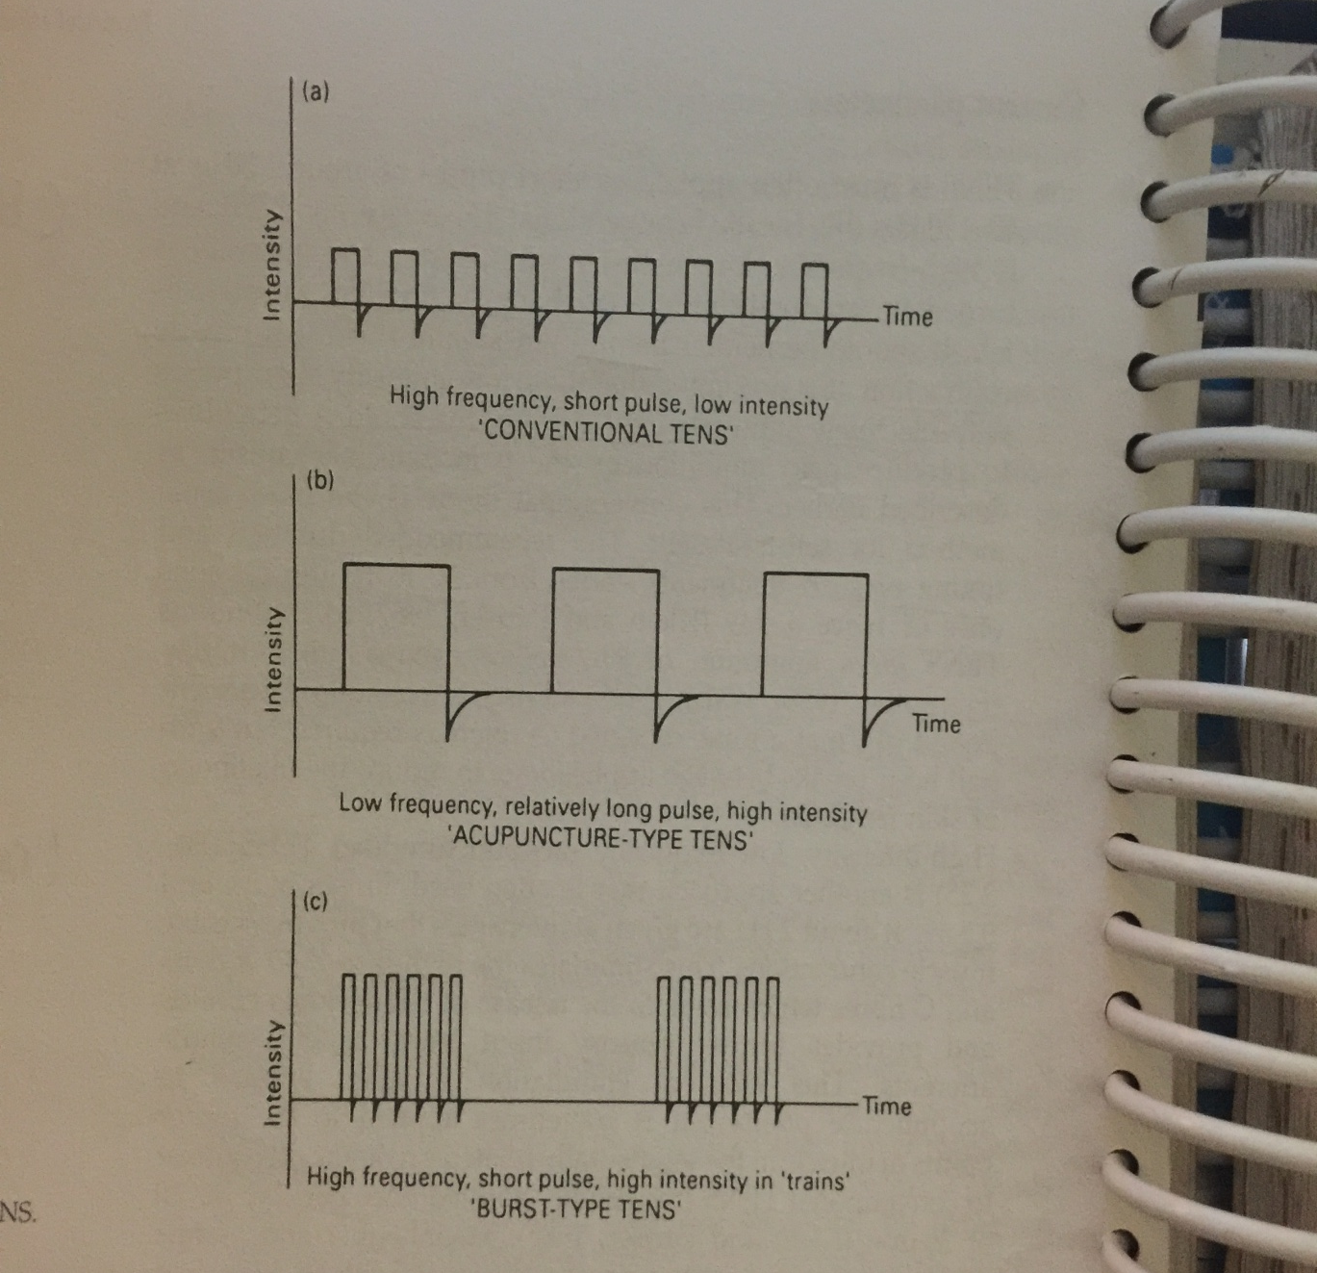
TYPES OF TENS

Slide 10
1. High (Conventional) TENS
NATURE: high frequency low intensity
FREQUENCY: 100-150Hz.
PULSE WIDTH: 100-500µs
INTENSITY: 12-30mA(mild tingling sensation)

Slide 11
MECHANISUM:
Due to stimulation-
impulse produce in large diameter afferent fibres-
presyaneptic inhibition- of Aδ & C at SG-
physiological block of pain gate
ANALGESIA NOT REMAIN PERMENT

Slide 12
ELECTRODE PLACEMENT: at the site of pain or site of dermatome region.
TREATMENT TIME: it gives immediate relief due to release of encephalin.
Two session per day and for 30 mit.
Maximum 6-8 hours/day.can be given 24 hours.
USE: Acute pain
    Pain of superficial nature.

Slide 13
2.LOW TENS(Acupuncture)
NATURE: low frequency,high intensity.
FREQUENCY: 1-5 Hz.
PULSE WIDTH- 100-150 µs
INTENSITY: 300mAmp.

Slide 14
MECHANISUM:
Negative feedback mechanism
stimulation of Aδ & C
Release of endogenous opioid B-endorphin & enkephalins.
Blocking of forward transmission in pain
Produce muscle contraction.

Slide 15
ELECTRODE PLACEMENT-
On trigger point
On motor point
TREATMENT TIME: 30MIN/DAY
USE: long standing deep aching pain
Chronic pain

Slide 16
3. BURST TENS
NATURE: low frequency trains with high internal frequency
FREQUENCY: 50-150Hz.
INTENSITY: it is a series of pulses,repeated 1-5 times a second.
Each train consist of a number of individual pulses.

Slide 17
MECHANISUM:
The interval of high frequency cases pre syaneptic inhibition.
Burst cause release of B- endorphin opiod .
So muscle contraction occur due to low frequency and presyanptic inhibition due to high frequency.

Slide 18
TREATMENT TIME- 30MIN/DAY
USE: it requires comparatively less intensity than low TENS because all internal frequency are going for summation.
So it can be used for both acute and chronic pain.

Slide 19
4. RANDOM TENS
NATURE: RANDOM ,MODULATED PULSE DURATION.
To prevent accomodation or to improve patient tolerance ,the pulse width,pulse frequency,intensity can be changed automatically.

Slide 20
5. INTENSE(Brief) TENS
NATURE- most severe form of TENS,keep all the parameters at maximum.
MECHANISUM:
Endogenous opiods release.
Nagative feedback mechanism
Counter irritent effect- decrease the conduction velocity.

Slide 21
INTENSITY- hot needle sensation with muscle contraction.
TREATMENT TIME: 30-60 SEC., stop if muscle gets fatigue.
USE: before wound debridement.
Tooth extraction
For complete analgesia
Not used in regular clinical practice.

Slide 22
Modulated TENS: Pulse length, frequency, amplitude:- constantly & automatically varied to prevent nerve accommodation.
Notes:
Some provide this facility for all three parameters some allow for one or two. The cyclic variation is believed to prevent the adaptation of the nerve to the current. Variant of conventional tens. Used for longer duration.

Slide 23
Physiological effects
Pain relief by,
Antidromic blocking of afferent impulses
Pain gate mechanism
Physiological conduction block
Placebo effect
Negative feedback
Reflex vasodilatation by which drainage of metabolites

Slide 24
2. blood Increased supply by,
Reflex vasodilatation
pumping effect of contracting muscle
Reduction in edema- pumping effect of muscle
Healing of wounds
Remodeling of wounds
Release of histamine which causes tripple response

Slide 25
INDICATIONS
1. Acute pain
Sport injuries
Old orthopedic conditions
Oro facial conditions
Dental pain
Post operative incisional pain
Entrapped condition like CTS

Slide 26
Radiculopathy
Chronic pain
Orthopedic condition
LBA
LS
CS
Arthritic conditions
Degenerative conditions

Slide 27
Neurological origin
Post herpatic neuralgia
Trigeminal neuralgia
Peripheral neuropathy
Phantom limb in amputation
Reflex sympathetic dystrophy (RSD)

Slide 28
Pain with present defect
Ischemic pain
Raynod's disease
Bueger’s disease
Diabetic neuropathy

Slide 29
CONTRAINDICATIONS
Over carotid sinus area- it leads to cardiac arrhythmia
Patients with pacemaker
Over pharyngeal region because, it causes interference with breathing and swallowing coordination
Over insensitive skin
Pregnancy
Patients with CV stroke
Head/neck region in epileptics
Never applied on mucosal membrane
Open wound
Thoracic region in cardiac disease patients

Slide 30
LONG TERM EFFECTS (DANGERS)
Electrical burns
Chemical burns
Micropunctate burns
Allergic reaction of electrode so ask patient to change position of electrode if continuous use is there.
Thermal burns- Concentration density
Without using gel
No proper contact

Slide 31
FACTORS AFFECTING
Posture and body mechanism
Medications- eg Diazepam
Corticosteroids
Narcotics
Chronic pain, multidisciplinary approach
Stress reduction
Current modulation
Variable electrode placement
Motivation, education of patient

Slide 32
PRECAUTIONS
Sensations
Proper stabilization of patient
Open wound
Erythma
Viscosity

Slide 33
THINGS TO BE DOCUMENTED
Mode
Waveform (pulse shape)
Pulse duration
Pulse frequency
Pulse modulation
Intensity
Treatment area
Electrode placement (site)
Duration of treatment

Slide 34
HOME TENS
Simple in operation
Purpose of unit is explained
Provide pain assessment chart
Electrode preffered placement chart
Battery charging
Schedule for treatment time and rest period
Electrode care and use
Precautions of TENS unit
Proper skin care
Do’s and Dont’s list
Possible or potential trouble in shooting
Not take during sleep

