Slide 1
DEVLOPMENTAL DISORDER OF CNS
By: Dr. Dhwani Chanpura

Slide 2
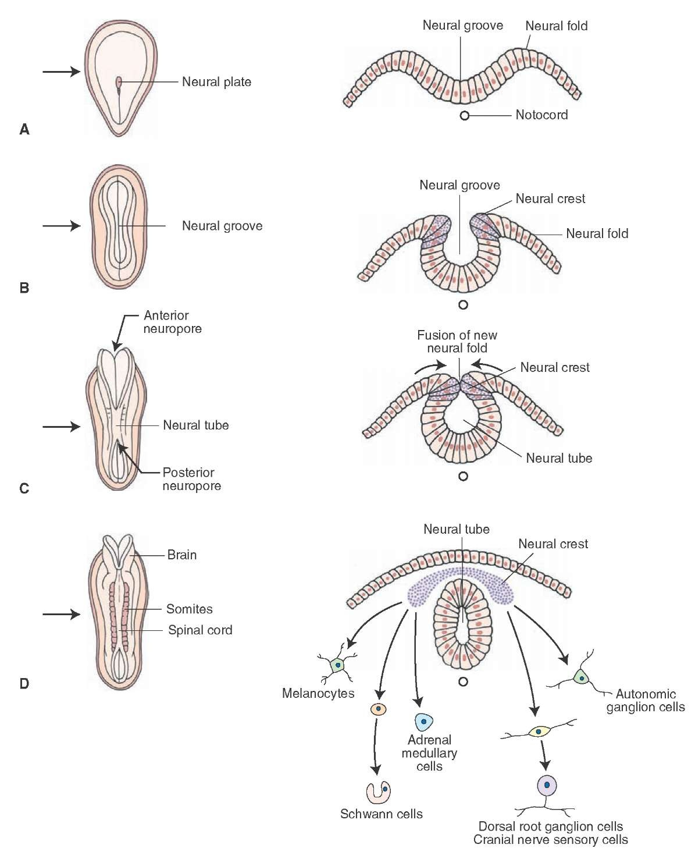

Slide 3
NEUROEMBRYOLOGY
In embryo, development of nervous system (NS) begins when ectodermal cells start to form neural tube
Neural tube begins to form in 3rd week and is completed by 4th week of embryonic life
1st stage in neural tube development is a thickening of ectoderm, forming neural plate
A longitudinal fissure develops in neural plate and progressively enlarges to form neural groove

Slide 4
As groove deepens, its edges become more prominent, and become neural folds
Neural folds eventually meet, fuse, and complete transformation into a tubular structure
Cranial part of neural tube evolves into brain, and caudal part becomes spinal cord
Neural crest cells give rise to peripheral nervous system (PNS)

Slide 5
CLASSIFICATION OF CONGENITAL NEUROLOGIC DISORDERS
Craniospinal deformities
Restricted developmental abnormalities of NS
Congenital abnormalities of motor function (cerebral palsy)

Slide 6
CRANIOSPINAL DEFORMITIES
Enlarged head Hydrocephalus
  Hydranencephaly
  Macrocephaly
Disturbances of neuronal formation and migration
  Anencephaly
Microcephaly
  Primary
  Secondary to cerebral disease

Slide 7
Rachischisis
  Cephalic and spinal meningocele, meningoencephalocele, meningomyelocele
  Dandy-Walker syndrome
  Chiari malformation
  Platybasia and cervical-spinal anomalies
Chromosomal abnormalities
  Downs syndrome

Slide 8
Restricted developmental abnormalities of NS
spina bifida
craniorachischisis totalis
anencephaly
encephalocele

Slide 9
HYDROCEPHALUS
Hydrocephalus occurs when there is in an increase in cerebrospinal fluid (CSF) circulating in and around the brain.
Normally the fluid is produced by the choroid plexuses situated in the cerebral ventricles and circulates through the ventricular system and around the base of the brain to the surface where it is absorbed by the arachnoid granulations into the sagittal sinus.
It also circulates around the spinal cord and down the central canal.

Slide 10
If there is a block in the pathway, particularly at the aqueduct or around the base of the brain, the CSF cannot be reabsorbed he pressure begins to build up. In the baby, the head is able to grow easily as the sutures of the skull and fontanelles are very flexible.
Hydrocephalus develops in 80% of children with spina bifida.
It may be present at birth, but usually develops after the closure of the spinal lesion, when the head circumference rapidly rises.
This is caused by a change in the fluid dynamics acting on the Arnold-Chiari malformation which is usually present. The medulla and part of the cerebellum are displaced into the foramen magnum causing the block of the fourth ventricle which is usually incomplete.

Slide 11
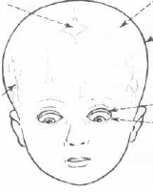
CLINICAL FEATURES
Hydrocephalus is distinguished by several features:
  frontal protuberance, or bossing
  sunset sign
  thinning of scalp
  prominence of scalp veins
  separation of cranial sutures
  cracked pot sound on percussion of skull

Slide 12
TREATMENT
John Holter and a neurosurgeon, Eugene Spitz, perfected the Spitz –Holter shunt which is designed to drain excess CSF from the ventricles into the right atrium of the heart.
Many surgeons use the peritoneal sac, instead of the circulation, to absorb the CSF. The need for lengthening the lower catheter occurs less often, but the catheter may become blocked by adhesions.

Slide 13
Common neurological problems occurring with hydrocephalus are:
1. spasticity of one or both arms
2. cerebellar signs with clumsiness or incoordination and poor balance.
3. dissociated sensory loss and weakness in the arms and hands associated with syringomyelia.

Slide 14
SPINA BIFIDA
Spina bifida is one of the neural tube defects. These are the group of developmental abnormalities that occur when the neural tube fails to fuse anywhere along its length.
The commonest position of the lesion is in the thoraco-lumbar region of the spine, then the lumbo-sacral, thoracic and cervical regions.
If the forebrain fails to develop, anencephaly occurs-a condition incompatible with life. An encephalocele lesion may occur anywhere along the midline of the skull, commonly in the occipital region.

Slide 15
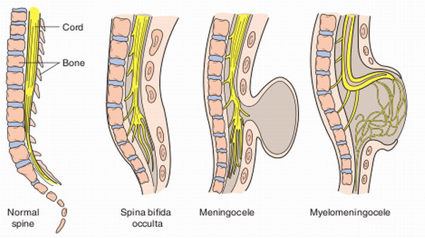

Slide 16
SPINA BIFIDA CYSTICA (APERTA)
MENINGOCELE: the meninges form a sac lined by arachnoid membrane and dura containing cerebrospinal fluid (CSF) and, rarely, a small amount of nervous tissue.
MYELOMENINGOCELE: The neural tube is closed and covered by a membrane centrally and skin peripherally, but the spinal cord and all the nerve roots are outside the vertebral canal. In many cases there are associated anomalies of the cord, with dilatation of the central canal, lipomata and other associated neural defects, such as split cord or tethering of nerve roots.

Slide 17
TYPES OF LESIONS
At birth, two types of lesions are recognisable:
TYPE 1 (one-third of patients): there is complete loss of the spinal cord function, below a certain segmental level which results in sensory loss and absent reflexes. These infants have characteristic deformities of muscle imbalance , the deformity depending on the level of lesion.
TYPE 2 (Two- thirds of patients): associated with interruption of the corticospinal tracts. There is preservation of purely reflex activity in isolated distal segments.

Slide 18
Below the level of spinal cord involvement:
there is a segment with flaccid paralysis and sensory and reflex loss and ,below this isolated cord function with reflex activity and spasticity.
Toe clonus may be striking.

Slide 19
2) A flaccid segment is almost absent and therefore there is virtually complete spinal cord transaction with only reflex activity below the level of the lesion.
it is likely that paralysis in mylomeningocele is due to a lesion of the upper motor neurone(UMN) rather than the lower motor neurone(LMN) .
In high lesions, the UMN lesions tend to occur above the plaque. In low lesions, it may occur elsewhere, e.g. within the plaque itself.

Slide 20
3) Incomplete transection of the long tracts occur, so the child has a spastic paraplegia with some preservation of voluntary movement and sensation.

Slide 21
ASSESSMENT OF THE NEONATE WITH SPINA BIFIDA APERTA
NEUROLOGICAL EXAMINATION:
The purpose of the examination is to determine, as far as possible, the level at which normal cord function ceases, and to assess the presence and degree of hydrocephalus.
Skull: the skull should be examined and the sutures and fontanelles palpated for evidence of distension and increased pressure. Measurement of the occipital frontal circumference (OFC) should be carried out and charted.

Slide 22
Cranial nerves: the cranial nerves may be assessed by observation of the movement of the face, tongue and palate and by watching the baby suck.
Spine: the spine should be palpated along its length as sometimes there are multiple lesions which are not always obvious. The length and width of the lesion should be measured and the position on the spine noted.

Slide 23
Limbs: the presence of active movements of the limbs should be looked for by stimulating the legs and eliciting neonatal reflexes. The power of the muscles may be assessed by making them operate both with and without gravity and with and without resistance. Deformities such as talipes and congenital dislocation of the hip should be looked for.
Bowel and bladder: sphincter tone and bladder function should be assessed.

Slide 24
Sensory level: it is difficult to elicit a sensory level in a baby. If he is asleep, it may be possible to produce a level by stimulation with a pin, starting at the lower sacral territory perianal region, buttocks, thighs and legs and moving upwards over successive dermatomes of the anterior surface and on to the abdomen.
Radiological examination of the skull and spine and hips should be carried out.

Slide 25
NEONATAL PHYSIOTHERAPY
The physiotherapist is called upon to make a physical assessment of the child, and this early assessment if correctly done, can give a fairly accurate indication of the future physical ability of the child.
To carry out the assessment the examiner first records her general impressions, abnormal limb positions, movement, deformities and so on.
Reflexes are tested and sensory chart is completed. While the baby is still in hospital, providing he is well enough, the physiotherapist turns her attention to any deformities that may be present. Most common of these is talipes equinovarus.

Slide 26
TALIPES EQUINOVARUS: this may be strapped with zinc oxide or elastic strapping, or treated by splinting. Whichever is used the physiotherapist must remember that the baby has impaired sensation, poor circulation and probably limbs that are in a poor condition generally so that she must be even more careful than usual in applying corrective measures.

Slide 27
As the child grows, the foot deformities will be revived by the orthopaedic surgeon. Early surgery is rarely indicated unless the deformity is impossible to hold by strapping.
A simple tenotomy of the deforming tendon will usually allow further effective correction by conservative means to continue.

Slide 28
The knee: both flexion and hyperextension may be present at birth.
Treatment is passive stretching and splintage should be used.
The Hip : Dislocation, subluxation and dysplasia are common.

Slide 29
PHYSIOTHERAPY
Physiotherapy already started while the child was in hospital should be continued at home for many reasons-
to treat any deformities present and to prevent others developing ,
encourage what movement there may be in the limbs
to encourage the child to keep up his peers in his milestone, i.e. rolling over , crawling, sitting up, and in later stages to teach him to walk in whatever orthoses are necessary.

Slide 30
Hip extension stretching should be routine- as well as teaching the mother to place the baby in a prone position during playtime , preferably on the floor.
it is hip flexion that causes the marked lordosis that is characteristic of older children with spina bifida.

Slide 31
Any movement present must be noted and encouraged , and if there is any sensation in the legs this can be used to stimulate movement by tickling or touching.
Arm movement can be started as soon as the baby responds and the exercises to strengthen the shoulder girdle gradually introduced . this is necessary because most patients with spina bifida will need to rely on sticks or crutches to help them to walk and a strong shoulder girdle is very necessary.

Slide 32
Play therapy with brightly coloured toys and those that make a noise ,squeaky toys to press on, bridging.
if spasticity is present , treatment is given following that used for cerebral palsy.

Slide 33
AMBULATION
Child is ready to stand,usually between 18onths and 2 years,an assessment needs to be made of degree of support required fromorthosis.
At first more support may be necessary and can be removed gradually as the child becomes stronger and more confident.

Slide 34
AMBULATION SUPPORT ACCORDING TO THE NEUROLOGICAL LEVEL
LEVEL OF PARALYSIS | EQUIPMENT REQUIRED
ABOVE L1 | Thoraco-lumber –sacral orthosis with knee-ankle-foot orthosis,high guidance orthosis
Below L2 | TLSO with KAFOs or lumbar-sacral orthosis
Below L3-4 | LSO with KAFOs Or KAFOS
Below L5 | KAFOs or AFOs
Below S1 | AFOs

Slide 35
ORTHOSIS
The child with the high lesion requires a pelvic or thoracic band for support , and he usually needs a rollator walker initially.
The length of time taken to progress to using quadripod sticks, independent sticks or crutches varies tremendously according to the child’s self confidence and enthusiasm and encouragement given to the child by the parents.

Slide 36
The hip guidance orthosis was developed for children with high lesions has poor prognosis for long term walking.
In more severely handicapped child , a wheelchair will be used.

Slide 37
Parents need advice and encouragement in the management of the orthosis:
1) toes may become curled inside a boot and produce pressure sores.
2) a regular check of boot size needs to be made.
3) regular inspection of the anaesthetic areas must become routine.
4) clothing must be pulled down to prevent pressure under the orthosis.

Slide 38
SPINAL DEFORMITY IN SPINA BIFIDA
Spinal deformity commonly develops in high or severe spina bifida lesion.
The vertebrae may be malformed , there may be fusion of part of the vertebra leading to abnormal growth and increasing curvature.
These are related to muscle imbalance and become worse with growth.

Slide 39
TREATMENT
Bracing: the general indication for the bracing are:
A small curved under 45 degree which remains flexible and reaming growth potential.
Braces will not affect the progression of structural curve , or a large curve over 50 degree which has become stiff or where growth has ceased.

Slide 40
Surgical techniques:
In some instances minor surgery may prevent serious progression.
Spinal corrective procedures are usually carrie out between 10 and 13 years.
Postoperative treatment : immediately no brace is worn.
At about 2weeks the child is allowed to sit in a brace which is worn at all times except when lying flat.

Slide 41
MANAGEMENT OF ANAESTHETIC SKIN
Pressure sores almost inevitably develop in some children:
1) excessive pressure localized to a small area caused by deformity and asymmetrical posture.
2) poor circulation of both blood and lymph.
3) wet skin, contaminated with urine or faeces.
4) Abnormal skeletal structure,eg: khyphosis , callus formation.
5)scar tissue associated with poor subcutaneous tissue following clouse of back lesion.

Slide 42
Prevention:
buttocks: good basic hygiene, with a daily bath, combined with control of incontinence is the first consideration.
Lower limbs: fitting of orthosis and in providing extra padding for post operative plasters.

Slide 43
MANAGEMENT
CONSERVATIVE:
To provide effective relief pressure on the buttock area by the use of chip foam , cushion ,with a cut out area.
LOCAL PREPARATION:
Necosis and infection are present ,twice daily application of eusol and paraffin emulsion is most effective.

Slide 44
MINOR SURGERY:
Healing process can be accelerated by the excision of necrotic tissue and fibrotic areas.
PLASTIC SURGERY:
Surgical excision of the burse , combined with a rotation flap is required.

Slide 45
MANAGEMENT OF NEUROGENIC BLADDER AND BOWEL
Most spina bifida children with paralysis of the legs will have some degree of neurogenic bladder and bowel.
1)The hyper-reflexic bladder with poor sphincter tone which continuously empties but is safe.
2)The moderately reflexic bladder with inco- ordinated between bladder and sphincter ’detrusor-sphincter dyssynergia’.
3)In some cases the bladder contracts against the closed sphincter, and become dilated and trabeculated and a source of infection.

Slide 46
METHOD OF MANAGEMENT OF INCONTINENCE
1)Clean intermittent catheterisation
2)Indwelling catheter
3)Artificial sphincters
Bowel control
In children with some sphincter tone, toilet training can be usually achieved by regular time of evacuation schedule which is continued indefinitely.

Slide 47
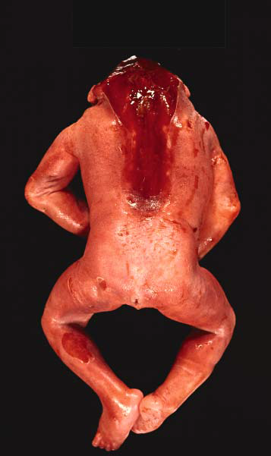
CRANIORACHISCHISIS TOTALIS
Most severe open defect
Involves a complete failure of formation of neural tube

Slide 48
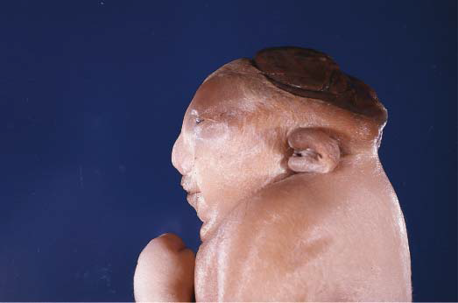
ANENCEPHALY
Anencephaly is characterized by absence of calvarium and abnormalities of base of skull and sphenoid bone with shallow orbits causing protrusion of eyes
Cerebral hemispheres are replaced by a mass of neuroglial tissue and vessels

Slide 49
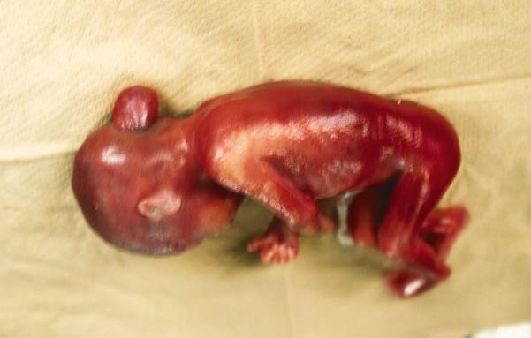
ENCEPHALOCELE
Meninges & part of CNS (or) meninges, CNS & a part of ventricular system may herniate through a defect in skull, most commonly in occiput region

Slide 50
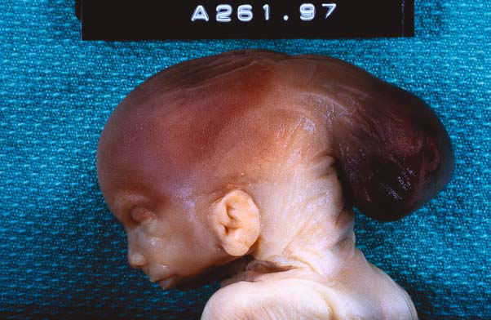

Slide 51
ARNOLD-CHIARI MALFORMATIONS
Type 1: Cerebellar tonsils herniate into foramen magnum
Type 2: Cerebellar tonsils or vermis, medulla, & fourth ventricle are displaced into foramen magnum (classic Arnold-Chiari malformation) & is commonly associated with a small posterior fossa, lumbar meningomyelocele, aqueduct stenosis, hydrocephalus
Type 3: Cerebellar suboccipital encephalocele. It may be associated with an elongated brain stem, & lumbar spina bifida
Type 4: Cerebellar hypoplasia

Slide 52
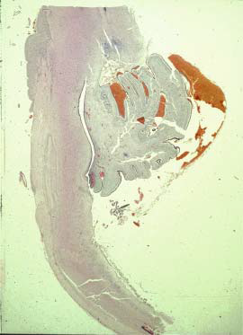
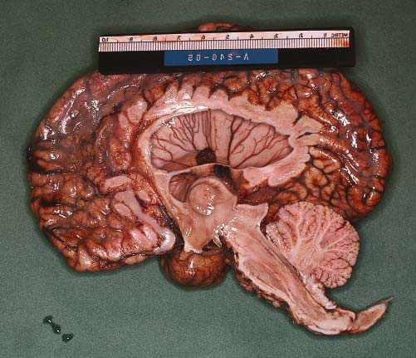
Commonly seen with cavitation of central canal in spinal cord or caudal medulla (syringomyelia or syringobulbia)

Slide 53
DANDY-WALKER SYNDROME
Agenesis (complete or partial) of vermis
Cystic dilatation of fourth ventricle
Enlargement of posterior fossa

