Slide 1
HEAD INJURY
BY: JIGNASHA VADI

Slide 2
Introduction
One of the most disabling and challenging condition in physiotherapy rehabilitation. This is because of the multiple system involvement due to brain injury and high chances of developing secondary impairments after head injury.

Slide 3
Classification
1. Based on GCS: a) Mild
b) Moderate
c) Severe
2. Based on communication with outer environment:
a) Open – if skull fracture is present
b) Closed – if skull fracture is not present
3. Based on velocity of trauma:
a) High velocity impact – e.g.: motor vehicle accident
b) Low velocity impact – e.g.: blow from a blunt object
4. Based on extent of injury:
a) Focal injury – involving one part of brain
b) Diffuse injury – involving all the parts of brain

Slide 4
Factors influencing outcome of the patients with head injury:
1. Premorbid status:Previous brain injury or disease affects the recovery adversely. E.g.: previous TBI, Stroke, Encephalitis etc.
2. Primary injury:
3. Secondary injury:

Slide 5
Primary injury:
Primary injury can be of following types depending on nature, direction and magnitude of forces:
1) Local brain damage: Occurs directly under the area of impact on the skull. It can present in the form of clot, contusion, laceration or the combination of all.
2) Coup – countercoup injuries:A severe blow to the head leads to this type of injury. Here the brain gets injured on the side of hit and it also bounces to the opposite side and gets hit by the inner surface of the skull on that side as well.
3) Polar brain damage: Occurs when the brain is subjected to acceleration-deceleration forces as occurs in head - on collision. Brain moves forward due to momentum but stops suddenly by the impact of the skull.Damage to the frontal and temporal lobes are more frequent followed by occipital lobe.
4) Diffuse axonal injury: Refers to widely scattered shearing of sub-cortical axons within their myelin sheath. It can occur in isolation or with other types of brain injury also. Prognosis is poor with this type of brain injury.

Slide 6
Secondary injury:
1) Hypoxic ischemic injury: Following severe brain injury, several conditions may decrease the energy supply to the brain resulting in to secondary brain damage. After TBI, shifting of brain structures may lead to compromise in circulation in a particular vascular territory and hence infarction. Arterial hypoxemia results in more diffuse HII. Arterial hypoxemia may occur because of cardiovascular or respiratory compromise.
2) Intracranial hematoma: Are of three types – epidural, subdural and intra-cerebral. Late occurring intracranial hematomas are source of secondary brain damage. Initially the patient may remain conscious and oriented (Lucid interval) but they later go in to coma and die. This late occurring loss of consciousness is due to compression of brain by expanding hematoma.
3) Increased intracranial pressure: Human skull is like a rigid closed box which contains brain. Therefore any abnormality in brain fluid dynamics or brain swelling results in increased intra-cranial pressure.

Slide 7
4) Intracranial infection
5) Cerebral artery vasospasm
6) Post traumatic epilepsy
7) Obstructive hydrocephalus
8) Auto-destructive cellular phenomena

Slide 8
Clinical rating scales
Glasgow Coma Scale:
Activity | Score
Eye opening:
Spontaneous | 4
To speech | 3
To pain | 2
No response | 1
Best motor response:
Follows motor command | 6
Localizes | 5
Withdraws | 4
Abnormal flexion | 3
Extension response | 2
No response | 1
Verbal response:
Oriented | 5
Confused conversation | 4
Inappropriate words | 3
Incomprehensible sounds | 2
No response | 1

Slide 9
GCS is used to measure level of consciousness and defines the severity of injury. Patients who are having GCS score 8 or less are considered to be in coma and severe brain injury. A score of 9 to 12 shows moderate brain injury and 13 and above indicates mild brain injury.

Slide 10
Ranchos Los Amigos Level of Cognitive Functioning:
It is a descriptive scale which outlines a predictable sequence of cognitive and behavioural recovery seen in individuals with traumatic brain injury. It contains VIII stages of cognitive and behavioural recovery. A patient may plateau at any level. It helps in treatment planning.
I. No response
II. Generalized response
III. Localized response
IV. Confused-Agitated
V. Confused-Inappropriate
VI. Confused-Appropriate
VII. Automatic-Appropriate
VIII. Purposeful-Appropriate

Slide 11
Diagnostic procedures
Following diagnostic tests are used to confirm the diagnosis, to localize and quantify the lesion, to detect any secondary injury and to establish the prognosis.
Electroencephalograms:
It measures electric signals of CNS. EEG is inexpensive, easily obtained and non-invasive. It provides both qualitative and quantitative information about brain signals. It is particularly useful in gray matter injuries.
Computed tomography:
It is useful in identifying any hematoma, ventricular enlargements and atrophy. It is relatively insensitive in detecting minor abnormalities when compared to MRI. A normal CT scan does not rule out brain damage.
Magnetic resonance imaging:
MRI is more sensitive to soft tissue injuries when compared to CT, especially to non hemorrhagic lesions.
Cerebral blood flow mapping:

Slide 12
Direct Impairments
1. Cognitive impairment:
2. Post-traumatic amnesia:
3. Lack of orientation:
4. Memory deficit:
5.Decreased Attention span:
6. Lack of insight:
7. Later high level executive functioning, planning tasks and problem solving may be affected and become evident.
8. Neuromuscular impairments:
Motor impairment may resemble hemiparesis in CVA. Motor impairment is much more complicated in head injury patients (because of multiple system affection). Ataxia and nystagmus accompany deficits in balance many a times.
9. Visual perceptual impairments:
10. Swallowing impairments:
11. Behavioural deficits:
12. Communication impairments:

Slide 13
Indirect impairments
1. Contracture
2. Mobility deficits
3. Skin breakdown
4. Heterotrophic ossificance : Heterotrophic ossificance is a abnormal formation of bone in muscle and other soft tisuue .it usually occurs more proximal joints.( shoulder ,hip and knees)
5. Infection
6. Deep venous thrombosis
7. Impaired speech because of tracheostomy etc.

Slide 14
Assessment of patients with head injury
Demographic data:
Note name, age, gender, dominance, address and informant.
Date of assessment and repeat assessment must be mentioned to monitor any improvement and deterioration.
Chief complain:
In acute head injury patients often the chief complaint is obtained by relatives as the consciousness of patient may be affected.
Chief complaint will often be in terms of cognitive and behavioural impairment. Chief complaint will also include neuromuscular impairment in terms of paucity of movement in one limb, one side of the body or all four limbs.
Sometimes memory deficit and lack of orientation may also come up as chief complaint if the injury is subacute.

Slide 15
History of presenting illness:
History should be in terms of patient or relatives.An accurate history profiling the timing of neurological events is obtained.
Most important:
The exact mechanism of injury (or accident in case of RTA) should be noted if available.
On the basis of mechanism of injury we can suspect type of head injury the patient is having (eg; High velocity impact, Low velocity impact etc.)
Ask also about how the patient was transported from the site of injury to hospital. Whether the spine was stabilized while transfers or not. Any bleed from ear of nose was present or not.
Duration of post traumatic amnesia.
Past history: Previous episode of head injury if any, and the recovery followed by it.
Ask about patient’s likes and dislikes which may be used for coma stimulation.

Slide 16
Observation:
  Patient body position
    Alignment of head, trunk and limbs
  Presence of movement
    Volitional- purposeful or non purposeful
Spontaneous – automatic or reflexive
  Invasive lines , tubes and monitoring equipments
    Airways, chest tubes, nutritional management, IV lines, CVP lines, arterial lines, and ICP monitor

Slide 17
Physical examination: The physical examination of the patient includes a general medical examination including vital signs, cardio-pulmonary examination (especially if any trauma to chest is present), orthopaedic examination (especially if any trauma to limbs are present).
Post surgical assessment:
Monitor-ICP , LOC, behavior, motor and sensory functions, vital signs, Glasgow coma scale
Establish baseline assessment
Look for sudden changes
Monitor insertion site for CSF leakage, drainage or infection
Monitor changes in vital signs, chills, positive culture of drainage
Strict aseptic technique

Slide 18
Neurological examination:
Important components of neurological examination which are affected commonly in head injury are as follow:
Level of consciousness:
Altered level of consciousness occurs consistently with acceleration-deceleration, some focal and diffuse axonal injuries. This can be assessed using the Glasgow coma scale.
Coma:Unarousable with absence of sleep/wake cycle on electroencephalogram and loss of the ability of environmental interaction. GCS less than 8.
Persistantvegitatve state: Affected cognitive neurological function and awareness of the environment but relatively preserved non-cognitive function and a preserved sleep-wake cycle.
Delirium or acute confusional state: Mostly patient remains awake to easily aroused, level of consciousness fluctuates
Stupor: Difficult to arouse, medical emergency

Slide 19
Cognitive dysfunction:
Post traumatic amnesia: Total duration of PTA should be taken.
Attention span should be assessed. Orientation to time place and person should also be assessed. Patient may not have insight which may be dangerous for the patient’s safety. Assessment of memory, ability to follow one two or three level commands should also be done as all these will help in planning and treatment of the patient. Abstract thinking depth perception, figure ground discrimination, left - right discrimination and judgement also to be checked. Lack of insight and fore sight should be checked for the safety of patient.
Use Ranchos Los Amigos scale of Levels of Cognitive functioning and management

Slide 20
Behavioural deficits:
These involve long term behavioural changes like sexual disinhibition, low frustration tolerance, depression, emotional disinhibition, aggressiveness etc. these deficits should be observed during the examination and noted.
Communication impairments:
Expressive aphasia, receptive aphasia, reading comprehension, written expression, language skill deficits and disarthria may be present. If communication is severely limited, altered forms are required which include gestures, demonstration etc.
Visual &Perceptual dysfunction: There are many tests and test batteries available to assess body scheme, body image, spatial relations, agnosia and apraxia. Cranial nerve or occipital lobe affection may lead to visual deficit which often involves hemianopsia or cortical blindness.

Slide 21
Cranial nerve integrity: check in the same way as done in stroke patients.
Swallowing impairments:Swallowing difficulties may occur in head injury patients due to cranial nerve involvement, apraxia, motor control impairment, postural control problem etc.
Sensory integrity: It includes testing of superficial sensations, deep sensations and combined cortical sensations.
Joint integrity and mobility: This includes assessment of ROM, joint hyper-mobility, hypo-mobility and soft tissue changes (swelling, inflammation or restriction). Elbow and knee should be carefully examined for any swelling, redness, pain and ROM restriction which may be a suggestive of heterotrophic ossificance. Developing contractures and any limitation in ROM should be documented carefully.

Slide 22
Motor deficits: Motor impairment may resemble hemiparesis in CVA. Motor impairment is much more complicated in head injury patients (because of multiple system affection). Ataxia and nystagmus accompany deficits in balance many a times.
The position of affected limbs at rest and with movement should be observed for tonal abnormality. An assessment of stretch reflex (DTR) and pathological reflexes (babinski, tonic reflexes) should be done.
The quality of movement should also be assessed. Weakness, slowness of movement, abnormal movements should be carefully assessed.
Co-ordination and timing deficits should be assessed. The ability to perform skilled movement (writing, dressing and feeding) should be assessed.

Slide 23
Observational gait analysis should be done. Distance walked, time, cadence, velocity and stride length should be measured.
Disturbance in postural control and balance: postural control is assessed in sitting and standing. Here patient’s ability to maintain a steady and symmetric position within the base of support – static balance, and ability to move within given posture in all directions- dynamic balancecan also be assessed.
For balance assessment, tools like berg balance scale or tests like functional reach test in all directions in sitting and standing should be performed.
Functional assessment: it is to be done to assess the impact of impairment, establish outcomes, goals and plan of care, and monitor progress and outcomes.
Common tools like Barthel Index and Functional Independence Measure etc. can be used.

Slide 24
Management of patients with head injury
Early physical therapy goals in ICU:
Post surgical goals
Provide psychological support to patient and family
Maintain optimal cerebral perfusion; GCS > 13, ICP 10 mmHg or less
Baseline assessment and frequent monitoring
Monitor function of catheter to monitor ICP
Monitor temperature
Improve arousal of patients
maintain airway free of secretion : normal ABGs and pulse oximetry
Reduce risk for infection

Slide 25
Post Operative Management
Pre-oxygenate 100% O2 before suctioning
Limit to 10 sec. suctioning to reduce the risk of sudden de-saturation and to prevent abnormal increase in tone
Monitor ABGs
Avoid hyperextension or exaggerated neck flexion
Avoid valsalva maneuver
Do not use foot board, avoid restraints if ICP is increased
Optimal spacing of activities should be done, provide frequent rest periods
Provide quiet environment to prevent overload of sensory stimuli, limit noxious stimuli to prevent abnormal increase in tone and fluctuation of vital signs.
Reposition 2 hours to prevent bed sores
Position patient on side, with non-surgical side down

Slide 26
Avoid head tipping down
Strict aseptic precautions: Wearing gowns, gloves, and mask
Coma arousal therapy
A coma stimulation programm(sometimes called a coma arousal programme) is an approach based on stimulating the unconscious person’s senses of hearing, touch, smell, taste and vision individually in order to help their recovery.
Rationale behind coma arousal therapy
May affect the RAS and increase arousal and attention to the level necessary to perceive incoming stimuli
May prevent environmental (sensory) deprivation, which has been shown to retard recovery and the development of central nervous function and further depress impaired brain functioning
Allows for frequent monitoring of patient's responsiveness
May improve the quantity and quality of responses toward purposeful activity
May provide opportunities for the patient to respond to the environment in an adaptive way

Slide 27
Techniques of coma stimulation
Approaching the patient
Visual stimuli
Auditory stimuli
Touch stimulation
Movement stimulation
Position stimulation
Smell stimulation
Taste and oral stimulation
Dosagesfor coma stimulation
Programs range from 1 or 2 cycles of stimulation daily (approximately one hour each), to hourly stimulation cycles, lasting approximately 15-20 minutes, for 12-14 hours per day, 6 days a week.

Slide 28
Reduce secondary impairment:
Chest: infection – (Prevention of lung infection and maintenance of clear airways) (refer to management of stroke)
Skin: pressure sores - Reposition every 2 hours
Turning Proper pressure reliving – water or alpha bed, sacral ring, cushion etc
Hygiene
Skin care
Avoid splint during raised ICP
Bed sore management
Dressing with aseptic precaution
Pressure relief
Icing around the wound
IRR and UVR
Contracture - Positioning and passive handling to active movements wherever possible
Mobility deficit - Passive to active mobilization of the patients when allowed.Due to decreased circulation
Vascular problem:DVT,Lung embolism, Pressure sore, Edema, Affect wound healing

Slide 29
Management
Turning
Pressure garments
Creep bandage
PROM
Massage
Heterotrophic ossification– Avoid vigorous passive movement of extremities especially elbow and knee. Using short lever for passive movement and stretching will reduce stress around joint.Avoid massage of extremities.
Decreased endurance– Prolonged bed rest will leads to reduced cardio vascular and muscle endurance. Increase tolerance of activity and positions. Improve tolerance to the different postures in the bed.Even in unconscious patient sitting position in and out of bed, standing on the tilt table, assisted standing with knee and pelvic support – duration will be increased gradually.

Slide 30
Positioning in ICU (supine):
Head
Neutral
Roll behind – neck
Roll parallel to head
Trunk
Roll behind shoulder
Roll behind hip
Maintain Normal alignment
Upper limb
Roll behind shoulder
Cone in hand
Wedge between fingers
Lower limb
Hip and knee in slight flexion
No pressure on ball of foot
Roll between legs
Foot splint to avoid plantar flexion contracture

Slide 31
Handling techniques to maintain ROM and prevent contractures:
Head
Gentle ROM – ICP & CPP stable
Hands at base of skull or sides
Trunk
Scapular movement
Pelvic rotation with supported legs
Rolling segmentally
Upper limb
Hand placement on ulnar side to reduce flexor tone
ROM of 5th finger or thumb
Hand place on triceps if flexor tone is more
Lower limb
Hand on lateral side of foot
Hand behind knee for hip flexion and ext rotation and knee flexion

Slide 32
Different Positioning in ICU:
Supine:
Supine positioning should be avoided whenever possible because it is often associated with:
Increase extensor tone in neck and in trunk
Thorax may go in rigid extension
Continuous positioning of neck in extension may lead to:
Head ache and facial pain
Later in rehabilitation it also leads to difficulty in mouth closer, eating, breathing, drinking and speaking
Difficulty in sitting in wheelchair, and balance in all position
Arms in marked flexion
Risk of pneumonia and pressure sore
Flatten the rib AP direction – decreased respiratory function
Scapular retraction and reduced upper trunk rotation
Delay full hand function in front of the body

Slide 33
Side lying:
Advantage
  Reduce spasticity
  No pressure on sacrum
  Assist drainage of secretions
Unconscious – passive turning
Legs in step position to reduce spasticity
Draw pelvis forward with supporting the lower limb
Guide the arm forward
As soon as reacting to stimuli – opportunity for active participation

Slide 34
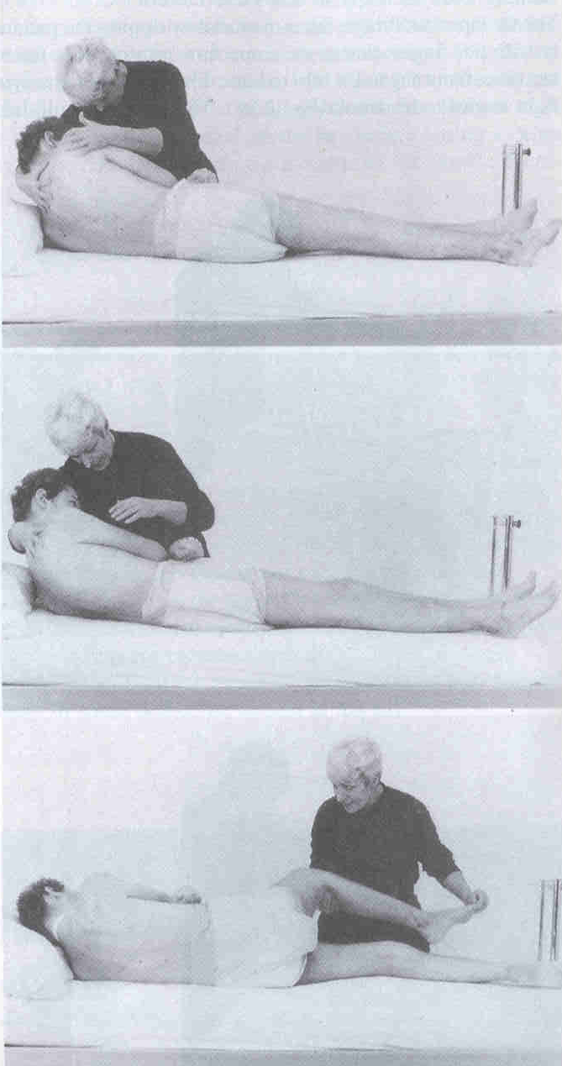
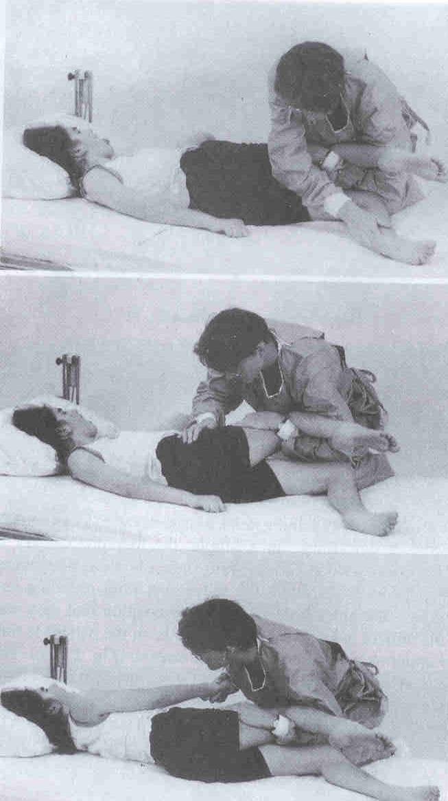

Slide 35
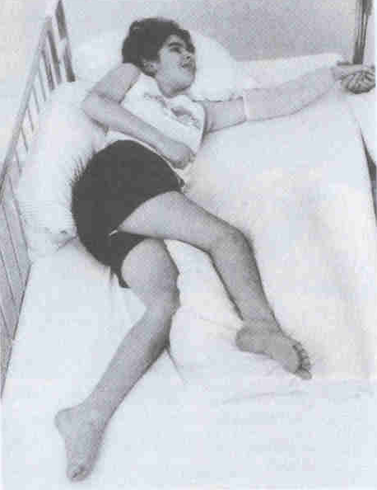
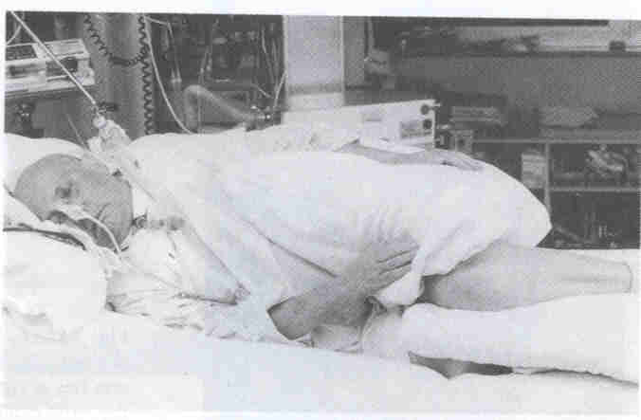

Slide 36
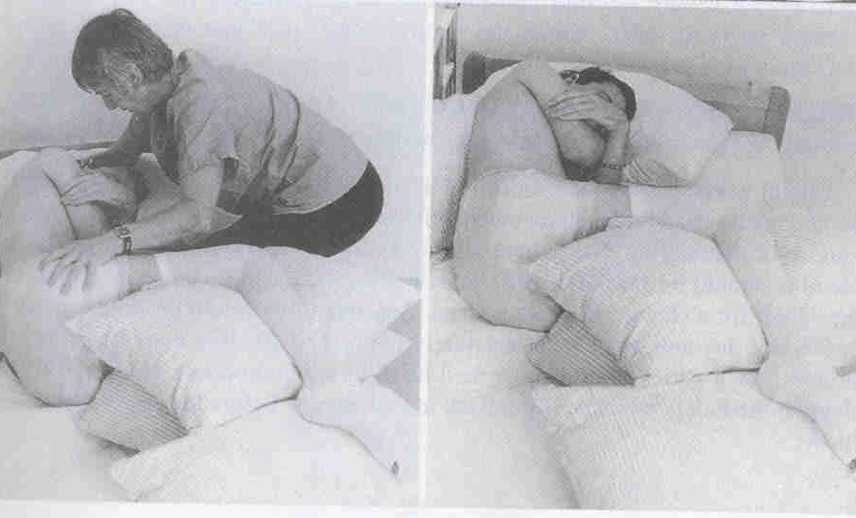
In marked extensor spasticity unable to flex the trunk or limbs
Flexion of neck and arms break this spasticity
Two large pillow in between thigh

Slide 37
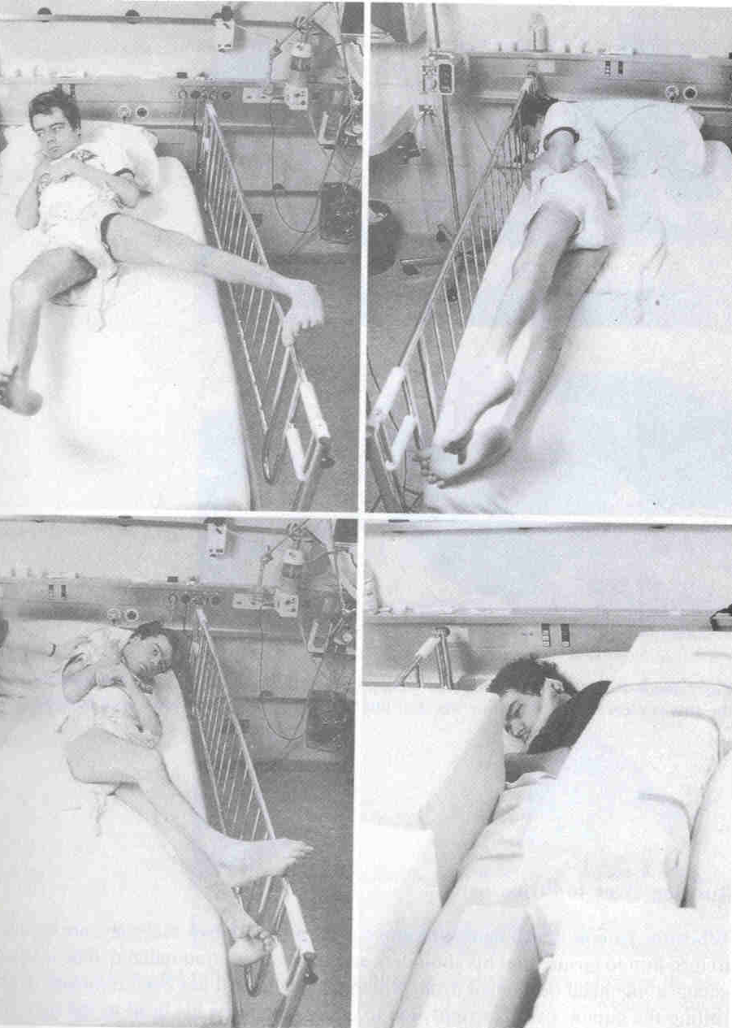
Restlessness and hyperactivity
  Desperate search for information from his surrounding
  Firm padded blocks around the patient to reduce the open area of bed
  Never be tied down
    Fight against
    Impede circulation
    Skin injury

Slide 38
Strategies for normalizing tone:
Abnormal sensation is the frequently underlying cause of the hypertonicity. Patient may remain unable to feel some part of their body. Sensory input may be confusing unfamiliar and unstable for the head injury patients.
Management will remain the same as in stroke.

Slide 39
Physiotherapy for non - critical patient
Goals:
Increase level of alertness
Reduce secondary impairment
Improve postural control
Reduce the effect of tone
Increase tolerance of activity and positions
Improve joint mobility and integrity
Improve functional activity
Improve oro-motor function and communication
Provide Family education
Coordination between rehabilitation team
In addition to the physiotherapy treatment used in ICU, following is included in management.

Slide 40
Moving out of bed:
Vitals should be noted and should be normal
Moving away from bed – variety of situation gives further stimulationand may improve level of consciousness.
Wheelchair sitting can be given to even unconscious patients
Hypotension and pelvic fracture are contraindications
Patient with ventilator can be made to sit with careful handling
Moving from lying to sitting
Unconscious patient passively made to sit
Moving to edge of the couch

Slide 41
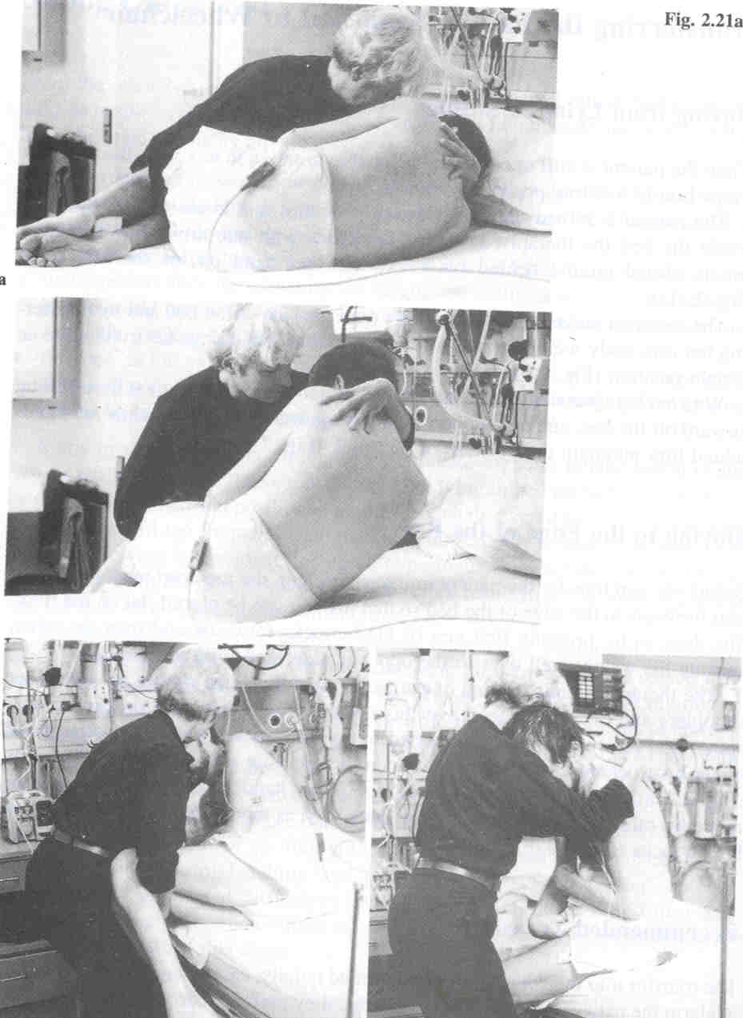

Slide 42
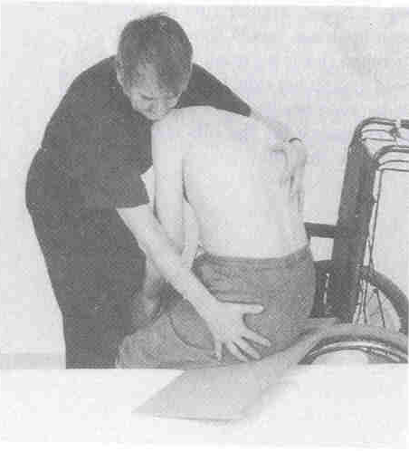
Transfer
Pivot – hold the trunk,
head supported and arms left down
With trunk flexed forward
Using slide board

Slide 43
Position in the wheelchair
Light weight
Only for short time use
Motor ability will change with time, wheelchair chosen to suit his need
Backrest should be reclined backwards
Removable arm rest
Wheelchair table should be there and easily removable
Seat should come up to knee and does not sag down
Height and angle of foot rest should be adjustable
Maintain as normal alignment of sitting as possible
Avoid excessive extension of neck or leaning of trunk to one side (this will also help in reducing abnormal tonal influence on the body)
Use corrective pads or wedge for support
Use head rest only if neck control is not there

Slide 44
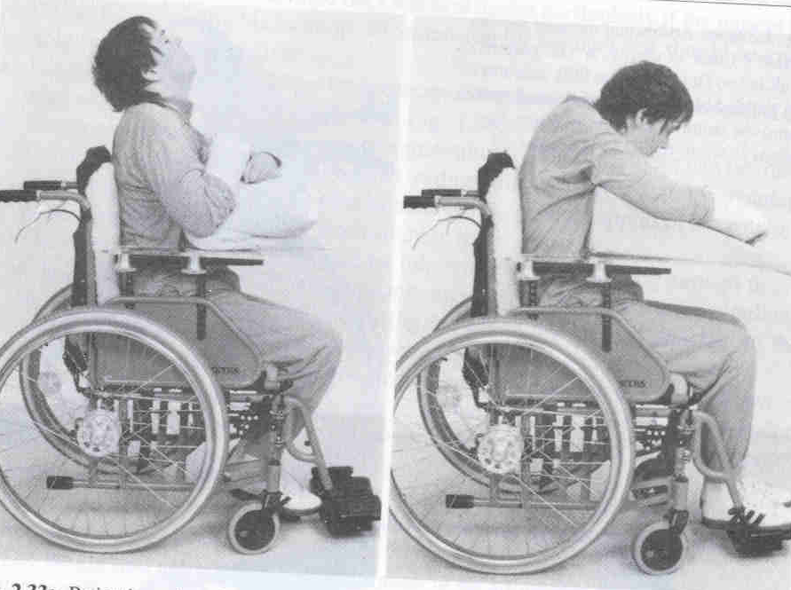
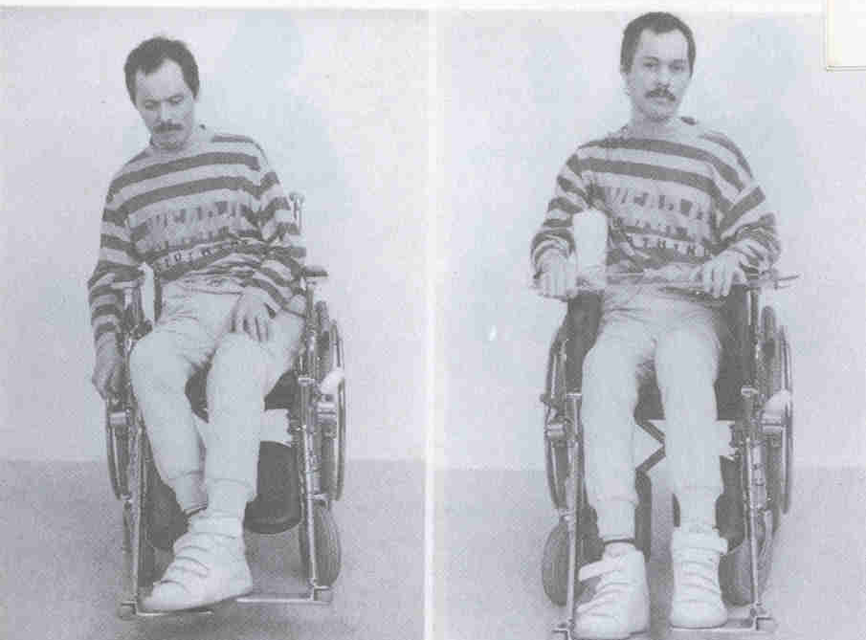

Slide 45
Strategies to improve trunk and proximal muscle control
Strategies to improve balance
Strategies to improve gait
Strategies to improve upper and lower extremity control
(Above mentioned strategies will remain same as in the case of stroke)

Slide 46
Management of head injury patients according to Ranchos Los Amigo (RLA) Scale
Level I: No Response
Total Assistance
Coma arousal therapy
Complete absence of observable change in behavior when presented visual, auditory, tactile, proprioceptive, vestibular or painful stimuli
Level II:Generalized Response
Total Assistance
Demonstrates generalized reflex response to painful stimuli.
Responds to repeated auditory stimuli with increased or decreased activity.
Responds to external stimuli with physiological changes generalized, gross body movement and / or not purposeful vocalization.
Responses noted above may be same regardless of type and location of stimulation.
Responses may be significantly delayed.

Slide 47
Level III:Localized response
Total Assistance
Demonstrates withdrawal or vocalization to painful stimuli.
Turns toward or away from auditory stimuli.
Blinks when strong light crosses visual field.
Follows moving object passed within visual field.
Responds to discomfort by pulling tubes or restraints.
Responds inconsistently to simple commands.
Response directly related to type of stimulus.
May respond to some persons (especially family and friends) but not to others.
Level IV: Confused – Agitated
Patient is in a heightened state of activity and severely confused
Disoriented and unaware of present events
His behavior is frequently bizarre and inappropriate to his immediate environment
He is unable to perform self-care. If not physically disabled
He may perform automatic motor activities such as sitting, reaching and walking as part of his agitated state, but not necessarily as a purposeful act.

Slide 48
Goals of management of patient in RLA stage I, II, III and IV stages:
To improve endurance
Joint mobility and integrity
Secondary problems
Improve tolerance
Family education
Prevent the agitation
Highly structured, stable and closed environment
To reduce confusion
  Same person, time, routine
  Frequent orientation – non threatening
Medication and neuropsychological support
Expect no carry over
  no new skills
  Only automatic activity
Model calm behavior
  Patient perceive and reflect caregiver

Slide 49
Level V: Confused –Inappropriate, Non – agitated:
Patient appears alert and responds to simple commands
More complex commands, however produce responses that are non-purposeful and random
The patient may show some agitated behavior it is in response to external stimuli rather than internal confusion
The patient is highly distractible and generally had difficulty in learning new information
can manage self-care activities with assistance
Memory is impaired and verbalization is often inappropriate . Formal assessment possible
Level VI: Confused – Appropriate:
Patient shows goal – directed behavior, but relies on cueing for direction
He can relearn old skills such as ADL’s
But memory problems interfere with new learning
Patient has a beginning awareness of self and others.
Expect egocentric behavior
Difficult in assessment

Slide 50
Goals of management of patient in RLA stage V and VI:
functional and ADL activities
Gait
Balance
Motor and Postural control
Strength and Endurance
Family education
Community re-entry
Level VII: Automatic – Appropriate:
Patient goes through daily routine automatically
Robot – like with appropriate behavior and minimal confusion
Has shallow recall of activities, and superficial awareness of, but lack of insight to, his condition
requires at least minimal supervision because judgment, problem solving and planning skills are impaired

Slide 51
Level VIII: Purposeful – Appropriate:
Patient is alert and oriented and is able to recall and integrate past and recent events
Can learn new activities and continue in home and living skills
Judgment, abstract reasoning, social, emotional and intellectual capacities may persist
Goals of management of patient in RLA stage VII and VIII:
To reintegration work
To increase leisure activity
To improve functional mobility, posture, balance and gait
To decrease level of supervision and assistance for task performance
Patient and family education

Slide 52
EVIDANCES
P- Impaired balance and gait
I - Balance and gait training
C- Conventional treatment protocol
O- International classification of function

Slide 53
Effectiveness of physical therapy for improving gait and balance in ambulatory individuals with traumatic brain injury: a systematic review of the literature
Type of study | SYSTEMIC REVIEW
Year of publication | 2011
Level of evidence | HIGH LEVEL OF EVIDANCE
Authors | Daniel C. Bland,^{1,2} Cristiane Zampieri-Gallagher,¹ and Diane L. Damiano
Citation | Brain Inj. 2011; 25(7-8): 664–679.
Aim | TO IMPROVE GAIT AND BALANCE IN PATIENT WITH TRUMATIC BRAIN INJURY
Method | BALANCE AND GAIT TRAINING VERSES CONVENTIONAL
Result | Balance and gait training was found to be effective
Conclusion | Balance and gait training is beneficial in patient with traumatic brain injury.

