Slide 1
ANKYLOSING SPONDILITIS
By Dr Neha Mukkamala (PT)
08-03-17

Slide 2
Objectives
At the end of the session the student should be able to
Define Ankylosing spondilitis
Enumerate clinical features of Ankylosing spondilitis
List the important points of assessment
Enumerate the principles of treatment

Slide 3
Definition
It is an inflammatory condition affecting the spine, sacro-iliac joints, and sometimes, especially in the younger patient, peripheral joints.
Ankylosis-fusion
Spondilitis-inflammation

Slide 4
Peripheral joint involvement-60% patients
Large joints (hips and shoulders) are most commonly affected.
In the young patient (12-20)peripheral picture may characterise the presentation

Slide 5
Incidence
Young men>> Women (9:1 or 4:1)
Usually starting in the 3rd decade of life

Slide 6
Aetiology
Genetic predisposition for the disease
HLA B27 antigen present in over 90% patients.
7% of normal population are also B27 positive
50% of offspring will also carry HLA B27 antigen but only 1 in 5 will develop the disease.

Slide 7
Pathology
Involvement of synovium, articular capsule and ligaments where attached to bones.
Inflammation at the site of attachment of ligaments to bone is known as enthesopathy and is characteristic of AS.
Occurs especially in spine and pelvis

Slide 8
Inflammation → reactive bone formation (marginal syndesmophyte)→ Spinal fusion (bamboo-spine) due to involvement of Anterior and Posterior Longitudinal ligament
Common site for syndesmophyte formation-dorso-lumbar region.
Atlanto-axial subluxation may occur.
Neurological sequelae is rare

Slide 9
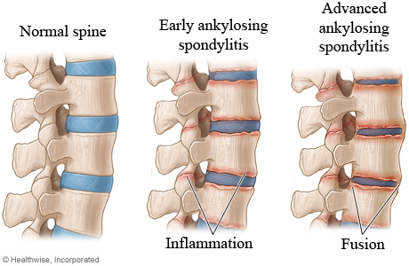

Slide 10
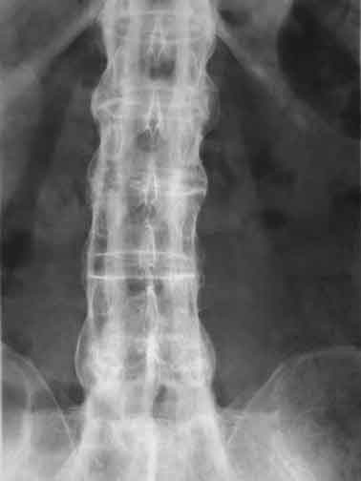

Slide 11
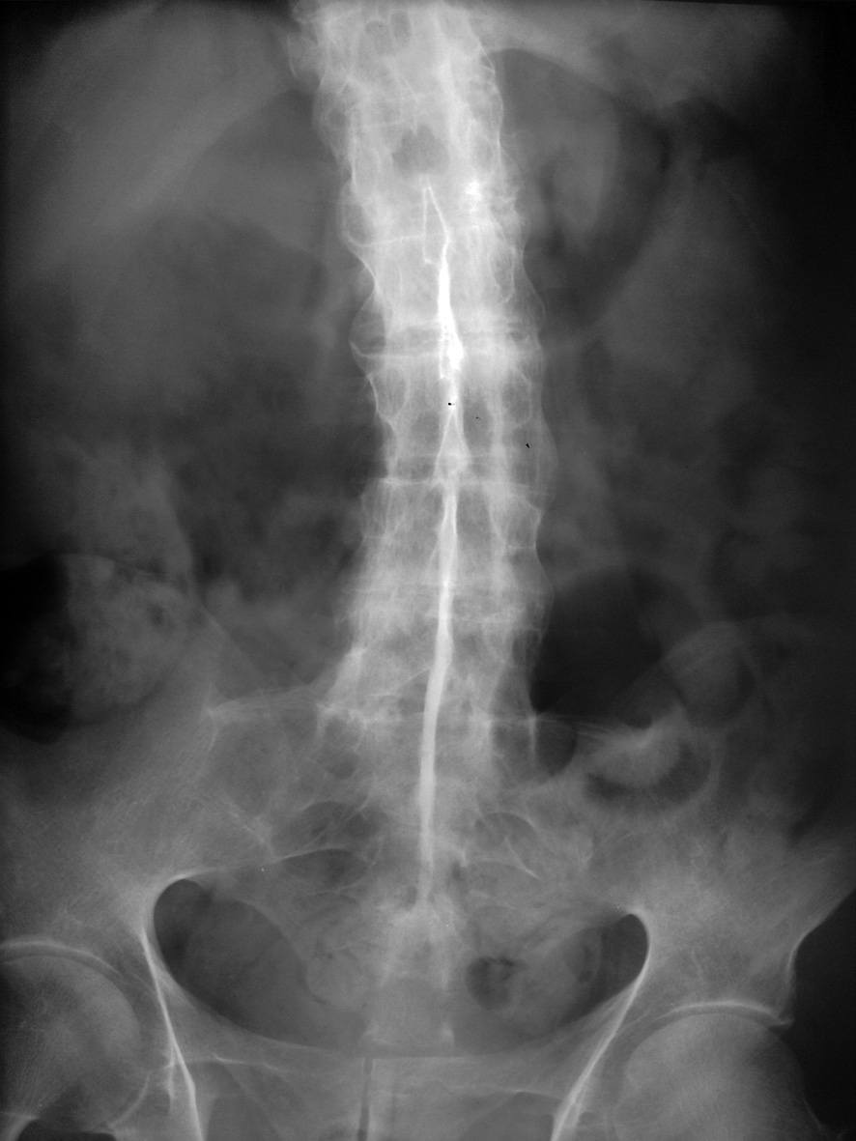

Slide 12
Signs & Symptoms
Onset is insidious
Low back pain is dominant symptom (bil. SI joint pain) and associated with stiffness
Loss of normal lumbar lordosis is one of the first signs
Back symptoms are made worse by resting and improved with mild exercise.
Morning stiffness is common.
Eventually bony ankylosis leads to a fixed back with a dorsal kyphos.

Slide 13
Head appears to be pushed forwards
Shoulders are rounded
Chest expansion is found diminished.
Lateral flexion is also impaired
Flexion deformities at hips are common

Slide 14
Pain is elicited when pressure is applied to bony points around the pelvis.
Stressing the SI joints can result in pain (Sacro-ilitis)
In the young, peripheral joints may be the first affected
Less commonly iritis may be the presenting feature

Slide 15
Course
It may abort at any stage
Dorso-lumbar and Sacro-iliac involvement is more common than total spinal fusion
Back pain is the most obvious symptom.
Eventual posture will depend on the degree of spinal fusion and the success of Physiotherapy and postural exercises

Slide 16
Complications
Iritis
Neurological- due to atlanto-axial subluxation or fractures
Cardiovascular problems are infrequent
Impaired respiratory excursion

Slide 17
Investigations
Raised ESR and CRP
HLA B27 is NOT diagnostic
Radiological changes in the SI joints(erosions and sclerosis)
Lumbar vertebrae may become squared
Syndesmophyte formation at the dorso-lumbar region
Calcification of ALL and PLL ligaments and fusion of posterior facet joints

Slide 18
Treatment
Pain-Simple analgesics or NSAIDs if pain is very severe
DMARDs have not proved helpful in AS
Physiotherapy
Exercises
Hydrotherapy in warm water
Postural advice-beds should be firm and only one pillow used
Acute stage-rest
Psychological counselling
Surgeries (replacement) in later stages

Slide 19
Physiotherapy-Assessment
Spinal joints are principally affected
General Posture
Observed with clothes removed in standing and sitting
Loss of lumbar curve and increased thoracic curve
Hips and knees flexed
Loss of cervical curve leads to hyperextension at atlanto-occipital joint and protrusion of jaw

Slide 20
Spinal Posture
Loss of secondary spinal curves-1st lumbar and then cervical
Thoracic curve exaggerated and spine becomes progressively rounded
Lateral deviations are rare
Serial clinical photographs

Slide 21
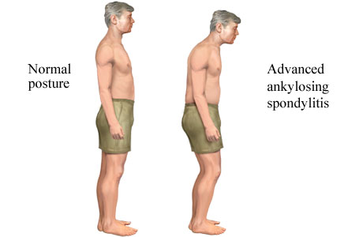

Slide 22
Spinal Mobility
Cervical spine-active and passive all ranges
Thoraco-lumbar flexion and extension
Lumbar flexion and extension-Schober’s Method
Lateral flexion-Finger-tip to floor distance. Rotation must be prevented
Rotation-Sitting or lying with hips and knees flexed and pelvis rotated
Hip, knees shoulders and TM joints-active and passive ranges

Slide 23
Respiratory function
Costovertebral joints are affected at an early stage
Chest expansion at two levels:Nipple level (4th rib) and Xiphoid process (7th rib)
Measurements should be noted at full expiration and full inspiration
Vital capacity, Peak flow and FEV1 are taken regularly

Slide 24
Physiotherapy Management
Physical therapy aims:
to retain spinal mobility,
minimise spinal deformity,
relieve pain
improve endurance

Slide 25
Physiotherapy Management
Aimed at maintaining back posture
It is characteristic of this disease that patients find their symptoms improve with exercise
Regular exercise programs can be carried out only within the limits of pain
Swimming should be encouraged in warm water

Slide 26
With appropriate treatment patients retain a high level of functional independence
Hospital sessions are in addition to the home program taught.

Slide 27
Home program should be simple, specific, and require minimum apparatus for performance. Eg mobilising exs for spine, hips, and thoracic cage, posture correction and activities to improve muscle performance

Slide 28
Maintenance of mobility
Movement of affected joints will retard the rate of ankylosis, but will not prevent it occuring
All joints must be moved daily through their fullest range of movement.
Extension exercises should be emphasized

Slide 29
The grade and type of mobilisation is determined by the degree of disease activity.
Vigorous active exercises are performed wherever possible.
Suspension therapy-muscular effort is solely devoted to producing movements.
Specifically lumbar and hip movts should be encouraged

Slide 30
Pool therapy
encourages joint mobility
Warmth of water reduces protective muscle guarding
Swimming improves endurance and also encourages extension of the spine, mobilisation of hip and shoulder girdle.
Bad Ragaz patterns for arms, legs and trunk are effective in restoring mobility
Exs to improve movts of thoracic cage and breathing exs to improve respiratory excursion will be required.

Slide 31
Minimizing deformity
Early and continued attention to good positioning is essential
Sleeping on a firm mattress is encouraged, with only one pillow to retain the extended spinal position.
Adjustment of height of chairs and work surfaces will reduce the tendency to stoop.

Slide 32
At all the times the patient must actively retain an ERECT POSTURE
A period of prone or supine lying will preserve hip extension
Wearing of spinal supports or prolonged bed rest is discouraged as extensor muscles will weaken

Slide 33
Management of Pain
Not significant but will present when joints are in a phase of exacerbation
Application of heat to decrease pain and muscle spasm
Hot packs, radiant heat and SWD are effective. But SWD may aggravate symptoms when inflammation is present

Slide 34
Maintenance of Muscle Power & Endurance
Muscle weakness not a significant feature, so increase of muscle power is not an essential part of Exs program.
Muscle power is retained by working the muscles against maximal resistance for short time
resistance is given manually or mechanically through springs, weights or water.

Slide 35
Endurance-submaximal resistance for progressively longer time
Group treatment fosters improved motivation, competition which encourages more effort.
A full day program should include group activities, individual ex against spring or mech. Resistance, posture correction, games, circuits and pool therapy.

Slide 36
What is the effect of exercises in overall well-being in AS?
P- AS patients
I- Exercises
C- None
O- well-being

Slide 37
Exercise for ankylosing spondylitis: An evidence-based consensus statement
Evidence based consensus statement Level of Evidence-Medium | Janet R.Millner, KirstyM.Beinke, Rachael BrionyE.Chasle, LindsayJ.Dutton, MargaretA.Lewington, TaniaWinzenberg, Jane Zochling, | 10 clinical questions were generated and a systematic literature review was conducted .Draft recommendations were developed at on the integration of evidence summaries and expert opinion. | Assessment, Monitoring, safety, disease management, mobility, other exs, adherence were recommended.

