Slide 1
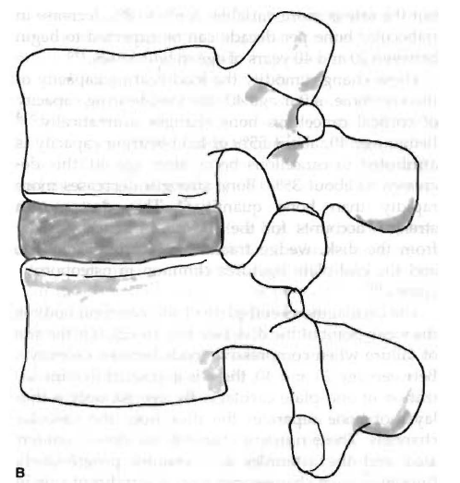
Prolapsed Intervertebral Disc
Niketa Patel

Slide 2
Objectives
After completing this lecture, you will be able to:
Retrieve structure and function of Intervertebral Disks
Classify different disc injuries
Discuss mechanism of injury, clinical features and investiation findings

Slide 3
Structure and Function of Intervertebral Disks
The intervertebral disk, consists of the annulus fibrosus and nucleus pulposus, is one component of a three-joint complex between two adjacent vertebrae.
The structure of the disk dictates its function.
Annulus fibrosus. The outer portion of the disk is made up of dense layers of collagen fibers and fibrocartilage

Slide 4
Orientation of the fibers → tensile strength to the disk when the spine is distracted, rotated, or bent.
The annulus is firmly attached to adjacent vertebrae. The annulus fibrosus is supported by the anterior and posterior longitudinal ligaments.

Slide 5
Nucleus pulposus. The central portion of the disk is a gelatinous mass.
It is located centrally in the disk except in the lumbar spine, where it is situated closer to the posterior border.
Aggregating proteoglycans, have great affinity for water → functions to distribute pressure evenly throughout the disk and from one vertebral body to the next under loaded conditions.

Slide 6
Because of the affinity for water, the nucleus imbibes water when pressure is reduced on the disk and water is squeezed out under compressive loads.
These fluid dynamics provide transport for nutrients and help maintain tissue health in the disk.
With flexion (forward bending) of a vertebral segment, the anterior portion of the disk is compressed, and the posterior is distracted.

Slide 7
Cartilaginous end-plates: End-plates cover the nucleus pulposus superiorly and inferiorly and lie between the nucleus and vertebral bodies.
The collagen fibers of the inner annulus fibrosus insert into the end-plate and angle centrally →encapsulating the nucleus pulposus.
Nutrition diffuses from the marrow of the vertebral bodies to the disk via the end-plates.

Slide 8
Definition
Varoius authors have definied the terms herniation, protrusion, prolapse and extrusion differently.
Herniation: a general term used when there is any change in the shape of the annulus that causes it to bulge beyond its normal perimeter.

Slide 9
Protrusion: nuclear material is contained by the outer layers of the annulus and supporting ligamentous structures.
Prolapse: frank rupture of the nuclear material into the vertebral canal.
Extrusion: extension of nuclear material beyond the confines of the posterior longitudinal ligament or above and below the disk space, as detected on magnetic resonance imagine (MRI), but still in contact with the disk.

Slide 10
Free sequestration: the extruded nucleus has separated from the disk and moved away from the prolapsed area.

Slide 11
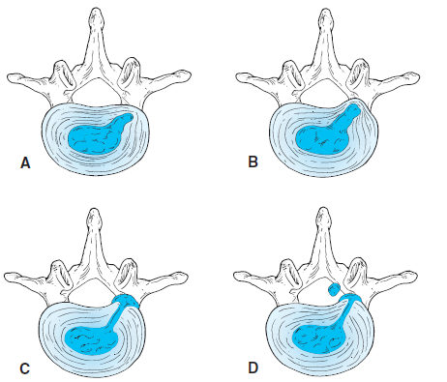

Slide 12
Fatigue Breakdown and Traumatic Rupture
A decrease in the continuity and integrity of structure of the annulus fibrosus may occur with (1) repeated stress over time causing fatigue breakdown or (2) traumatic rupture.
Fatigue breakdown. Over time, the annulus breaks down as a result of repeated overloading of the spine in flexion with asymmetrical forward bending and torsional stresses.

Slide 13
With torsional stresses, the annulus becomes distorted, most obviously at the posterolateral corner opposite the direction of rotation. The layers of the outer annulus fibrosus lose their cohesion and begin to separate from each other.
Each layer then acts as a separate barrier to the nuclear material. Eventually, radial tears occur, and there is communication of the nuclear material between the layers.

Slide 14
With repeated forward bending and lifting stresses, the layers of the annulus are strained; they become tightly packed together in the posterolateral corners, radial fissures develop, and the nuclear material migrates down the fissures.
Outer layers of annular fibers can contain the nuclear material so long as they remain a continuous layer.
After injury, there is a tendency for the nucleus to swell and distort the annulus. Distortion is more severe in the region where the annular fibers are stretched.
If the outer layers rupture, nuclear material may herniate through the fissures.

Slide 15
Healing is attempted, but there is poor circulation in the disk.
There may be self-sealing of a defect with nuclear gel or proliferation of cells of the annulus.
Any fibrous repair is weaker than normal and takes a long time because of the relative avascular status of the disk.

Slide 16
Traumatic rupture. Rupture of the annulus can occur as a one-time event, or it can be superimposed on a disk where there has been gradual breakdown of the annular rings.
This is seen most commonly in traumatic hyperflexion injuries.
Axial Overload: Axial overload (compression) of the spine usually results in end-plate damage or vertebral body fracture before there is any damage to the annulus fibrosus

Slide 17
Age: Individuals are most susceptible to symptomatic disk injuries between the ages of 30 and 45 years.
Degenerative Changes: As the nucleus becomes more fibrotic, it loses its capacity to imbibe fluid. Water content decreases, and there is an associated decrease in the size of the nucleus.
Acute disk protrusions caused by a bulging nucleus pulposus against the annulus or extrusions of the nucleus through a torn annulus are rare in older people.

Slide 18
Clinical Features
The disk is largely aneural; therefore not all disk protrusions are symptomatic.
Pain. Symptoms of pain arise from pressure of a swollen disk or swollen tissues against pain-sensitive structures (ligaments, dura mater, blood vessels around nerve roots) or from the chemical irritants of inflammation if there is herniated disk material.

Slide 19
Neurological signs and symptoms. Neurological signs arise from pressure against the spinal cord or nerve roots.
The only true neurological signs an symptoms are specific motor weaknesses and specific dermatome sensory changes.
Variability of symptoms. Symptoms are variable depending on the degree and direction of the protrusion as well as the spinal level of the lesion.

Slide 20
Posterior or posterolateral protrusions are most common.
With a small posterior or posterolateral lesion, there may be pressure against the posterior longitudinal ligament or against the dura mater or its extensions around the nerve roots. The patient may describe a severe midline backache or pain spreading across the back into the buttock and thigh.
A large posterior protrusion may cause spinal cord signs such as loss of bladder control and saddle anesthesia.

Slide 21
A large posterolateral protrusion may cause partial cord or nerve root signs.
An anterior protrusion may cause pressure against the anterior longitudinal ligament, resulting in back pain. There are no neurological signs.
The most common levels of protrusion are the segments between the fourth and fifth lumbar vertebrae and between the fifth lumbar vertebra and sacrum, although a protrusion may occur at any level, including the cervical spine

Slide 22
Inflammation: Contents of the nucleus pulposus in the neural canal may cause an inflammatory reaction and irritate the dural sac, its nerve root sleeves, or the nerve roots.
The symptoms may persist for extended periods and are not responsive to purely mechanical changes. The back pain may be worse than leg pain on the straight-leg raising test.
Poor resolution of this inflammatory stimulus may lead to fibrotic reactions, nerve mobility impairments, and chronic pain.
Early medical intervention with antiinflammatory agents is usually necessary.

Slide 23
Onset and Behavior of Symptoms from Disk Lesions
Onset. Onset is usually between 20 and 55 years of age but most frequently from the mid-thirties to forties. Except in cases of trauma, symptomatic onset in the lumbar spine usually associated simply with bending, bending and lifting, or attempting to stand up after having been in a prolonged recumbent, sitting, or forward-bent posture.

Slide 24
Although cervical disk lesions are not as prevalent, a prolonged flexed spinal position as in a forward head posture may lead to or exacerbate symptoms from a protrusion. Many patients have a predisposing history of a faulty flexion posture.
Pain behavior. Pain may increase gradually when the person is inactive, such as when sitting or after a night’s rest.

Slide 25
Symptoms are usually aggravated with activities that increase the intradiskal pressure, such as sitting, forward bending, coughing, or straining or when attempting to stand after being in a flexed position.
Usually, symptoms are lessened when walking except when the bulge is large or the nuclear material has prolapsed and moved beyond the confines of the annulus.

Slide 26
Acute pain. When there is inflammation during the acute phase, pain is almost always present but varies in intensity, depending on the person’s position or activity.
When there is a lumbar disk lesion, initially discomfort is noticed in the lumbosacral or buttock region. Some patients experience aching that extends into the thigh or leg.
In the cervical spine, initially pain is noticed in the midscapular and shoulder area. Neurological signs are not noted unless the protrusion has progressed to a degree to which there is nerve root, spinal cord, or caud equina compression.

Slide 27
Objective Clinical Findings in the Lumbar Spine
The patient usually prefers standing and walking to sitting.
The patient may have a decrease in or loss of lumbar lordosis.
Forward bending is limited. When repeating the forwardbending test, the symptoms increase or peripheralize. Peripheralization means the symptoms are experienced farther down the leg

Slide 28
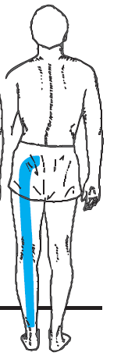

Slide 29
Testing passive lumbar flexion in the supine position (double knees-to-chest) and passive extension in the prone position (press-ups) usually produces signs similar to those of the standing tests, but results may not be as dramatic because gravity is eliminated.

Slide 30
Objective Clinical Findings in the Cervical Spine
Findings are similar to those in the lumbar spine except they are displayed in the respective dermatomes and myotomes of the cervical nerve roots.
Initially, the patient may present with a faulty forward head posture and may hold the head in a guarded sidebent or rotated position away from the symptomatic side.

Slide 31
Cervical flexion peripheralizes the symptoms; neck retractions (axial extension) followed by extension may centralize the symptoms of a contained nuclear bulge.
There may be nerve mobility impairments in the upper extremity.

Slide 32
Investigations
XRAY
MRI
CT SCAN
Discography

Slide 33
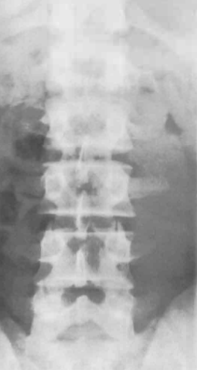

Slide 34
Points to be noted in plain X-ray
Shape of the vertebrae
Wedge fracture of any vertebrae
Disc shape reduced as seen in spondylosis

Slide 35
Discography
Radiopaque dye is injected into the nucleous pulposus to see whether dye injected reproduces the patient’s symptoms.
It is not commonly used technique.

Slide 36
MCQs
1. Objective Clinical Findings in the Lumbar Spine is
Patient prefers to stand and walk more than sit
Patient prefers to stand and run than sit
Patient prefers to be in supine position than stand and walk.

Slide 37
2. ___________ is a component of a three-joint complex between two adjacent vertebrae.
Nucleous pulposus
Annulus fibrosus
Intervertebral disc
3. The annulus fibrosus is supported by the ________ ligaments.
anterior and posterior longitudinal
Interspinous ligament

Slide 38
4. Nutrition diffuses from the marrow of the vertebral bodies to the disk via________
Nucleous pulposus
the end-plates
Annulous fibrosus
5. frank rupture of the nuclear material into the vertebral canal
Herniation
prolapse
protrusion

