Slide 1
Ankle Sprain

Slide 2
Objectives
At the end of the lecture, the students will be able :
Revise about Lateral and medial Ligament sprain
Discuss about Grades of ankle ligament sprain
Discuss about Principles of physical examination
Discuss about Principles of physiotherapy management

Slide 3
Introduction
It is common injury in sports.
If improperly treated, it may result in chronic laxity, pain or delayed recovery.

Slide 4
Lateral ligament Sprain
This is most common musculoskeletal injury.
The lateral collateral ligament of ankle joint are ligaments of the ankle which attach to the fibula.

Slide 5
Its components are:
anterior talofibular ligament
Posterior Talofibular Ligament
Calcaneofibular Ligament
It is due to inversion and planter flexion of the foot.

Slide 6
Anterior Talofibular Ligament:
The anterior talofibular ligament attaches the anterior margin of the lateral malleolus to the adjacent region of the talus bone.
The most common ligament involved in ankle sprain is the anterior talofibular ligament.

Slide 7
The lateral ligament commonly injured is anterior talofibular ligament followed by calcaneofibular ligament.
The posterior talofibular ligament is rarely sprained because it is the strongest of the lateral ligaments, and is torn only with massive inversion stresses.

Slide 8
Medial Ligament Sprain
The medial ligament of talocrural joint (or deltoid ligament) is a strong, flat, triangular band, attached, above, to the apex and anterior and posterior borders of the medial malleolus.
The deltoid ligament is composed of
anterior tibiotalar ligament,
tibiocalcaneal ligament,
posterior tibiotalar ligament
tibionavicular ligament.

Slide 9
Superficial deltoid ligament primarily resists eversion of hindfoot.
Pronation eversion injury damages DELTOID LIGAMENT.

Slide 10
GRADES
Ligamentous injuries are categorized into three gradations.
Grade I is a partial tear without laxity and only mild swelling.
Grade II is a partial tear with mild laxity and moderate pain, tenderness, and instability.
Grade III is a complete rupture resulting in considerable swelling, increased pain, significant laxity, and often an unstable joint

Slide 11
Clinical features
Pain over the injured ligaments
Associated swelling and tenderness
Reflex muscle inhibition
Decreased function and range of motion along with instability (grade 2 & 3)
Difficulty in walking secondary to pain

Slide 12
Physical Examination
Examine for swelling and ecchymosis laterally (most common) as well as around the entire ankle joint.
Bony avulsion/fracture should be sought by palpation of the medial and lateral malleoli
Ankle inversion injuries are associated with peroneal nerve injury → results in sensory changes on the dorsum of the foot (superficial peroneal nerve) or the first web space (deep peroneal nerve).

Slide 13
Non-operative management

Slide 14
Management: Protection Phase
Goal: To minimize the swelling
Intervention:
Use compression,
elevation, and ice.
The ankle should be immobilized in neutral or in slight dorsiflexion and eversion.

Slide 15
Goal: Educate the patient
Intervention: Teach the patient the importance of RICE (rest, ice, compression, and elevation) and to apply the ice every 2 hours during the first 24 to 48 hours.
• Teach partial weight bearing with crutches to decrease the stress of ambulation.
• Teach muscle-setting techniques and active toe curls to help maintain muscle integrity and assist with circulation.

Slide 16
Management: Controlled Motion Phase
As the acute symptoms subside, continue to provide protection for the involved ligament with a splint during weight bearing.
Apply cross-fiber massage to the ligaments as tolerated.

Slide 17
Nonweight-bearing AROM into dorsiflexion and plantarflexion, inversion and eversion.
Toe curls and writing the alphabet in the air with the foot.
Sitting with the heel on floor and scrunching paper or a towel and picking up marbles with the toes.

Slide 18
Sitting with both feet or just the involved foot on a rocker or balance board. Have patient perform controlled ankle and foot motions (with or without the assistance of the normal foot) into dorsiflexion and plantarflexion and inversion and eversion.
Also stretch the gastrocnemius–soleus muscle group for adequate dorsiflexion.

Slide 19
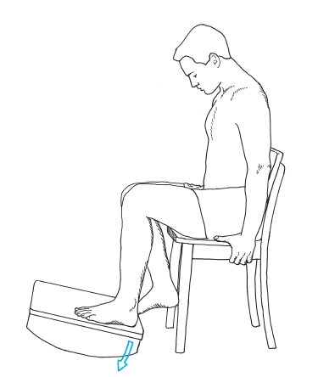

Slide 20
As swelling decreases and weight-bearing tolerance increases, progress to strengthening, endurance, and stabilization exercises.
Include isometric resistance to the peroneals, bicycle ergometry.
Have the patient wear a brace or splint that restricts end-range motion to control the range and prevent excessive stress on the healing ligament.

Slide 21
STRENGTHENING EXERCISES

Slide 22
Open-chain strengthening exercises
Plantarflexion: Long-sitting with the leg resting on a rolled towel to slightly elevate the heel off the treatment table.
Have the patient hold onto the ends of elasticized material that is looped under the forefoot and then plantarflex the foot against the resistance.

Slide 23
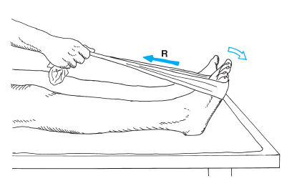

Slide 24
Eversion and Inversion with Elastic Resistance
To resist eversion, place a loop of elastic tubing around both feet and have the patient evert one or both feet against the resistance
Instruct the patient to keep the knees still and just turn the foot outward, not allowing the thigh and leg to abduct or externally rotate.

Slide 25
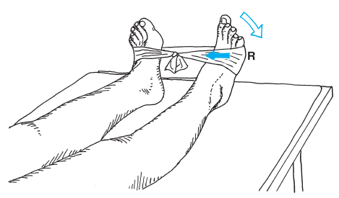

Slide 26
To resist inversion, tie the elastic band or tubing to a structure on the lateral side of the foot → only turn the foot inward without allowing the hip to adduct and internally rotate.
Dorsiflexion: Long-sitting or supine with a rolled towel under the distal leg to elevate the heel slightly.
Tie an elastic band or tubing to the foot end of the bed (or other object), and place a loop over the dorsum of the foot. Have the patient dorsiflex against the resistance

Slide 27
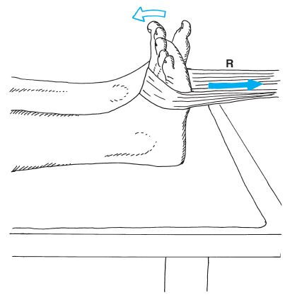

Slide 28
Adduction with Inversion and Abduction with Eversion Using Weights: Sitting with the foot on the floor. Place a towel under the forefoot and a weight on the end of the towel
Have the patient pull the weighted towel with the forefoot by keeping the heel fixed on the floor and swinging the foot either inward or outward.

Slide 29
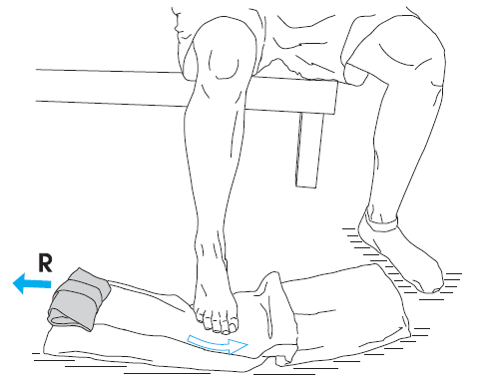

Slide 30
Closed-chain strengthening exercises
Patient position is standing.
If the patient does not initially tolerate full weight bearing without reproduction of symptoms → begin by standing in the parallel bars

Slide 31
Have the patient hold onto a wooden dowel rod or cane with both hands.
Apply the resistance through the rod in various directions and with varying intensities and speeds as the patient attempts to remain stable.

Slide 32
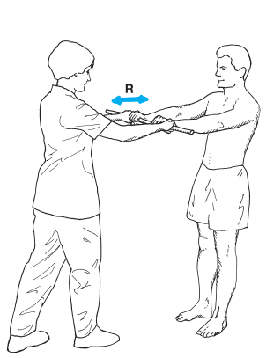

Slide 33
Dynamic Strength Training:
Have the patient perform
Bilateral toe raises,
Bilateral Heel raises,
Progress to unilateral toe raises, heel raises

Slide 34
Management: Return to Function Phase
Progress strengthening exercises by adding elastic resistance to foot movements in long-sitting (open-chain) and sitting with the heel on the floor for partial weight bearing.
Progress stabilization and proprioceptive/balance training for ankle stability, coordination, and reflex response with full weight-bearing activities on a rocker, wobble board.

Slide 35
Train the ankle with weight-bearing activities such as walking, jogging, and running.
Agility and skill: Develop an obstacle course and have the patient maneuver around or up and over the obstacles, first walking, then running and jumping.
Include forward, backward, and side-to-side maneuvers.

Slide 36
When the patient is involved in sports activities, the ankle should be splinted, taped, or wrapped, and proper shoes should be worn to protect the ligament from reinjury.

Slide 37
Evidence Based Practice
Comparison of 3 treatment procedures for minimizing ankle sprain swelling

Slide 38
PICO
P | ANKLE SPRAIN PATIENT
I | CONTRAST BATH
C | COLD TREATMENT; HEAT TREATMENT
O | VOLUMETRIC MEASUREMENT

Slide 39
JOURNAL AND AUTHORS | STUDY DESIGN AND LEVEL OF EVIDENCE | AIMS | METHODOLOGY | CONCLUSION
Journal of American Physical therapy Association APTA Cote et al., 1988 | RCT 1b | The purpose of this study was to compare the effects of cold, heat, and contrast bath treatments on the amount of edema in first- and second-degree sprained ankles during the postacute phase of rehabilitation | Subjects were then assigned to the Cold Treatment (n = 10), Heat Treatment (n = 10), or Contrast Bath Treatment (n = 10) Group | Cold therapy clearly produced the least amount of edema. Heat and contrast bath therapy produced almost identical increases in the amount of edema during all three days of the study.

Slide 40
MCQs
1. Inversion and planter flexion of the foot with moderate intensity cause which ligament sprain?
a. Anterior Talofibular Lig c. TibioCalacneal Lig
b. Anterior Tibiotalar Lig d. Tibio Navicular Lig

Slide 41
2. Deltoid ligament primarily resists _____of hindfoot
a. Inversion c. Supination
b. Eversion d. None of the above

Slide 42
3. The first ligament involved in lateral ankle sprain is the _______
anterior talofibular lig c. Talocalcaneal lig
Posterior talofibular liga d. All of above

Slide 43
4. For acute Medial ligament injury ___ is not advisable
Cold Pack c. Compression
b. Heat Therapy d. Rest

Slide 44
5. Following ligaments are part of which ligament?
anterior talofibular ligament
Posterior Talofibular Ligament
Calcaneofibular Ligament
Ans.
a. Spring ligament of Ankle
b. Lateral ligament of Ankle
c. Deltoid ligament of Ankle
d. Superficial deltoid ligament

