Slide 1
ADHESIVE CAPSULITIS
Dr. Purvi

Slide 2
It is characterized by the development of dense adhesions, capsular thickening and capsular restriction.
Onset- insidious
Age- 40 to 60 years

Slide 3
Types
Primary
secondary

Slide 4
Stages of Capsulitis
Freezing
Frozen
Thawing

Slide 5
Phases
Acute
Subacute
Chronic

Slide 6
Common Impairments
Night pain.
Pain on motion and often at rest during acute flares.
Mobility, decreased joint play and ROM, usually limiting external rotation and abduction with some limitation of internal rotation and elevation in flexion.
Posture: protracted and anteriorly tipped scapula, rounded shoulders, and elevated and protected shoulder.
Decreased arm swing during gait
Muscle performance:
Guarded shoulder motions

Slide 7
Common Functional Limitations/Disabilities
Inability to reach overhead,
behind head,
and behind back; thus, having difficulty dressing
reaching hand into back pocket of pants (to retrieve wallet)
reaching out a car window (to use an ATM machine),
self-grooming (such as combing hair, brushing teeth, washing face),
Difficulty lifting weighted objects, such as dishes into a cupboard
Limited ability to sustain repetitive activities

Slide 8
Management
Protection Phase
Control pain, Edema, and Muscle Guarding
Maintain Soft Tissue and Joint Integrity and Mobility
Maintain Integrity and Function of Associated Areas

Slide 9
To control pain:
Therapeutic Ultrasound, Short Wave Diathermy, Moist pack can be used

Slide 10
Maintain Soft Tissue and Joint
Integrity and Mobility
Passive range of motion
Pendulum (Codman’s) exercises
Passive joint distraction and glides, grade I and II with
Pendulum (Codman’s) exercises
Gentle muscle setting

Slide 11
Controlled motion phase

Slide 12
Progressively Increase Joint and Soft Tissue Mobility
Passive joint mobilization techniques. Stretch grades (grade III sustained or grade III and IV oscillation)
Pendulum exercises can also be used for joint stretching by adding a cuff weight to the wrist
Self-mobilization techniques.
Manual stretching.
Self-stretching exercises.
Improve muscle performance

Slide 13
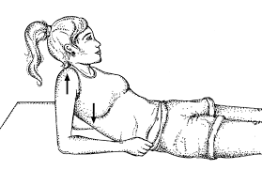
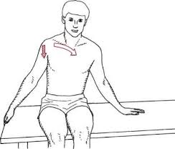

Slide 14
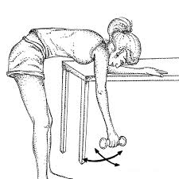

Slide 15
Return to function phase
Progressively increase flexibility and strength
Prepare for functional demands

Slide 16
Clinical query
Is High grade mobilization or low grade mobilization more effective in increasing the range in Adhesive Capsulitis?
PICO
P-Persons with idiopathic adhesive capsulitis
I- High grade mobilization
C- low grade mobilization
O- Range of motion, Function

Slide 17
Comparison of High-Grade and Low- Grade Mobilization Techniques in the Management of Adhesive Capsulitis of the Shoulder: Randomized Controlled Trial
RCT High level of evidence(RCT) | Henricus M Vermeulen, Piet M Rozing, Wim R Obermann, Saskia le Cessie, Thea PM Vliet Vlieland Physical Therapy . Volume 86 . Number 3 . March 2006 | Methodology: One hundred subjects with unilateral adhesive capsulitis lasting 3 months or more and a 50% decrease in passive joint mobility relative to the nonaffected side were enrolled in this study. Subjects randomly assigned to the HGMT group were treated with intensive passive mobilization techniques in end-range positions of the glenohumeral joint, and subjects in the LGMT group were treated with passive mobilization techniques within the pain-free zone. The duration of treatment was a maximum of 12 weeks (24 sessions) in both groups. Subjects were assessed at baseline and at 3, 6, and 12 months by a masked assessor. Primary outcome measures included active and passive range of motion and shoulder disability (Shoulder Rating Questionnaire [SRQ] and Shoulder Disability Questionnaire [SDQ]). | Results. Overall, subjects in both groups improved over 12 months. Statistically significant greater change scores were found in the HGMT group for passive abduction (at the time points 3 and 12 months), and for active and passive external rotation (at 12 months). A statistically significant difference (p,0.05)in trend between both groups over the total follow-up period of 12 months was found for passive external rotation, SRQ, and SDQ with greater change scores in the HGMT group. | Conclusion. In subjects with adhesive capsulitis of the shoulder, HGMTs appear to be more effective in improving glenohumeral joint mobility and reducing disability than LGMTs, with the overall differences between the 2 interventions being small.

Slide 18
Thank you

