Slide 1
Tuberculosis of spine
By: Purvi Patel

Slide 2
Objectives
At the end of the topic, students should be able to
Enumerate types, clinical features of TB spine
Explain pathology
Describe principles of assessment and management for the same for conservative and operative patients

Slide 3
pott’s disease/ caries disease
It is a tubercular infection of the vertebrae.
This is the most common form of skeletal TB constituting about 50 % of all the cases.
More common in children between age group of 5 to 10 years.

Slide 4
Regional distribution
Cervical – 12%
Cervicodorsal – 5%
Dorsal – 42%
Dorsolumbar – 12%
Lumbar – 26%
Lumbosacral – 3%

Slide 5
Types of vertebral TB
Paradiscal: The commonest type. The contiguous areas of two adjacent vertebrae along with the intervening disc are affected.
Central: the body of single vertebra is affected.
Anterior: the infection is localized to the anterior part of the vertebral body.
Posterior: the posterior complex of the vertebra i.e. the pedicle, lamina, spinous process or transverse process are affected.

Slide 6
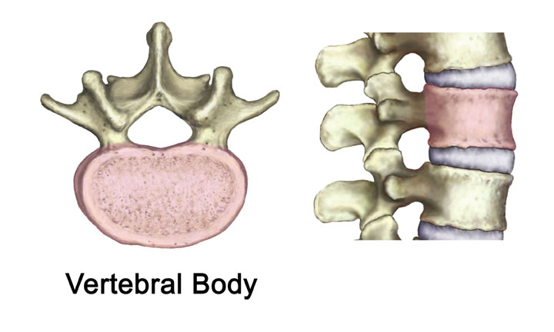

Slide 7
Pathology
TB of the spine is always secondary.
Spreads via haematogenous route, from the lungs or lymph nodes.
Commoner paradiscal type
Bacteria lodge in the contiguous areas of two adjacent vertebrae

Slide 8
Granulomatous inflammation
Erosion of the margins of vertebrae
Nutrition of the disc gets compromised
Disc degeneration
Complete destruction

Slide 9
Weakening of the trabeculae of the vertebral body
Collapse of the vertebrae
Wedging
Dorsal spine- kyphosis

Slide 10
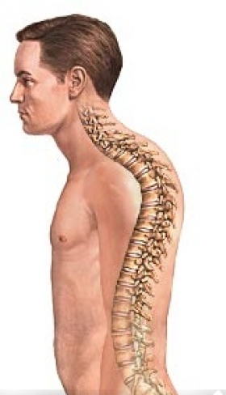
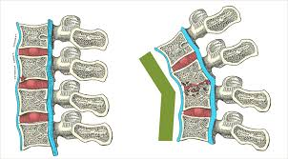

Slide 11
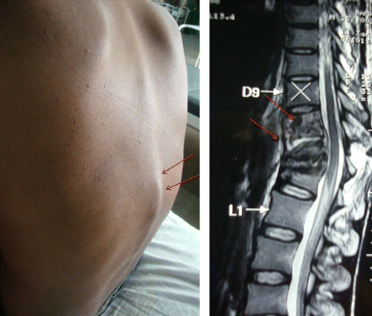

Slide 12
Cold abscess
Collection of pus and tubercular debris from affected vertebrae
Can track in any direction
Anterior( pre vertebral abscess)
Sides( para-vertebral abscess)
Travels along musculo-fascial planes or neuro-vascular bundles, appear far away from the site of lesion

Slide 13
Clinical features
Usually insidious onset
Constitutional symptoms – fever( evening rise), night cries, loss of appetite and weight
Back pain- localized or referred
Cervical roots – arm pain
Dorsal roots – girdle pain
Lumbar roots – groin pain
Sacral roots – sciatica
Back stiffness – spasm of paraspinal muscles
Paraplegia
Deformity

Slide 14
Assessment
History
Gradual onset
Fever- evening rise
Loss of appetite and weight
Back pain- localized or radiating
If neural involvement- weakness, difficulty in ADL’s and walking

Slide 15
Observation
posture: sitting, standing- protective stiff back
Deformity: kyphosis, gibbus
Swelling: due to abscess
Gait: cautious gait with stiff back
Palpation
-Tenderness: spinous process of affected vertebrae
- Spasm: paraspinal muscles

Slide 16
Examination
Pain examination
Range of motion: spinal movements will be painful and restricted
Neurological examination:
Gait
Functional: difficulty in basic ADL’s due to pain or neurological involvement.

Slide 17
Investigations
X-rays:
Reduction of the disc space
Destruction of vertebral body
Evidence of cold abscess
Signs of healing
C. T. scan: indicate precisely the extent of destruction of the vertebral body and posterior elements.

Slide 18
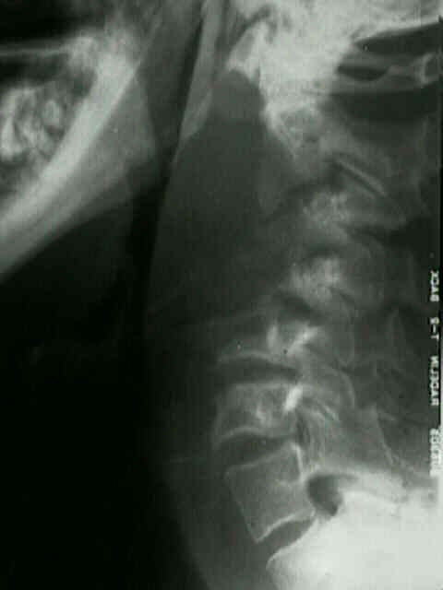
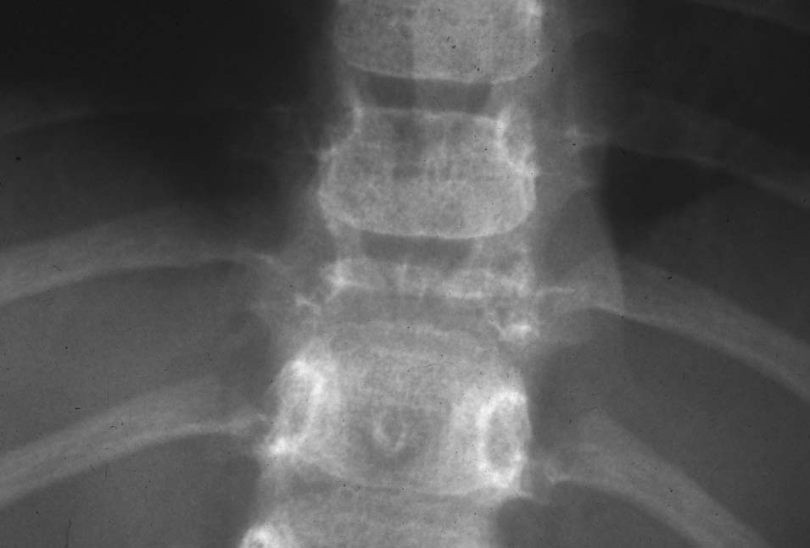

Slide 19
M.R.I. : type and extent of compression of the cord.
Myelography: indicated in cases presenting with spinal tumor syndrome.
Biopsy: required in cases with doubtful diagnosis.

Slide 20
Treatment
Conservative
Specific drug therapy
Nutritious diet
Rest
Immobilization of the spine
-bed rest
-plaster jacket
-brace
As the disease becomes quiescent, the patient may be allowed to sit up and walk with the proper spinal support.

Slide 21
Surgical
Principles
Drainage of the pus
Decompression of the cord
Aspiration and evacuation
Costo-transversectomy
Antero-lateral decompression
Anterior decompression
Laminactomy

Slide 22
Physiotherapy treatment
For the patients treated conservatively
Education of the patient about postural attitudes
Gentle full range active movements are given to the extremities
Slow and deep breathing to maintain the vital capacity
Proper positioning to avoid bed sores
Strength of the muscle groups, innervated by spinal segment of affected vertebra.

Slide 23
After healing of the lesion
Isometrics to the spinal flexors, rotators and side flexors.
Costal, diaphragmatic breathing should be made vigorous to improve mobility of the thoracic spine.
Begin spinal exercises, extension-hyperextension-side flexion, flexion and rotation.
Small active free trunk movements.
Sitting, standing and ambulation with spinal brace.
Preventive measures to avoid recurrence.

Slide 24
For the patients treated by surgery
Preoperative training
Chest physiotherapy
Positioning and movements to avoid immediate after surgery
Methodology of safe bed activities
Techniques of sitting from lying, getting up from bed, standing and ambulation.
Mobility and strengthening exercise to spine
ergonomics

Slide 25
Immediate postoperative phase (till 3-4 weeks)
Care should be taken to avoid stress over operated area
Chest physiotherapy: deep breathing and diaphragmatic breathing exercises with support to the operated area
Strong ankle toe movements to prevent thrombosis
Pressure points should be inspected and protected.
Simple resistive exercises of the arms can be given avoiding overhead stretching.
Isotonic exercises for UL & LL muscles
Isometric abdominal exercises

Slide 26
During mobilization (after 4 weeks)
Gradual mobilization after checking proper fitting of corset.
Log rolling, standing and ambulation are progressed gradually.
After 8 weeks
Once the spinal fusion consolidates, mobilization of the spine can be begun.
Vigorous strengthening of the spinal extensors and abdominals
Use of corset
Treatment of paraplegia

Slide 27
Ergonomic advices
Avoid bending forward
Avoid Carrying weights
Contraindications
During initial phase of post surgery
Avoid strenuous activities of the lower extremities
SLR
Pelvic rolling

Slide 28
Complications
Abscess formation
paraplegia

Slide 29
THANK YOU

