Slide 1
Chondromalacia patella
Dr. Maitri shukla

Slide 2
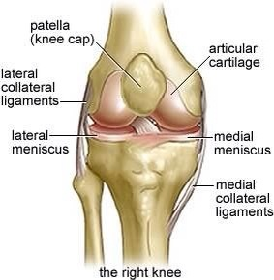
Knee joint

Slide 3
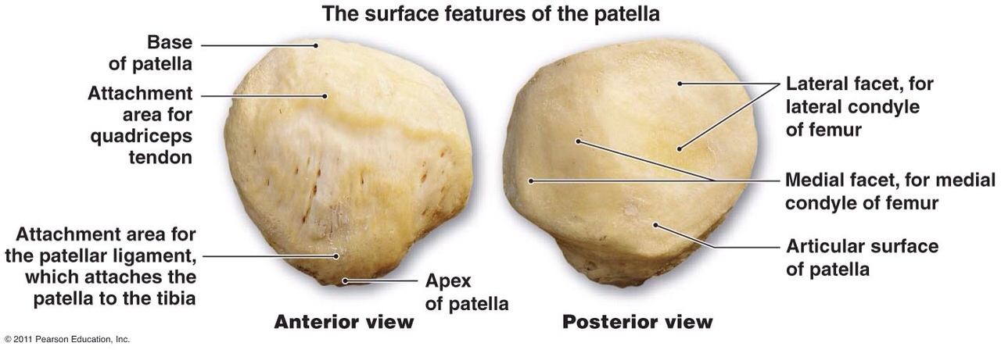
Patella view

Slide 4
Introduction
Chondromalacia there is softening and fissuring of the cartilaginous surface of the patella.
It is defined as a cystic change of the patellar cartilage and usually affects the medial facet of the patella.
It is caused by the combination of several factors which push the patella out of its groove on the femur.

Slide 5
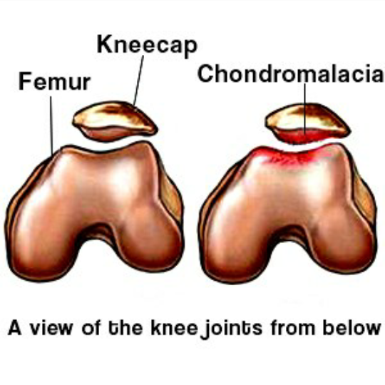
Condromlacia patella

Slide 6
Aetiology
It is unknown.
Mild repeated trauma, inflammatory or metabolic joint disease [osteoporoisi] may precipitation the condition.
Adolescent and young adults are commonly affected.
It is more common in females.

Slide 7
Factors
Weakness of the vastus medialis muscle so patella is pulled more towards lateral side due to strong vastus lateralis muscle.

Slide 8
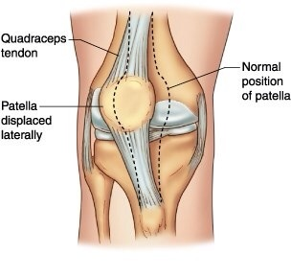
Malalignment produced by foot pathomechanics leading to abnormal excessive pronation and internal rotation of the tibia.

Slide 9
Clinical features
Deep pain in the knee joint
The patella will appear out of alignment
Patient unable to squats due to pain
Knee may be swollen with a chronic effusion of synovial fluid
Positive patellofemoral grinding test when condition is severe.

Slide 10
Grinding test
Purpose : the purpose of the test is to detect the presence of patellofemoral joint disease like condromalacia patella.
Pushing down on the directly. The patient is asked to contract the quadriceps muscles while the examinaer push down.
Positive : if the patient can not maintain the contraction without pain.

Slide 11
Symptoms
Pain : posterior aspect of patella
Pain worsen with strong quadriceps contraction ( descending stairs, getting up from squatting or from chair)
ROM at the knee is usually full but painful.
There may be slight effusion and quadriceps atrophy
Compression of the patella againts femoral condyles causes pain.

Slide 12
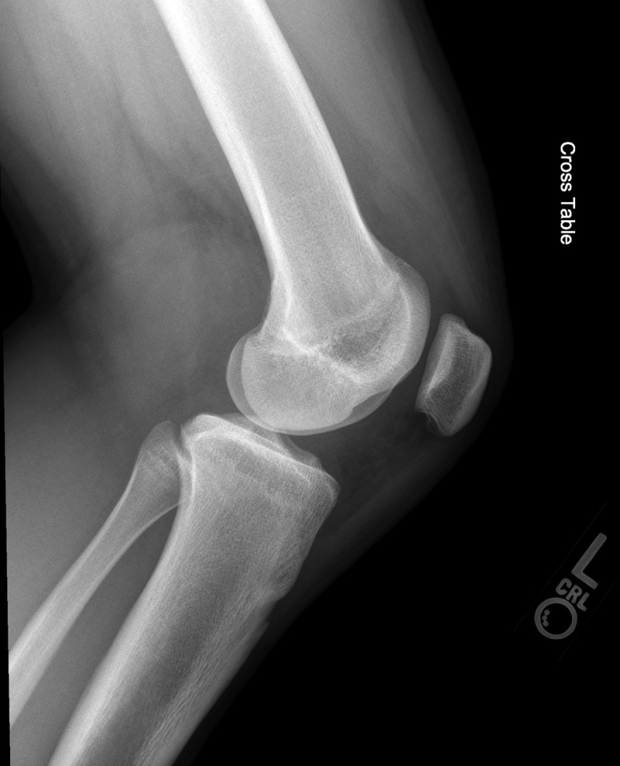
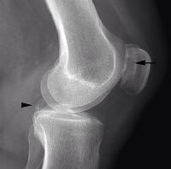
Investigations
Radiographs of the knee shows irregular retro patellar surface.

Slide 13
Management
Protection phase:
When symptoms are acute ,treat them with modalities ,rest, gentle motion , muscle setting exercises in pain free position.
Splinting the patella with brace or tape may unload the join and relieve the irritating stress.

Slide 14
Controlled motion and return to functional phase
When signs of inflammation are no longer present, management is directed toward correcting or modifying the impairment.
Educate the patient
Patient advice
Increase flexibility of restricting tissues
Patellar mobilization – medial glide
Patellar taping
Self stretching- insertion of IT band

Slide 15
Non weight bearing exercises
1. Quadriceps setting in pain free position
2. Quad sets with straight leg raising.
3. Progression of resisted isometrics
Weight bearing exercises
1. If weight bearing is painful, begin with partial weight bearing exercises
2. To improve strength and muscular endurance, the patient should perform the repeation of the appropriate exercise.
3. Mini squats which may be useful for improving patellar tracking.
Functional activities
Modified Biomechanical stresses

Slide 16
Injection therapy
Corticosteroid injection into the joint.
Drugs like painkiller, muscle relaxants, anti inflammatory drugs.

Slide 17
Surgery
Surgery is indicated only when the conservative treatment fails.
Arthroscopy
Patellectomy in severe cases
Lateral retinacular release

Slide 18
Physiotherapy following surgery
After surgery an above knee cast is applied. After the soft tissue healing the above PT followed.
Isometric to hip, quadriceps etc.
Assisted SLR to strengthen the quadriceps.
ROM exs. Both active and passive for the knee.
Gradual PRE to the knee joint muscles.
Shoe raise on the normal leg during ambulation.
Preventive measures to be employed to prevent excessive hyperextension of the knee while ambulation.

Slide 19
clinical query: are close kinetic chain exercises and/ or hip strengthening exercises help in patellofemoral pain?
P: patients with patellofemoral pain
I : close kinetic chain exercises with additional hip exercises
C : only close kinetic chain exercises
O : pain, function of knee joint, muscle torque

Slide 20
a randomized controlled trial | EUR J PHYS REHABIL MED 2013;49:687-98 | Method | Result | Conclusion
1 b level of evidence | Aim : to determine the effect of a CKC exercises program on pain intensity, and hip abductors and lateral rotators eccentric and concentric torques in patients with PFPS compared with the same program of CKC exercise with additional isolated open kinetic hip muscles exercises. | Total 32 patients, randomized ckc(16) and ckc+ hip(16). CKC group Mini wall squat Forward step up Lateral step up Terminal knee extension. The hip strengthening exercises for Co group include resistive exercises for hip abduction and external rotation. | There was a significant improvement in knee function and reduction in pain in both groups and additional hip exercises give better result than only ckc exercises. | They recommend the uses of selected CKC exercises as strengthening exercises which focus on hip abductors and lateral rotators together with knee extensors specially the vastus medialis to produce both strength gain and pain relief in cases needing pain relief to the clinical relevant level. However isolated hip abductors and lateral rotators strengthening exercises have the advantage of more pain relief.

Slide 21
REFERENCES
CAROLYN KISNER, Therapeutic exercise ;5th edition page no 712
Jyant joshi
Abnazer
Article- net

Slide 22
Questions
1.Which facet affect more in condromalacia pattela ?
lateral facet
Odd facet
Medial facet
none of above

Slide 23
2.Special test for condromalacia patrlla to do?
A. Faber test
B. SLR
C. Grinding test
D. Patellar tap test

Slide 24
3.In this condition knee may be swollen due to???
A. Synovial fluid
B. Interstitial fluid
C. Blood
D. Intracellular fluid

Slide 25
4.Which surgery is done for this condition?
Arthroscopy
Patellectomy in severe cases
Lateral retinacular release
All of above

Slide 26
5.It is more common in
male
Female
Children
None

Slide 27
Thank you……………

