Slide 1
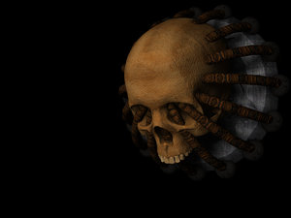

INTRODUCTION
TO
Oral & Maxillofacial Surgery

Slide 2
DR. NAVIN SHAH
Head Of The Department
Professor & P. G. Guide

Slide 3
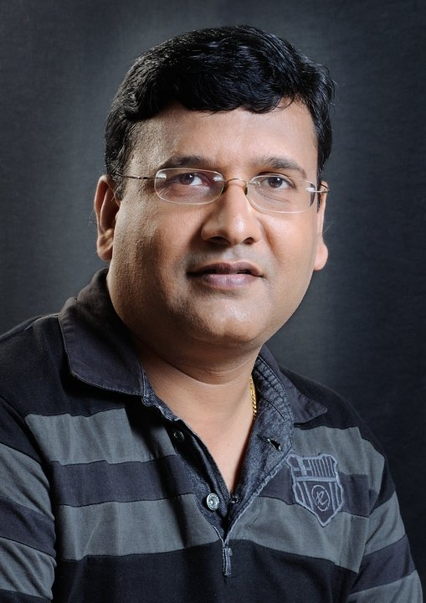
DR. RAKESH SHAH
Professor & P. G. Guide

Slide 4
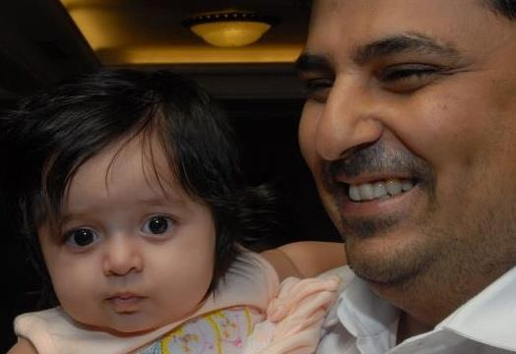
DR. AMIT MAHAJAN
Professor & P. G. Guide

Slide 5
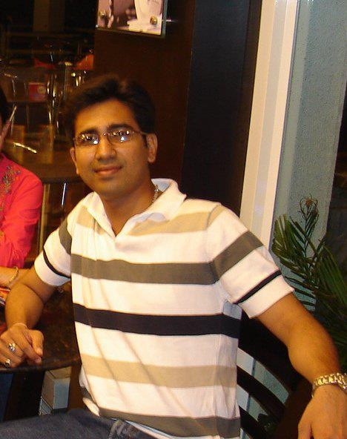
DR. PRACHUR KUMAR MALHOTRA
READER

Slide 6
DR. DIXIT SHAH
PRO CHANCELLOR
SUMANDEEP VIDYAPEETH

Slide 7
What is Oral & Maxillofacial Surgery…??????

Slide 8
What is Oral Surgery?????
Is it only Exodontia??
NO ANATOMY >>> NO SURGERY
Surgeon Without Confidence Is Dangerous
NO
By Dr Kiran Desai

Slide 9
DEFINITION
Oral & Maxillofacial Surgery is a specialty of dentistry concerned with diagnosis & surgical treatment of congenital or acquired diseases, dysfunction, defects or injuries of the mouth, jaws, face, neck and adjacent craniofacial structures

Slide 10
Connected Specialties
ORAL & MAXILLOFACIAL SURGERY
Anesthetist
Plastic Surgeon
Cardiac Physician
ENT Surgeon
Ophthalmologist
Orthopedics

Slide 11
HISTORY TAKING

Slide 12
EXODONTIA
The ideal tooth extraction is the painless removal of the whole tooth, or tooth-root, with minimal trauma to the investing tissues, so that the wound heals uneventfully and no postoperative prosthetic problem is created.

Slide 13
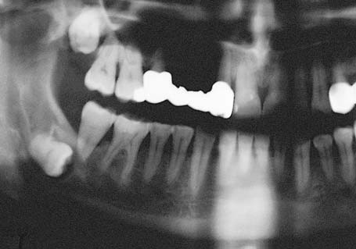
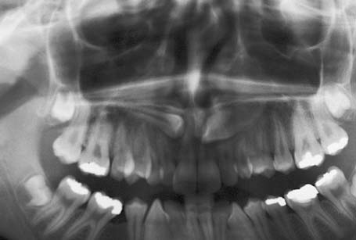
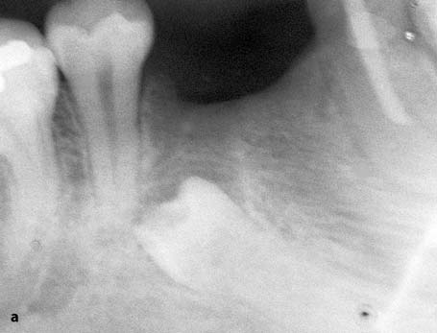

Slide 14
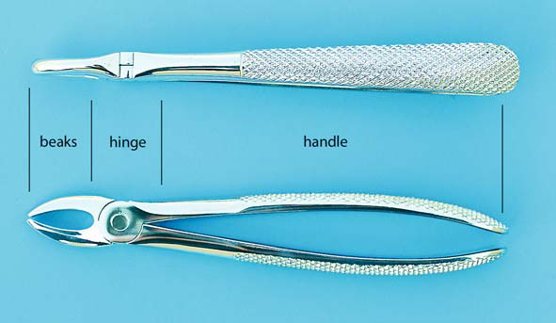
Maxillary extraction forceps used for the six anterior teeth of the maxilla (superior and side view)

Slide 15
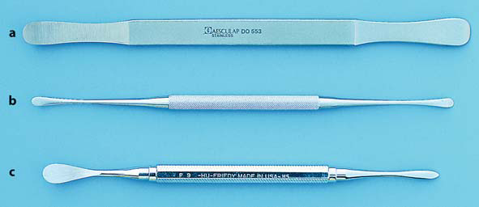
Various types of periosteal elevators.
a Seldin. b Freer. C No. 9 Molt

Slide 16
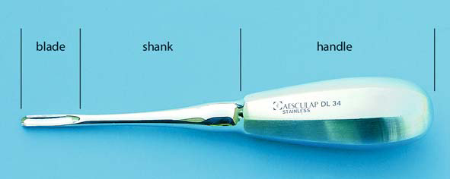
Straight Bein elevator

Slide 17
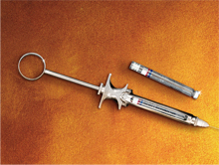
ANAESTHESIA

Slide 18
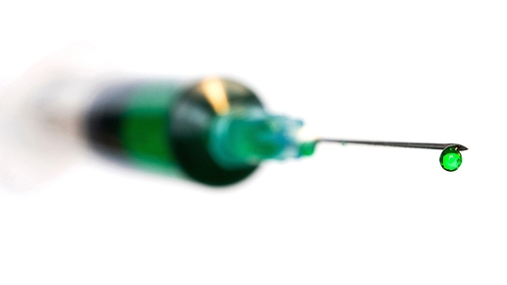

Slide 19
Anaesthesia
We are not restricted only at the use of Local Anaesthesia.
We also have to be familier with General Anaesthesia
A Dentist !!!!!!!!!

Slide 20
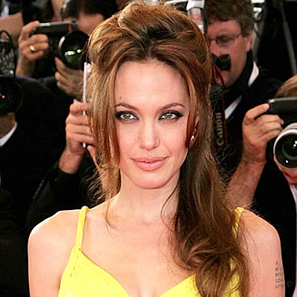

WHO AM I ????

Slide 21
WHO AM I ????

Slide 22
WHO AM I ????

Slide 23
WHO AM I ????

Slide 24

Your smile is your identity..

Slide 25
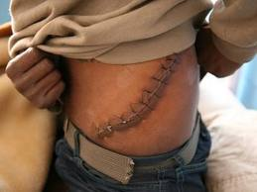

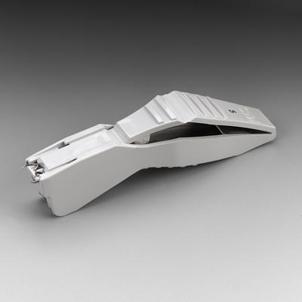
Needs A Great Skill ……

Slide 26
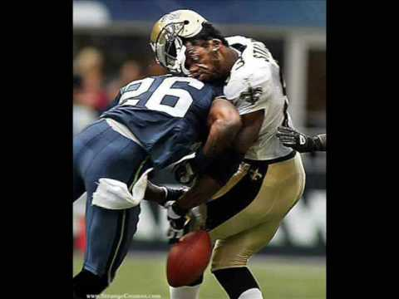
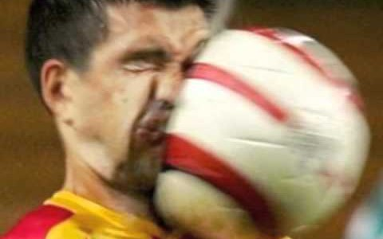
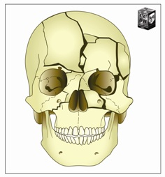
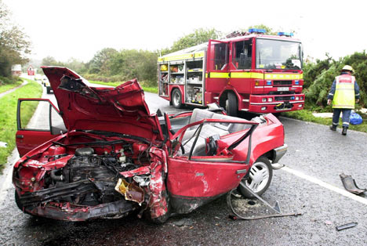

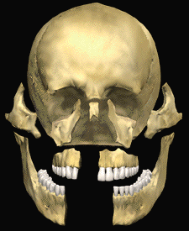
TRAUMA

Slide 27
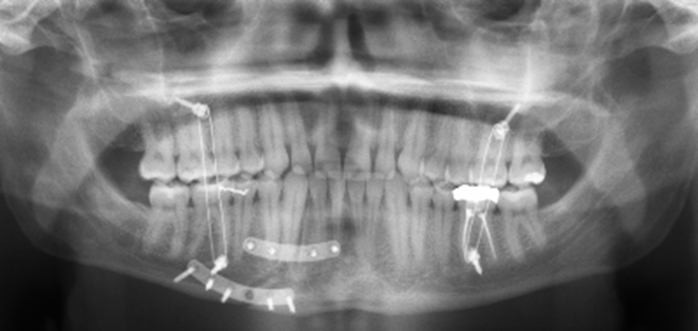

Slide 28
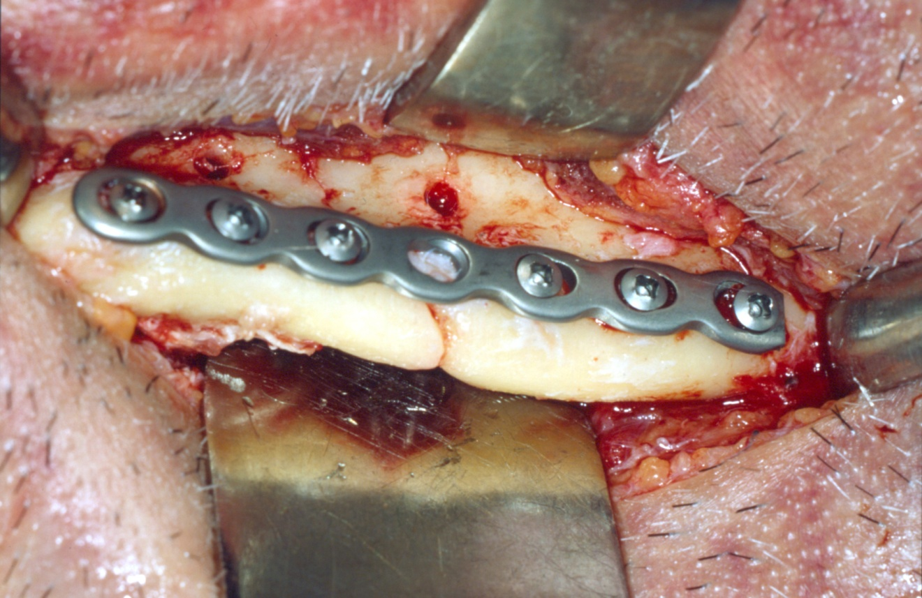

Slide 29
CYST

Slide 30
Cyst & Tumour
Patient with a long standing extraoral swelling comes to you……
How to Examine……?
How to Diagnose……?
How to Treat…..?

Slide 31
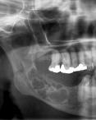
AMELOBLASTOMA
affecting right body and ramus of the mandible

Slide 32
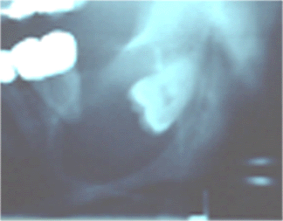
DENTIGEROUS CYST
Affecting left body and ramus of the mandible

Slide 33
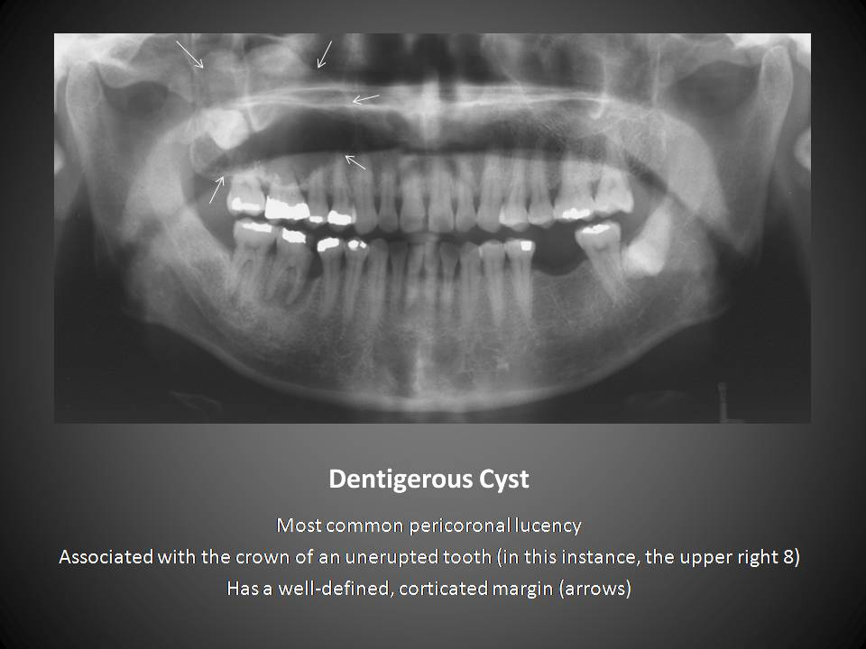
Tumor & Cyst
When a patient with large lesion comes up to you! How would you diagnose and treat them?

Slide 34
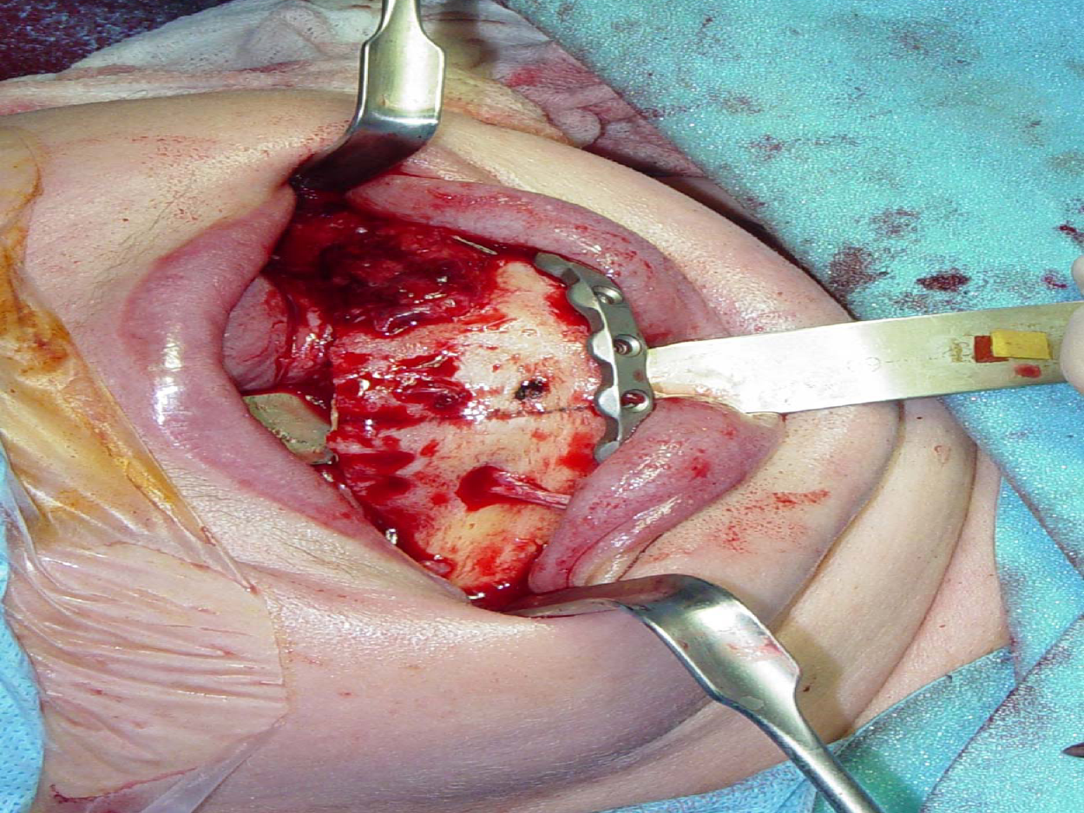

Slide 35
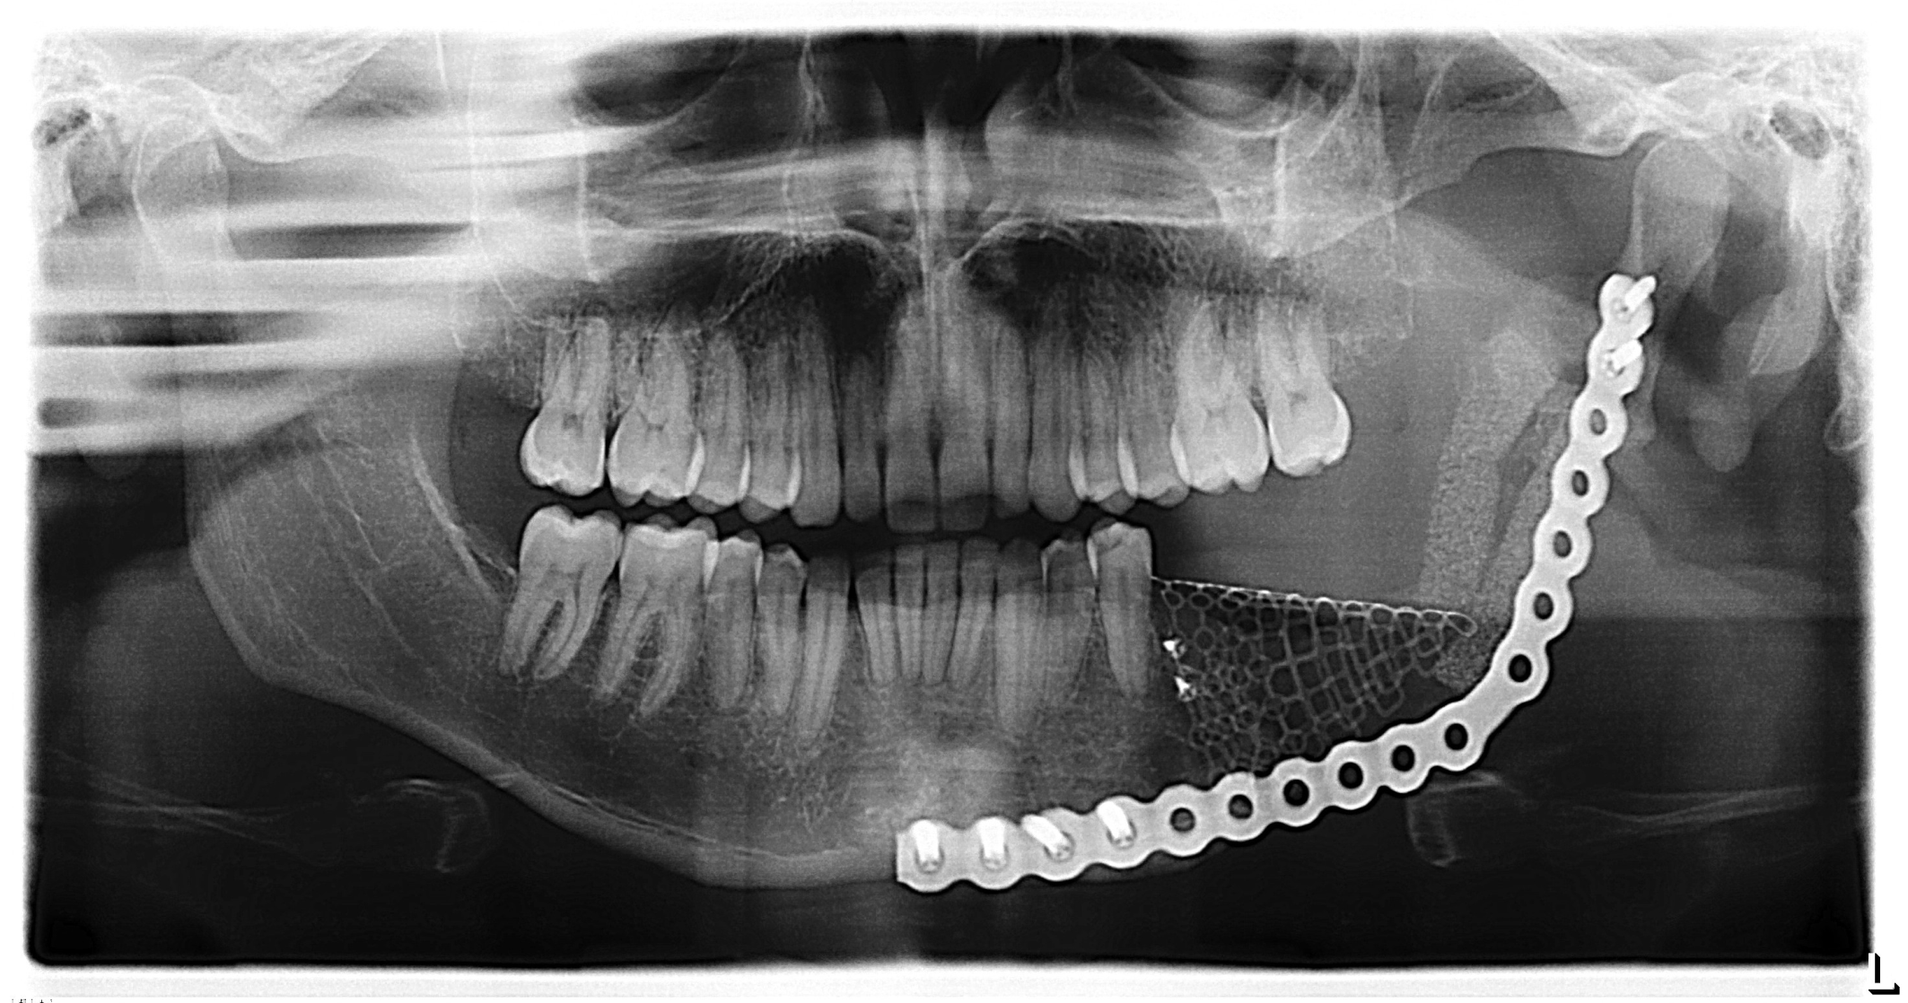

Slide 36
Cleft Lip & Cleft Palate

Slide 37
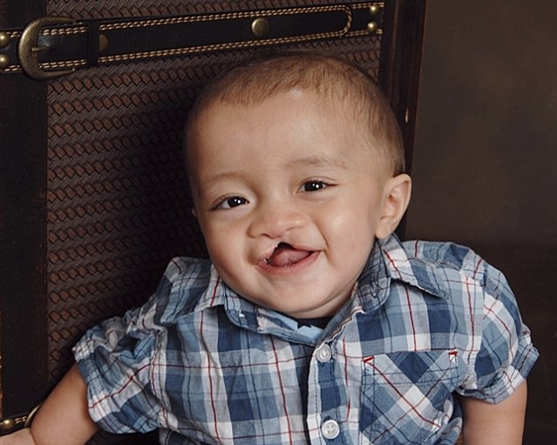

Slide 38
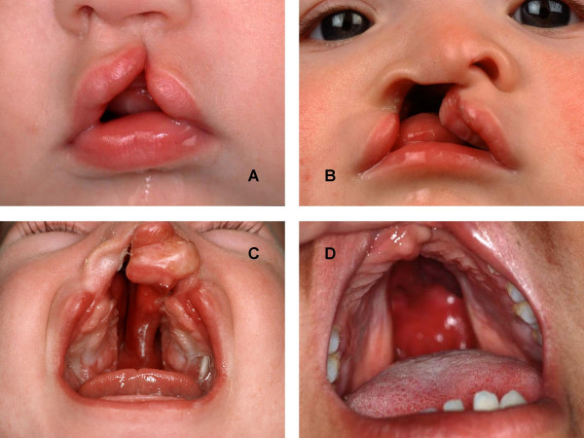

Slide 39
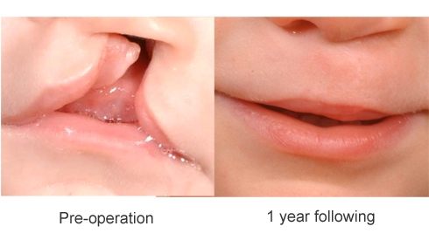
Miraculous results …. Leading to better social life

Slide 40
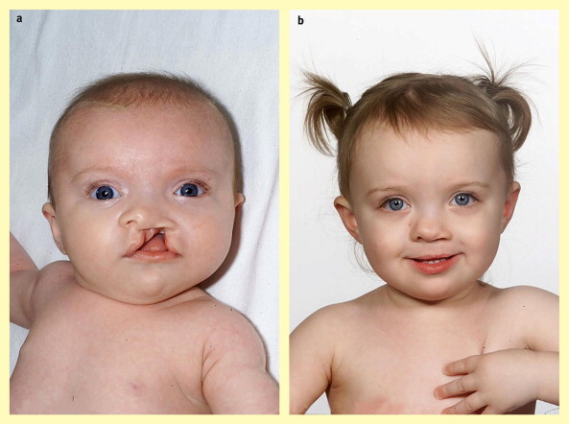

Slide 41
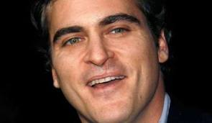
JOAQUIN RAFAEL PHOENIX

Slide 42
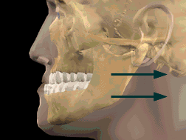
ORTHOGNATHIC SURGERY

Slide 43
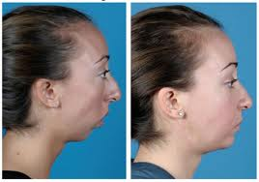

Slide 44
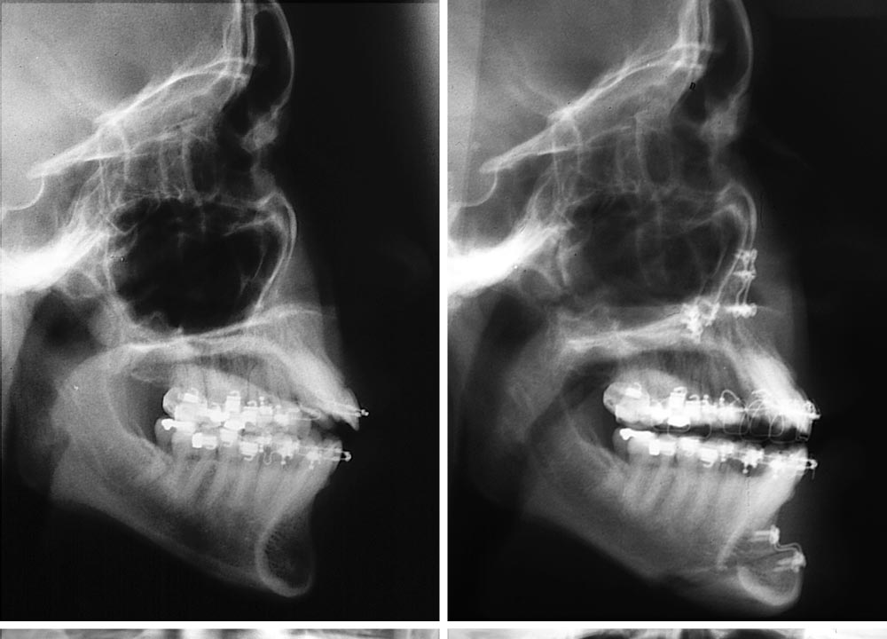

Slide 45
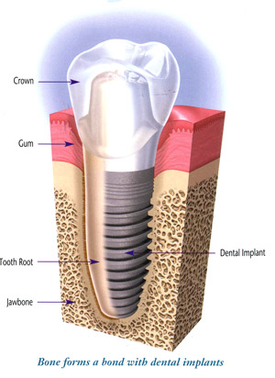
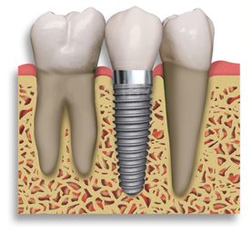
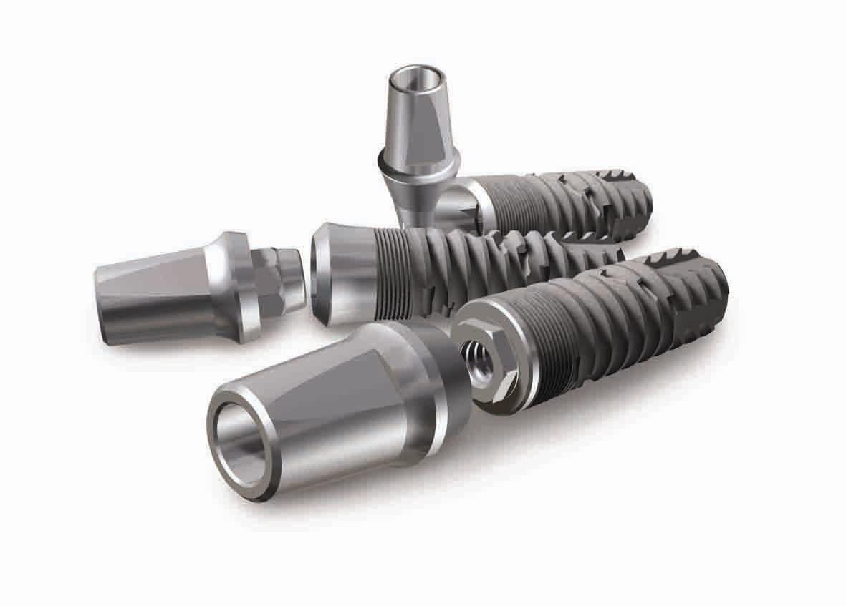
Dental Implants

Slide 46
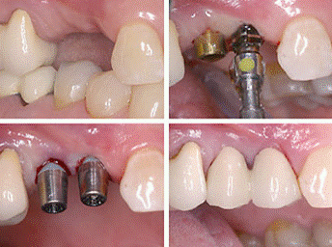

Slide 47
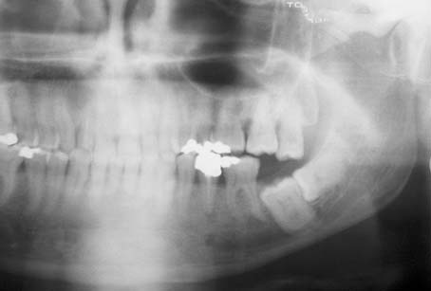
IMPACTION
Removing an impacted tooth is a real challenging task.
It is the Bread & Butter for a daily routine practice of an Oral & Maxillofacial Surgeon

Slide 48
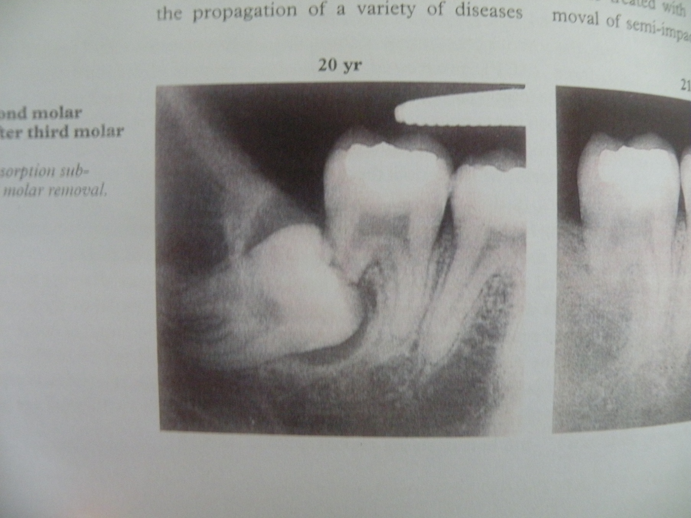

Slide 49
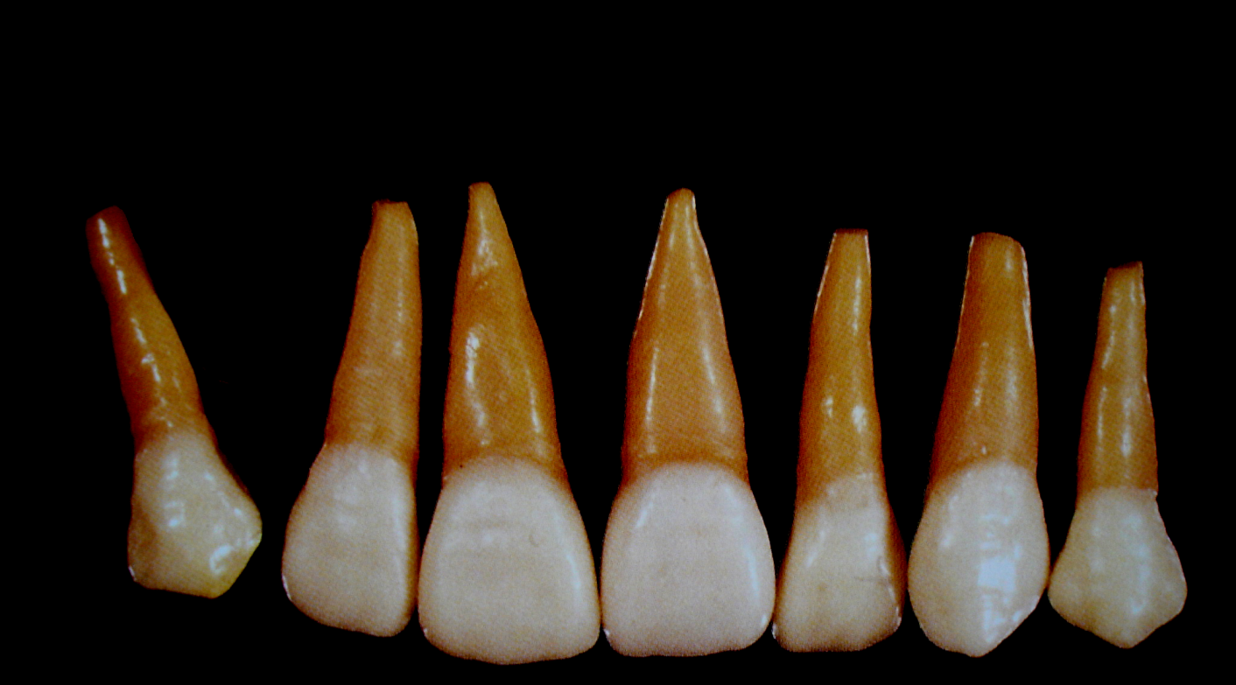
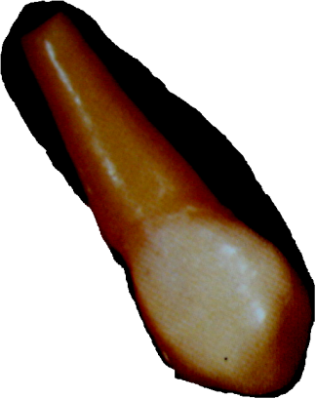
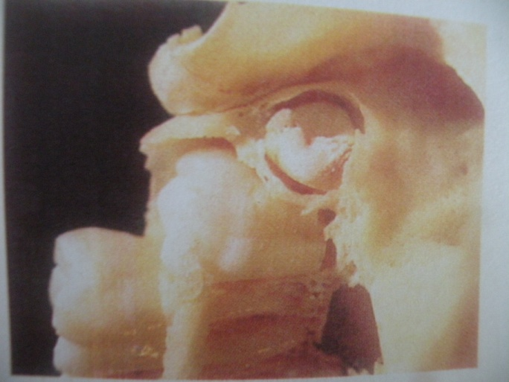
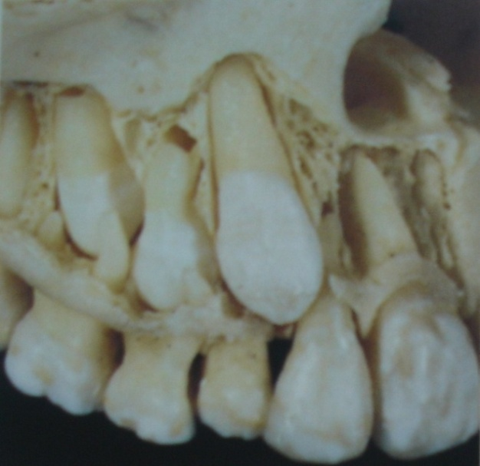
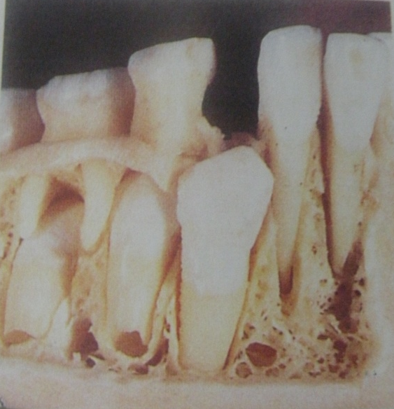
OTHER IMPACTIONS

Slide 50
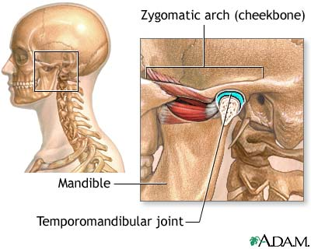
TEMPORO MANDIBULAR JOINT
The most challenging area of the oral & maxillofacial surgery, because of its complicated, unique and dangerous anatomy
Most surgeons still fear to operate around TMJ

Slide 51
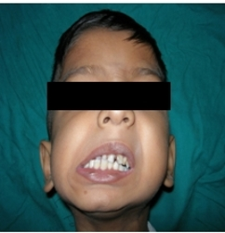

Slide 52
Distraction Osteogenesis
Bone reconstruction can be achieved by this method

Slide 53
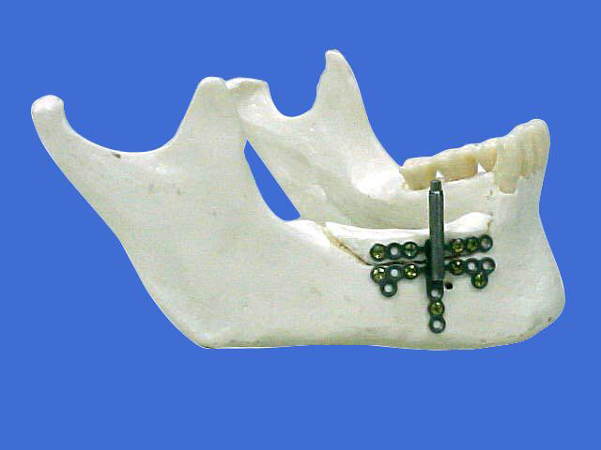

Slide 54
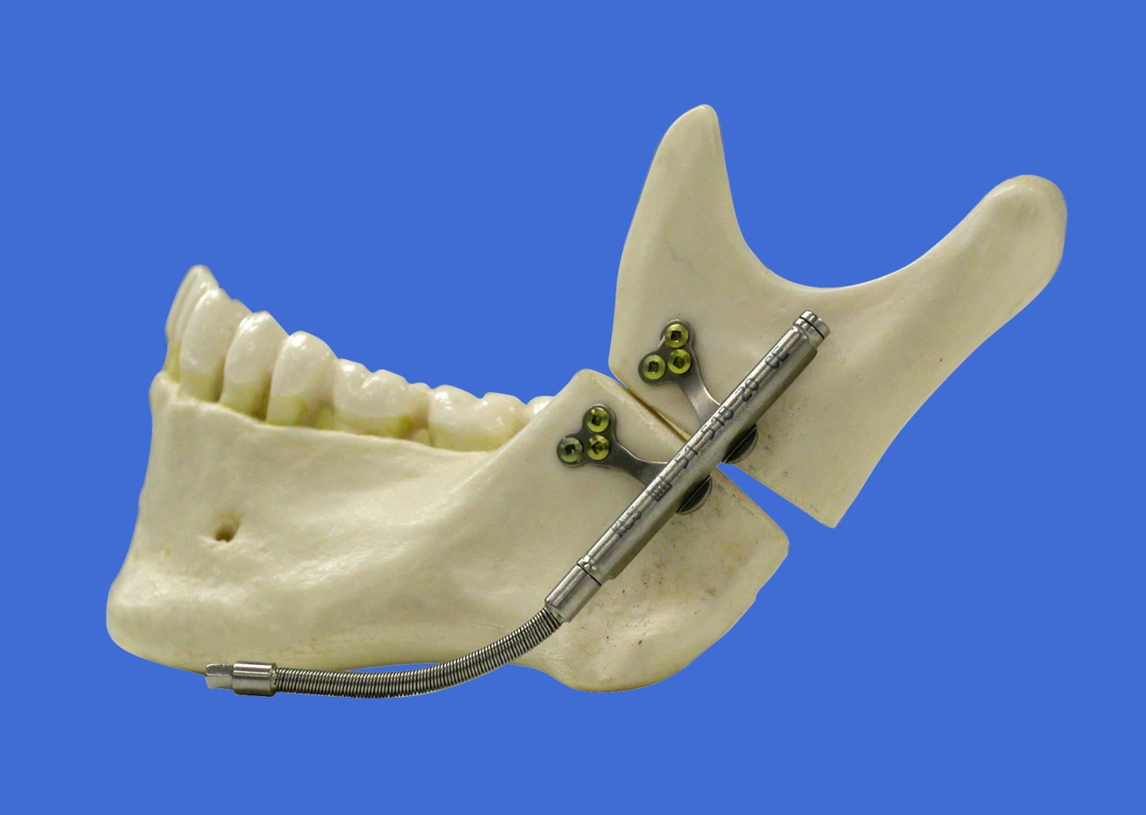

Slide 55

Cryosurgery

Slide 56


Slide 57


LASER

Slide 58

Oral Cancer

Slide 59


Slide 60
RECONSTRUCTION

Slide 61


Slide 62


Slide 63


Slide 64

Microvascular Surgery
Microvascular reconstruction after an extensive ablative surgeries of oral & maxillofacial region provides a better life and function to the patients of oral malignancies and other major diseases

Slide 65



Slide 66

Hair Transplant

Slide 67
Medico legal Aspect
Records of the patient are to be preserved
Informed consent is compulsary
You can refuse the patient
Don’t hesitate in referring to other doctor
Know your limitations

Slide 68
Take Home Messages
The living tissues which are left in the body are more important and respectable as compared to the ones which you are removing

Slide 69
Take Home Messages
It’s a Team Work with specific protocols for every team member

Slide 70
Take Home Messages
It’s a Team Work with specific protocols for every team member

Slide 71


Slide 72


