Slide 1
PHYSIOTHERAPY IN ENT CONDITIONS
By, Dr. Kalpesh Satani

Slide 2
OBJECTIVES
To know about different ENT conditions in brief .
To learn about physiotherapy treatment in various ENT conditions.

Slide 3
THESE ARE THE COMMON ENT CONDITIONS
Sinusitis
Otitis media
Mastoiditis
Facial palsy

Slide 4
SINUSES
The sinuses are hollow air-filled sacs lined by mucous membrane.
Each sinus has an opening into the nose for the free exchange of air and mucus, and each is joined with the nasal passages by a continuous mucous membrane lining.

Slide 5
Four pairs of paranasal sinuses:
1. Frontal: above eyes in forehead bone.
2. Maxillary: in cheekbones.
3. Ethmoid (under eyes): between eyes and nose.
4. Sphenoid: in center of skull, behind nose and eyes.

Slide 6
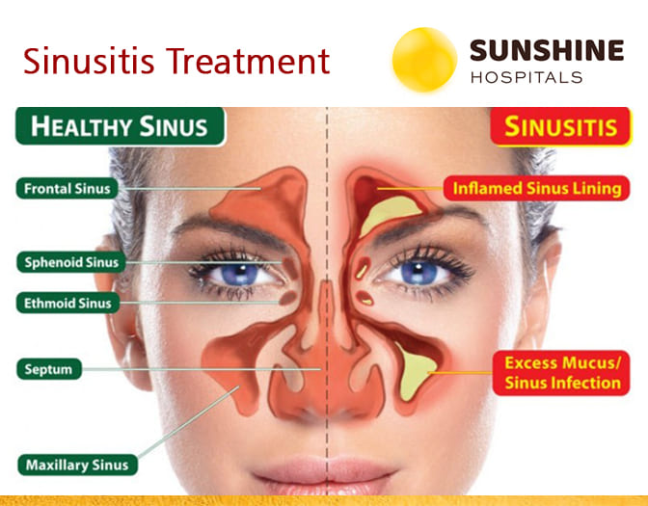

Slide 7
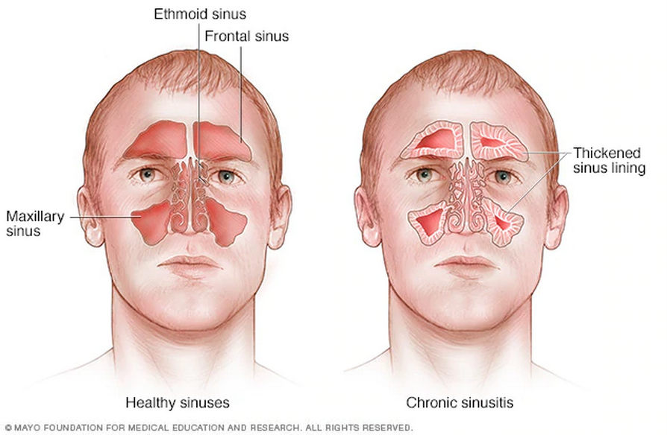
SINUSITIS
Sinusitis, also known as a sinus infection or rhinosinusitis, is inflammation of the mucous membrane that lines the sinuses resulting in symptoms.

Slide 8
CLASSIFICATION (Chronologically )
Acute sinusitis – A new infection that may last up to four weeks and can be subdivided symptomatically into severe and non-severe.
Recurrent acute sinusitis – Four or more full episodes of acute sinusitis that occur within one year.
Subacute sinusitis – An infection that lasts between four and 12 weeks, and represents a transition between acute and chronic infection
Chronic sinusitis – When the signs and symptoms last for more than 12 weeks.
Acute exacerbation of chronic sinusitis – When the signs and symptoms of chronic sinusitis exacerbate, but return to baseline after treatment.

Slide 9
CLASSIFICATION (Location)
Maxillary– can cause pain or pressure in the maxillary (cheek) area (e.g., toothache, or headache) .
Frontal – can cause pain or pressure in the frontal sinus cavity (located above the eyes), particularly in the forehead .
Ethmoidal – can cause pain or pressure pain between/behind the eyes, the sides of the upper part of the nose and headaches .
Sphenoidal– can cause pain or pressure behind the eyes, but is often felt in the top of the head, over the mastoid processes, or the back of the head.

Slide 10
CAUSES
Infection(Most cases are caused by a viral infection)
Allergies
Air pollution
Structural problems in the nose.
Recurrent episodes are more likely in persons with asthma, cystic fibrosis
Poor immune function.

Slide 11
SIGNS AND SYMPTOMS
Headache/facial pain or pressure of a dull, constant, or aching sort
This pain is usually localized to the involved sinus and may worsen when the affected person bends over or when lying down.
Pain often starts on one side of the head and progresses to both sides.

Slide 12
SIGNS AND SYMPTOMS
Accompanied by thick nasal discharge that is usually green in color and may contain pus or blood.
Often a localized headache or toothache is present
Post-nasal drip
Halitosis

Slide 13
MEDICAL MANAGEMENT
Antibiotics: Amoxicillin, Fluoroquinolones, Clarithromycin, Doxycycline are useful to treat sinusitis.
For unconfirmed acute sinusitis, nasal sprays using corticosteroids have been found to be better.
Surgery should only be considered for those people who do not benefit with medication.
The benefit of functional endoscopic sinus surgery (FESS) is its ability to allow for a more targeted approach.

Slide 14
PHYSIOTHERAPY MANAGEMENT
SHORT WAVE DIATHERMY (SWD)
SWD is useful in increasing metabolic activity and increased blood flow.
The cross-fire method is used to treat the walls of cavities containing air .example : frontal, maxillary and ethmoid sinuses.
Here, the electric field lies at right angle preferably by monopolar technique.

Slide 15
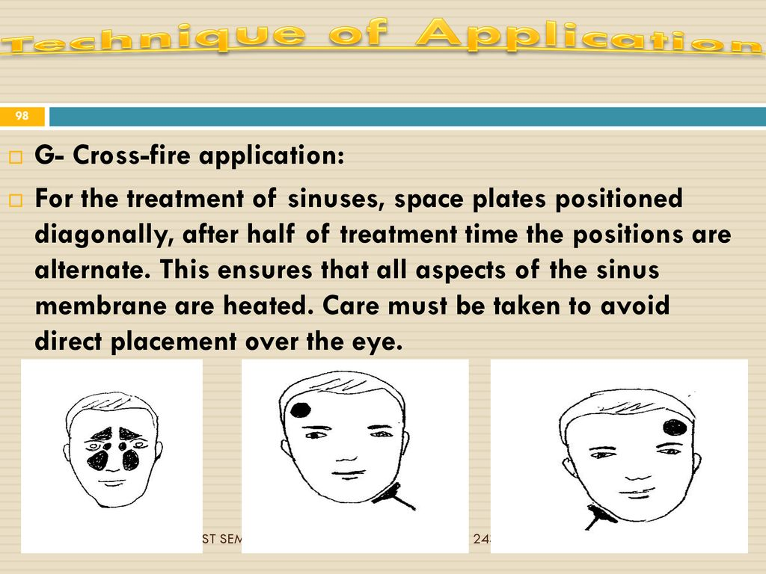
SWD ( cross-fire placement)

Slide 16
ULTRASOUND
Excellent and good improvements in chronic rhinosinusitis symptoms; were observed in 90% of patients treated with continuous ultrasound (US).
The possible increased blood circulation in the mucosa of the sinuses from the thermal effect of continuous US may assist reduction of sinus inflammation.
The mechanical vibration of the secretions by US to loosen stagnant secretions may also contribute to the facilitation of sinus drainage, which is very important to sinus health.

Slide 17
ULTRASOUND
The US parameters were as follows:
Continuous mode
An intensity of 1W/cm² and 0.5W/cm² for maxillary and frontal sinuses, respectively
A frequency of 1MHz Duration of treatment of five minutes for each maxillary sinus and for each frontal sinus.

Slide 18
OTITIS MEDIA
Otitis media is a group of inflammatory diseases of the middle ear.
The two main types are acute otitis media (AOM) and otitis media with effusion (OME).
AOM is an infection of rapid onset that usually presents with ear pain.

Slide 19
OME is defined as the presence of non-infectious fluid in the middle ear for more than three months.
Chronic suppurative otitis media (CSOM) is middle ear inflammation of greater than two weeks that results in frequent episodes of discharge from the ear.

Slide 20
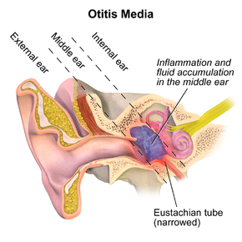
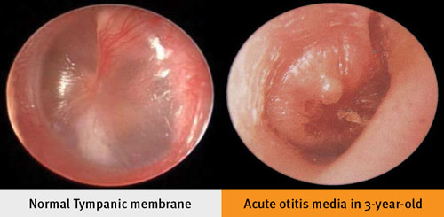

Slide 21
CAUSES
The common cause of all forms of otitis media is dysfunction of the Eustachian tube.
This is usually due to inflammation of the mucous membranes in the nasopharynx, which can be caused by a viral URTI, strep throat, or possibly by allergies.

Slide 22
SIGNS AND SYMPTOMS
Ear pain is an integral symptom.
Other possible symptoms include fever and irritability .
Since an episode of otitis media is usually precipitated by an upper respiratory tract infection (URTI), there are often accompanying symptoms like a cough and nasal discharge.

Slide 23
MEDICAL MANAGEMENT
Oral and topical pain killers are effective to treat the pain caused by otitis media.
Oral agents such as : include Ibuprofen, Paracetamol (Acetaminophen), And Opiates.
Topical agents shown to be effective include Antipyrine And Benzocaine Ear Drops.
Decongestants and antihistamines, either nasal or oral, are recommended.

Slide 24
MASTOIDITIS
Mastoiditis is the result of an infection that extends to the air cells of the skull behind the ear.
Specifically, it is an inflammation of the mucosal lining of the mastoid antrum and mastoid air cell system inside the mastoid process.

Slide 25
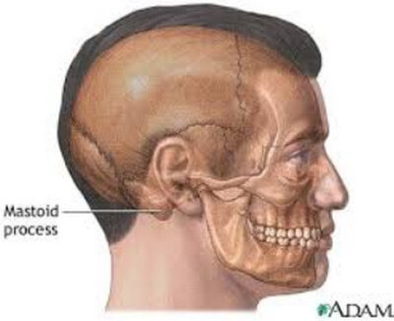

Slide 26
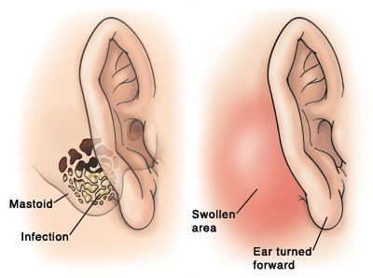

Slide 27
CAUSES
Mastoiditis is usually caused by untreated acute otitis media (middle ear infection) and used to be a leading cause of child mortality.

Slide 28
SIGNS AND SYMPTOMS
Pain
Tenderness and swelling.
There may be ear pain (otalgia)
The ear or mastoid region may be red (erythematous).

Slide 29
SIGNS AND SYMPTOMS
Fever or headaches
Infants usually show nonspecific symptoms, including anorexia, diarrhea, or irritability.
Drainage from the ear occurs in more serious cases, often manifest as brown discharge on the pillowcase upon waking.

Slide 30
MEDICAL MANAGEMENT
The primary treatment for mastoiditis is administration of intravenous antibiotics.
Initially, broad-spectrum antibiotics are given, such as ceftriaxone.
Long-term antibiotics may be necessary to completely eradicate the infection.

Slide 31
MEDICAL MANAGEMENT
If the condition does not quickly improve with antibiotics, surgical procedures may be performed (while continuing the medication).
Mastoidectomy: a procedure in which a portion of the bone is removed and the infection drained.

Slide 32
PHYSIOTHERAPY MANAGEMENT
Each session will consist of a combination of the following therapies.
As with the medication, it is a course of treatments, running for at least 4 sessions before the full impact of treatment is felt.
Thinning the secretions: To thin the mucus,the humidifying mist, generated ultrasonically, which is a combination of normal saline and the mucolytic is prescribed.

Slide 33
PHYSIOTHERAPY MANAGEMENT
Opening the sinus drains: The ostia are very small and easily blocked by inflammation. The ultrasound and the laser machines are used to help here.
Moving the secretions: Laser and Ultrasound also help to drive the mucous toward the drain holes and encourage normal mucus clearance.

Slide 34
PHYSIOTHERAPY MANAGEMENT
Mobilization: Your therapist may choose to perform head/neck mobilization to help “open” the sinuses.
Dry needling: Needles help to reduce pain and the swelling that blocks the ostia.

Slide 35
FACIAL PLASY
Facial palsy is due to the damage in the facial nerve that supplies the muscles of the face.
It can be categorized into two based on the location of casual pathology:
Central facial palsy- due to damage above the facial nucleus
Peripheral facial palsy-due to damage at or below the facial nucleus

Slide 36
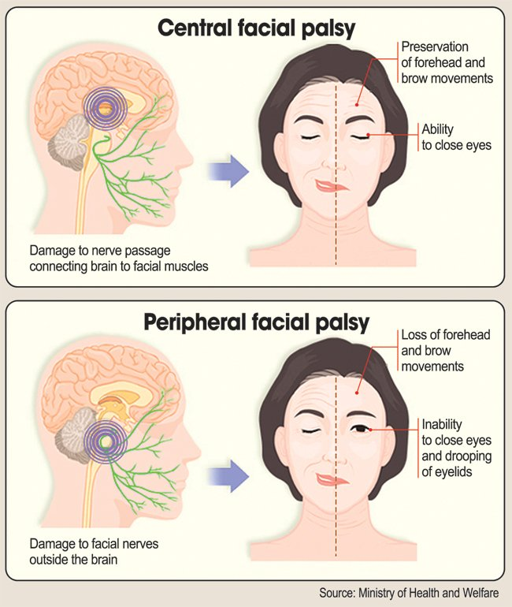

Slide 37
PHYSIOTHERAPY MANAGEMENT
Neuromuscular Retraining (NMR)
Electromyography (EMG) and mirror biofeedback
Trophic Electrical Stimulation (TES)
Proprioceptive Neuro Muscular Facilitation Techniques
Mime's therapy

Slide 38
THANK YOU !

