Slide 1
PHYSIOTHERAPY IN PSYCHIATRIC CONDITIONS
By, Dr. Kalpesh Satani

Slide 2
OBJECTIVES
To know about psychiatric conditions in brief .
To learn about physiotherapy treatment in psychiatric conditions.

Slide 3
INTRODUCTION
Psychiatric disorders have traditionally been considered as mental rather than as physical illnesses. This is probably because they manifest with disordered functioning in the areas of emotion, perception, thinking and memory, and/or have had no clearly established biological basis.

Slide 4
Lifestyle modifications can assume great importance in individuals especially with serious mental illness.
Many of these individuals are at high risk of chronic diseases associated with sedentary behaviour and medications side effects, including diabetes, hyperlipidemia and cardiovascular diseases.' So, these individuals have a higher levels of mortality and morbidity.

Slide 5
CLASSIFICATION OF PSYCHIATRIC DISORDERS
Stress-related disorders for i.e Acute stress disorder, Post-traumatic stress disorder.
2. Anxiety disorders for i.e Generalized anxiety
Phobic anxiety, Panic disorder.
3. Affective (mood) disorders for i.e Depressive disorder, Mania and bipolar disorder.
4. Schizophrenia and delusional disorders.

Slide 6
GENERAL AETIOLOGY OF PSYCHIATRIC DISORDERS
Predisposing Factors
Increase susceptibility to psychiatric disorder
Established in utero or in childhood
Operate throughout patient’s lifetime (e.g. genetic factors, congenital defects, chronic physical illness, disturbed family background)

Slide 7
CONTI…
Precipitating Factors
• Trigger an episode of illness
• Determine its time of onset (e.g. stressful life events,acute physical illness)
Perpetuating Factors
• Delay recovery from illness (e.g. lack of social support, chronic physical illness)

Slide 8
GENERAL SYMPTOMS OF PSYCHIATRIC DISORDER
Psychological
• Depressed mood
• Reduced self-esteem
• Pessimism
• Guilt
• Loss of interest
• Loss of enjoyment (anhedonia)
• Suicidal thinking

Slide 9
CONTII…
Somatic
• Reduced appetite
• Weight change
• Disturbed sleep
• Fatigue
• Loss of libido
• Bowel disturbance
• Motor retardation (slowing of activity)

Slide 10
TREATMENT OF PSYCHIATRIC CONDITIONS
• Biological treatments (psychotropic drugs: Antipsychotic, Antidepressant, Mood-stabilizing, Anti-anxiety and Electroconvulsive therapy )
• Psychological treatments ( General or supportive psychotherapy, Cognitive Therapy, Problem Solving Therapy Behavioural Therapy)

Slide 11
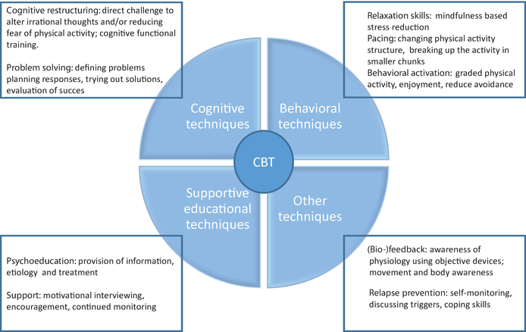

Slide 12
CONTI…
Physiotherapy Treatment (Physical activity Programs).
Social interventions (appropriate financial assistance and medical recommendations)

Slide 13
ROLE PHYSIOTHERAPY IN PSYCHIATRIC DISORDERS
The role of physiotherapy in this field includes the evaluation and treatment of patients with pain, somatic disorders, anxiety, depression, personality disorders, acquired brain injury, dementia, behaviour problems, eating disorders, addictions and others.
There are various literature supporting the effects of physical fitness on mental and emotional health is extensive.

Slide 14
GOALS OF PHYSIOTHERAPY
There are evidence that exercise is beneficial for mental health:
It reduces anxiety, depression, and negative mood, and improves self-esteem and cognitive functioning.
Exercise is also associated with improvements in the quality of life.

Slide 15
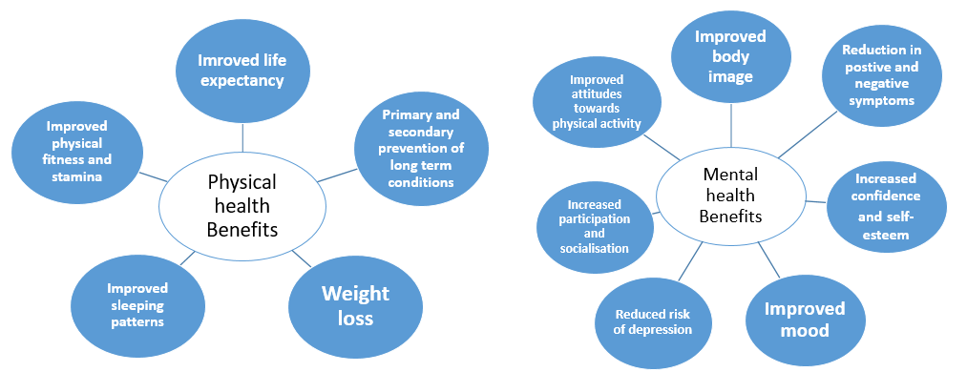

Slide 16
PSYCHOLOGICAL GOALS
To raise self esteem and confidence.
To improve mood and promote wellbeing through a structured exercise program.
To motivate the patients and promote self management in mental and physical health issues.
To promote a more positive body image.
To reduce social isolation.
To address impaired body awareness and reduce dissociation associated with poor mental health.

Slide 17
PHYSICAL GOALS
To provide non-pharmacological management of pain.
To improve muscle strength and flexibility.
To improve cardiovascular endurance.
Prevention and management of falls and other mobility issues in older subjects.
Advice on weight management
To improve quality of life.

Slide 18
PHYSIOLOGICAL BASIS
Aerobic exercises have been proved to reduce anxiety and depression.
These improvements in mood are proposed to be caused by exercise-induced increase in blood circulation to the brain and by an influence on the hypothalamic-pituitary-adrenal (HPA) axis and thus,on the physiologic reactivity to stress.

Slide 19
CONTI..
This physiologic influence is probably mediated by the communication of the HPA axis with several regions of the brain, which plays an important part in memory formation as well as in mood and motivation.

Slide 20
DESIGNING PHYSICAL ACTIVITY PROGRAM
The major concerns while designing a physical activity programme:
Structured versus lifestyle activities.
Individually Tailored Interventions.
Self Monitoring
Group versus Individual sessions.
Self efficacy and patients safety.

Slide 21
RECOMMENDED LEVEL OF PHYSICAL ACTIVITY
The American College of Sports Medicine (ACSM), a national organization interested in promoting the health of all Americans has published a position statement that recommends appropriate amounts of exercise needed to attain minimal levels of physical fitness and good mental health.
According to ACSM guidelines, a minimal exercise program should consist of at least three 20 to 60 minute exercise sessions each week.

Slide 22
Exercises prescribed for mental health disorder:
Relaxed deep breathing exercises
Muscle flexibility exercises
Relaxation techniques
Endurance training
Hydrotherapy
Biofeedback
Ergonomics
Gait Re-education.

Slide 23
CONTII…
Cycle ergometry
Muscle strengthening
General mobility exercises
Multi-sensorial stimulation
Balance and Equilibrium training
Re education of posture and motion associated with intense and chronic pain .
In addition, physiotherapist's responsibility in mental health also involves possible problems of incontinence, skeletal muscle, orthopaedic and neurologic deficit.

Slide 24
EVIDENCES
Guskwoska reviewed the study on the effect of the physical activity on the emotional states –anxiety, depression and mood.
He found that most improvements are caused by rythmic,aerobic exercises,using of large muscle groups of moderate and low intensity.it was conducted for 15-30 minutes and was performed three times a week for 10 weeks.
The results confirmed the acute effects of exercise lead to reduction in anxiety and depression.

Slide 25
EVIDENCES
Several studies have reported the relationship between physical activity and reduced incidence of dementia or cognitive deterioration.
In study. Teri et al. observed that daily 30 min of physical training (aerobic, flexibility and strength) reduced the number of hospitalizations in 153 patients suffering with acute clinical depression. It not only decreased depressive symptoms but also improved quality of life.

Slide 26
EVIDENCES
Physical exercise and Schizophrenia Exercise is especially important in patients with schizophrenia since these patients are already vulnerable to obesity and also because of the additional risk of weight gain associated with antipsychotic treatment, especially with the atypical antipsychotics.
In a study by Fogarty et al." patients suffering from schizophrenia who participated in a 3-month physical conditioning program showed improvements in weight control and reported increased fitness level, exercise tolerance, reduced blood pressure levels, increased perceived energy levels, and increased upper body and hand grip strength levels.

Slide 27
THANK YOU.

