Slide 1
Pulmonary function testing
(PFT)
By, Dr. Kalpesh Satani

Slide 2
Pulmonary Function Tests
A wide variety of objective tests to assess lung function.
Provide objective and standardized measurements for assessing the presence and severity of respiratory dysfunction.

Slide 3
GOALS of PFT
To screen for the presence of obstruction or restriction.
To assess the severity of disease.
To assess the progression of disease.
To assess the response to treatment.
To assess the patient prior to surgery, to identify the risk for post operative complications.
To assess the patient for weaning from ventilator.

Slide 4
INDICATIONS OF PFT IN PAC
Age > 70 yrs.
Morbid obesity
Thoracic or Upper abdominal surgery
Smoking history and cough
Any pulmonary disease
Undergoing anesthesia for lengthy period of time

Slide 5
Normal values / variables
Normal values vary and depend on
  Height - Height varies directly with VC (Increase values are found in heighted people)
  Age - VC increases with age up to age 20 years then becomes inversely proportion to age
  Gender - Women usually have lower values than men
  Ethnicity/Race - higher Values in white population than blacks, Chinese or Indians
Notes:
Height varies directly with vc
VC increases with age up to age 20 years then becomes inversely proportion to age
Women usually with lower vc than men

Slide 6
Categories of PFT
Tests of ventilatory function
Tests of gas flow rates
Tests of gas exchange
Exercise testing

Slide 7
Tests of ventilatory function
This measures the action of the thoracic cage & lungs, to detect any abnormal inference, the free flow of air from atmosphere to alveoli & back.
There are four volume and capacities

Slide 8
Volumes | Capacities
TV 500 ml | VC
IRV 2500 ml | IC
ERV 1000 ml | FRC
RV 1500 ml | TLC
Students should know definition and normal values of Volume and capacities.

Slide 9
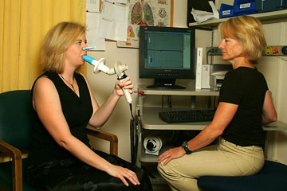
Spirometer
Two types
Traditional water seal type
Electrical computerized device
In either case, a graphic tracing is done – known as spirogram.

Slide 10
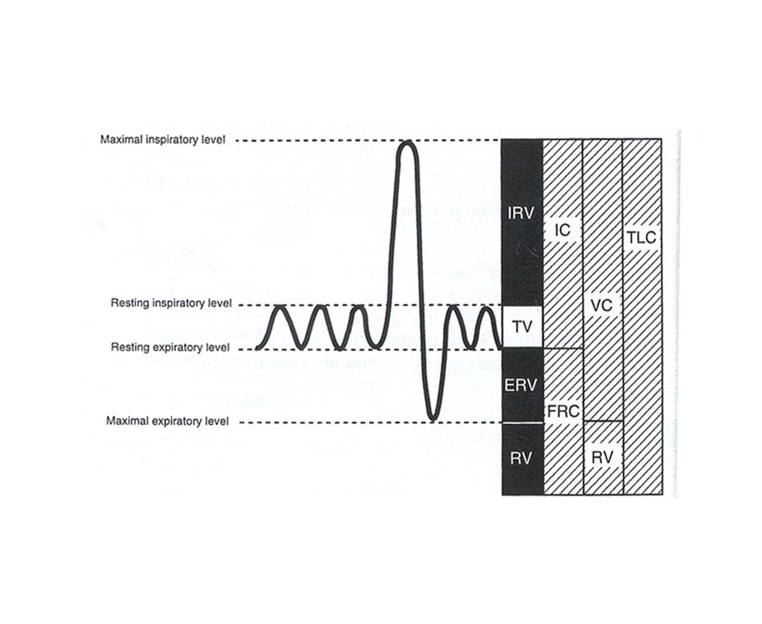
Spirogram

Slide 11
RV is not measured directly with the spirometer
So RV= FRC-ERV
Common method to measure RV are
Nitrogen washout method.
Helium dilution method.
Total body plethysmography.

Slide 12
Tests of gas flow rates
Tests that measures air flow rates during forced breathing maneuvers, provides an imp info relating to the functions of the lung, the degree of impairment & sometimes the location of the problem (larger or smaller airways)

Slide 13
FVC
Max volume of air expired after a max inspiration.
Imp for the diagnosis of obstructive & restrictive dz.
VC= TV+ERV+IRV
Normal- 3.1-4.8 Lit. OR 60-70 ml/kg

Slide 14
FEV1
FEV1%= FEV1
FVC
FEV3%
PEFR
FEF25-75 - Sensitive & important indicator of obstruction of small distal airways.

Slide 15
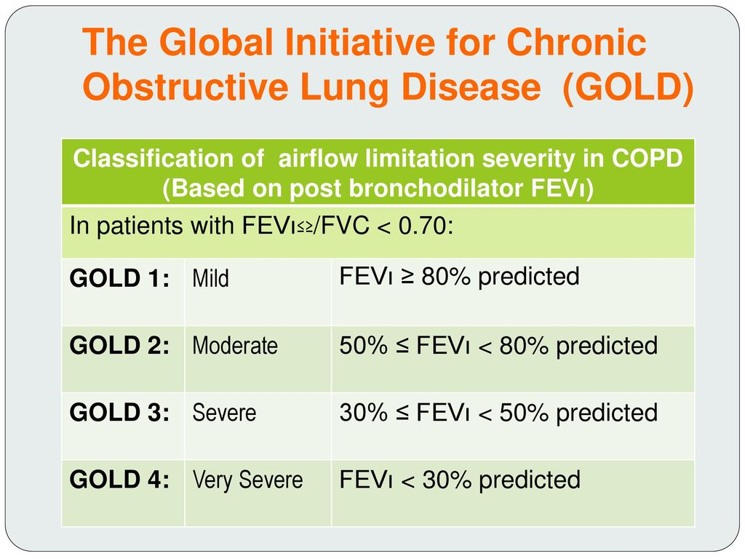

Slide 16
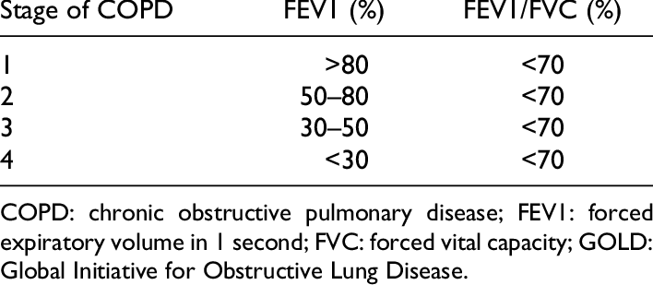
In simple language
Gold classification

Slide 17
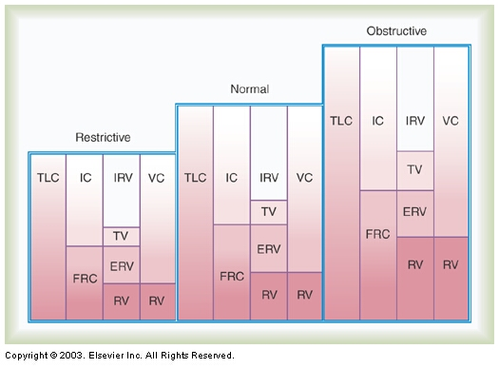

Slide 18
Tests of gas exchange
A) Alveolar-arterial po2 gradient
B) Diffusion capacity
C) Gas distribution tests - single breath
D) ventilation – perfusion tests
A) ABG
B) Single breath CO₂ elimination test
C) Shunt equation

Slide 19
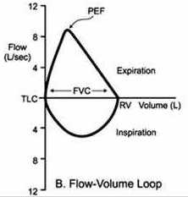
Flow-volume loops
Flow-volume loops is a plot of inspiratory and expiratory flow in the vertical axis against volume in the horizontal axis, during the performance of maximally forced inspiratory and expiratory maneuvers.
Loops in various types of respiratory problems is shown in next slide.

Slide 20
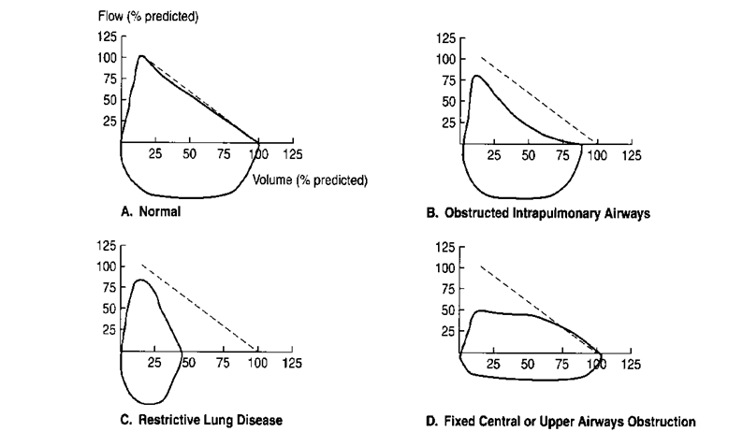

Slide 21
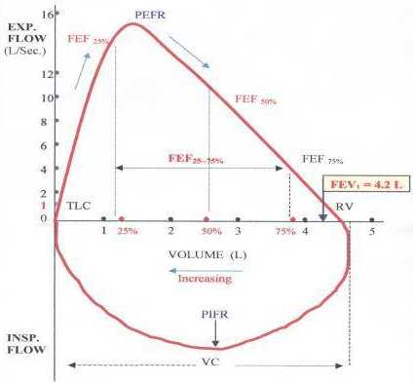

Slide 22
Exercise testing
6 minute walk test – It is also one of the way of assessing pulmonary function.
At the end of the test, we can have idea about pts functional capacity, which is related to pulmonary function.

