Slide 1
Geriatrics –Physiology of Aging, Environmental changes and adaptations, Balance and falls, Physiotherapy management, Role of Physiotherapy in prolonged bed rest and in home for aged
Community Physiotherapy and Rehabilitation

Slide 2
Objectives
At the end of the Lecture the students will be able to:
Revise about Physiology of Aging
Describe about Environmental Changes and adaptations that occur with aging
Correlate Balance & Falls with Aging
Describe about Role of Physiotherapy Mx in the Aging Population, in prolong bed rest & in home for aged.

Slide 3

Gerontology
Gerontology• This is the study of the aging process itself. The study of physical and psychological changes which are incident to the old age is called gerontology.
Geriatrics • Geriatrics is the branch of internal medicine that focuses on health care of the elderly. It aims mainly to promote health and to diagnosis , prevent and treat diseases and disabilities in older adults.

Slide 4
AGING
Aging can be defined as a progressive and generalized impairment of function resulting in the loss of adaptive response to stress and increased risk of age related diseases.
The overall effect of these alterations is an increase in the probability of declining health and dying.
It is the accumulation of Irreversible changes in a person over time. Ageing in humans refers to a multidimensional process of physical, psychological, and social changes.

Slide 5
Age-Related Physiological Changes
…all people age, but not at the same rate

Slide 6
At age 75, the average person, compared to age 30:
92% of brain weight
84% of basal metabolism
70% kidney filtration rate
43% of maximul breathing capacity
We are not the people we once were!

Slide 7

Physiological Changes occurs in the Elderly
Skin
Nails
MusculoSkeletal system changes
Gastrointestinal System
Respiratory System
Cardiac Changes
Urinary System
Vision

Slide 8
COMMON GERIATRIC DISORDERS PT Cases
Cardiovascular disorders: hypertension, CHD, heart failure.
Respiratory disorders : asthma, COPD
Neurological and cognitive conditions: Stroke, Parkinson's disease, dementia, delirium, Alzheimer,depression, fear of falling
Musculoskeletal: osteoporosis, OA, RA, falls, fracture, incontinence
Integumentary conditions: Pressure ulcers, diabetic ulcers, venous stasis ulcers, herpes zoster, malignant tumors

Slide 9
Definition of elderly
Most developed world countries ( including USA) have accepted the chronological age of 65 years as a definition of 'elderly' or older person,
this definition is somewhat arbitrary.
there is no United Nations standard numerical criterion, but the UN agreed cutoff is 60+ years to refer to the older population.
Notes:
Geriatric health problem may occur early at 50s and older athletes may in their 40s

Slide 10
Classification of elderly
PT. is aimed at primary prevention of diseases
PT is concentrated on achievement of human comfort
Young old (60,65–75).
Old (75–85)
Old- old (85+)
PT is directed at the improvement in function status

Slide 11
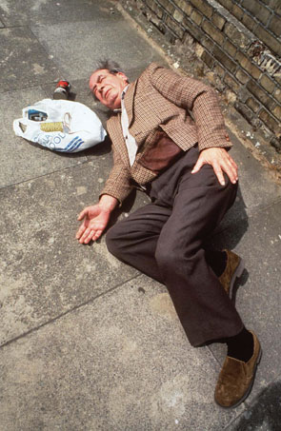
Definition of Falls
Falls is an event which result in a person coming to rest on the ground or another lower level with or without loss of consciousness or injury.

Slide 12
Incidence of falls
Falls are the sixth leading cause of death in older adults.
About 25% of person aged 70 years .It increase to 35% for people aged 75 years and older .
Between one –half and two third of institutionalized elderly people experience fall every years .
Falls occur approximately 25 to 33% of community dwelling older adult
50 to 67% of nursing home resident experience falls.

Slide 13
Risk factors of falls
Intrinsic risk factors:
Age Related changes
Diseases (medical problems).
Female sex .

Slide 14
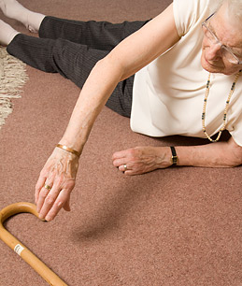
Extrinsic risk factors
    Drugs:
Such as cardiac medication, CNS depressant, laxative, antihypertensive, Narcotic, Chemotherapy drugs, narcotic and oral hypoglycemic .
    Environmental
    Improper assistive devices

Slide 15
Consequence of falls
Physical consequences:
    Skin tear and internal bleeding, subdural hematoma.
    Falls result in physical injures, disability and death
    Sever injures that require hospitalization.
    Hypothermia, dehydration, bronchial pneumonia and pressure damage to the skin .
    Hip fracture one of the most serious injures resulting annually more than 233,000 hip fracture
    Immobilization

Slide 16
Psychological consequences
Fear of falling can itself be debilitating. It can lead to restricted activity, decreased exercise, eventually to increased dependency, depression, anxiety, loss of confidence, social withdrawal and institutionalization.
Older adults who fall may or may not experience psychological trauma post fall (falls phobia syndrome) one significant consequences of falling may be fear of falling aging .
Economic consequences

Slide 17
Geriatric physical therapy role
The primary goal of geriatric physical therapy is to prevent, maintain or rehabilitate an impairment or functional limitation, which is accomplished with the application of evidence-based scientific principles.
Assisting the individual to return to optimal living within their capabilities.
To achieve the highest level of functional mobility as possible within their environment while maintaining safety.
Enabling the older adult to enjoy a longer life by living it more independently and with less pain.
Notes:
Main goal improved function

Slide 18

Essential Competencies in the Care of Elderly
Health Promotion and Safety
evaluation and assessment
Care Planning and Coordination Across the Care Spectrum (Including End-of- Life Care
Interdisciplinary and Team Care
Caregiver Support
Healthcare Systems and Benefits
Notes:
Essential Competencies in the Care of Older Adults according to Partnership for Health in Aging (PHA) by the American Geriatrics Society, including the APTA and Include 6 domains
that clarify the skills essential for a physical therapist to provide competent physical therapy care to older adults within each domain and for each PHA competency.

Slide 19
Geriatric physical therapy settings
Inpatient medical rehabilitation (rehabilitation units in acute care or rehabilitation hospitals, long term care, nursing-home rehabilitation)
Outpatient:
(primary care, private practice, etc).
Home health rehabilitation.

Slide 20

Indications for geriatric PT referral
Recent fall or history of falls
Deficits in strength or range of motion
Loss of mobility or ambulation requiring an assistive device
Musculoskeletal pain
Difficulty with transfers
Orthotic or prosthetic needs
Open wound
Neurological disorder
Balance deficits
Decreased endurance for ADLs
Bed bound status
Need for adaptive equipment to enhance safety and function

Slide 21

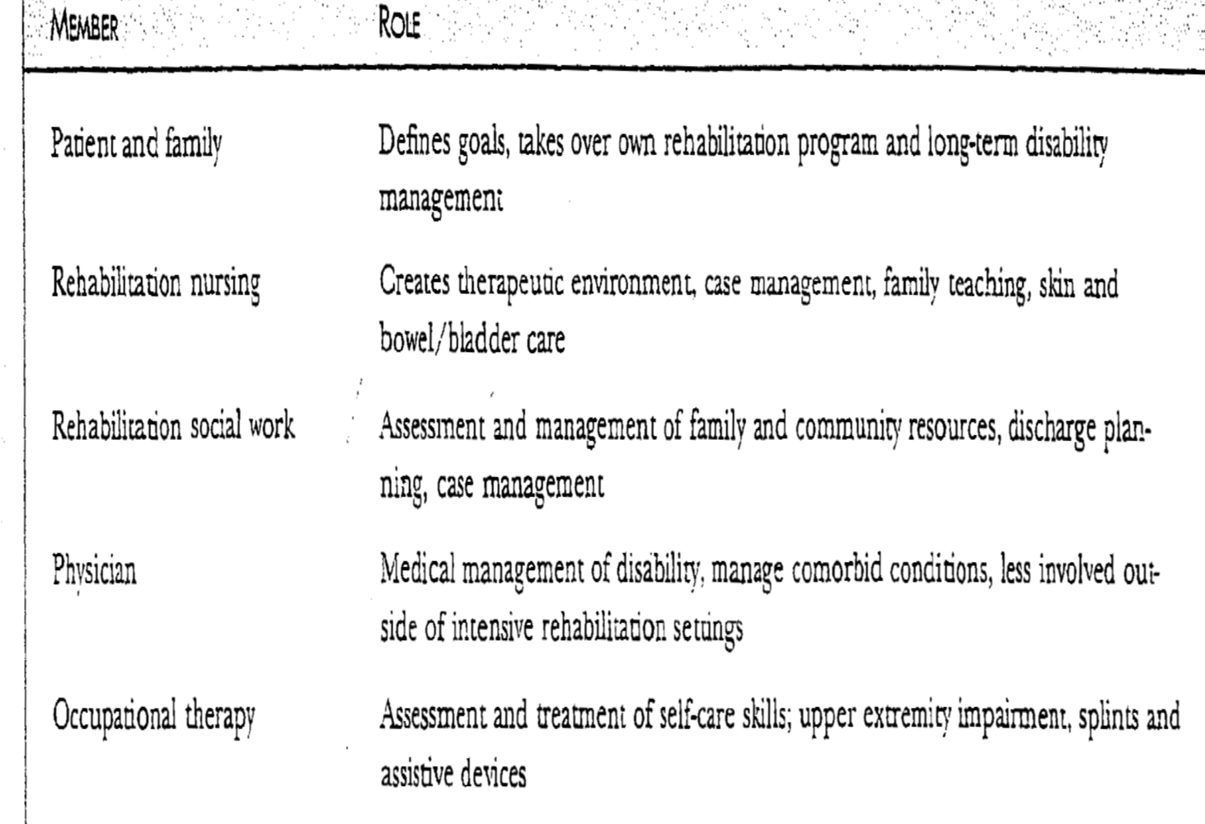
Geriatric Rehabilitation team

Slide 22
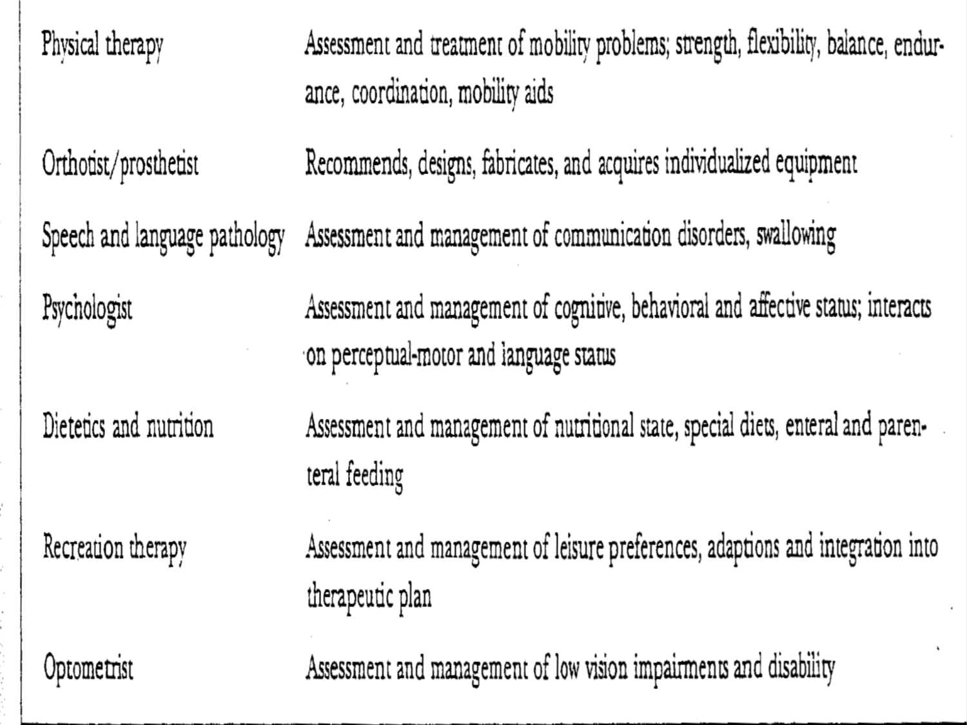
Geriatric Rehabilitation team

Slide 23
Thank you

