Slide 1
Health delivery system – 3 tier
Dr. Deepak Kumar
Assistant professor
COP,SV

Slide 2
Objectives
At the end of the lecture the students will be able to:
Describe about 3 tier health delivery system at Central, State and Local level
Describe about 3 tier health delivery system at Primary, Secondary and tertiary health care levels

Slide 3
Since health is influenced by a number of factors such as adequate food, housing, sanitation, healthy life style, protection against environmental hazards and communicable diseases, the frontiers of health extends beyond the narrow limit of medical care. it is thus clear that health care implies more than medical care.

Slide 4
India is a union of 28 states and 7 union territories.
States are largely independent in matters relating to the delivery of health care to the people. Each state has developed its own system of health care delivery, independent of the Central Government.
The Central Government responsibility consists mainly of policy making, planning, guiding, assisting, evaluating and coordinating the work of the State Health Ministries.

Slide 5
The health system in India has 3 main links
Central
Local or peripheral
State

Slide 6
At the central level
The official “organs” of health system at national level are
The Ministry of Health and Family welfare
The directorate general of Health Services (DGHS)
The central council of health and family welfare

Slide 7
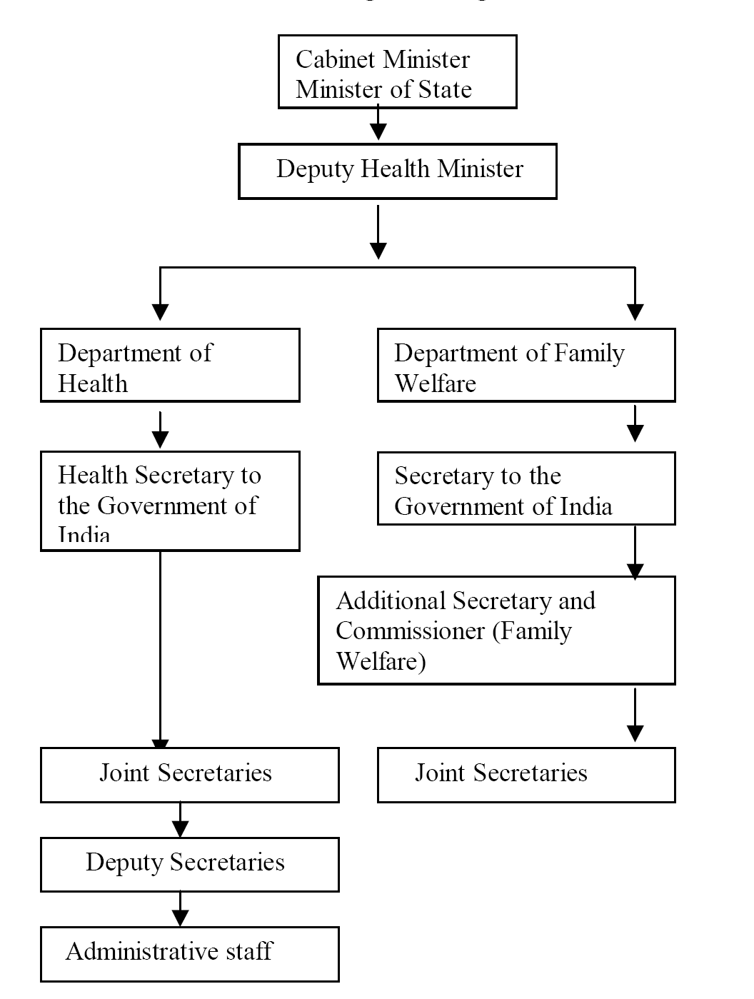
Union Ministry of Health and Family Welfare.
Organization Structure

Slide 8
Functions
Union list
International health relations and administration of port quarintine
Administration of Central Institutes like National institute for the control of communicable diseases, Delhi
Promotion of research
Regulation and development of medical, pharmaceutical, dental and nursing professions
Establishment and maintenance of drug standards
Census and collection and publication of other statistical data
Coordination with states and other ministries for promotion of health

Slide 9
Concurrent List:
Prevention of Communicable disease
Prevention of foodstuff adulteration
Control of drugs and poisons
Vital statistics
Labour welfare
Economic and social planning
Population control and family planning

Slide 10
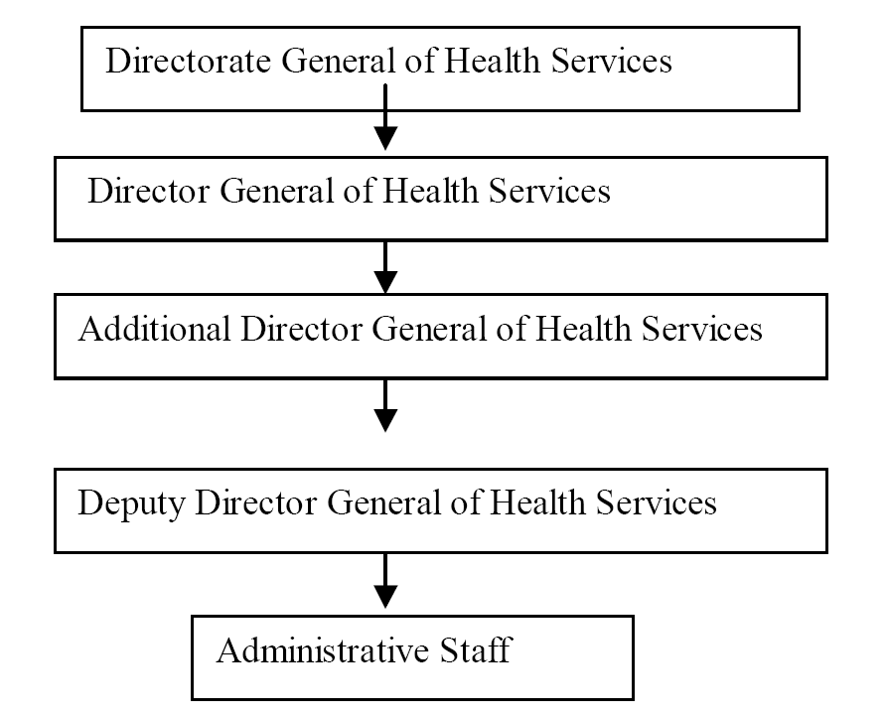
Directorate General of Health Services (DGHS)
Organization chart

Slide 11
Functions
General functions
Surveys
Planning
Coordination
Programming and appraisal of all health matters
Specific function
International health relations and quarantine of all major ports in country and international airport.
Control of drug standards (Drug Control Organisation)
Maintain medical store depots
Administration of post graduate training programmes

Slide 12
Administration of certain medical colleges in India
Conducting medical research through Indian Council of Medical Research ( ICMR )
Central Government Health Schemes.
Implementation of national health programmes
Preparation of health education material for creating health awareness through Health Education Bureau
Collection, compilation, analysis, evaluation and dissemination of information
National Medical Library

Slide 13
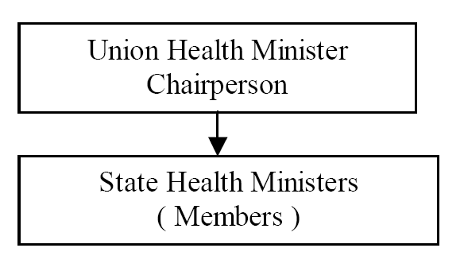
Central Council of health
Organization chart

Slide 14
Functions
To consider and recommend broad outlines of policy related to matters concerning health like environment hygiene, nutrition and health education.
To make proposals for legislation relating to medical and public health matters.
To make recommendations to the Central Government regarding distribution of grants-in-aid.

Slide 15
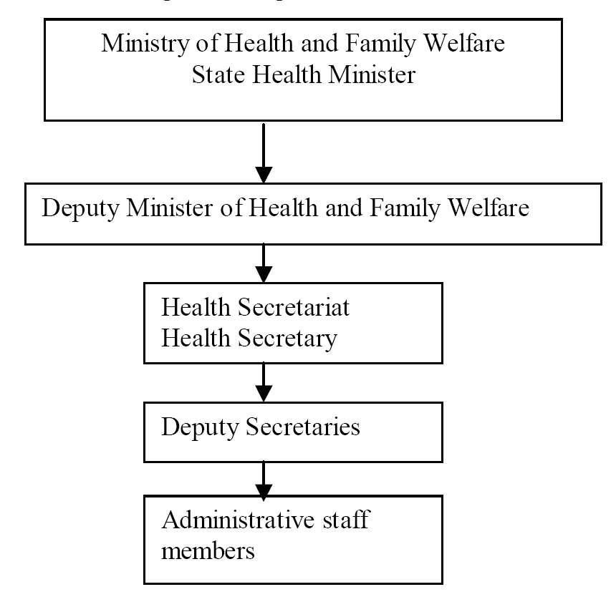
State Level

Slide 16
Functions of state health Director:
(1) Studies in depth the health problem and needs in the state and plans scheme to solve them
(2) Providing curative & preventive services
(3) Provision for control of milk and food sanitation
(4) Prevention of any outbreak of communicable diseases
(5) Promotion of health education
(6) Promotion of health programmes such as school health, family planning, Occupational health
(7) Supervision of PHC
(8) Establishing training courses for health personnel
(9) Co-ordination of all health services with other minister of state such as minister of education, central health minister &voluntary agency

Slide 17
At District level
There are 614 ( year 2007 census) districts in India. Within each district, there are 6 types of administrative areas.
  1. Sub –division(2 or more)
  2. Tehsils ( Talukas )
  3. Community Development Blocks
  4. Municipalities and Corporations
  5. Villages and
  6. Panchayats

Slide 18
Districts
Tehsils /Talukas (200-600 villages)
Town Area Committee (5,000-10,000 Pop)
Community Development Blocks (approx 100 Villages & 80,000 -1.2 Lac Pop)
Municipal Board (10,000- 2 Lac Pop)
Municipalities & Corporations
Villages
Corporations (> 2 lac pop)
Panchayats

Slide 19
Most district in India are divided into two or more subdivision, each incharge of an Assistant Collector or Sub Collector
Each division is again divided into talukas, incharge of a Thasildhar. A taluk usually comprises between 200 to 600 villages
The community development block comprises approximately 100 villages and about 80000 to 1,20,000 population, in charge of a Block Development Officer.
Finally, there are the village panchayats, which are institutions of rural local self-government.

Slide 20
The urban areas of the district are organized into
Town Area Committees (in areas with population ranging between 5,000 to 10,000
Municipal Boards (in areas with population ranging between 10,000 and 2,00,000)
Corporations (with population above 2,00,000)
The Town Area Committees are like panchayats.They provide sanitary services.
The Municipal Boards are headed by Chairmen /President, elected by members.

Slide 21
The functions of Municipal Board:
Construction and maintenance of roads
Sanitation and drainage
Street lighting
Water supply
Maintenance of hospitals and dispensaries
Education and
Registration of births and deaths etc
The Corporations are headed by Mayors, elected by councillors, who are elected from different wards of the city. The executive agency includes the commissioner, the secretary, the engineer and the health officer.
The activities are similar to those of municipalities, on a much wider scale.

Slide 22
Panchayati Raj -
The panchayati raj is a 3-tier structure of rural local self-government in India linking the village to the district. It includes
Panchayat (at the village level)
Panchayat Samiti ( at the block level)
Zila Parishad (at the district level)

Slide 23
(1) Panchayat (at the village level):
The Panchayat Raj at the village level consists of
The Gram Sabha
The Gram Panchayat
The Gram Sabha:
It is the assembly of all the adults of the village, which meets at least twice a year. The gram sabha considers proposals for taxation,and elect members of The Gram Panchayat.

Slide 24
The Gram Panchayat
It is the executive organ of the gram sabha and an agency for planning and development at the village level. The population covered varies from 5000 to 15000 or more.
The members of panchayat hold offices for a period of 3to4 years. Every panchayat has an elected president (Sarpanch or Sabhapati or Mukhia), a vice president and panchayat secretary.
It covers the civic administration including sanitation and public health and work for the social and economic development of the village

Slide 25
(2) Panchayat Samiti (at the block level):
The block consists of about 100 villages and a population of about 80,000 to 1,20,000. The panchayat samiti consists of Sarpanch, MLAs, MPs residing in block area, representative of women, SC, ST and cooperative socities. The primary function of The Panchayat Samiti is the execute the community development programme in the block. The Block development Officer and his staff give technical assistance and guidance in development work.

Slide 26
(3) Zila Parishad (at the district level):
The Zila Parishad is the agency of rural local self government at the district level . The members of Zila parishad include all heads of panchayat samiti in the district, MPs, MLAs, representative of SC, ST and women and 2 persons of experience in administration, public life or rural development. Its functions and powers vary from state to state.

Slide 27
Health care systems
Intended to delivery healthcare services and represented by five major sectors different from each other by health technology
Public health sector
Primary health care
  Primary health centres
  Sub centres
Hospitals/Health centres
  Community health centres
  Rural hospitals
  District hospitals/health centres
  Specialist hospitals
  Teaching hospitals
Health insurance schemes
  Employees State Insurance
  Central Govt. Health Schemes
Other agencies
    Defense services
    Railways

Slide 28
Private sector
  • Private hospitals
  • Independent clinics
  • 70% general practitioners
  • Highly unorganized, concentrated in urban areas
  • Provide mainly curative services
  • MCI, IMA regulate some functions and activities
Indigenous system of medicine
Ayurveda and Siddha
Unani and Tibbi
Homeopathy
Unregistered practitioners-Provide bulk of medical care to rural people
National Institute of Ayurveda
National Institute of Homeopathy
Govt studying how these can be best utilized for more effective health coverage

Slide 29
4. Voluntary health agencies
  1. Indian Red Cross Society
  2. Hind Kusht nivaran sangh
  3. Indian council for child welfare
  4. Tuberculosis association of India
  5. Bharat sevak samaj
  6. Central social welfare board
  7. The kasturba memorial fund
  8. The All‐India blind relief society
  9. Professional bodies
  10. International agencies

Slide 30
5. National health programmes
    1. Anti‐malaria programme
    2. National filaria control programme
    3. Kala‐azar control programme
    4. Japanese encephalitis control
    5. Dengue control
    6. National Leprosy‐eradication programme
    7. National tuberculosis programme
    8. National AIDS control programme
    9. National programme for control of blindness
    10. Iodine deficiency programme
    11. Universal immunization programme
    12. Reproductive and child health programme
    13. National caner control programme

Slide 31
Levels of health care
Secondary health care
Primary health care
Primary Health care
Provided at the community level
Sub centers, PHC,
Secondary health care
Provided at CHC, DH etc.
Tertiary health care
Provided at hospitals
Tertiary health care

Slide 32
Primary health care in India
In 1977, GOI launched Rural Health Scheme based on the principle of “placing people’s health in people’s hand”
Subsequently in the international conference of Alma-Ata(1978) the goal of “Health for all” by 2000 through primary health care approach was set.
Keeping in view WHO “Health for all” by 2000 GOI formulated National health policy 2002

Slide 33
More recently GOI formulated NRHM,URHM and Indian Public Health Standards (IPHS) in this regards
In order to provide quality care in the public health agencies of health care delivery IPHS are being prescribed.
These standards provides basic promotive, preventive and curative primary health care to the community and……
…….achieve and maintain an acceptable quality of care
These standards would help monitor and improve functioning of the health care delivery system

Slide 34
Definition
Primary health care is essential health care made universally accessible to individuals and acceptable to them through their full participation and at a cost the community and country can afford

Slide 35
Primary Health Care includes:
  Primary Care (physicians, midwives & nurses);
  Health promotion, illness prevention;
  Health maintenance & home support;
  Community rehabilitation;
  Pre-hospital emergency medical services
  Coordination and referral to other areas of health care

Slide 36
It is the first level of contact with the health system to promote health, prevent illness, care for common illnesses, and manage ongoing health problems.
Primary Health Care involves concerted effort to provide rural population of developing countries with least bare minimum of health services
Some services are also provided by community and hospitals
Primary Health Care is different in each community depending upon:
  Needs of the residents;
  Availability of health care providers;
  The communities geographic location; &
  Proximity to other health care services in the area.

Slide 37

Elements of primary health care
Education about prevailing health conditions and methods to prevent and control them
Promotion of food supply and proper nutrition
Adequate water supply and basic sanitation
Maternal and child health care with family planning
Immunization against major infectious diseases
Prevention and control of locally endemic diseases
Appropriate treatment of common diseases and injuries
Provision of essential drugs

Slide 38




Principles of primary health care
Equitable distribution
Community participation
Intersectoral coordination
Appropriate technology

Slide 39
Rural Health care system in India
Community Health Centre (CHC)
A 30 bedded Hospital/ Referral unit for 4 no. of PHCs with specialized Health Services
Primary Health Centre (PHC)
A Referral unit for 4-6 Subcentres; 4-6 bedded manned with a Medical Officer in-charge and 14 subordinate paramedical staff no. of PHCs with specialized Health Services
Sub Centre (SC)
Most peripheral contact point of community with Primary Health Care system; manned with one MPW(M) and MPW(F)

Slide 40
Rural Health care system in India
The health care infrastructure in rural areas has been developed as a three tier system and is based on the above population norms.
Health Facility | Population Norms
 | Plain Area | Hilly/Tribal/Difficult Area
Sub-Centre | 5000 | 3000
Primary Health Centre | 30,000 | 20,000
Community Health Centre | 1,20,000 | 80,000

Slide 41
Sub Center
The most peripheral and first contact point between the primary health care system and the community.
The Ministry of Health & Family Welfare is providing 100% Central assistanc
They are established on the basis of
  One SC for every 5,000 pop in general and…
  One SC for every 3,000 pop in hilly, tribal and backward area
Each Sub-Centre is manned by one Male and one female Health Worker.
One Lady Health Worker (LHV) is entrusted with the task of supervision of six Sub-Centers.

Slide 42
Sub Centre are assigned tasks relating to interpersonal communication
…..in order to bring about behavioral change and provide services in relation to….
  Maternal and child health,
  Family welfare,
  Nutrition,
  Immunization,
  Diarrhea control and
  Control of communicable diseases programmes.
The sub centre are provided with basic drugs for minor ailments.

Slide 43
Primary Health Center
PHC is the first contact point between village community and the Medical Officer.
The PHCs were envisaged to provide an integrated curative and preventive health care to the rural population with emphasis on preventive and promotive aspects of health care.
The PHCs are established and maintained by the State Governments.
At present, a PHC is manned by a Medical Officer supported by 14 paramedical and other staff.

Slide 44
It acts as a referral unit for 6 SubCentres.
It has 4 - 6 beds for patients.
The activities of PHC involve curative, preventive, primitive and Family Welfare Services.
National Health Plan (1983) proposed reorganization of PHCs on the basis of….
One PHC for every…..30,000 pop in Rural areas
One PHC for every…..50,000 pop in Urban areas

Slide 45
Functions of PHCs
Medical care
Health programmes
MCH care and family planning
Health education and training
Referral services
Safe water supply and basic sanitation
Prevention and control of locally endemic diseases
Collection and reporting of vital events
Basic laboratory services

Slide 46
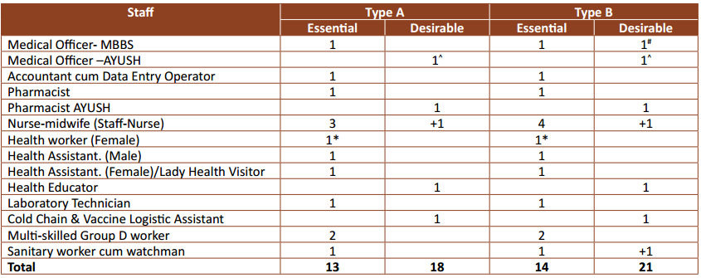
Staffing of PHCs

Slide 47
Community Health Center (CHC)
These were established by upgrading the primary health centers
CHCs are being established and maintained by the State Government.
centers, each community health center should cover a population of 8000 to 1.2 lakh
It is manned by four medical specialists i.e. Surgeon, Physician, Gynecologist and Pediatrician and….
……supported by paramedical and other staff.
It has 30 in-door beds with one OT, X-ray, Labour Room and Laboratory facilities.
It serves as a referral centre for 4 PHCs and also provides facilities for obstetric care and specialist consultations.

Slide 48
Functions of CHCs
Care of Routine and Emergency Cases in Surgery
  Dressings, I&D, and surgery for Hernia, Hydrocele, Appendicitis etc.
  Emergencies like Intestinal Obstruction, Haemorrhage, etc.
  Other management including nasal packing, tracheostomy, foreign body removal etc.
  Fracture reduction and putting splints/plaster cast.
  Conducting daily OPD.
Care of Routine and Emergency Cases in Medicine
  Daily OPD
  Handling all the emergency and routine cases

Slide 49
Maternal Health
  Minimum 4 ANC check ups including Registration & associated services
    1st visit: Within 12 weeks—preferably as soon as pregnancy
    2nd visit: Between 14 and 26 weeks
    3rd visit: Between 28 and 34 weeks
    4th visit: Between 36 weeks and term
  24 hr delivery services including normal and assisted delivery and cesarean section
  Managing labour using Partograph.
  Minimum 48 hours of stay after delivery, 3-7 days stay post delivery for managing Complications

Slide 50
Newborn Care and Child Health
  Essential Newborn Care and Resuscitation
  Counseling on Infant and young child feeding
  Routine and emergency care of sick children
  Full Immunization of infants and children against VPDs
  Management of Malnutrition cases.
Family Planning
  Counseling, provision of Contraceptives, NSV, Laparoscopic Sterilization Services and their follow up.
  Safe Abortion Services

Slide 51
All National Health Programmes delivered through CHCs
School health services
Others
  Blood storage facility
  Essential laboratory services
  Referral (transport) services
Maternal Death review (MDR)

Slide 52
Secondary Health Care
Secondary Healthcare refers to a second tier of health system, in which patients from primary health care are referred to specialists in higher hospitals for treatment.
In India, the health centres for secondary health care include District hospitals and Community Health Centre at block level within the public health system.
Secondary care is the health care services provided by medical specialists, dental specialists and other health professionals who generally do not have first contact with patients: for example, cardiologists, urologists, dermatilogist, and oral and maxillofacial surgeons.

Slide 53
It includes acute care: necessary treatment for a short period of time for a brief but serious illness, injury or other health condition, such as in a hospital emergency department. It also includes skilled attendance during childbirth, intensive care, and medical imaging services.
The term "secondary care" is sometimes used synonymously with "hospital care". However, many secondary care providers do not necessarily work in hospitals, such as psychiatrists, clinical psychologists, occupational therapists, most dental specialties or physiotherapists (physiotherapists are also primary care providers, and a referral is not required to see a physiotherapist), and some primary care services are delivered within hospitals

Slide 54
Depending on the organization and policies of the national health system, patients may be required to see a primary care provider for a referral before they can access secondary care.
Allied health professionals, such as physical therapists, respiratory therapists, occupational therapists, speech therapists, and dieticians, also generally work in secondary care, accessed through either patient self-referral or through physician referral.

Slide 55
Tertiary Health Care
Tertiary Health care refers to a third level of health system, in which specialized consultative care , usually for inpatients and on referral from a primary or secondary health professional is provided.
Specialised Intensive Care Units, advanced diagnostic support services and specialized medical personnel on the key features of tertiary health care.
In India, under public health system, tertiary care service is provided by medical colleges and advanced medical research institutes.

Slide 56
Examples of tertiary care services are cancer management, neurosurgery, cardiac surgery, plastic surgery, treatment for severe burns, advanced neonatology services, palliative, and other complex medical and surgical interventions

Slide 57
1. DGHS works at
A. National level B. state level C. district level D. none of them
2. Tertiary Health care system in public health consist
A. Medical colleges B. district hospitals C. community health centre D. primary health center
3.National medical library is controlled by
A. Central council B.DGHS C. state health ministry D.The Ministry of Health and Family welfare

Slide 58
4.The community development block comprises approximately
A. 100 villages B. 200 villages C. 300 villages D. 150 villages
5. National health mission is a part of
A. Primary health care B. secondary health care C. tertiary health care D. none of them

