Slide 1
DEPARTMENT OF MANAGEMENT
HUMAN RESOURCE MANAGEMENT
CH-6 RECRUITING HR
Dr. Subhasish Chatterjee

Slide 2
TOPICS
Introduction
Nature of recruitment
Purposes of recruitment
Factors of recruitment
Recruitment process
Searching
Screening
Evaluation and control
Conclusion

Slide 3
INTRODUCTION
HRP helps determine the number and type of people a firm needs. Job analysis and job design specify the tasks and duties job and the qualifications expected from prospective job holders.
The next logical step is to hire the right number of people of the right type to fill the jobs. Hiring involves two broad groups of activities: (1) recruitment and (2) selection.

Slide 4


Slide 5
NATURE OF RECRUITMENT
Recruitment is understood as the process of searching for and obtaining applicants for jobs, from among whom the right people can be selected.
Recruitment involves attracting and obtaining as many applications as possible from eligible job-seekers.

Slide 6
PURPOSES OF RECRUITMENT
The general purpose of recruitment is to provide a pool of potentially qualified job candidates.
1) Determine the present and future requirements of the firm in conjunction with its personnel-planning and job-analysis activities.
2) Increase the pool of job candidates at minimum cost.
3) Help increase the success rate of the selection process by reducing the no. of visibly underqualified or overqualified job applicants.

Slide 7
4) Help increase the probability that job applicants, once recruited and selected, will leave the organization only after a short period of time.
5) Meet the organization’s legal and social obligations regarding the composition of its workforce.
6) Begin identifying and preparing potential job applicants who will be appropriate candidates.
7) Increase organizational and individual effectiveness in the short term and long short.
8) Evaluate the effectiveness of various recruiting techniques and sources for all types of job applicants.

Slide 8
FACTORS OF RECRUITMENT
It is key role and external visibility, recruitment is naturally subject to influence of several factors. These include external as well as internal forces.

Slide 9
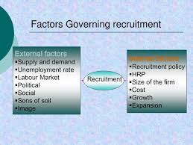
Factors influencing recruitment

Slide 10
RECRUITMENT PROCESS
Recruitment refers to the process of identifying and attracting job seekers so as to build a pool of qualified job applicants.
The process comprises five interrelated stages;
1. planning
2. Strategy development
3. Searching
4. Screening and
5. Evaluation and control

Slide 11
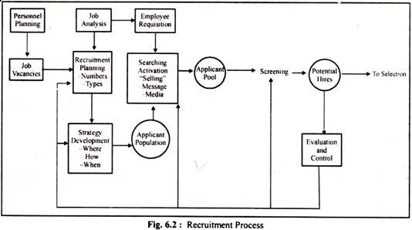

Slide 12
RECRUITMENT PLANNING
The first stage in the recruitment process is planning. Planning involves the translation of likely job vacancies and information about the nature of these jobs into a set of objectives or targets that specify the 1. number of contacts. & 2. type of applicants to be contacted.

Slide 13
Number of contacts
Organizations nearly always, plan to attract more applicants than they will hire. Some of those contacted will be uninterested, unqualified, or both. Each time a recruitment programme is contemplated, one task is to estimate the number of applicants necessary to fill all vacancies with qualified people.

Slide 14
Yield ratio
Yield ratios express the relationship of applicant inputs to outputs at various decision points.

Slide 15
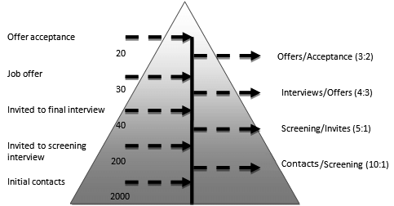
Recruiting yield pyramid

Slide 16
Type of contacts
These refers to the type of people to be informed about job openings. The type of people depends on the tasks and responsibilities involved and the qualifications and experience expected.

Slide 17
Strategy development
Once it is known how many and what type of recruits are required, serious consideration needs to be given to
‘make’ or ‘buy’ employees
technological sophistication of recruitment and selection devices.
geographic distribution of labour markets comprising job seekers.
sources of recruitment.
sequencing the activities in the recruitment process.

Slide 18
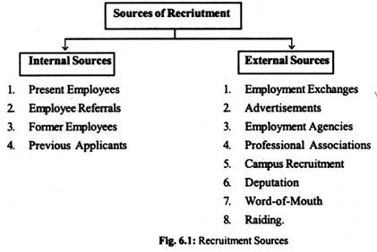

Slide 19
Evaluation of internal recruitment
There are three major advantages of internal recruitment.
It is less costly than external recruiting.
Firms typically have a better knowledge of the internal candidates’ skills and abilities than the ones acquired through external recruiting.
An organizational policy of promoting from within can enhance employees’ morale, organizational commitment and job satisfaction.

Slide 20
Disadvantages
the method simply perpetuates the old concept of doing things-that creative problem solving may be hindered by the lack of new talents.
Some companies complain of unit raiding in which divisions compete for the same people.
Politics probably has a greater impact on internal recruiting and selection then does external recruiting.
Thus, while more job-related information may be known about internal candidates, personnel decisions involving internal candidates are more likely to be affected by the political agenda of the decisions makers.

Slide 21
Evaluation of external recruitment
E-recruiting involves screening candidates electronically, directing potential hires to a special website online skill assessment, conducting background checks over the internet, interviewing candidates via videoconferecing , and managing the entire process with web-based software.

Slide 22
External sources of recruitment have both merits and demerits;
The firm will have the benefit of new skills, new talents and new experiences, if people are hired from external sources.
The management will be able to fulfill reservation requirements in favour of the disadvantaged section of the society.
Scope for resentment, heartburn and jealousy can be avoided by recruiting from outside.

Slide 23
Demerits
Better motivation and increased morale associated with promoting own employees are lost to the company.
External recruitment is costly.
If recruitment and selection processes are not properly carried out, chance of right candidates being rejected and wrong applicants being selected occur.

Slide 24
Application forms serve three useful purposes..
They are the records of applicants’ desire to obtain jobs;
They provide the interviewer with profiles of applicants which can be used in the interview;
They are the basic personnel records for applicants who later become employees.

Slide 25
SEARCHING
Once a recruiting plan and strategy are worked out, the search process can begin.
Search involves two-steps.
1. Source activation
sources and search methods are activated by the issuance of an epmployee requisition. This means that no actual recruiting takes place until line managers have verified that a vacancy does exist or will exist.

Slide 26
2. Selling
A second issue to be addressed in the searching process concerns communications.
Here, organizations walk a tightrop.
On hand, they want to do whatever they can to attract desirable applicants.
On the other, they must resist temptation of overselling their virtues.

Slide 27
SCREENING
Screening of applications can be regarded as an integral part of the recruiting process, though many view it as the first step in the selection process.
The purpose of screening is to remove from the recruitment process, at an early stage, those applicants who are visibly unqualified for the job. Effective screening can save a great deal of time and money.
Care must be exercised, however, to assure that potentially good employees are not lost and that women and minorities receive full and fair consideration & are not rejected without justification.

Slide 28
In screening, clear job specifications are invaluable. It is both a good practice and a legal necessity that applicants’ qualifications be judged on the basis of their knowledge, skills, abilities & interest required to do the job.
The techniques used to screen applicants vary depending on the candidate sources & recruiting methods used.

Slide 29
EVALUATION AND CONTROL
Evaluation and control is necessary as consideration costs are incurred in the recruitment process. The cost generally incurred are..
Salaries for recruiters.
Management & professional time spent on preparing job description, job specification, advertisements, agency liaison, & so forth.
Cost of advertisements or other recruitment methods, i.e. agency fees.

Slide 30
Cost of producing supporting literature.
Recruitment overheads and administrative expenses.
Costs of overtime and outsourcing while the vacancies remain unfilled.
Cost of recruiting suitable candidates for the selection process.

Slide 31
Evaluation of recruitment process
The recruitment process has the objective of searching for & obtaining applications from job-seekers in sufficient numbers & quality.
Return rate of applications sent out.
Number of suitable candidates for selection.
Retention & performance of the candidates selected.
Cost of the recruitment process.
Time lapsed data.
Comments on image projected.

Slide 32
Evaluation of recruitment methods
The evaluation of recruitment methods might include:
No. Of initial enquiries received which resulted in completed application forms.
No. Of candidates at various stages of the recruitment & selection process, especially those shortlisted.
No. Of candidates recruited.
No. Of candidates retained in the organization after six months.

Slide 33
Philosophies Of Recruiting
The traditional philosophy of recruiting has been to get as many people to apply for a job as possible.
A large no. Of jobseekers waiting in queues would make the final selection difficult, often resulting in wrong selection.
Job dissatisfaction & employee turnover are the consequences of this.
A persuasive agreement can be made that matching the needs of the organization to the needs of the applicants will enhance the effectiveness of the recruitment process.

Slide 34
The result will be a work force which is likely to stay with the firm longer & performs at a higher level of effectiveness.
Two approaches are available to bring about this match..
1) realistic job preview.
2) job compatibility questionnaire.

Slide 35
Realistic job previews
Realistic job preview (RJP) provides complete job-related information to the applicants so that they can make right decisions before taking up jobs.

Slide 36
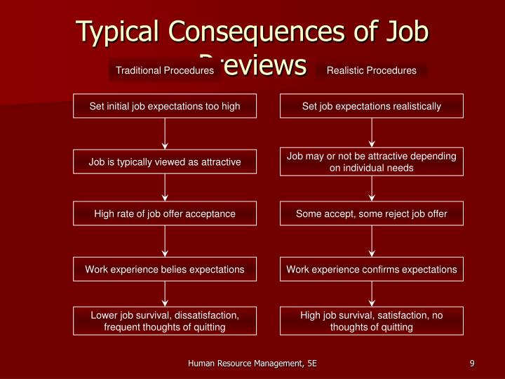

Slide 37
Job compatibility questionnaire
The JCQ was developed to determine whether an applicant’s preferences for work match the characteristics of the job.
The JCQ is designed to collect information on al aspects of a job which have a bearing on employee performance, absenteeism, turnover & job satisfaction.
The JCQ is administered to jobseekers who are very familiar with either a specific position to be filled and/or a target job under study. Respondents are asked to indicate the extent to which each JCQ item is descriptive of the job/position under study.

Slide 38
Alternatives to recruitment
Companies search for alternatives to recruitment because of the cost of recruiting. Three such alternatives to recruitment are overtime, employee leasing & temporary employment.
1. Overtime - when demand for product peaks, firm seeks to make present employees work overtime, instead of recruiting new hands.

Slide 39
2. Employee leasing - often called “staff outsourcing”, employee leasing involve paying fee to a leasing company or a consulting firm that handles the payroll, employee benefits & routine HR functions for the client company.
3. Temporary employment - one of the effect of downsizing is the use of employees on temporary basis.

Slide 40
CONCLUSION
Recruitment is the process of searching for & obtaining applications so as to build a pool of job seekers from whom the right people for the right jobs may be selected.
The purpose of recruitment is to build a pool of applicants. Recruitment represents the first contact a company makes with potential employees. Recruitment done well will result in better selection.

Slide 41
Recruitment is a five-steps process. The steps are..
Planning
Strategy development
Searching
Screening
Evaluation & control

Slide 42
The philosophy of attracting as many applicants as possible for given jobs guided recruitment activities in the past.
These days the emphasis is on matching the needs of the firm to the needs of the applicants. This would minimize employee turnover & enhance the satisfaction. Realistic job preview & job compatibility questionnaire help achieve this.

Slide 43


