Slide 1
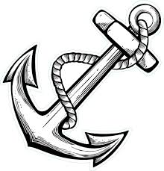

Anchorage
Dr. Romil Shah
Professor & PG Guide,
Dept. of Orthodontics and Dentofacial Orthopaedics,
KMSDC&H, SVDU

Slide 2
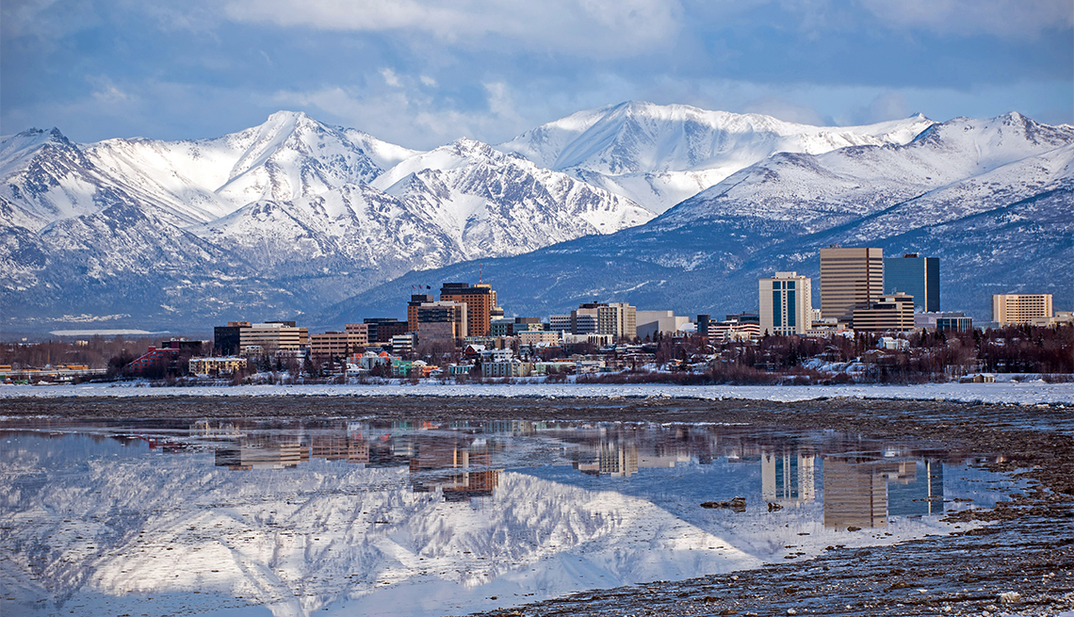
City in Alaska……………….

Slide 3
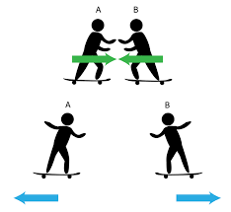
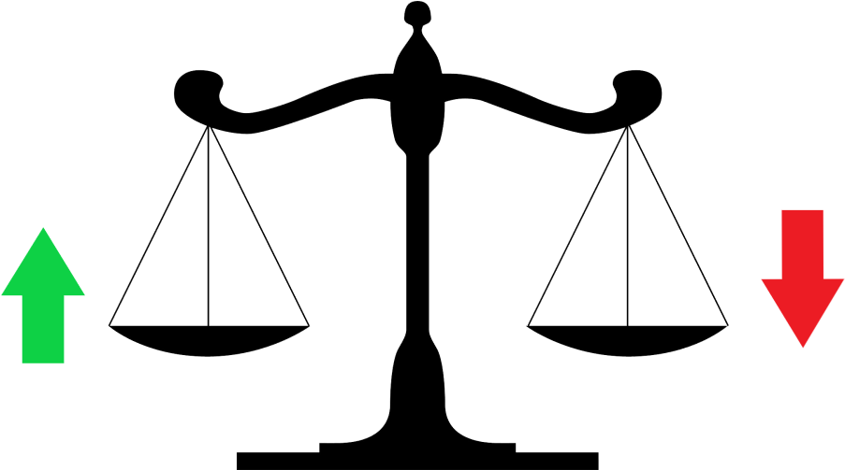
For every desired action there is an equal and opposite reaction
[Newton’s third low of motion].

Slide 4
Definition: anchorage is “Resistance to unwanted tooth movement” [Proffit].
Anchorage in orthodontics refers to the nature and degree of resistance to displacement offered by an anatomical unit when used for the purpose of effecting tooth movement [T.M.Graber].
Anchorage is the site of delivery from which a force is exerted [White and Gardiner].

Slide 5
TYPES OF ANCHORAGE [PROFFIT]
1. According to the manner of the force application
Simple anchorage.
Stationary anchorage.
Reciprocal anchorage.
2. According to the site where the anchor units
Intra oral anchorage.
Extra oral anchorage.
Muscular anchorage.

Slide 6
3. According to the jaws involved
Intra maxillary anchorage.
Inter maxillary anchorage.
4. According to numbers of anchor units
Single
Compound
reinforced

Slide 7
Outline of kinds of Anchorage
Single
Simple Compound
Intramaxillary Reinforced
Stationary
Reciprocal
Intra-oral
Simple
Intermaxillary - Stationary
Reciprocal
Cervical
Extra-oral - Occipital
Cranial
Facial

Slide 8
Simple Anchorage
Dental anchorage in which the manner and application of force tends to displace or change the axial inclination of tooth or teeth that form the anchorage unit in the plane of the space in which force is being applied.
The resistance of the anchorage unit to tipping is utilized to move another tooth or teeth.
Example: Removable Appliances

Slide 9
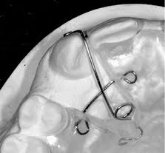
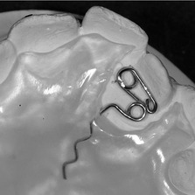
Simple Anchorage
(Removable Appliances)
Anchor Unit: Tipping
Retraction Unit: Tipping

Slide 10
Stationary Anchorage
Dental anchorage in which the manner and application of force tends to displace the anchorage unit bodily in the plane of space in which force is being applied is termed stationary anchorage.
The resistance of the anchorage unit to Bodily movement is utilized to move another tooth or teeth (Tipping).
Example: Fixed Orthodontic Appliance

Slide 11
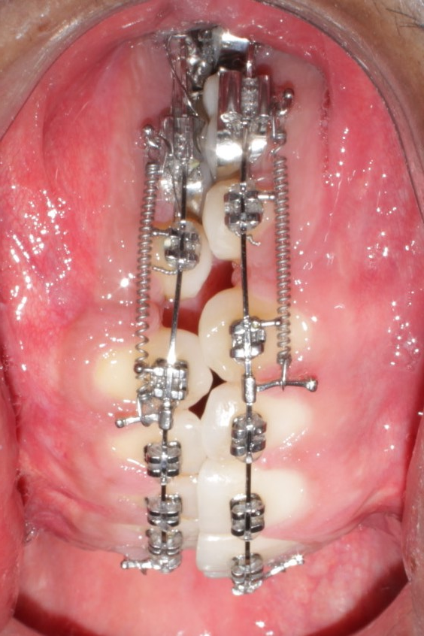
Stationary Anchorage
Anchorage Unit: Bodily Movement
Retraction Unit- Tipping / Bodily Movement

Slide 12
Reciprocal Anchorage
Anchorage in which the resistance of one or more dental unit is utilized to move one or more opposing dental unit is reciprocal anchorage.
Here both resistance units are malposed and the dissipation of Equal and Opposite Force tends to move each unit towards more normal occlusion.

Slide 13
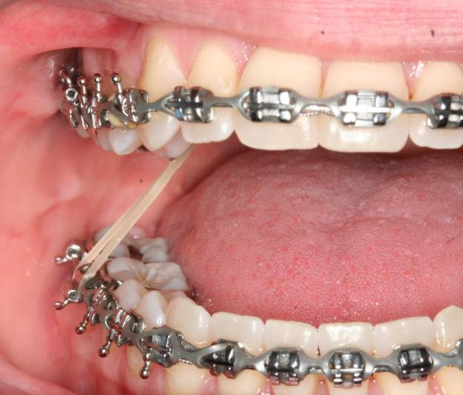
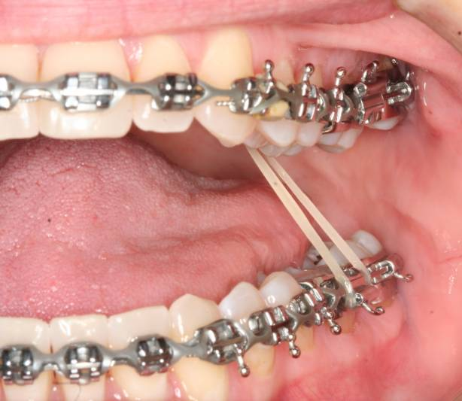
Reciprocal Anchorage
Cross Elastics

Slide 14
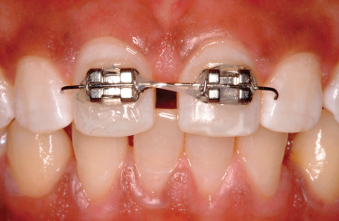
Correction of Midline Diastema

Slide 15
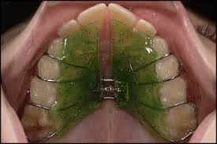
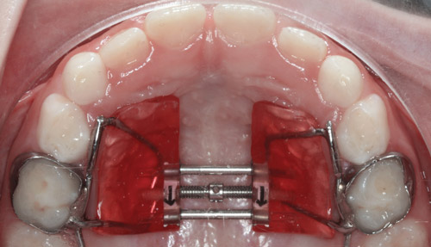
Reciprocal Anchorage
Slow maxillary expansion
Rapid Maxillary Expansion

Slide 16
Compound Anchorage
These type of anchorage provides for the use of more teeth with greater anchorage potential to move a tooth or teeth with lesser support.

Slide 17
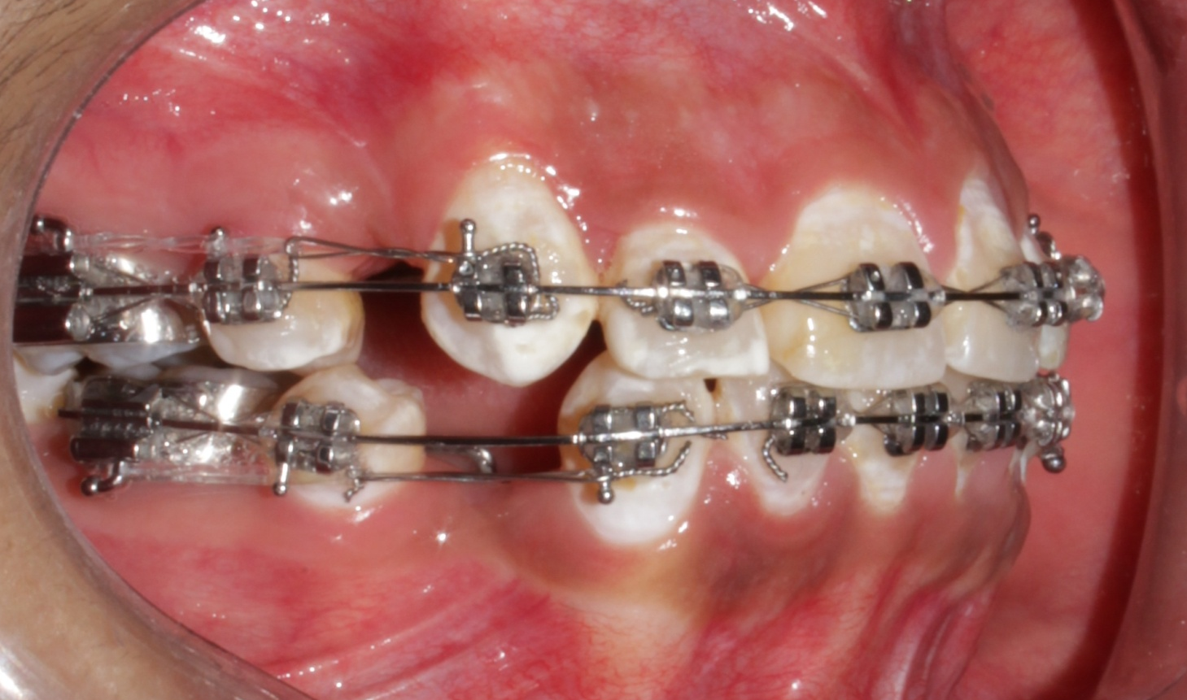
Individual Canine Retraction

Slide 18
Reinforced Anchorage
Here the anchorage units are reinforced by the use of more than one type of resistance units.
Example: use of Trans-Palatal Arch or Lingual Arch with routine fixed therapy.

Slide 19
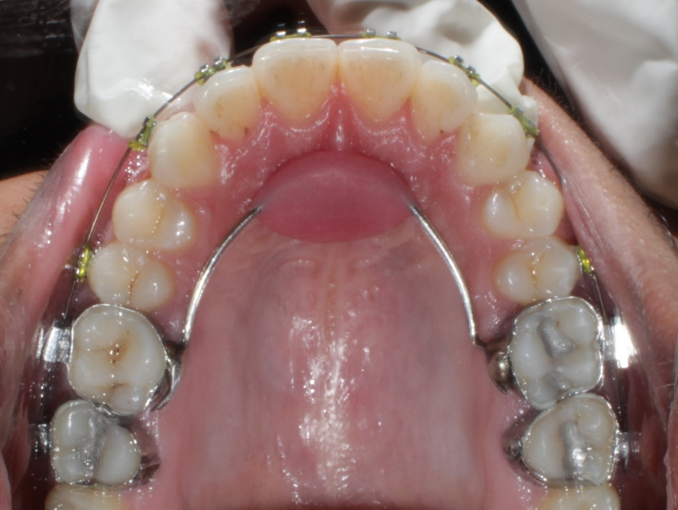
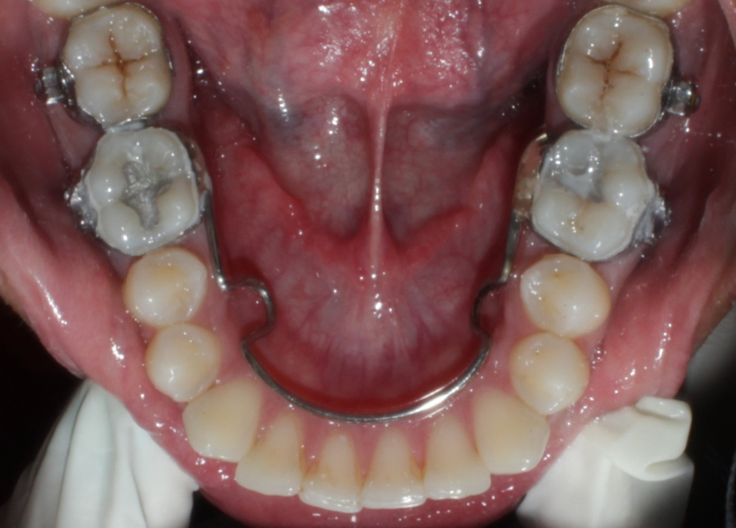
Nance Palatal Arch & Lingual Arch

Slide 20
INTRA MAXILLARY ANCHORAGE
When all the elements providing the anchorage as well as those to be moved are situated within the same jaw, the anchorage is described as intra-maxillary.
Three sub types are simple, stationary and reciprocal.

Slide 21
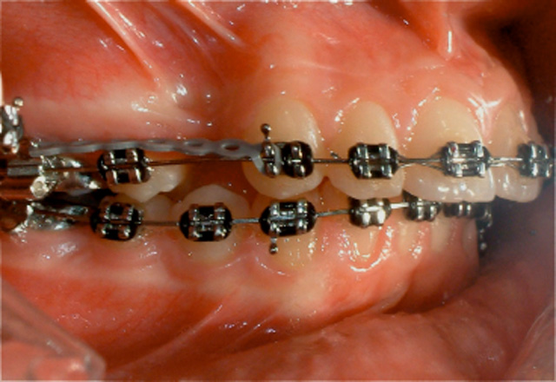
EXAMPLE
INTRA MAXILLARY ANCHORAGE

Slide 22
INTER MAXILLARY ANCHORAGE
When the anchorage units situated in one jaw are used to provide the force required to move the teeth in the opposing jaw the anchorage is called inter-maxillary.
This type of anchorage is also termed as Baker’s anchorage.
Subdivisions are simple, stationary and reciprocal anchorage.

Slide 23
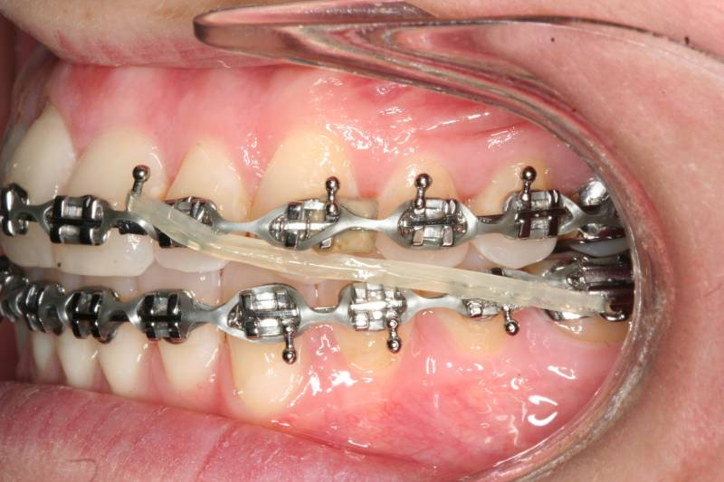
EXAMPLE
INTER MAXILLARY ANCHORAGE

Slide 24
EXTRA ORAL ANCHORAGE
Extra oral anchorage is anchorage in which one of the resistance units is situated outside the oral cavity.
Extra oral anchorage is usually employed in the correction of basal or maxillomandibular jaw malrelationships [Class II or Class III therapy].
It is also used to reinforce intra oral anchorage units.

Slide 25
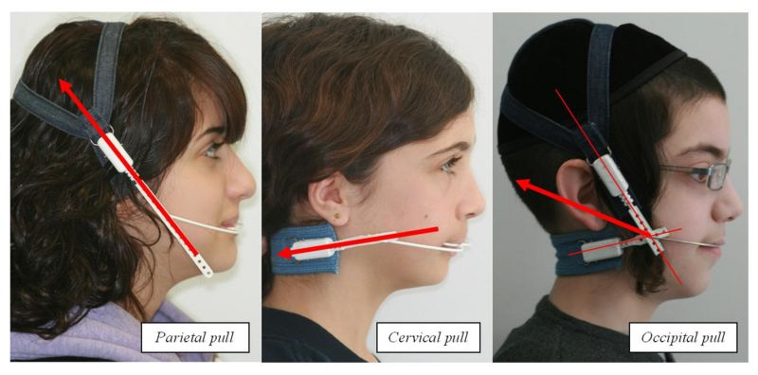
EXTRA ORAL ANCHORAGE
HEADGEARS

Slide 26
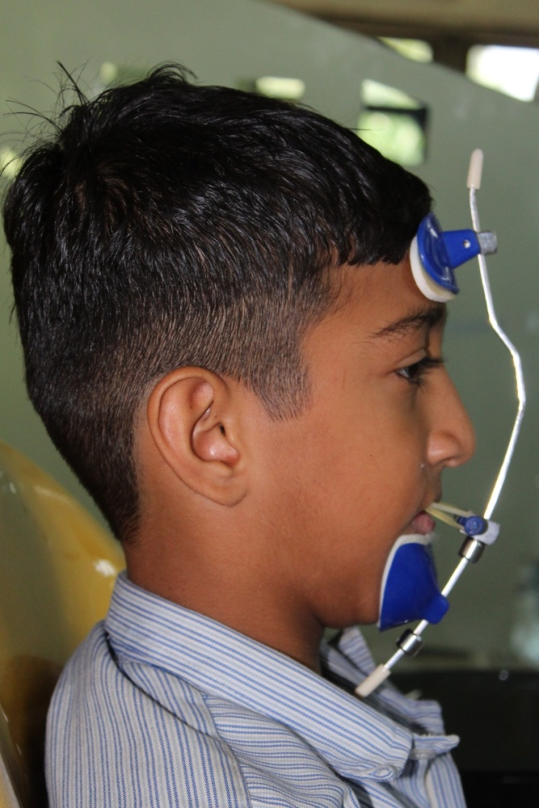
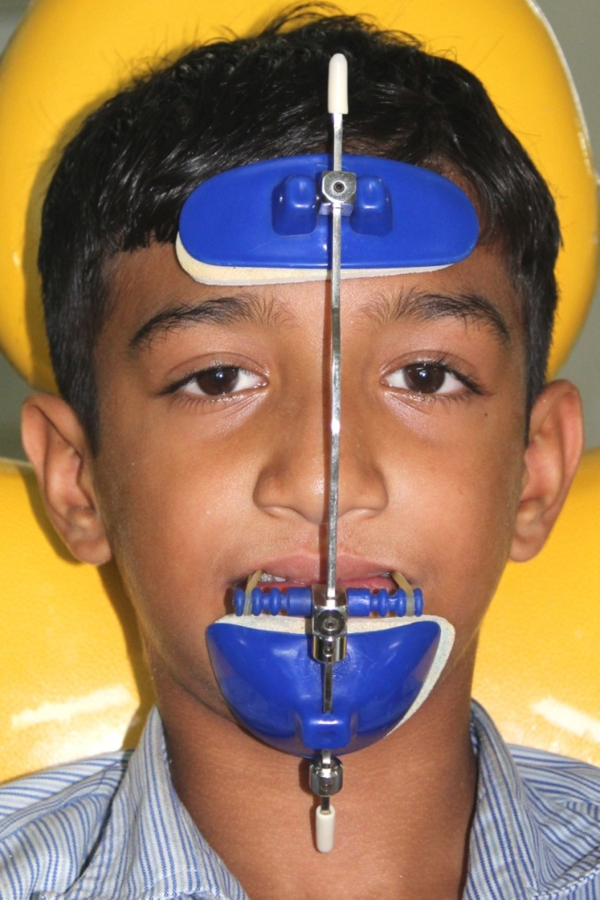
Reverse Pull Headgear
(Orthopedic Face Mask therapy)

Slide 27
MUSCULAR ANCHORAGE
The perioral musculature is not only very strong but also resilient. The forces generated by the musculature can sometimes be used to bring about tooth movement.
Example: lip bumper appliance to distalize the mandibular first molar.

Slide 28
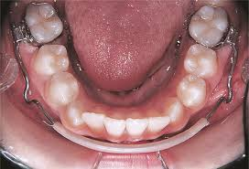
EXAMPLE
LIP BUMPER

Slide 29
MICRO IMPLANT ANCHORAGE
Absolute anchorage
With the intent to nullify the third law of motion.
Conventionally perceived “impossible” movements now possible with ease, all in much less time.

Slide 30
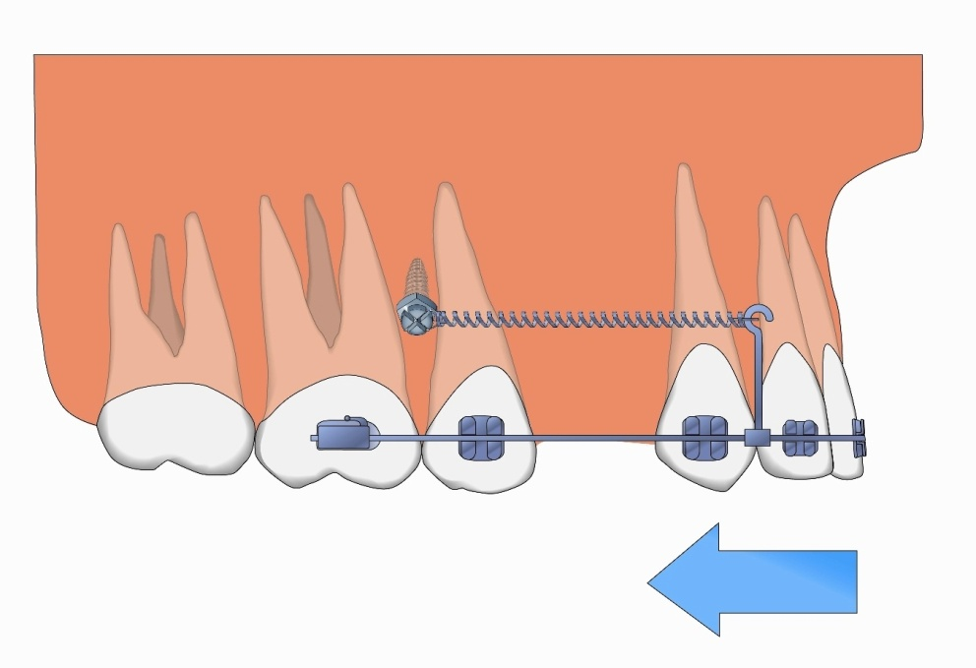
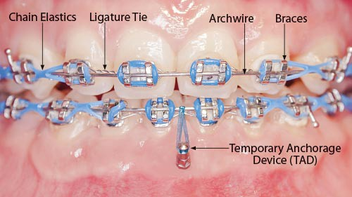
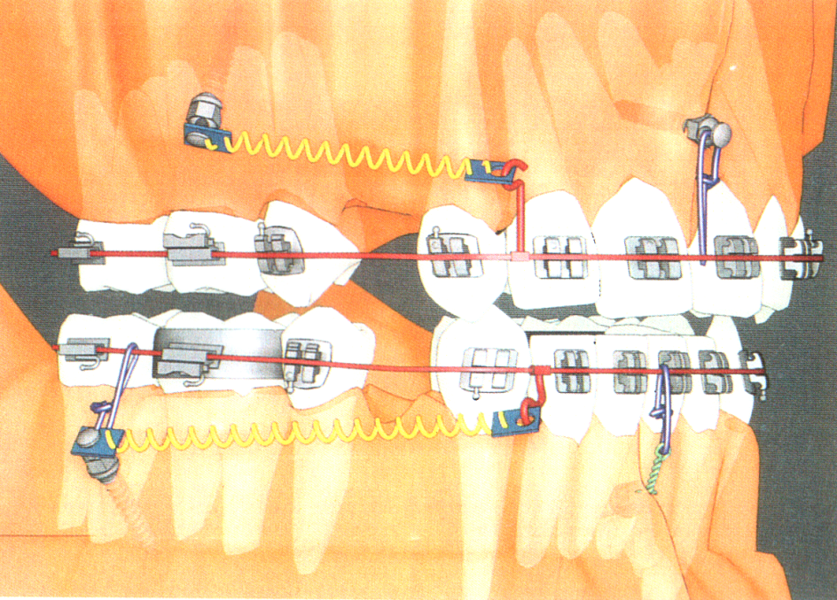
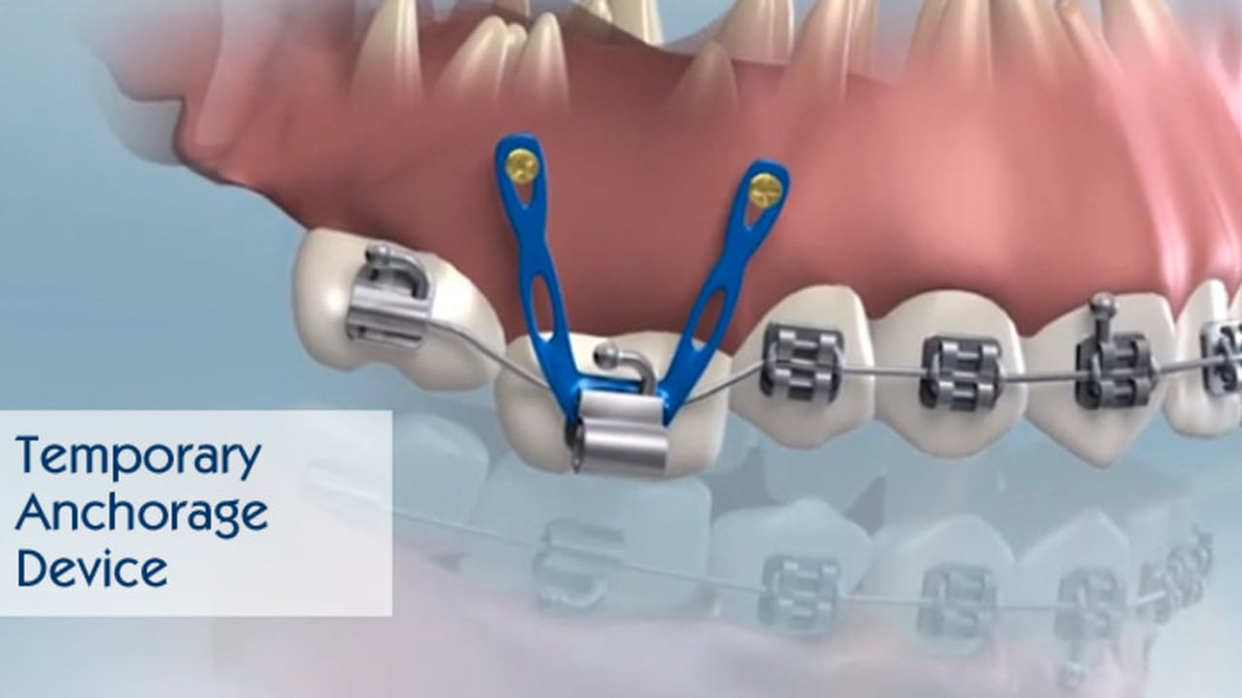
MICRO IMPLANT ANCHORAGE

Slide 31
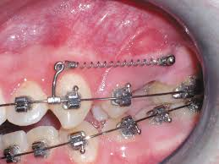
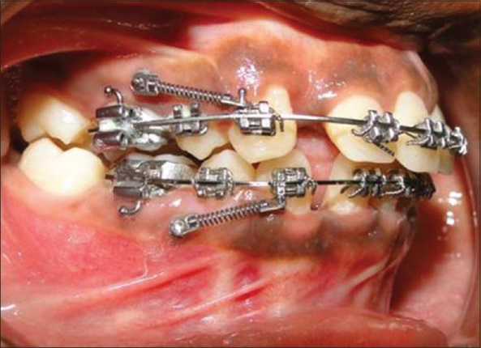
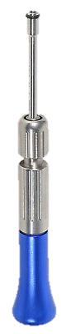
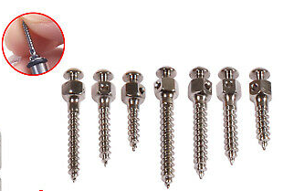
Enmasse Retraction using Micro-implants

Slide 32
Article & Authors | Objective | Material & methods/ Results | conclusion
. J Dent Res.2011 Aug;90(8):969-76. Clinical effectiveness of orthodontic miniscrew implants: A meta-analysis Level of evidence: 1 Papadopoulos MA et.al. | Examined the clinical effectiveness of miniscrew implants (MI) used for anchorage reinforcement compared with conventional orthodontic means, as well as to assess the success rates of MIs and the possible risk factors affecting their clinical effectiveness. | Literature searches were conducted, and, using specific inclusion and exclusion criteria, two independent investigators performed data extraction and analysis. Overall pooled estimates with 95% confidence intervals (CI) were obtained with the random-effects model. Eight out of 3183 original papers met the inclusion criteria. | MIs significantly decreased or negated loss of anchorage. Anchorage loss seemed to be less in the mandible, when the MIs were inserted between the second premolar and the first molar. MIs presented a success rate of 87.7%, with no significant differences between the various subgroups.

Slide 33
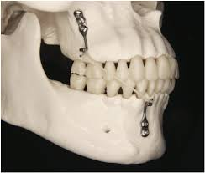
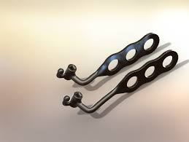
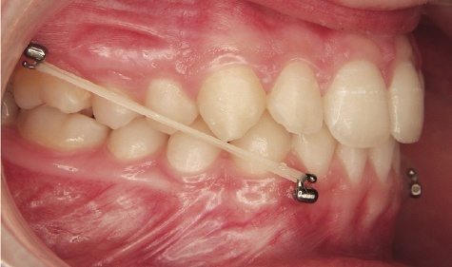
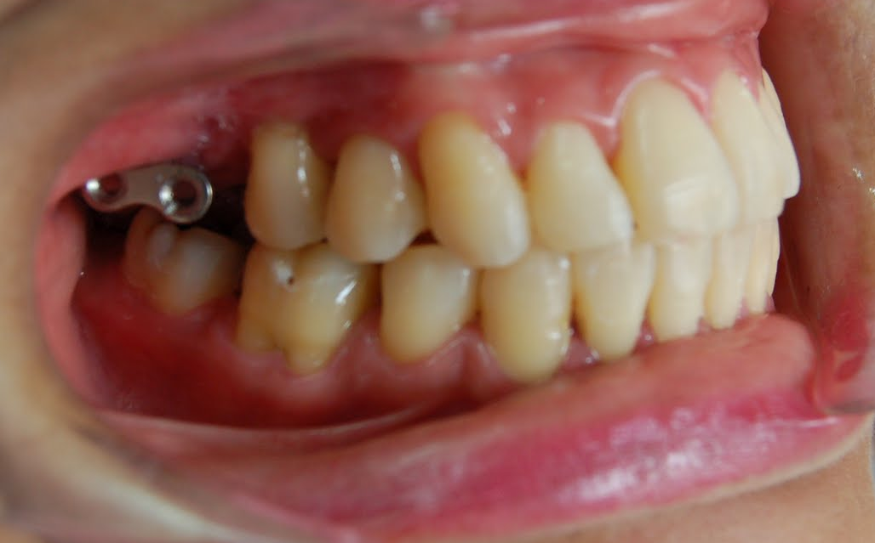
SKELETAL / ZYGOMATIC ANCHORAGE SYSTEM

Slide 34
Clinical Anchorage [Nanda]
A Critical / severe/ maximum
75 % or more of the extraction space is needed for anterior retraction.
B Moderate
Relatively symmetric space closure (50%)
C Mild / non critical/ minimum
75% or more of space closure by mesial movement of posterior teeth

Slide 35
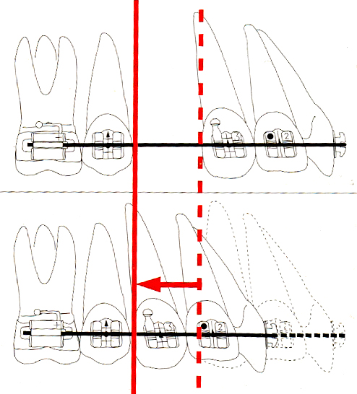
MAXIMUM ANCHORAGE
In cases where the anchorage demand is very high, not more than 1/4th of the extraction space should be lost by forward movement of the anchor teeth. The anchorage in these patients should be augmented to avoid unwanted movement of the anchor teeth.

Slide 36
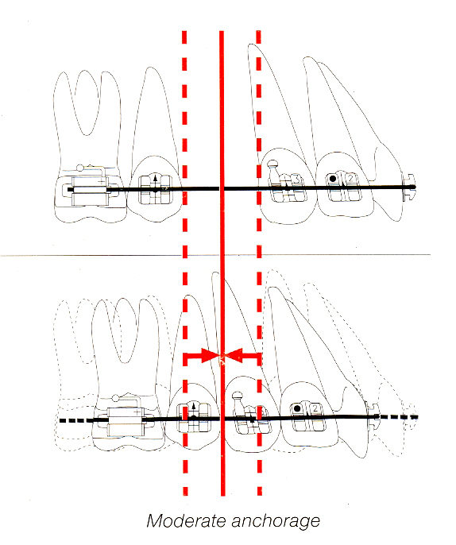
MODERATE ANCHORAGE
In these cases, anchor teeth can be permitted to move forward into 1/4th to 1/2 of the extraction space.

Slide 37
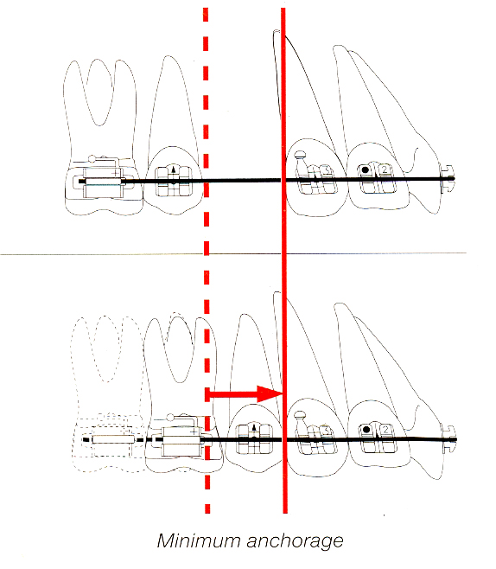
MINIMUM ANCHORAGE
In these cases, the anchorage demand is very low. More than half the extraction space can be lost by the anchor teeth moving mesially.

Slide 38
FACTORS AFFECTING ANCHORAGE
T. M. GRABER

Slide 39
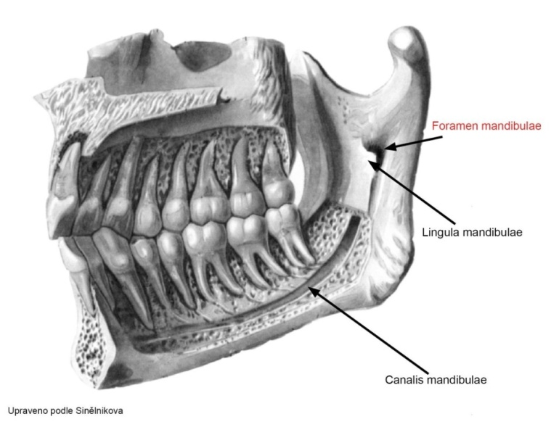
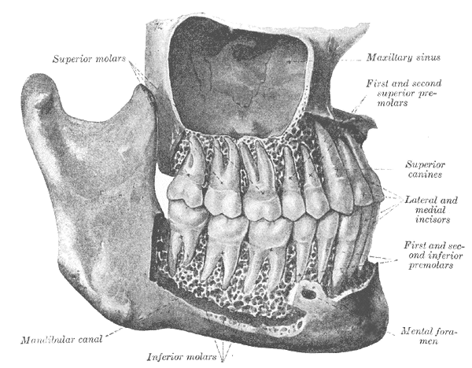
ANATOMICAL
TEETH
Root form
Size of roots
Number of roots
Position of tooth
Axial inclination of tooth
Root formation
Contact points
Inter-cuspation
Ankylosis

Slide 40
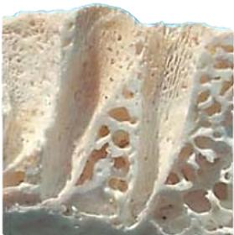
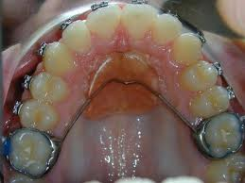
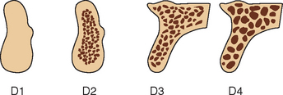
2. Alveolar bone [density, surface area & trabecular pattern]
3. Basal bone [hard palate]
4. Cortical bone [Ricketts]
5. Musculature [tonicity]

Slide 41
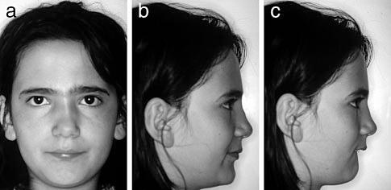
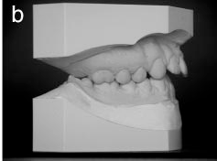
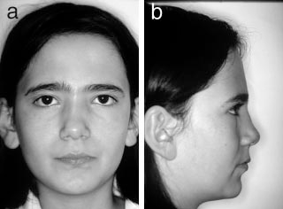
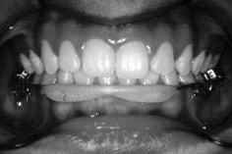
Hyper Active Lower Lip / Lip Bumper

Slide 42
MECHANICAL
Arch wires: material, cross-section, size, shape, surface texture, stiffness and method of ligation with bracket.
Brackets: material, manufacturing process, slot width and depth, bracket design and position, inter-bracket distance.
Force system
Friction

Slide 43
BIOLOGICAL
Saliva [Lubrication]
Plaque
Corrosion
Acquired pellicle

Slide 44
Thank you…..

Slide 45
ASSIGNMENT

Slide 46
MCQ’S
1. Baker’s anchorage is?
Stationary anchorage
Intra-maxillary anchorage
Reciprocal anchorage
Inter-maxillary anchorage

Slide 47
2.Which of the following is not Reinforced anchorage?
Maxillary First molar
TPA
Nance palatal arch
Lingual arch

Slide 48
3. Which of the following is not Extra-oral reinforced anchorage?
Chin cup
Lip bumper
Head gear
Face mask

Slide 49
4. Which provides the transverse anchorage control
Quad helix
Trans palatal arch
Rapid palatal expander
All of the above

Slide 50
5. Anchor loss means
Unwanted Movement of anchor teeth
Movement of anchor teeth
Extraction of anchor teeth
All of the above

