Slide 1
Axes and planes
Dr. Neha Mukkamala

Slide 2
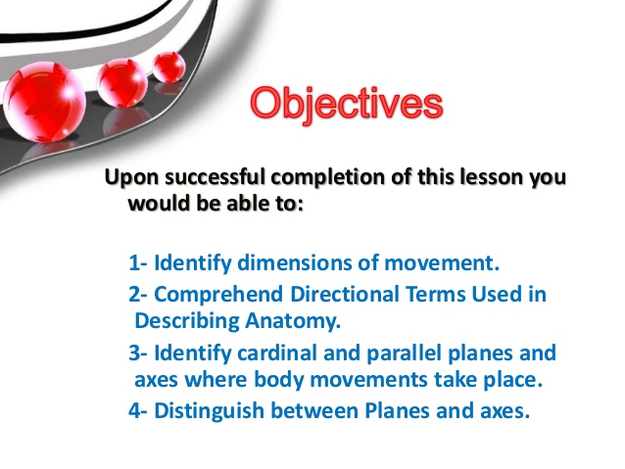

Slide 3

Introduction
The Axis: Axis is a line about which the movement takes place.
The Plane: Plane is the surface which lies right angle to it and in which the movement takes place.

Slide 4
The terms axes and planes are used to facilitate the description of the movement or direction.
As far as axes and planes of the joint movement are concerned, they are described with the body in the anatomical position.

Slide 5
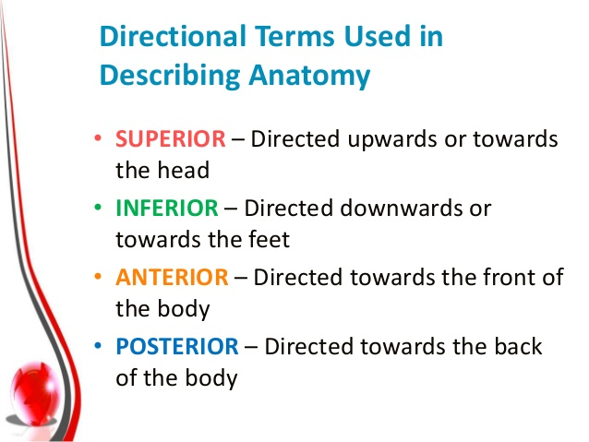

Slide 6
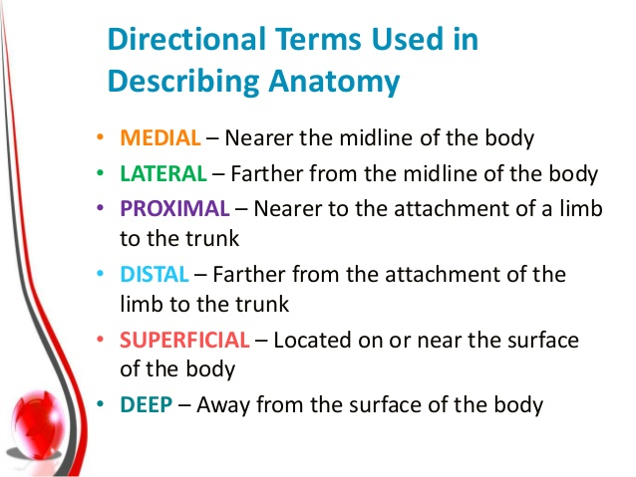

Slide 7
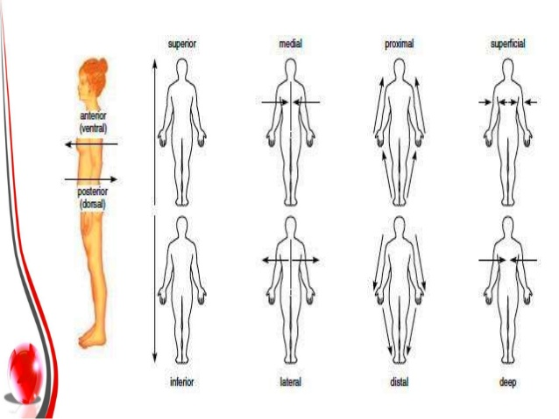

Slide 8


Slide 9
CARDINAL PLANE :
3 imaginary perpendicular reference planes that divides the body in half by mass and represent where the axial skeleton movements take place.

Slide 10
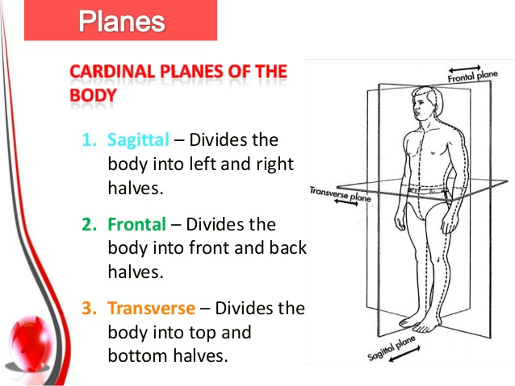

Slide 11
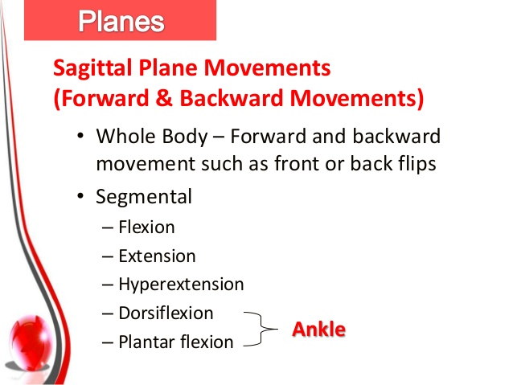

Slide 12
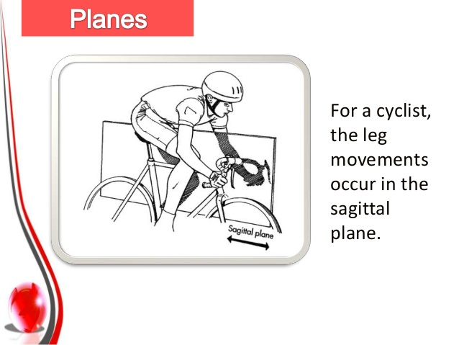

Slide 13
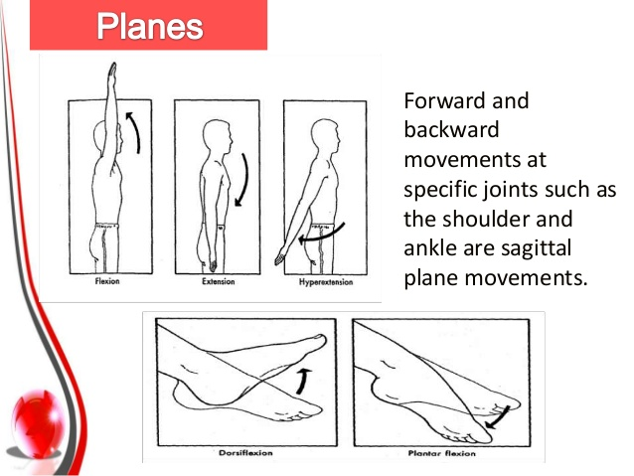

Slide 14
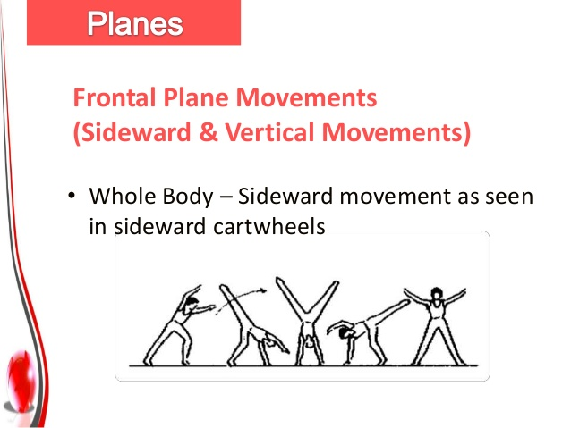

Slide 15
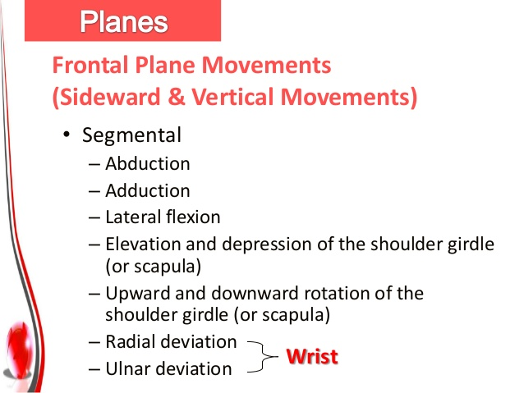

Slide 16
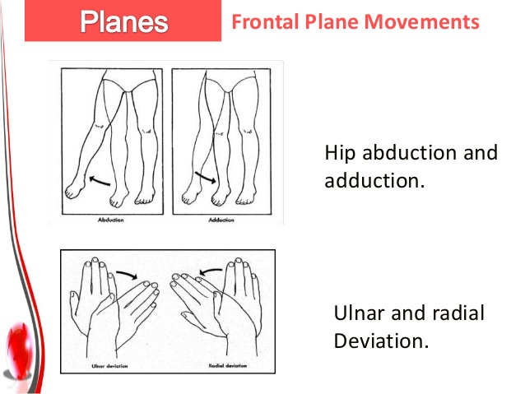

Slide 17
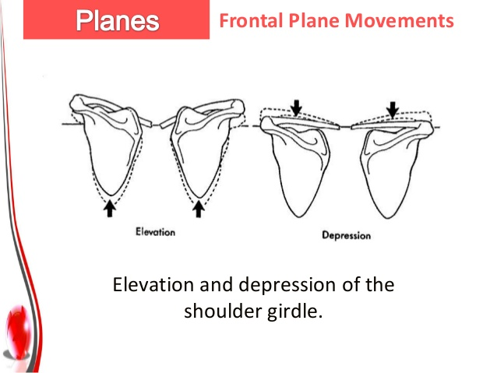

Slide 18
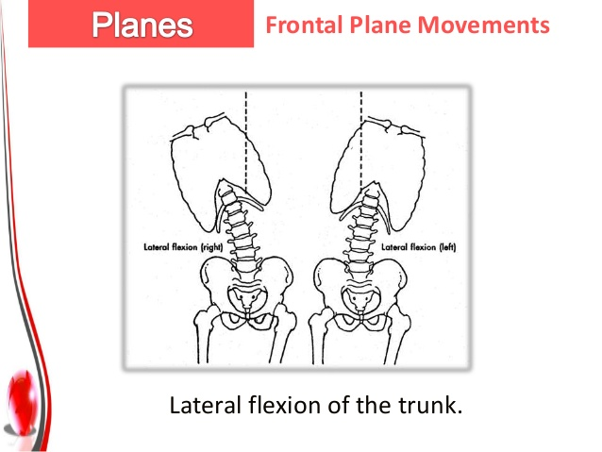

Slide 19
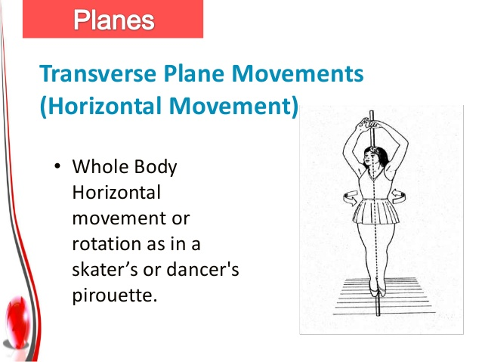

Slide 20
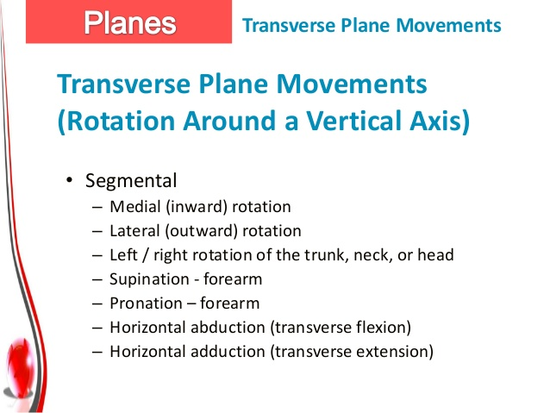

Slide 21
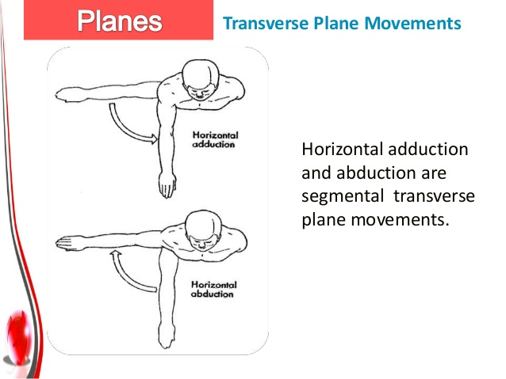

Slide 22

There are three types of cardinal axes:
Sagittal axis (antero-posterior axis)
Frontal axis (medio-lateral axis)
Vertical axis (top to bottom axis)

Slide 23
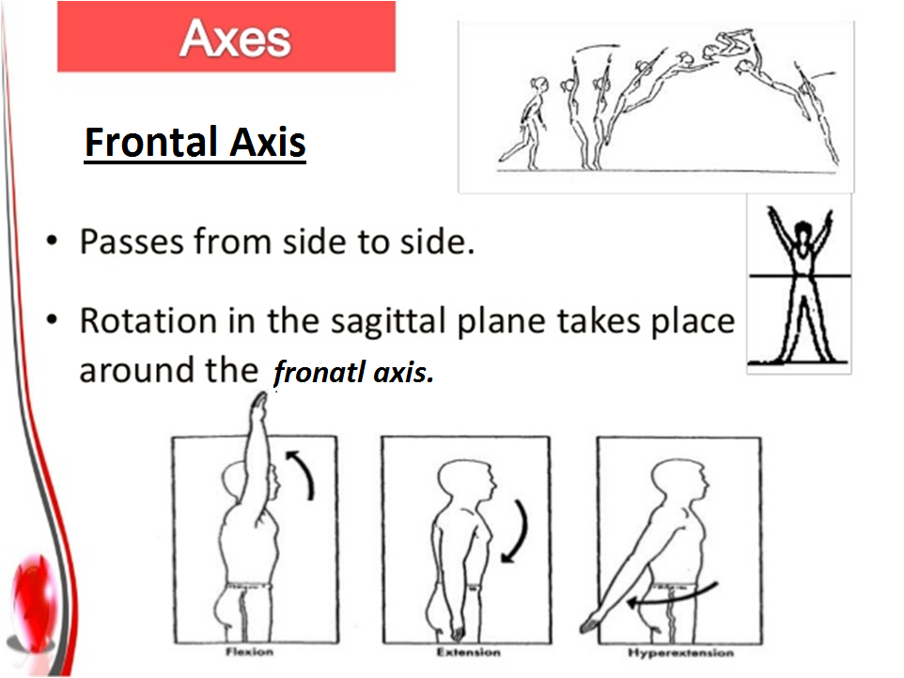

Slide 24
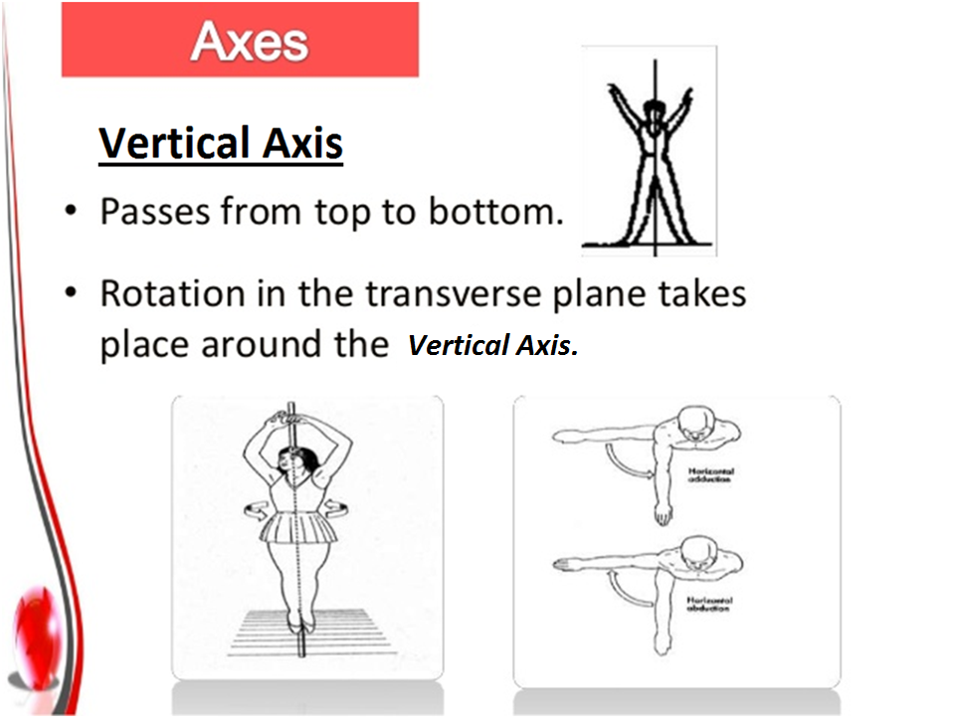

Slide 25
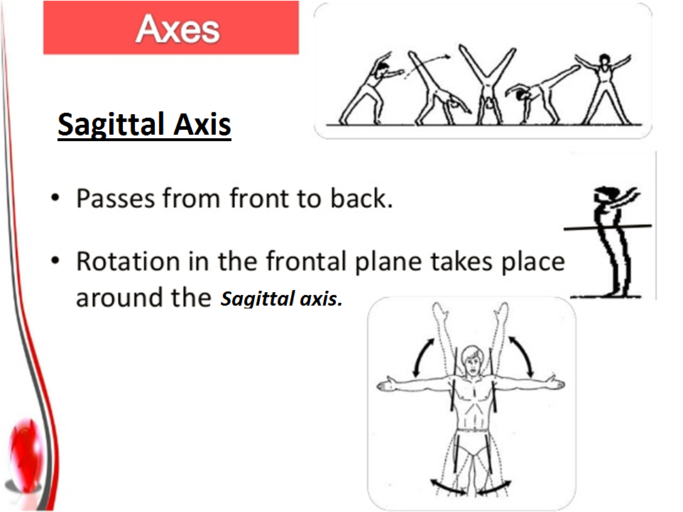

Slide 26
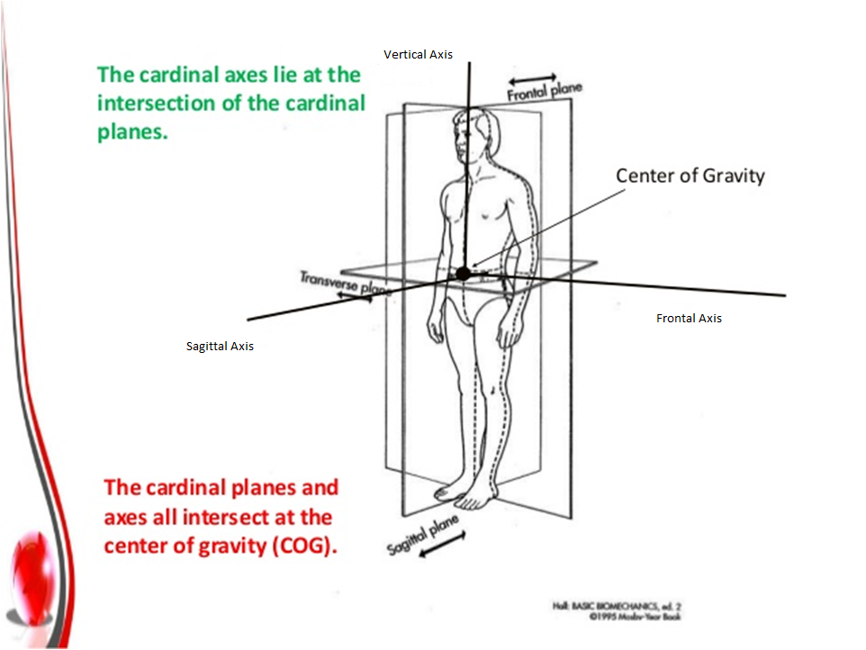

Slide 27
MCQS
Axis is a line in which movement takes place. True or false ?
True
False

Slide 28
2. _________ is the surface in which movement takes place.
Axis
Plane
None

Slide 29
3. Axis and plane lies at right angle to each other. True or false ?
True
False

Slide 30
4. This is not the type of cardinal plane.
Sagittal
Coronal
Transverse
None

Slide 31
5. Forward and backward movement occur in __________.
Sagittal
Frontal
Transverse
None

Slide 32
6. This is not the type of axis.
Sagittal
Frontal
Vertical
None

Slide 33
7. Abduction and adduction occurs in ________ axis.
Sagittal
Frontal
Vertical
None

Slide 34
8. X axis divides body into _________.
Front and back
Side to side
Top and bottom
None

Slide 35
9. Y axis divides body into ________.
Front and back
Side to side
Top and bottom
None

Slide 36
10. Z axis divides body into _________.
Front and back
Side to side
Top and bottom
None

Slide 37
KEY ANSWERS
B
B
A
D
A
D
A
B
C
A

Slide 38


