Slide 1
SUSTAINABLE DEVELOPMENT GOALS
Dr. Medha Wadhwa

Slide 2
MILLENIUM DEVELOPMENT GOALS
In September 2000, 189 countries’ representatives met at Millennium Summit in New York to adopt the UN Millennium Declaration
Commitment in seven areas: peace, security, disarmament, development, poverty eradication, environment protection, human rights, democracy, and good governance, protecting the vulnerable and meeting the special needs of Africa and strengthening the UN

Slide 3
It placed health at the heart of development and committed to reduce poverty and hunger, tackle ill-health, gender inequality and lack of education and access to clean water and environmental degradation
3 out of 8 goals have direct relation with health and remaining have indirect effects on health

Slide 4
INTRODUCTION
UN Sustainable Development Summit in New York from 25-27 September 2015
Summit outcome document, entitled “Transforming our World: The 2030 Agenda for Sustainable Development,” was agreed on by the 193 Member States of the United Nations, and includes 17 Sustainable Development Goals.
Calls for action by all countries, poor, rich and middle-income. It recognizes that ending poverty must go hand-in-hand with a plan that builds economic growth and addresses a range of social needs.
The new sustainable development agenda builds on the successful outcome of the Third International Conference on Financing for Development that recently concluded in Addis Ababa, Ethiopia.

Slide 5
The 17 Sustainable Development Goals (SDGs) and targets are “global” in nature taking into account different national realities, capacities and levels of development and respecting national policies and priorities.
The SDGS call for building peaceful, inclusive and well-governed societies with responsive institutions as the basis for shared prosperity. Fundamentally, they recognize that we cannot reach our development goals without addressing human rights and complex humanitarian issues at the same time.
The SDGs are people-centered and planet-sensitive. They are universal, applying to all countries while recognizing different realities and capabilities. The goals are not independent from each other; they need to be implemented in an integrated manner.
The SDGs are the result of a three year long transparent, participatory process inclusive of all stakeholders and people’s voices. They represent an unprecedented agreement around sustainable development priorities among 193 Member States. They have received worldwide support from civil society, business, parliamentarians and other actors.

Slide 6
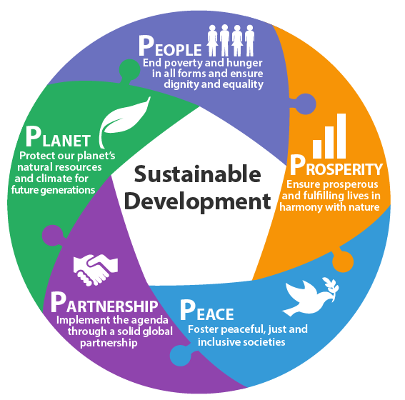
ELEMENTS OF SDG

Slide 7
MDG v/s SDG
The 17 Sustainable Development Goals with 169 targets are broader in scope and will go further than the MDGs by addressing the root causes of poverty and the universal need for development that works for all people.
Building on the success and momentum of the MDGs, the new global goals will cover more ground with ambitions to address inequalities, economic growth, decent jobs, cities and human settlements, industrialization, energy, climate change, sustainable consumption and production, peace and justice.
The new goals are universal and apply to all countries, whereas the MDGs were intended for action in developing countries only.
A core feature of the SDGs has been the means of implementation – the mobilization of financial resources – as well as capacity–building and the transfer of environmentally sound technologies.

Slide 8
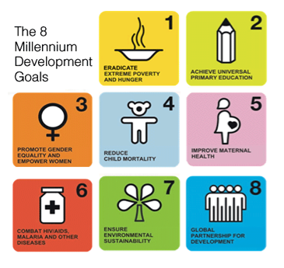
MDG

Slide 9
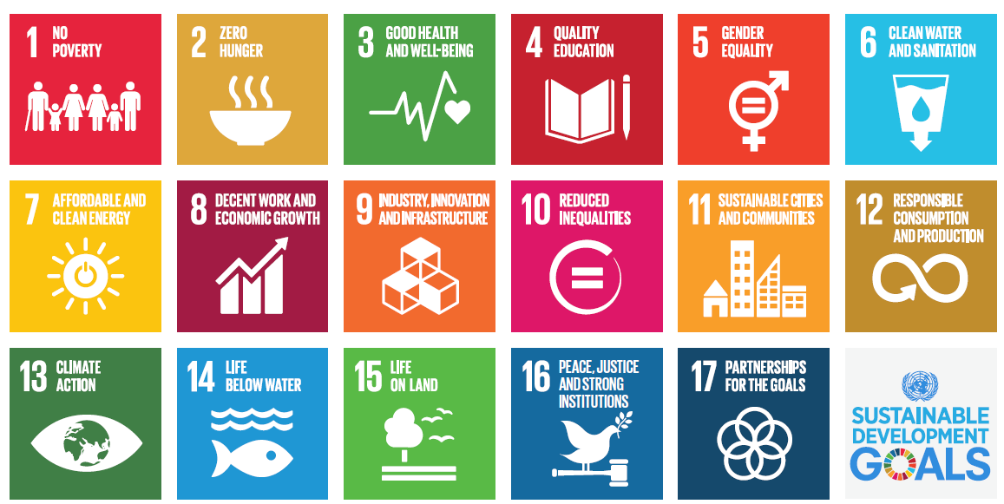
SDG

Slide 10
Facts about SDG
The Global Goals need you
The Global Goals will change the way the world does business
The Global Goals are one for all and all for one
The Global Goals will address climate change
The Global Goals will eradicate extreme poverty
The Global Goals will leave no one behind
The Global Goals are hands-on
The Global Goals are “Global”
The Global Goals are the people’s goals
The Global Goals are the world’s ultimate to-do list for the next 15 years

Slide 11


