Slide 1
Human Resource Development
Presented by :
Khan Shabana Parveen
Asst. Professor
Subject: Strategic Managemnet
Dept. Of Management

Slide 2
Defination of HRD
.Human resource development (HRD)is the framework for helping employee developing their personal & organizational skills, knowledge and abilities
.HRD includes such opportunities as employee training, employee career development ,performance management planning ,key employee identification and organizational development.

Slide 3
NEED OF HRD
Due to the changing role of HR functions
The shift of organization is from industrial era models to knowledge era mode!
Customer today are more demanding, quality conscious and cost sensitive.
For motivation people, managers emphasize on removal of barriers.

Slide 4
Evolution of HRD
The early of the century saw a concern for improved efficiency through careful design work
In the middle part of the century, emphasis shifted to the availability of managerial personnel and employee productivity.
Recent decades have focused on the demand for technical personnel, responses to new legislation and governmental regulations , increased concern for quality management and a renewed emphasis n productivity.

Slide 5
HRD & HRM
Human Resource Management-(HRM) is a branch of management; that is concerned with making best possible use of the enterpriser’s human resource, by providing better working conditions, to the employees
It involves those activities that arrange and coordinates the human resources of any entity.

Slide 6
Cont…
Human Resource Development (HRD):- is a wing of HRM that keeps focusing on the growth and development part of the organisation’s manpower.

Slide 7
Summary
HRD is a sub-section of HRM, i.e. HRD is a section with the department of HRM.
HRM deals with all aspects of the human resources function while HRD only deals with the development part.
HRM is concerned with recruitment ,rewards among others while HRD is concerned with employee skills development.

Slide 8
functions
managerial
operative

Slide 9
Managerial Functions
Planning
Organizing
Directing
Controlling

Slide 10
Planning
Planning is necessary to give the organization its goals and directions to establish best procedure to reach the goals.
Organizing
After objective has been established and plans been developed then personnel manager must design and develop organization structure to carry out various operations eg.. Grouping of personnel activity

Slide 11
Directing
The directing function of the personnel manager involves encouraging people to work willingly and effectively for the goals of the organization.
Controlling
Controlling helps to evaluate and control the performance of the development in terms of various operative functions.

Slide 12
Operative Functions
The process by which a job vacancy is identified and potential employees are notified
Training & Development
Provides new skills for the employees
Remuneration
Concern with determination and equitable remuneration of employees in the organization to the goals
Reward system
System of pay and benefits used by the firm to reward workers
Recruitment

Slide 13
Cont..
To retain good staff and to encourage them to give of their best while at work requires attention to the financial and psychological and even physiological rewards offered by the organization as a continuous exercise
Records and statistics
Keeps employee training records
Separations
Ensure the release of retirement benifits
Industrial relations
Good industrial relations, while a recognizable and legitimate objective for an organization
Motivation

Slide 14
Role of HRD Professional
Develop HRD Policies and Programmes
Plan HRD functions
Implantation HRD Processes
Monitor and Evaluate HRD Practices
Advocate HRD Philosophy

Slide 15
The role of HR manager must parallel the need of his or her changing organization. Successful organization are becoming more adaptable, resillent, quick to change direction and customer-centered
Depending on the size of the organization, the HR manager has responsibility for all of the functions that deal with the need and activities of the organization’s people including these area of responsibility

Slide 16
Recruiting
Hiring
Training
Organization development
Communication
Performance management
Coaching
Policy recommendation
Team building
Employee relations
leadership

Slide 17
Challenges
Leadership Development & Succession Planning
HR professionals are expected to provide essential frameworks, processes, tools and points of view for selection and development of the future leaders
HR as change agent
HR should be able to plan and lead large scale change programmes that improve performance.

Slide 18
Creating a consistent corporate culture
Communicating to all locations about a common corporate culture and allowing local cultures to maintain their identity in the context of corporate culture
HR as strategic partner
HR must help, coach, advise and educate senior executive on how workforce issues can affect overall performance
Challenges in recruitment
Attracting people with multi dimensional skills, anticipating and finding people for positions that don’t exist as of yet.

Slide 19
Attrition & Retention of talent
Retention of talent perhaps the biggest challenge in today’s era
Compensation Management
Compensation plays an important part in retention strategies
Organizational reward strategy influences both job satisfaction and motivation for the employee
Work life balance
HR’s job is to create programs that creates right balance between work and life

Slide 20
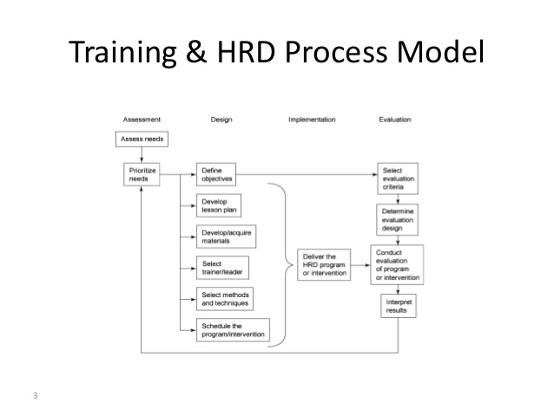
Framework for HRD process

Slide 21
HRD efforts should be use the following four phases(or stages)
Needs assessment
Design
Implementation
Evaluation

Slide 22
Needs Assessment phase
Establishing HRD priorities
Defining specific training and objectives
Establishing evaluation criteria

Slide 23
Design phase
Selecting who delivers programs
Selecting and development program content
Scheduling the training program

Slide 24
Implementation phase
Implementing or delivering the program

Slide 25
Evaluation phase
Determining program effectiveness-e.g.
Keep or change providers?
Offer it again?
What are the true costs?
Can we do it another way?

Slide 26
THANK YOU

