Slide 1


Treatment plan
Dr JASUMA J RAI

Slide 2
After Diagnosis & prognosis, treatment is planned. The treatment plan is the ‘Blueprint’ for case management.
AIM: is total treatment, that is coordination of all treatment procedures for purpose of creating well functioning dentition in healthy periodontal environment.

Slide 3
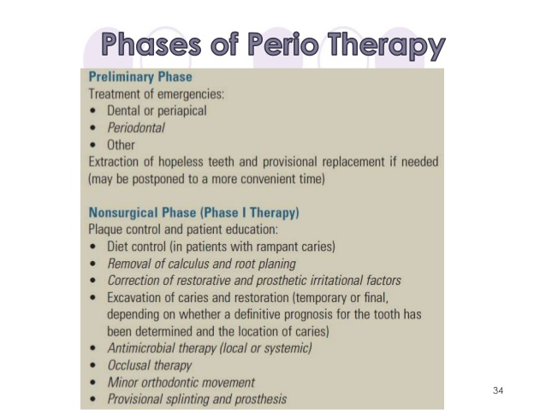

Slide 4
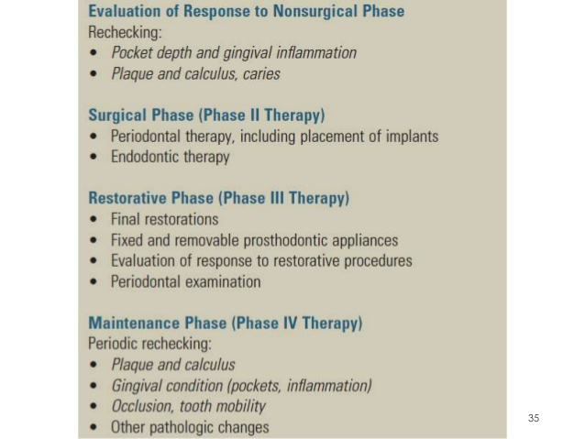

Slide 5
Preliminary Phase

Slide 6
Preliminary Phase
(a) Treatment of emergencies:
Periapical abscess
Periodontal abscess
Other
(b) Extraction of hopeless teeth and provisional replacement if needed (may be postponed to a more convenient time)

Slide 7
Phase - I

Slide 8
Plaque control and patient education:
• Diet control (in patients with rampant caries)
• Removal of calculus and root planing
• Correction of restorative and prosthetic irritation factors
• Excavation of caries and restoration (temporary or final, depending on whether a definitive prognosis for the tooth has been determined and the location of caries)
• Antimicrobial therapy (local or systemic)
• Occlusal therapy
• Minor orthodontic movement
• Provisional splinting and prosthesis

Slide 9
PHASE-II THERAPY
Surgical Therapy/ Periodontal Therapy.
Includes all instrumental therapy, that include intentional severing or incising of gingival tissue.
Purpose:
1. controlling / eliminating periodontal disease .
2. correcting anatomical condition.
3. placing implants.

Slide 10
Phase consist of :-
(I) Pocket Reduction Therapy :
1.New Attachment Technique- (Flap
surgery with bone grafting)
2.Removal of Pocket wall, Gingivectomy, undisplaced flap surgery.
3.Removal of tooth side of pocket: Extraction.

Slide 11
(II) Correction of Anatomic defect-
1.Plastic Surgery techniques to widen attached gingiva:-
Free gingival grafts, Lateral pedicle flap.
2.Esthetic surgery:- Free gingival autograft; Free
connective tissue autograft ;Pedicle autograft;
subepithelial connective tissue graft; Pouch &Tunnel
technique.
3.Preprosthetic Techniques:- Crown Lengthening procedure;
RidgeAugmentationProcedure; Vestibular Deepening
technique.
(III) Placement of Dental implants.

Slide 12
PHASE III THERAPY
Restorative phase; RPD/ FPD /Implant.
Re-evaluation of response to Restorative
therapy.

Slide 13
PHASE-IV THERAPY
Starts immediately after completion of phase I therapy.
Patients who are not maintained in a supervised recall program, shows obvious signs of Recurrent periodontitis.
Maintenance Program:
Each recall visits comprises 3 parts-
1.Examination & Evaluation of patient current oral health.
2.Necessary maintenance treatment & current oral hygiene .
3.Scheduling patient for next recall appointment.

Slide 14
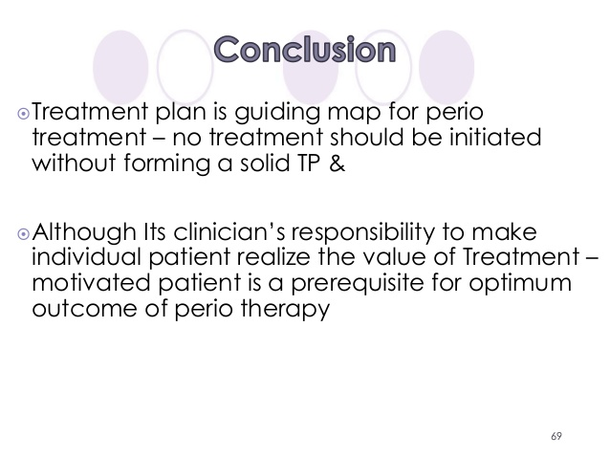

Slide 15
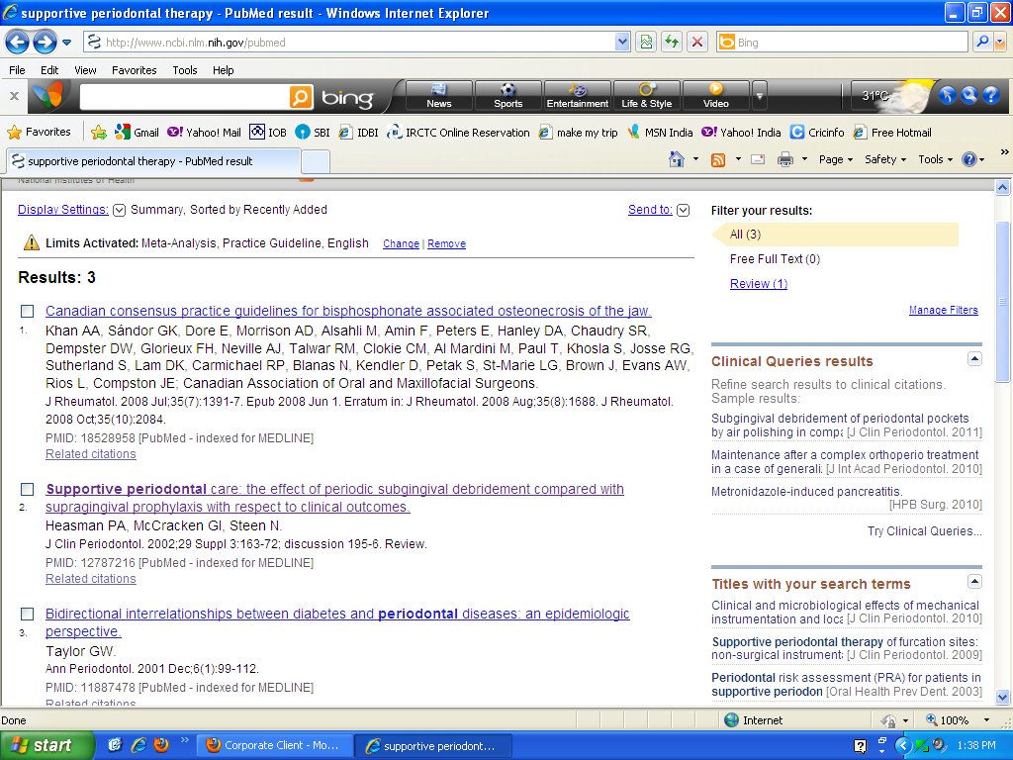

Slide 16
Who, where, when | what | why | conclude | remarks
Heasman PA et al in UK in 2002 | Systematic Review (28 papers) | To evaluate the effectiveness of supragingival prophylaxis vs. sub-gingival debridement for SPC following the treatment of chronic periodontitis. | SPC regimens of supragingival prophylaxis and subgingival debridement are comparable with respect to the clinical outcomes of probing depth and attachment levels at 12 months post non-surgical treatment. | Authers could not support it strongly

Slide 17
Thank you

