Slide 1
skin
Dr. Manoj Kulkarni
Associate Professor
Department of Anatomy
S.B.K.S.M.I. & R.C.

Slide 2
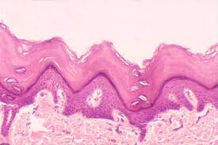
Thick skin

Slide 3
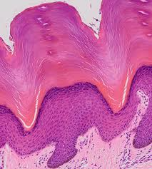
Thick skin

Slide 4
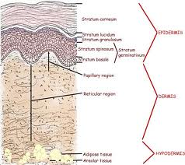
Thick skin

Slide 5
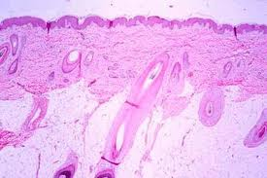
Thin skin

Slide 6
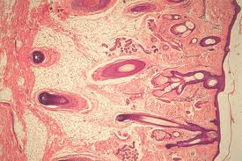
Thin skin

Slide 7
Journal of Investigative Dermatology (2001) 116, 846–852; doi:10.1046/j.0022-202x.2001.01337.x
Dr Salvador González, Assistant Professor of Dermatology, Wellman Laboratories of Photomedicine, 40 Blossom St. Bartlett Hall 814, Boston, MA 02114, U.S.A
Dr Salvador González, Assistant Professor of Dermatology, Wellman Laboratories of Photomedicine, | Topographic Variations in Normal Skin, as Viewed by In Vivo Reflectance Confocal Microscopy Medium Level of Evidence | reflectance confocal microscopy was performed in 10 adults (eight males, two females) of various skin phototypes. Six topographic sites were studied in each subject: forehead, cheek, inner and outer forearm surfaces, lower back and leg. | In the dermis, we have found some morphologic differences of the collagen at sites of chronic sun exposure, when compared with normally protected sites. It is irregular, compressed with a haphazard arrangement of voluminous bundles as seen through CM in areas of chronic sun exposure | Our results show statistically significant differences of normal skin topographic morphology. Epidermal cell population, thicknesses of various epidermal layers, morphology of dermoepidermal junction, dermal collagen, and vasculature vary significantly from areas of average daily sun exposure to routinely sun-protected sites.
EBM Presentation on Skin & Fasciae

