Slide 1
DR. HETAL VAISHNANI
ASSISTANT PROFESSOR
DEPARTMENT OF ANATOMY
S.B.K.S.M.I. & R.C.
CONNECTIVE TISSUE

Slide 2
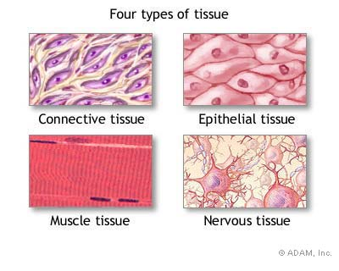
Introduction
There are (4) types of tissue:
  1. Epithelial
  2. Connective
  3. Muscle
  4. Nervous

Slide 3
CONNECTIVE TISSUE
It is one of the basic tissues which gives structural and metabolic support to other tissues and organs of the body.
It connects other tissues.

Slide 4
Functions of CT
Support
Strength
Storage
Transport
Packing
Repair
Defense

Slide 5
General features of the CT
Cells
Matrix- Ground substance
- Fibers

Slide 6
Connective Tissue Ground Substance
Gelatinous material between cells
  absorbs compressive forces
Consists of 3 classes of large molecules
  glycosaminoglycans – chondroitin sulfate
    disaccharides that attract sodium and hold water
    role in regulating water and electrolyte balance
  Proteoglycan (bottlebrush-shaped molecule)
    create bonds with cells or extracellular macromolecules
  adhesive glycoproteins
    protein-carbohydrate complexes bind cell membrane to collagen outside the cells

Slide 7
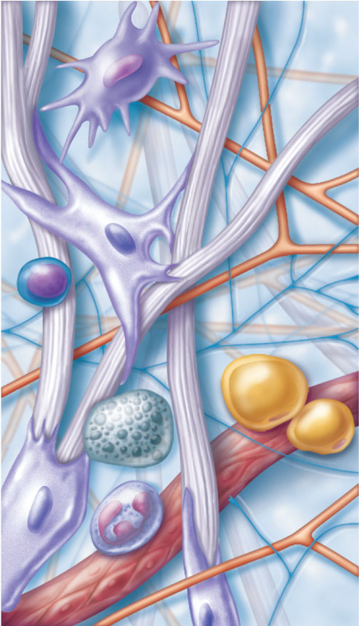
Figure 4.7 Areolar connective tissue: A prototype (model) connective tissue.
Cell types
Extracellular
matrix
Ground substance
Macrophage
Fibers
• Collagen fiber
• Elastic fiber
• Reticular fiber
Fibroblast
Lymphocyte
Fat cell
Capillary
Mast cell
Neutrophil

Slide 8
Fibers of Connective Tissue
Collagen fibers (white fibers)
  Strong, inelastic but flexible
  Tendons, ligaments and deep layer of the skin
Reticular fibers
  Thin, collagen fibers coated with glycoprotein
  Framework in spleen and lymph nodes
Elastic fibers (yellow fibers)
  thin branching fibers of elastin protein
  stretch and recoil like rubberband (elasticity)
  skin, lungs and arteries stretch and recoil

Slide 9
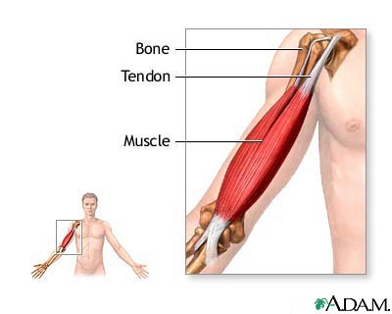
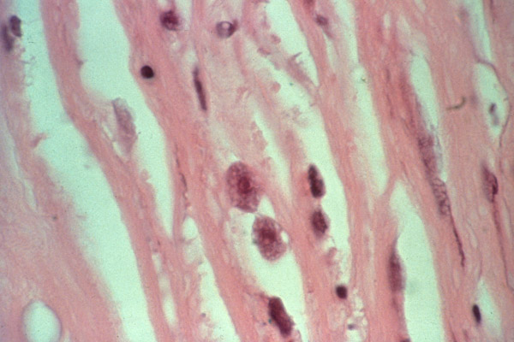
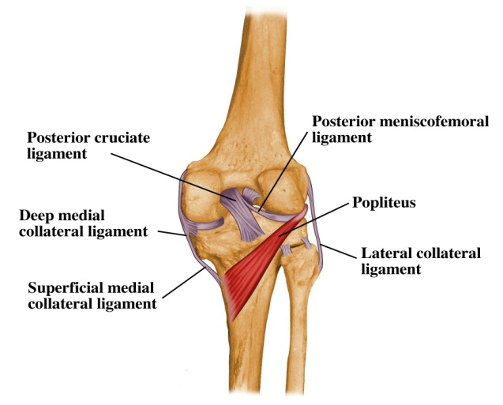
Connective tissue : FIBERS
Collagen
  Found in tendons and ligaments

Slide 10
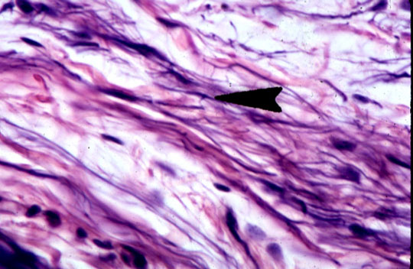
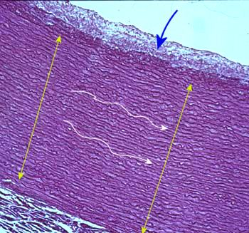
Connective tissue: FIBERS
Elastic Fibers
  Rare but important
  Found in lung, skin and aorta

Slide 11
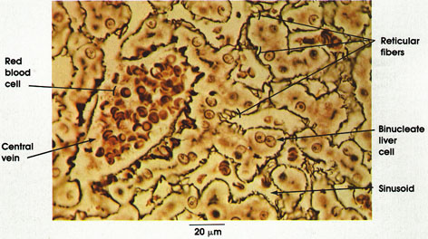
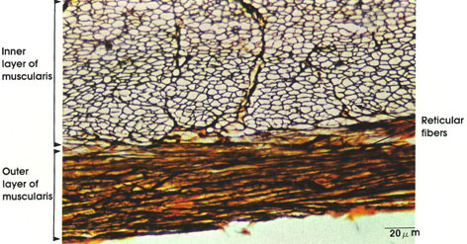
Connective tissue: FIBERS
Reticular Fibers
  holds blood vessels to surface of organs

Slide 12
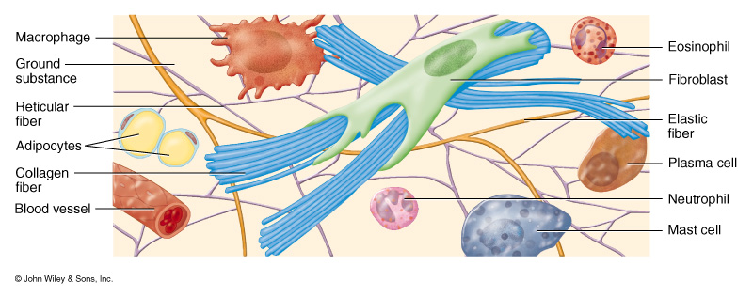
Cells of connective tissue

Slide 13
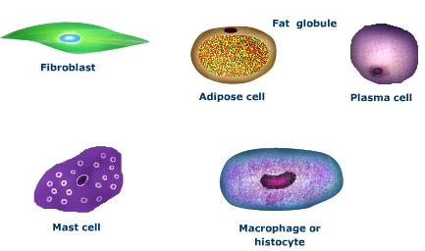
fibrocytes
Fibrocytes are the most common cell type in connective tissues.
Fibroblast are large, flat, spindle shaped cells that have many branching pattern
Fibroblast are responsible for secretion of ground substance and all types of CT fibers
Inactive form- fibrocytes
Active form- fibroblasts
Become very active during wound repair and synthesize collagen fibers

Slide 14
macrophages
Macrophages develops from monocytes of blood.
Monocytes originate in the bone marrow from where they are released into the blood stream.
Macrophages are capable of eating bacteria and cellular debris by the process of phagocytosis.
When need arises macrophages may fuse to form giant cells

Slide 15
Adipose cell
Fat cells or adipocytes are fixed cells in loose connective tissue.
Their main function is the storage of lipids
If "well fed" the cytoplasm only forms a very narrow rim around a large central lipid droplet.
The flattened nucleus may be found in a slightly thickened part of this cytoplasmic rim

Slide 16
Plasma cells
Plasma cells arise from B-lymphocytes
They synthesize antibodies against antigens. Found more in CT at the time of infection
Cells are ovoid in shape and nucleus is round and eccentrically placed, the choromatin pattern is unique, giving it a cart wheel appearance
Involved in protein synthesis

Slide 17
Mast cell
Are round or fusiform cells with centrally placed nucleus
Are found along small blood vessels
Their cytoplasm contains many granules
The most prominent substances contained in the vesicles are heparin and histamine
Are involved in inflammatory reactions, allergies and hypersensitive states.

Slide 18
Classification of CT
Connective tissue proper
Embryonic CT
Loose CT(areolar)
Adipose tissue
Reticular tissue
Dense CT : irregular and regular
Elastic CT
Specialized connective tissue
Cartilage
Bone
Blood

Slide 19
THANK YOU

Slide 20
Shahla Khan, Gulam S. Hashmi, UniversityJDentScie2015;1(1):1-2
Shahla Khan, Gulam S. Hashmi | HISTOLOGY AND FUNCTIONS OF CONNECTIVE TISSUES : A REVIEW ARTICLE | There are various kinds of cells present in connective tissue according to their location & type of organ or structure | such as fibroblast, myofibroblast, adipose cells, mast cells, tissue macrophages, white blood cells, osteoblast, chondroblast and blood forming cells. The intercellular substance is usually composed of both amorphous (non-sulphated and sulphated mucopolysaccharides) and formed elements collagen, reticular & elastic fibers. The function of the intercellular ground substance is to form the matrix, by which transportation of metabolites takes place | a review of connective tissue with their cells and functions.

