Slide 1
MASSAGE MANIPULATION-
EFFLUERAGE AND STROKING MANIPULATION
TAKEN BY:
DR. NOEL MACWAN
REFERENCE:
MARGARET HOLLIS
(Third Edition)

Slide 2
OBJECTIVE
At end of lecture, students should be able to,
Describe in detail about effleurage technique.
Describe in detail about stroking technique .

Slide 3
Effleurage/ Stroking manipulations
The word ‘effluerage’ means to stroke, and the manipulations in this group may be divided into:
Those in which intention is primarily to assist venous and lymphatic drainage and in which the direction of work is from distal to proximal – usually called effleurage.
Those in which intention is primarily to obtain a sensory reaction either sedative or stimulative and in which direction is not important but is often proximal to distal – usually called stroking.

Slide 4
EFFLEURAGE
MANIPULATIONS

Slide 5
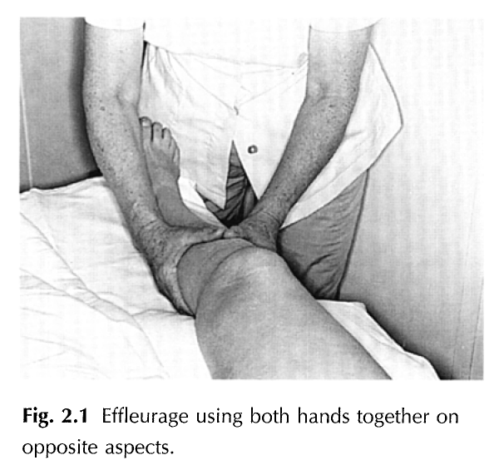

Slide 6
EFFLEURAGE- a form of massage involving a repeated circular stroking movement
Effleurage is a unidirectional manipulation in which the operator’s hand passes from distal to proximal (towards heart) with a depth compatible with the state of tissue and desired effect.
The manipulation may start at one end and proceed to proximal space, draining part to be treated. E.g. finger tips to axilla, neck to supraclavicular glands.
The depth should be such as to push fluid onwards in superficial vessels.

Slide 7
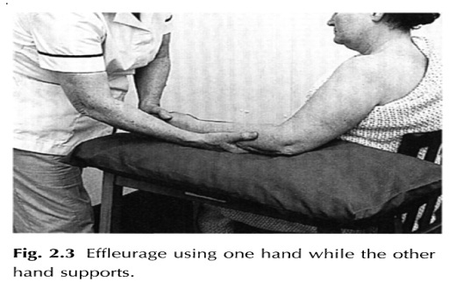
TECHNIQUE
The manipulation is performed with whole hand softly curved and relaxed to fit the part, or with any part of hand which fits part.
Both hands may be used together on opposite aspects of a part, or may follow one another.
Each hand may be used singly while opposite hand supports part in appropriate position. As manipulation proceeds over part, hands must change shape to maintain perfect contact.

Slide 8
When whole hand is used for effleurage, it should be placed obliquely on the skin so that leading edge is ‘C’ formed by thumb to forefinger cleft.
Pressure for manipulation is exerted by ‘C’ formed by lateral border of thumb, thenar eminence, hypothenar eminence and little finger. Pressure is graded from index to little finger and adjacent parts of palm.
If pressure is exerted by leading edge, it can be uncomfortable or jerky, or can cause sticking.

Slide 9


Slide 10
Stance of therapist: Walk standing
At the end of every line of effleurage there should be a small increase in depth and a slight pause before hand is lifted off and returned to distal part to start next line of work.
Disadvantage: Tickling effect if the return stroke is too light or a feeling of downdrag (exert a force with a heavy weight); if return stroke is too deep.

Slide 11
STROKING MANIPULATION

Slide 12
STROKING-
MOVE ONE’S HAND WITH GENTLE PRESSURE
Stroking is a unidirectional manipulation in which operator’s hand passes from proximal to distal down the length of tissues at a depth and speed compatible with the required effect, but direction of stroke may be varied to give greater comfort.
Strokes should start with firm contact and finish with a smooth lift off of your hands.
The hands may be positioned obliquely or so that heel travels first, but can adjust its position down length of part so that comfortable contact is maintained.

Slide 13
TYPES OF STROKES:
Slow and fast
Slow stroke:
Obviously greater depth can be achieved at slower rate, but the need for sedative effects, may limit your depth when pain and muscle spasm prevent further contact.
The slower strokes are more sedative. Try a speed of one stroke per five seconds.

Slide 14
Faster stroke:
The faster strokes are more stimulating.
Try a speed of four strokes every five seconds, i.e. four times faster. Faster stroking is often used to complete a more stimulating massage.

Slide 15
Whole area under treatment should be covered by a sequence of strokes.
Stroking may be performed using:
One hand – for narrow area
Two hands simultaneously – one each side of a broad area
Right and left hand following one another on a narrow area
Thumbs or fingers on confined areas one- handed, two-handed or alternately.

Slide 16
PHYSIOLOGICAL EFFECTS OF STROKING
Superficial stroking stimulates cutaneous touch receptors. It has sedative effect on body and if applied in a proper manner it has soothing and reposing effect.
Superficial stroking also indirectly improves circulation by activating axon reflex.
It facilitates contraction of the muscles. Superficial stroking, if performed faster can have a stimulating effect as against relaxing effect, when it is done slowly.

Slide 17
THERAPEUTIC USES OF STROKING
It is used owing to it’s sedative effect,
Prior to any massage procedure, to relax muscles and to accustom patients to manual contact.
In sleeplessness, gentle stroking of forehead offers great relief.
In anxiety, tension and psychological stress, slow rhythmic stroking for a prolonged period can be very useful.
In hypersensitivity, stroking is used to decrease hypersensitivity of part.
Fast stroking is used in all facilitation techniques to elicit contraction in hypotonic muscles.

Slide 18
Caution
In hypersensitive person, this technique can produce unwanted and excessive tickling.

Slide 19
MCQs
Which of the following technique is given from proximal to distal direction.
Effleurage
Stroking

Slide 20
2. Which of the following will give a stimulatory effect and therefore used prior to any other technique?
Effleurage
Stroking

Slide 21
3. Slow strokes of stroking is performed,
1 stroke in 5 seconds
4 stroke in 5 seconds
3 strokes in 5 seconds
2 strokes in 5 seconds

Slide 22
4. Fast stroke of Stroking is performed,
1 stroke in 5 seconds
4 stroke in 5 seconds
3 strokes in 5 seconds
2 strokes in 5 seconds

Slide 23
5. Which strokes of stroking is more stimulating?
A . Fast
B. Slow

Slide 24
THANKYOU……..

