Slide 1

DENTAL WAXES
Dr Piyush Javiya
Reader, Department of Prosthodontics,
KMSDCH, SVDU

Slide 2
Lesson Plan
Target: II BDS students
Duration: 01 Hour
Topic: Dental Waxes
Content | Duration in Minutes
Introduction | 05
Types of Waxes | 10
Classification | 05
Waxes in Detail | 20
Discussion | 10
CCES | 10

Slide 3
Introduction
Waxes are used in many aspects of dentistry – clinic & laboratory . Its not used in final dental restoration, but are important in the fabrication & success of final restoration.
Dental waxes – low molecular weight ester of fatty acids derived from natural & synthetic waxes.
Gums, fatty acids, fats ,oils ,& various resins – modify properties.
Supplied in variety of color to provide suitable contrast against die.

Slide 4
CHEMICAL NATURE OF WAXES
Waxes are made of two principle groups
Hydrocarbons
Esters
Alcohol
Fatty acids

Slide 5
Types
Natural
Animal,
Insect,
Plant and
Mineral sources
Synthetic

Slide 6
Mineral Waxes
Paraffin, Microcrystalline (natural)
Aldo33, Aerosol (synthetic)
Additives added as modifiers can be:
Fats- stearic acid, glyceryl-tristearate
Oils- turpentine oil
Colors

Slide 7
Waxes from plants
Carnauba wax, Candelilla, Japan wax, Coca butter
(additives here can be natural resins and rosins)
Waxes from insects
Bee wax
Waxes from animals
Spermacceti

Slide 8
Classification
2 Types
pattern waxes processing waxes
Pattern waxes – used to fabricate restoration using lost wax
technique.
e.g.. casting wax , base plate wax , & inlay wax
Processing wax – used as auxiliary materials – casting /
impressions / during soldering.
e.g.. Boxing wax , beading wax & sticky wax
Polymerizable resins , light cured resins – both pattern & processing
Waxes.

Slide 9
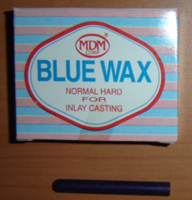
Pattern waxes
Inlay wax –
used to fabricate wax pattern for crowns, inlays , or bridges
available in round sticks ( 7.5 cm long X 6 cm diameter ) of diff colors
available in various hardness
acc to ANSI/ADA # 4 , 2 types –
Type 1 – medium wax ,used in direct technique
Type 2 – soft wax , used in the indirect technique
( Direct technique- in which wax pattern made within tooth )
( Indirect technique- in which pattern made within die )

Slide 10
Composition of Inlay wax
Paraffin wax –main ingredient , 40 – 60 wt%
-likely to flake , does not provide smooth glossy
surface.
Gum dammar / dammar resin – natural resin , added to improve smoothness , resistant to cracking & flaking , also toughness
Carnauba wax – quite hard ,has high mpt., added to flow at mouth temp. , also contributes to glossiness
Candelilla wax – not as hard as carnauba, replace it , low mpt., but properties similar to it.

Slide 11
Synthetic wax – e.g. nitrogen derivative of higher fatty acid, esters of acids ( montan wax )
- provide greater uniformity than natural wax ,
- working qualities also improved
Coloring agents – esthetic purposes
Fillers -- control expansion shrinkage of wax pattern

Slide 12
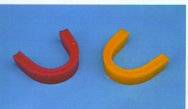
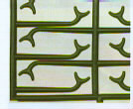
Casting wax – used to form wax pattern for metallic framework of removable partial denture.
-- available in sheets & in readymade shapes
-- believed to have similar composition as that of
inlay wax
Base plate wax – used to build contour of denture & hold the
position of denture teeth before processing
--available in sheets ( 7.5 cm wide, 15 cm long & 0.3 cm thick )

Slide 13
Composition– ceresin, beeswax, carnauba wax & various synthetic
wax.
3 types --
Type 1- soft at room temp. , used for contouring dentures
Type 2 – medium wax, used for pattern that will be placed into
mouth in temperate climate
Type 3 – hard wax , are for mouth use in tropical climates
Resins – used as pattern wax
- available as chemically cured & light cured
- higher strength & lower flow than pattern wax & burnout
without residue

Slide 14
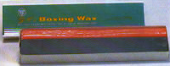
Processing waxes
Boxing & Utility waxes – used in taking & pouring impressions , soft , pliable ,dark color , have slight tackiness which allows them to be attached to each other or to stone models / impressions trays
Boxing wax –available as 40 cm strips ( 4-5 cm wide & 0.1 cm thick.
Utility & periphery wax –long beads ( 40 cm / more ) about 0.5 cm diameter.
Periphery wax – used in orthodontics during soldering , white in color

Slide 15
Sticky wax – used to assemble metallic / resin pieces temporarily in position or to seal plaster splint to stone cast in forming porcelain facings.
-- hard & brittle at room temp.
-- when heated, sticky & adhere to dental stone / other dental material.
Corrective impression wax – used as wax veneer over an original impression to register detail of soft
tissues in functional state.
-- flow at mouth temp. – 100%
-- distorted easily after removal from the mouth.

Slide 16
Bite registration wax – used for accurate articulation of opposing arches.
-- flow at 37.5* c–> 2.5- 22%
--made from beeswax / paraffin/ ceresin & oils
-- may contain Al / Cu particles
Other wax– 28 gauge casting / base plate wax also used as bite registration wax

Slide 17
INLAY CASTING WAXES
Ideal requirements according to ADA sp no 04.
When softened the wax should be uniform with no graininess or hard spots.
Contrast color with the die material.
No flakiness or roughness of surface when softened.
Should not stick to the carving instrument or chip off.
Should vaporize at 500⁰c with no residue.
Wax pattern should be rigid and dimensionally stable.
Should be plastic at slightly above Mouth temperature and rigid at mouth temperature.
Flow- 75% at 45⁰c and less than 1% at 37⁰c.

Slide 18
Other Properties of dental waxes
Melting range
Thermal expansion
Mechanical properties
Flow
Residual stresses
Ductility

Slide 19
Other properties….
Melting range – ,as waxes are mixture of diff components, do
not melt at single temp i.e.. No definite mpt.
Flow – change in shape under an applied force d/t slippage of
long chained wax molecules over each other.
-- depends on temp. & time ,each wax exhibit sharp
transition pt.( temp. ) at which it looses its plasticity.
-- its desirable for processing waxes but not for pattern
waxes

Slide 20
Maximum flow – type 1 wax at 37* c – 1%
Both type 1 & type 2 wax must have minimum flow – 70% at 45*c
Both type 1 & type 2 wax must have maximum flow – 90% at 45*c
Transition point→
soft wax → lower temp.
hard wax → higher temp.

Slide 21
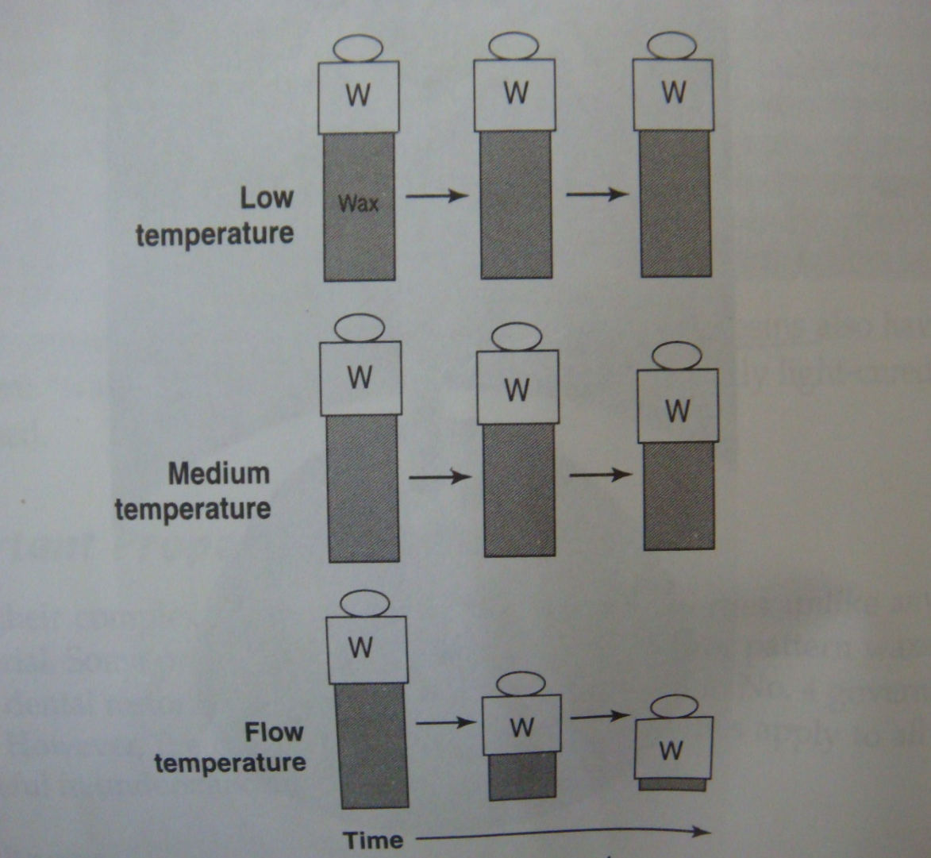
FLOW OF WAX

Slide 22
Thermal properties–
thermal conductivity of waxes – low
high coefficient of thermal expansion i.e. wax may expand as much as 0.7% with temp. of 20*c or may contract as much as 0.35% when temp. changed from 37* - 25*c
Avg. linear coefficient of thermal expansion – 350 x 10-6/*c
For pattern wax , thermal expansion-- critical

Slide 23
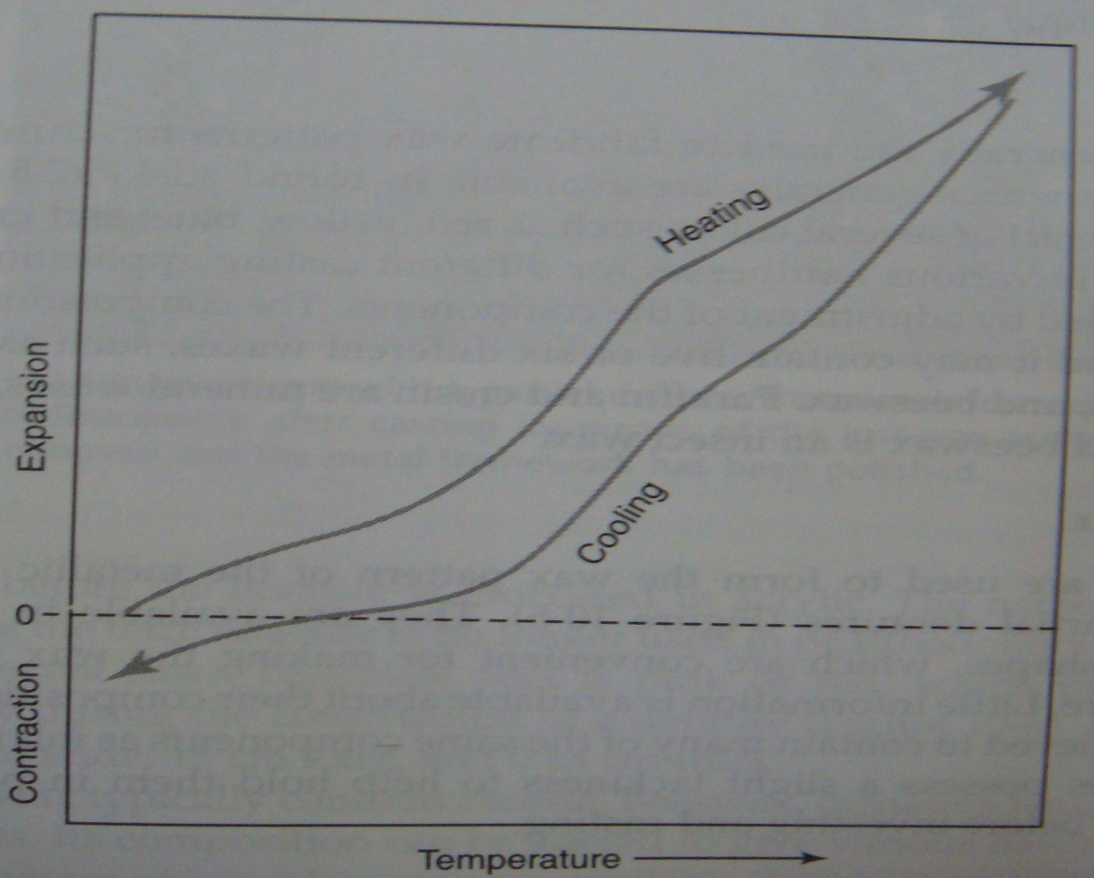
THERMAL EXPANSION OF WAX

Slide 24
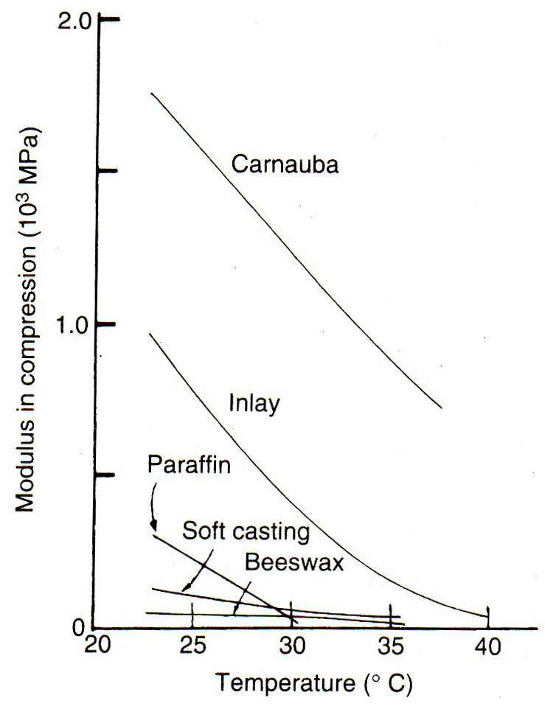
MECHANICAL PROPERTIES
The elastic modulus, proportional limit and compressive strength of waxes are low compared with those of other material and these properties depend strongly on the temperature.
The elastic modulus of various waxes are shown in this slide; with caranauba wax having the highest values and bees wax the lowest between 23º C and 40º C.

Slide 25
BIBLIOGRAPHY
Powers JM, Sakaguchi RL; Craig’s Restorative Dental Materials; 12th edition, 337-357.
Anusavice K.J; Science of Dental Materials; 11th edition, 283-293.
William J O‘Brien; Dental materials & their selection, 3rd edition,267-270.
Powers JM, Wataha JC; Dental Materials; 9th edition, 321-332.
Sorathur SH; Essentials of dental materials;256-261.

