Slide 1
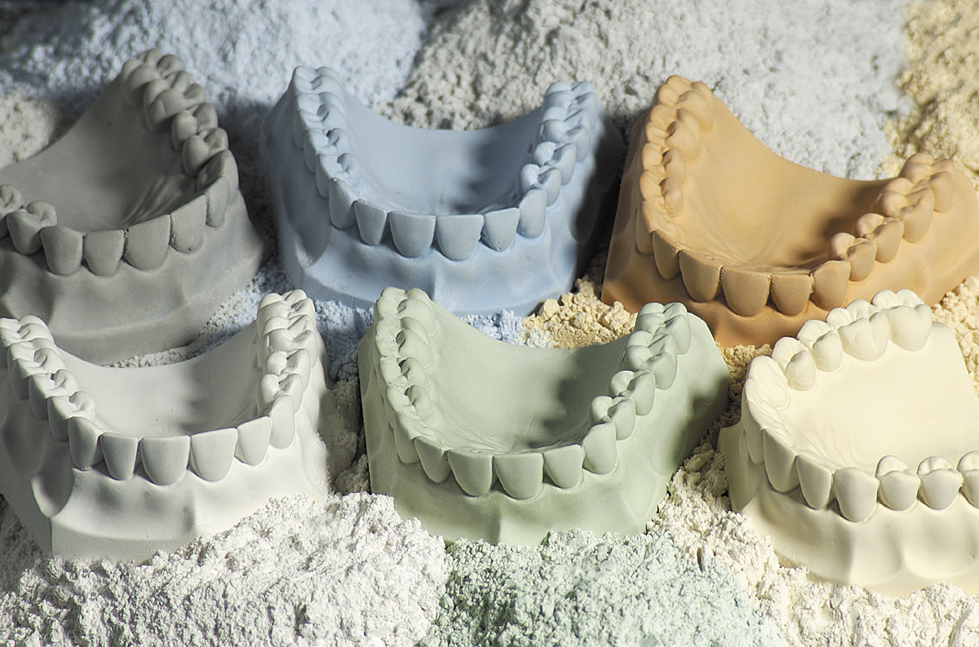

GYPSUM PRODUCTS

Slide 2
INDEX
Introduction
Applications
Classification
Properties
Types of gypsum products.
Manipulation
Infection control
Conclusion
References

Slide 3
Objectives of lecture
Definition
Applications of Gypsum products
ADA classification of gypsum products
Properties
Manipulation
Infection control

Slide 4
GYPSUM
Originates from the Greek word ‘Gypos’ which means chalk.
First found in the mines around the city of paris, so it is also called as ’Plaster of Paris’.
Mineral mined in various parts of the world.
Also a by product of some chemical processing operations.
Dihydrate of calcium sulfate.
Usually white to yellowish white in colour.

Slide 5
APPLICATIONS
General :
For Preparing statues.
In Construction work
Grounded gypsum (land plaster) is sometimes used as a fertilizer for soil that needs calcium
It is also used to make paint (as a filler), filters, insulation and wall plaster.
Alabaster is used for carving ornaments and vases.

Slide 6
Applications:
In Orthopedics:
For splinting & making plaster casts.
In Dentistry:
Making casts & dies on which dental prosthesis can be constructed.
Impressions for mouth and face.
To mounting of casts to an articulator.
For bite registration.
As mould material for processing complete dentures.
In dental investments.

Slide 7
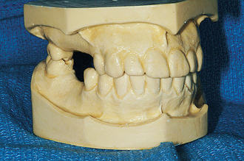
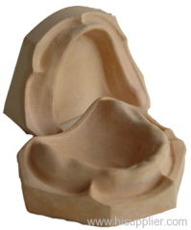

Slide 8
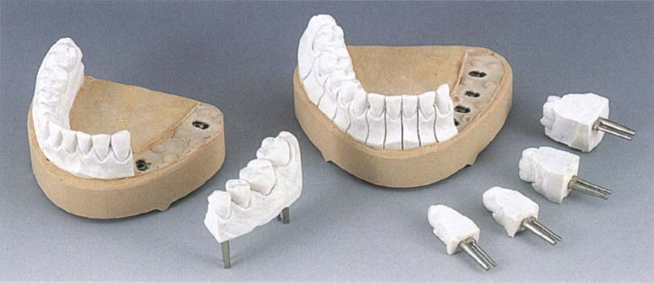

Slide 9
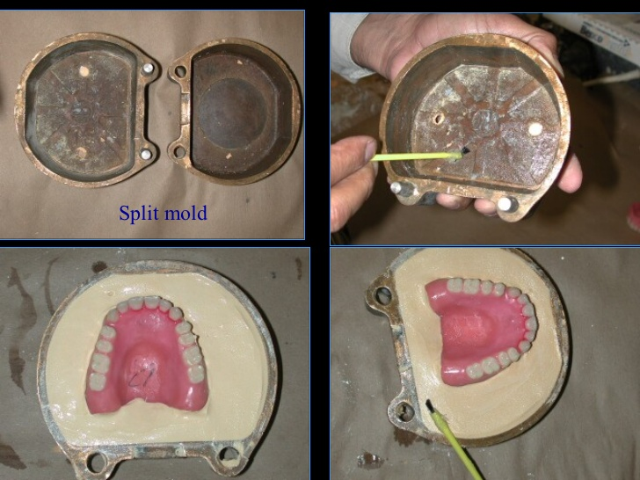

Slide 10
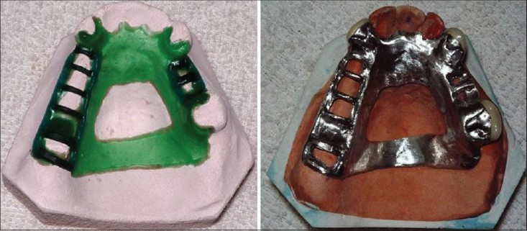

Slide 11
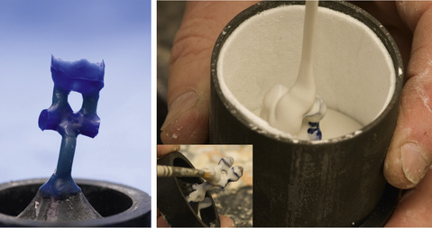

Slide 12
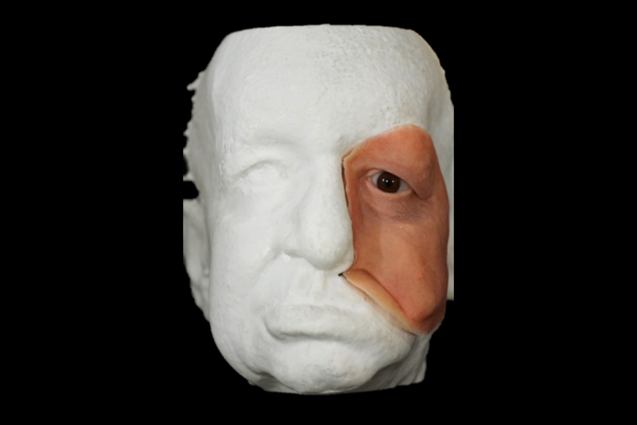

Slide 13
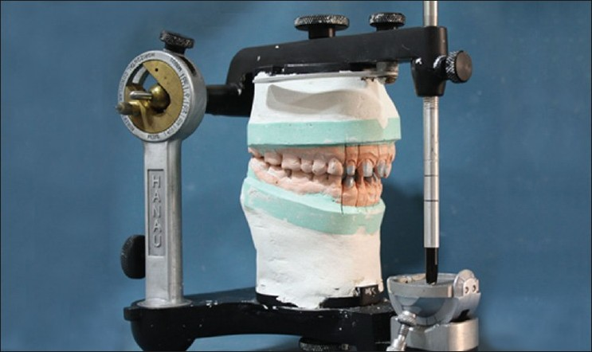
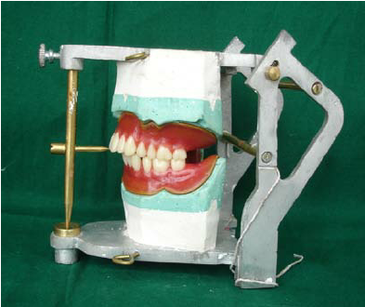

Slide 14
DESIRABLE PROPERTIES:-
1. Accuracy
2. Dimensional Stability
3. Ability to reproduce fine detail.
4. Strength & resistance to abrasion.
5. Compatibility with the impression materials.
6. Colour
7. Biological safety
8. Ease of use
9. Cost.

Slide 15
CLASSIFICATION
Acc. To ADA Specification No.25:
Type I : Impression plaster
Type II: Model plaster
Type III: Dental stone
Type IV: Improved stone/High strength low expansion
dental stone.
Type V : High strength high expansion dental stone.
Supplied as : Powders of various colors , in small preweighed sachets or in large bags, sacks or bins.

Slide 16
MANUFACTURE
Gypsum products used in dentistry are produced by calcination of calcium sulfate dihydrate or gypsum.
Chemical reaction :
₁₁₀º _{– 130}º_{C}
1) CaSO₄.2H₂O CaSO₄.1/2H₂O {Plaster or Stone}
(Calcium Sulfate
Hemihydrate)
₁₃₀º _{– 200}º_{C}
2) CaSO₄.1/2H₂O CaSO₄
(Hexagonal Form)
(Soluble anhydrite)
₂₀₀º _{– 1000}º_{C}
3) CaSO₄ CaSO₄
(Orthorhombic)
(Insoluble anhydrite)

Slide 17
Formed by calcining of gypsum .
CaSO₄ . 2H₂O ^{110-130ºC}(CaSO₄)₂ H₂O^{130-200ºC}CaSO₄^{200-1000ºC}CaSO₄
gypsum plaster/stone hexagonal ortho-
(calcium sulphate (calcium sulphate anhydrite rhombic
dihydrate) hemihydrate) anhydrite

Slide 18
HYDRATES OF CALCIUM SULPHATE
Mineral source By product of other industries
Calcium Sulphate Dihydrate( gypsum)
Heat in an open Heat in autoclave Heat ground gypsum Heat in boiling30%
vessel, 120ºc under steam in H₂O with small aqueous solution of
pressure, 120-130ºc quantity, organic CaCl₂/ MgCl₂
acid or salt, in an
autoclave,140ºc
Calcined CaSO₄ Autoclaved CaSO₄ Autoclaved CaSO₄ CaSO₄ hemihydrate
hemihydrate hemihydrate hemihydrate ( DENSITE)
(β- hemihydrate) (HYDROCAL or (α- hemihydrate)
α- hemihydrate)

Slide 19
Depending on the method of calcination, two forms of hemihydrate can be obtained:
ά-Hemihydrate
β-Hemihydrate
The differences between the α and β hemihydrates are a result of differences in the crystal size, surface area, and degree of lattice perfection.

Slide 20
β− HEMIHYDRATE α− HEMIHYDRATE
Crystal size LARGER SMALLER
Shape IRREGULAR PRISMATIC
Packing LOOSELY PACKED CLOSELY PACKED AMPLE SPACE B/W LITTLE SPACE B/W CRYSTALS CRYSTALS
W/P ratio MORE LESS
Strength LESS MORE
Surface MORE LESS
area/wt.
Example DENTAL PLASTER DENTAL STONE IMPRESSION PLASTER

Slide 21
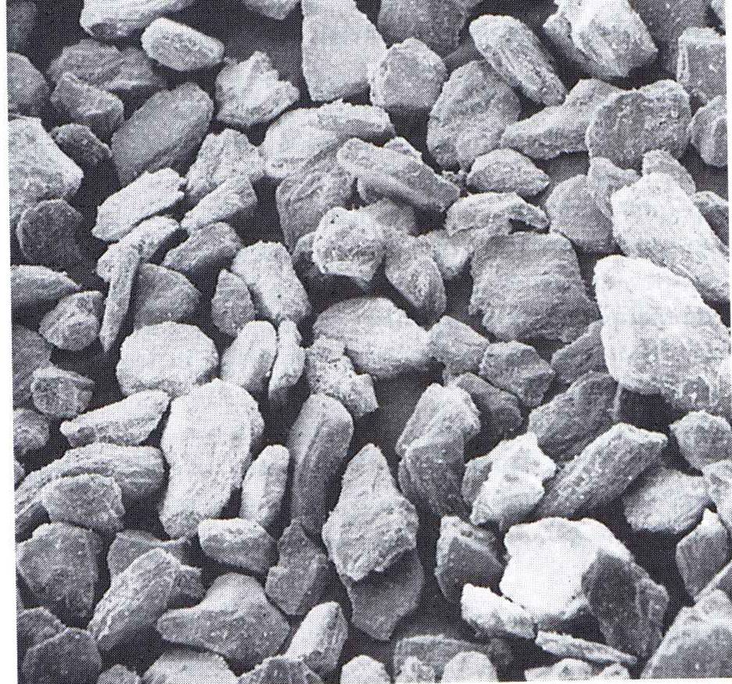
POWDER PARTICLES OF β-HEMIHYDRATE ( X 400.)

Slide 22
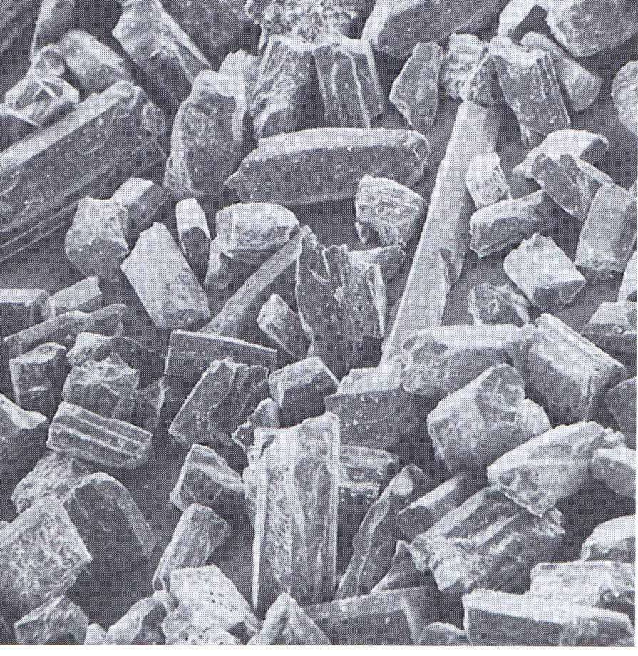
POWDER PARTICLES OF DENTAL STONE ( x 400.)

Slide 23
SETTING REACTION
The setting reaction is the reverse of the first stage of dehydration and so is exothermic.
2CaSO₄. ¹/2H₂O + 2H₂O 2CaSO₄.2H₂O+ Heat

Slide 24
Water powder ratio
It is the ratio or quotient obtained when the weight(or volume) of water is divided by the weight of the powder.
Important factor in determining the physical and chemical properties of the final gypsum product.
Higher the W:P ratio, longer is the setting time and weaker is the gypsum product.
Varies acc. To different types and brands:
Type I plaster : 0.5 to 0.75
Type II plaster : 0.45 to 0.50
Type III stone : 0.28 to 0.30
Type IV stone: 0.22 to 0.24
Type V stone : 0.18 to 0.22

Slide 25
Excess water : The actual amount of water required to mix the Calcium sulphate hemihydrate is greater than the amount required for the chemical reaction ie,18.6 gm water per 100 gm of hemihydrate (Gauging water).\
More Gauging water = More porosity
Water requirement affected by:
1.Shape & compactness of crystals.
2.Surface active materials (Calcium carbonate and gum arabic)
3.Particle size distribution.

Slide 26
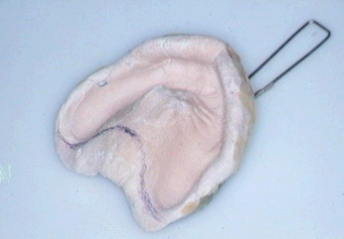
TYPES OF GYPSUM PRODUCTS
Impression Plaster
Type I
One of the earliest impression materials used.
Rigid, so had to be fractured from undercut areas.
Rarely used now a days.
Replaced by newer materials like hydrocolloids and elastomers.

Slide 27
It is CaSo₄ beta hemihydrate obtained by modifying type II plaster by adding small amounts of
Uncalcined gypsum & CaSo₄ anhydrite to decrease the setting time to 4±1(ADA-25)
Modifiers.
Potato starch or sugar: to form soluble plaster for dissolving & seperating cast from the impression.
Colouring pigments(Alizarin red) : to identify margins.

Slide 28
Properties:
Water powder ratio is 0.5 to 0.75.
Setting time is 4±1 minute.
Setting expansion is minimized (0 to 0.15%) to get good dimensional accuracy.
Low strength helps to separate impression by fracture.
Impression technique:
Used for edentulous cases without severe undercuts : use is similar to other inelastic impression materials. Apply separating media.

Slide 29
For partially edentulous cases or edentulous cases with severe undercuts: after impression sets, carefully fracture it by hammering to remove the impression, Join the broken pieces, apply seperating media, pour the cast.
After setting immerse in warm water to dissolve the impression.
Can also be used as wash or secondary impression.
Advantages:
Negligible dimensional change.
Good reproduction of details.

Slide 30
Disadvantages:
Non elastic.
Messy work
Bad taste, disliked by patients.
Due to availability of elastomeric and hydrocolloid impression materials, which are more convenient, it has become outdated now.

Slide 31
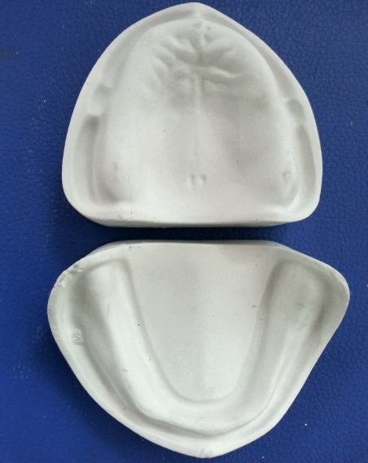
DENTAL PLASTER
Composition:
Beta hemihydrate and modifiers.
Uses:
Making study casts and models.
Making moulds for curing dentures.
Mounting casts on articulators.

Slide 32
Requirements:
Should set rapidly but give adequate time for manipulation.
Should set to a very hard and strong mass.
After mixing, Consistency should be such that it should flow into all parts of the impression and reproduce all the minute details.
Neither contract nor expand while setting.
After setting it should not warp or change shape.
It should not loose strength when subjected to moulding & curing procedures.

Slide 33
Properties :
Water powder ratio is 0.45-0.5
Setting time is 12±4 minutes.
Setting expansion is < 0.3%
Low strength: 9 MPa (1 hour) and 20-30 Mpa dry compressive strength- adequate for use.
Low surface hardness and abrasion resistance.

Slide 34
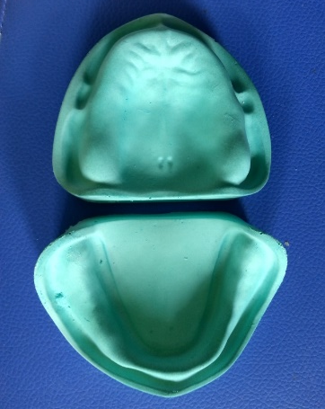
DENTAL STONE
Uses :
For preparing master casts and make moulds.
Binder for gypsum bonded investment material, for casting and soldering purpose.
Composition :
Alpha hemihydrate
Accelerators
Retarders
Colouring matter.
Balanced solution : A stone with the setting time established by the proper Quantities of both accelerators & retarders.

Slide 35
Properties:
W/P is 0.28 to 0.3.
Setting time is 12±4 minutes.
Compressive wet strength : 20 Mpa
Dry strength is 40-60 Mpa.
Setting expansion : <0.2%(0.06-0.12%)
Hardness : 60 RHN

Slide 36
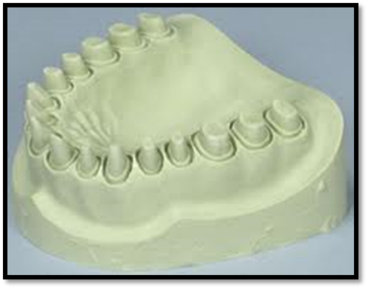
IMPROVED DENTAL STONE
Type IV stone. Die stone, Densite, Class II dental stone
The srongest & hardest variety of gypsum products.
Uses : Dies used for inlay, crown and bridge wax patterns.
Properties:
Low W/P ratio : 0.22 to 0.24
Lowest setting expansion < 0.1%
Higher compressive strength, wet strength: > 35 Mpa.
Dry strength is about 92 RHN.

Slide 37
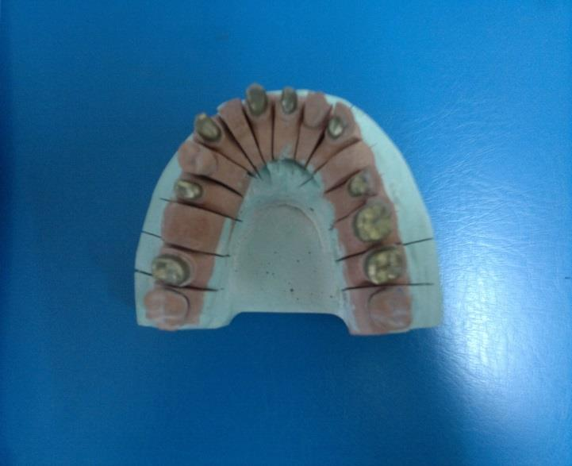
TYPE V DENTAL STONE WITH HIGH STRENGTH AND HIGH EXPANSION
To prepare dies.
Most recent gypsum product having an even higher compressive strength than type IV stone.
Obtained by lowering the w/p ration even further.
Setting expansion increased from a maximum of 0.10 to 0.30%.
This is for compensation for shrinkage of base metal alloys during solidification.

Slide 38
MIXING, WORKING AND SETTING TIMES:
MIXING TIME:
Defined as the time from the addition of the powder to the water until the mixing is completed.
Mechanical mixing of stones and plaster is usually completed in 20 to 30 seconds. Hand spatulation generally requires at least a minute to obtain a smooth mix.
WORKING TIME:
The time available to use a workable mix, one that maintains a uniform constituency to perform one or more tasks.
It is measured from the start of mixing to the point where the consistency is no longer acceptable for the product’s intended purpose.
Generally, a 3-minute working time is adequate.

Slide 39
SETTING TIME:
The time that elapses from the beginning of mixing until the material hardens is known as the setting time.
Measurement of setting time:
LOSS OF GLOSS TEST:
As the material sets, the mix loses its gloss. This occurs as some of the excess water is taken up in forming the dihydrate. This loss of the gloss is also sometimes considered as a indication of Initial set of the material.
PENETRATION TESTS:
Gillmore needles
Vicat needles

Slide 40
GILLMORE TEST FOR INITIAL SET:
The mixture is spread out, and the smaller needle is lowered onto the surface. The time at which it no longer leaves an impression is called the initial set.
This event is marked by a definite increase in strength.
Acts as a guide to the time when the rigid material is strong enough to handle and, in particular, when it can be carved or trimmed to the final shape.
The setting reaction continue for some time after this initial set.
GILLMORE TEST FOR FINAL SETTING TIME:
Measured by the use of the heavier Gillmore needle.
The elapsed time at which this needle leaves only a barely perceptible mark on the surface is called the final setting

Slide 41
VICAT TEST FOR SETTING TIME:
Consists of a rod weighing 300 gm with a needle of 1 mm diameter.
A ring container is filled with the mix. The needle with a weighted plunger rod is supported and held just in contact with the mix, then is the needle is released and allowed to penetrate the mix. The time elapsed until the needle no longer penetrates to the bottom of the mix is known as Vicat setting time.

Slide 42
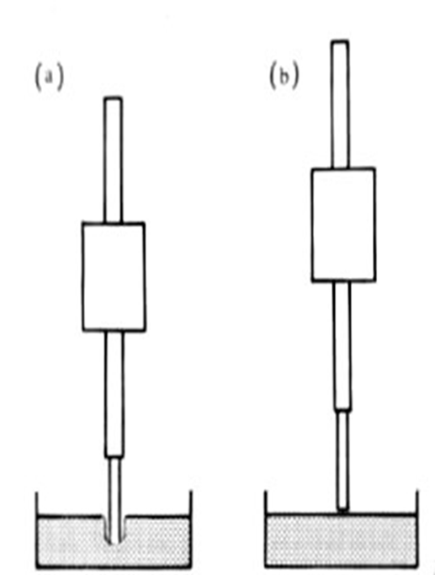
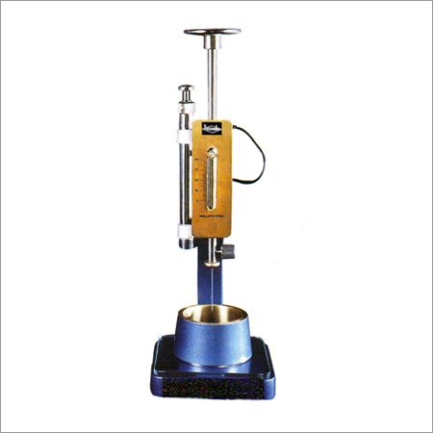
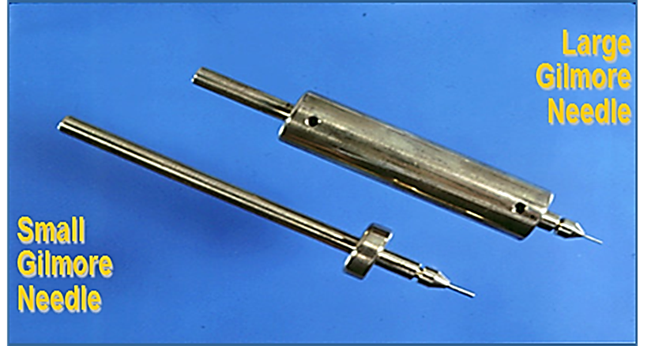
Material is unset
Material is set
Vicat Penetrometer

Slide 43
MANIPULATION
Proportioning:
To secure maximum strength, recommended water/powder ratio is used.
The water should be measured and powder weighed.
Instruments:
Flexible rubber mixing bowl(Parabolic), with a top diameter of 130 mm is recommended.
Stiff bladed spatula(width: 20-25mm & length 100 mm).
Hand mixing & Mechanical mixing

Slide 44
Hand-Mixing:
Take measured quantity of water in a rubber bowl & sift
a weighed quantity of powder into it.
Allow to selttle for 30 seconds.
The mix is stirred vigurosly.Periodically wipe the inside of the bowl with a spatula to ensure wetting of the powder& breaking of the lumps.
Continue till a smooth,Creamy mix is obtained.
Spatulation should be completed in 45-60 seconds.

Slide 45
Vibrate the mix(vibrator or hand tapping) & pour it into the impression.
Note:
The mixing instruments should be meticulously cleaned.
No air must be trapped into the mixed mass.

Slide 46
Mechanical mixing:
Done under vaccum.
Gives stronger and denser casts.
Expensive equipment.

Slide 47
Preparing the cast:
A small amount of mix is teased through the sides of the impression and vibrated to flow on the floor of the impression .
This is done to sweep all the trapped air bubbles.
Remaining of the mix is then poured with vibration and allowed to set.

Slide 48
Preparing the base:
A plaster mix is made and placed on a glazed tile.Over this the initially set cast is inverted & excess is removed from the sides, shaped & allowed to harden.
Boxing method :
The impression is first countoured by beading it and then building vertical walls by using boxing wax.
The plaster mix is poured; first in small quantity to cover the impression surface,Vibrated and then the remaining mix is poured and allow to set.

Slide 49
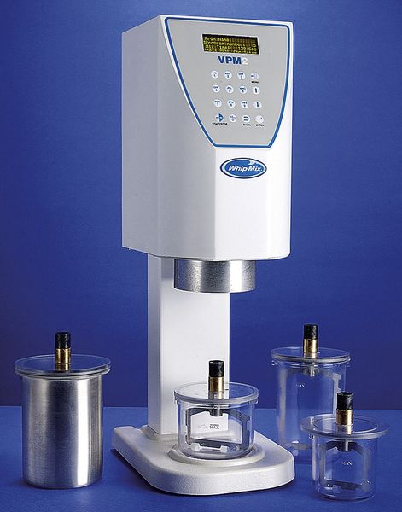
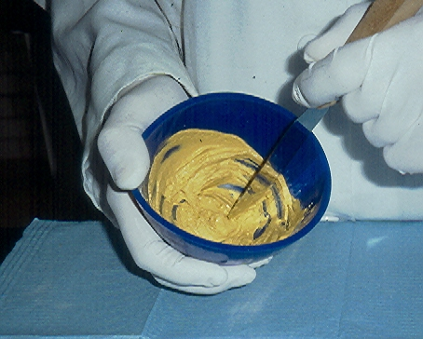
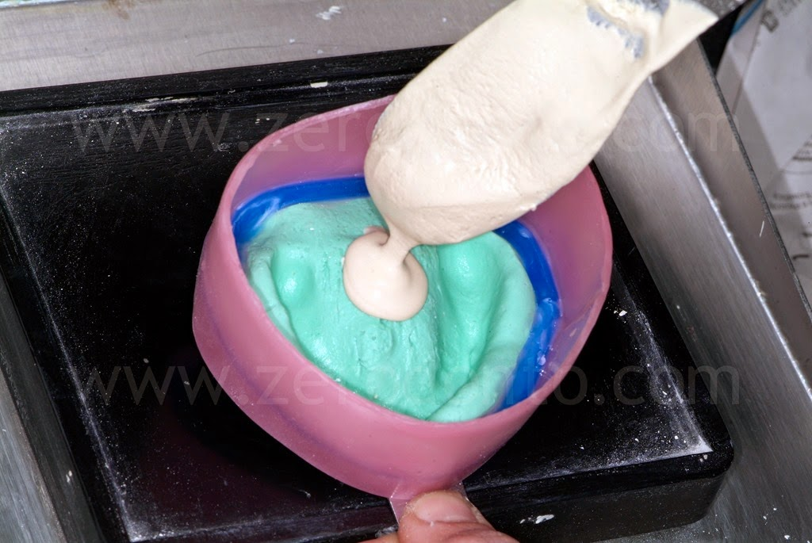
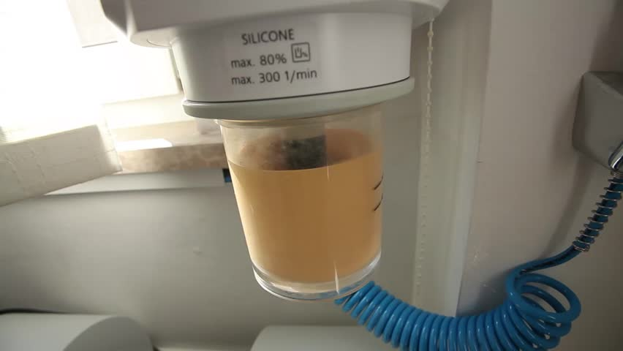

Slide 50
CARE OF GYPSUM
Care of the cast
All gypsum casts should be handled with care, as any departure from the expected accuracy may result in poor fitting appliance.
If the gypsum cast has to be soaked in water. It should be placed in a water bath in which the plaster debris are allowed to remain constantly at the bottom.
This is as slurry water.
Used to preserve surface details.

Slide 51
Storage of the powder:
As gypsum products are hygroscopic, so they should be stored in airtight containers.
When the relative humidity is more than 70%, it takes up moisture to start the setting reaction.
In earlier stages→crystals of gypsum→Nuclei of crystallization→Faster setting
Later stages→Entire mass covered by more gypsum crystals→Difficulty in water penetration→
Delayed setting.
It should be kept clean with no dirt or other foreign bodies.

Slide 52
Modifications of the Gypsum
Dental Casting Investment
To prepare refractory molds
Silica or quartz add to gypsum
Synthetic gypsum
Also produced as a by-product of manufacture of phosphoric acid.
More expensive
Orthodontic stone
To prepare Ortho study model
Longer working time

Slide 53
Resin modified stone
Resinrocks
It is a blend of synthetic resin and alpha gypsum.
The strength is more
Mounting plaster
Plaster used for attaching the cast to articulators
Low setting expansion
Type II plaster is used for this purpose
Specialized plaster is also available for this (3 min)
Easy separation and low setting expansion
Fast setting stone
Setting time is 2 min.
E.g. snap stone

Slide 54
INFECTION CONTROL
The process of killing (inactivating) harmful bacteria and other microorganisms (pathogenic) by various agents such as chemicals, heat, ultraviolet light, ultrasonic waves or radiation.

Slide 55
Cross contamination possible to dental office personnel through dental impressions.
So Disinfection of casts recommended.
Gypsum products can be disinfected by:
Immersing cast in disinfecting solutions.
Addition of disinfectant in the stone.
When patients with known cases of infection are being treated, overnight gas sterilization can be a option (impractical for routine use).
Commonly used stone disinfectants are spray disinfectants, hypochlorite and iodophores and glutaraldehyde

Slide 56
TITLE | AUTHOR AND JOURNAL | MATERIALS AND METHOD | RESULTS | CONCLUSION | LEVEL OF EVIDENCE
Disinfection procedures: their effect on the dimensional accuracy and surface quality of irreversible hydrocolloid impression materials and gypsum casts | Rebecca L. Taylor, , Paul S. Wright, Christopher Maryan Dental Materials Volume 18, Issue 2, March 2002, Pages 103–110 | Dimensional accuracy was determined from the mean percentage deviation of six measurements taken from casts made from disinfected impressions compared with corresponding measurements from the master model and controls. Statistical analysis of data was determined by analysis of variance. Surface quality was determined using a stainless steel test block in accordance with ISO 1563. | The dimensional accuracy of the impression materials tested were of a comparable standard following disinfection. The surface quality of casts taken from Blueprint Cremix impressions were unaffected by the disinfection procedures. The remaining impression materials studied showed greater surface deterioration on casts following disinfection with sodium hypochlorite than immersion in Perform®. All disinfection procedures selected proved appropriate for antibacterial purposes. | Individual analysis of impression materials is required to determine their suitability to a given disinfection protocol. | C3

Slide 57
REFERENCES
Philip’s science of dental materials,Tenth edition.
Restorative dental materials, Robert G.Craig,John M.Powers; eleventh edition.
Introduction to dental materials, Richard van Noort, second edition.
Science of dental materials;Clinical applications, B.T.Nandish,V.Shama Bhatt.
Dental materials, Sanjayagauda B Patil, first edition.
Applied dental materials, John F. McCabe and Angus W.G.Walls; eigth edition.

Slide 58
THANK YOU

