Slide 1
THORACIC WALL
AND
RESPIRATORY MOVEMENT
Mr. K.M.Parmar
Assistant Professor
Department of Anatomy
S.B.K.S.M.I. & R.C.

Slide 2
Objectives
Introduction to thorax
Walls of thorax
Skeletal framework of thorax
Intercostal space
Intercostal drainage
Respiratory movement

Slide 3
THORAX
Upper part of the trunk
Vital organs protected: lungs & heart
Major vessels – Superior vena cava, Inferior vena cava, Pulmonary artery, Aorta
Trachea, oesophagus, thoracic duct

Slide 4
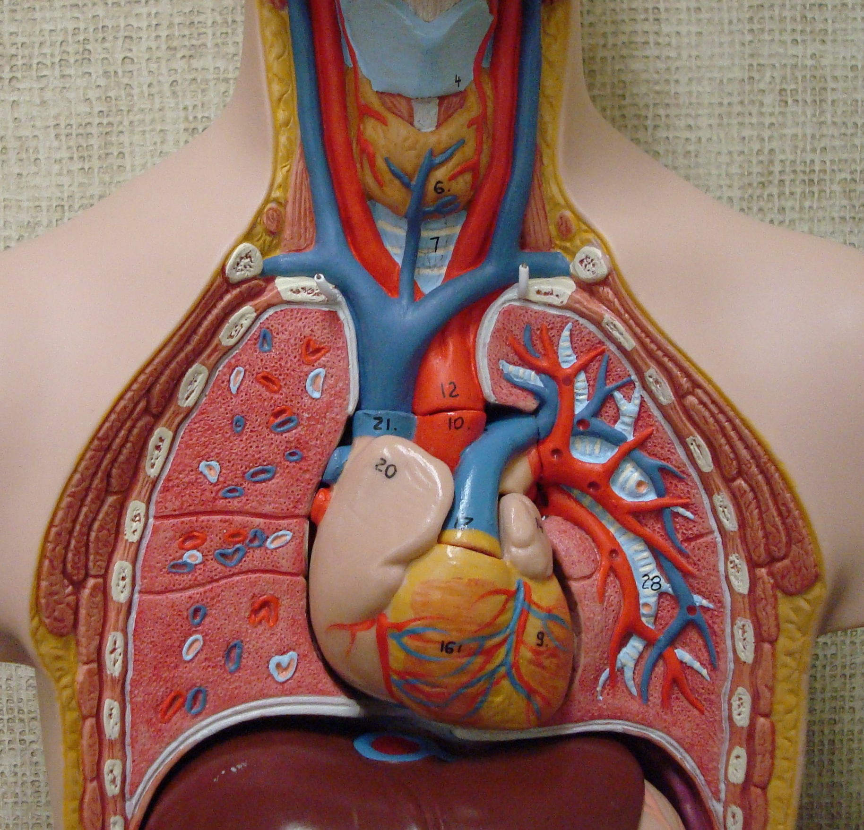

Slide 5
Thoracic wall
Coverings
Wall proper

Slide 6
Thoracic wall
Coverings:
skin, sup fascia, deep fascia, muscles
Muscles of other regions:
upper limb
Abdomen
back

Slide 7
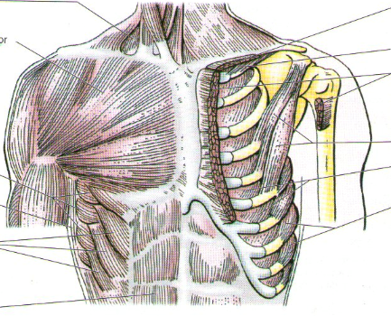

Slide 8
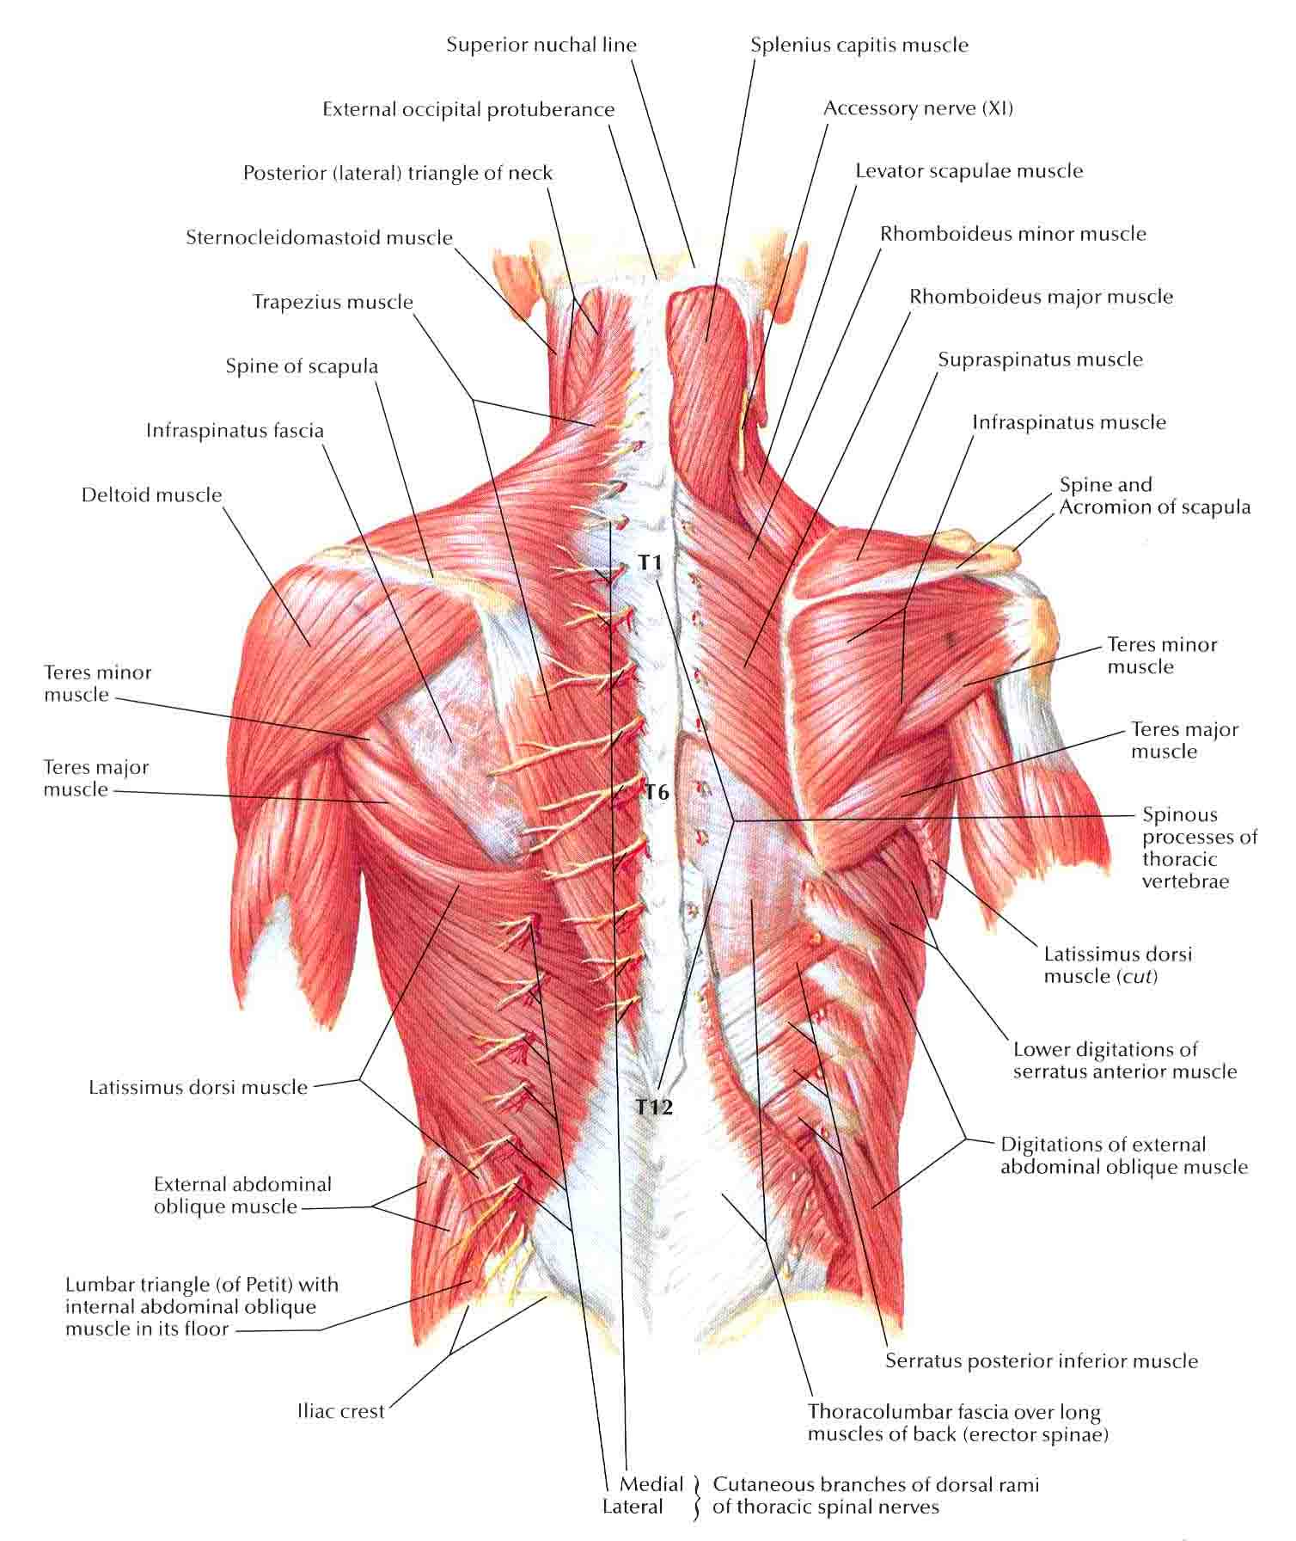

Slide 9
Thoracic wall Proper
Skeletal Framework
Intercostal spaces

Slide 10
Thoracic wall Proper
Skeletal Framework:
Osseo-cartilagenous
Elastic
12 pairs of ribs
Sternum
12 thoracic vertebrae

Slide 11
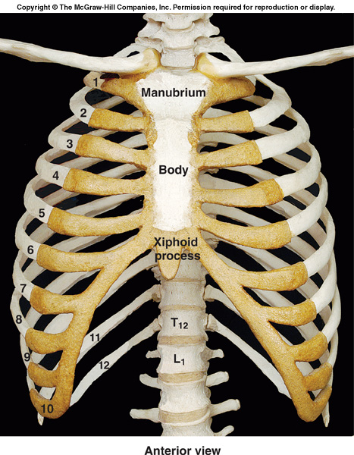

Slide 12
Thoracic wall
Intercostal spaces: space between two ribs, total - 11
Contains: intercostal muscles, vessels, nerves

Slide 13
Intercostal Muscles
External intercostal
Internal intercostal
Transversus thoracis:
  Sternocostalis
  Subcostalis
  Intercostalis intimi

Slide 14
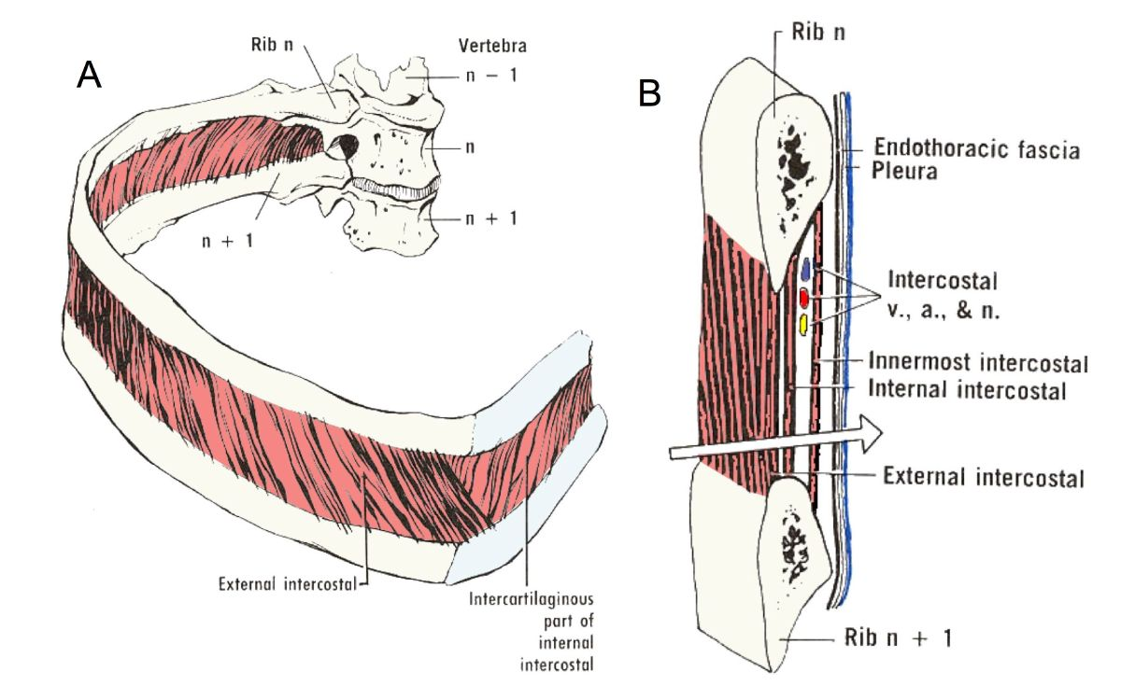

Slide 15
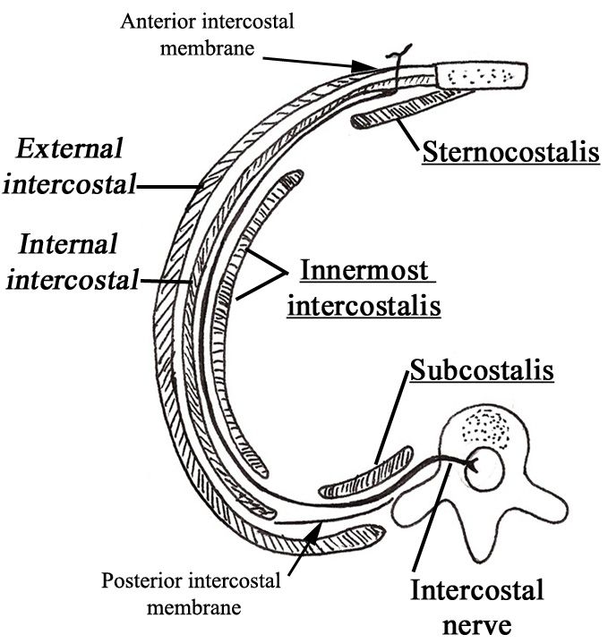
Transversus thoracis group
Arrangements and extension of the muscles

Slide 16
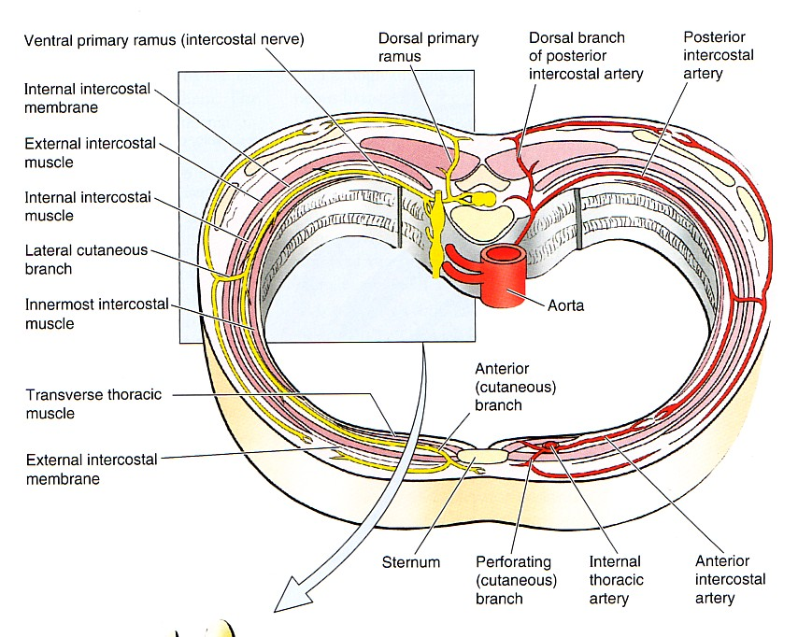
Intercostal Spaces
There are 9 anterior and 11 posterior
Each space contains:
1- Intercostal muscles: (External, Internal and transversus thoracicus)
2- An Intercostal nerve.
3- Intercostal vessels:
a. Intercostal arteries
(Anterior & Posterior)
b. Intercostal veins
(Anterior & Posterior).

Slide 17
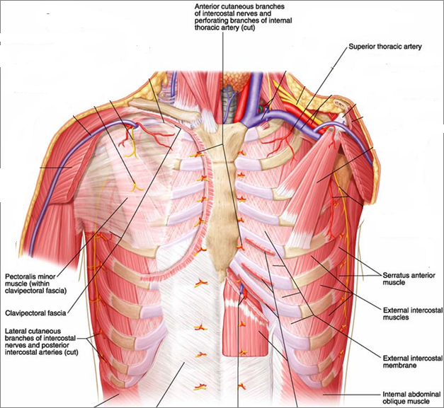
External Intercostal Muscle
Most superficial
Fibers directed downward & forward
Origin: from lower border of the rib above
Insertion: upper border of rib below
Extends from the rib tubercle behind to the costo-chondral junction in front
Deficient anteriorly & replaced by external (anterior) intercostal membrane
Costo-chondral junction

Slide 18
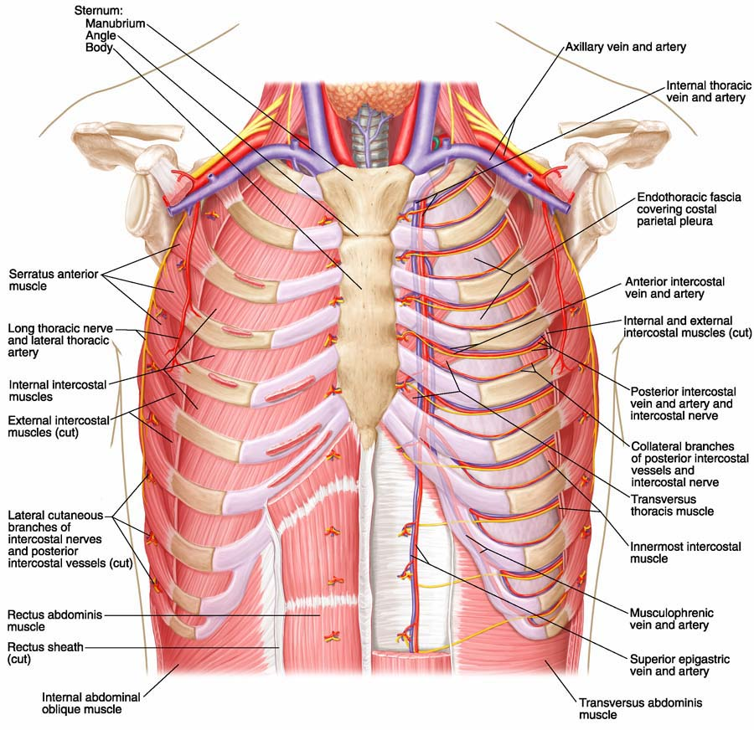
Internal Intercostal Muscle
Intermediate layer
Fibers directed downward & backward
Origin: from subcostal groove of the rib above
Insertion: upper border of rib below
Extends from the sternum in front to the angle of the rib behind
Deficient posteriorly & replaced by internal (posterior) intercostal membrane

Slide 19
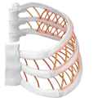
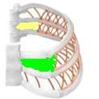
Angle of the rib
posterior intercostal membrane &
internal intercostal muscle
V
CC
S
costochondral junction
anterior intercostal membrane &
external intercostal muscle

Slide 20
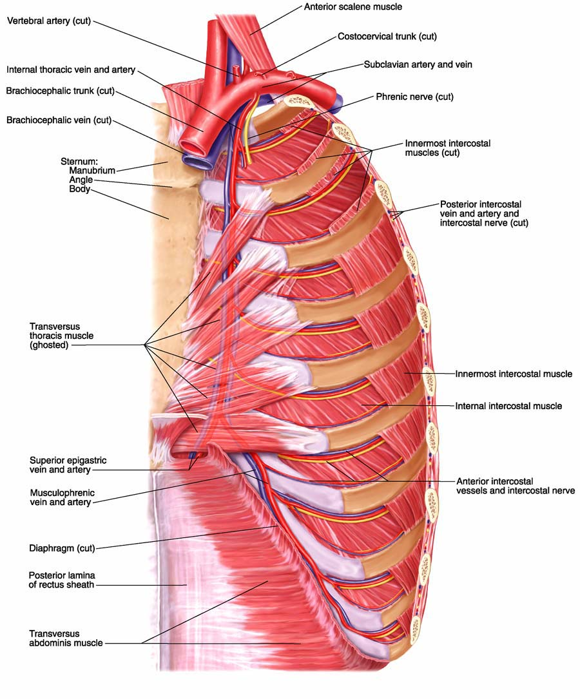
Innermost Intercostal Muscle
Deepest layer
Incomplete layer, divided into three portions
Fibers cross more than one intercostal space
Related externally to intercostal nerve and vessels, and internally to endothoracic fascia

Slide 21
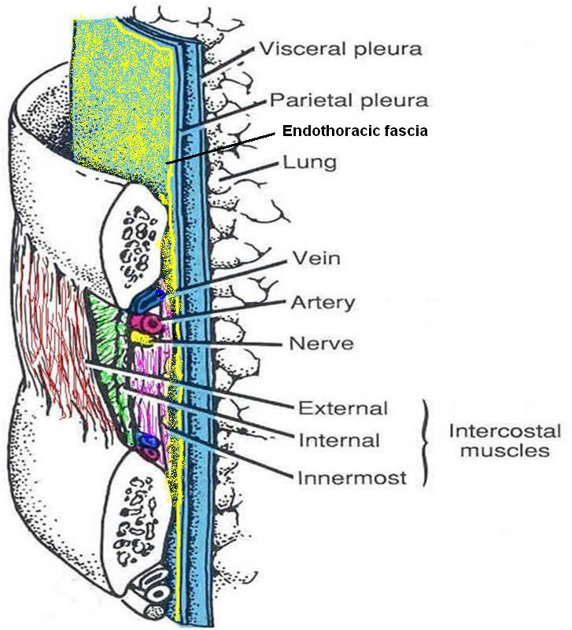
Intercostal Neurovascular Bundle
Lies between the innermost and the internal intercostal muscles
Runs high in the intercostal space, related to subcostal groove of the rib above
Has a strict order in arrangement: Vein-Artery-Nerve (VAN), from top to bottom
As the innermost intercostal muscle is not forming a complete layer, the bundle is generally covered on the inside by the endothoracic fascia

Slide 22
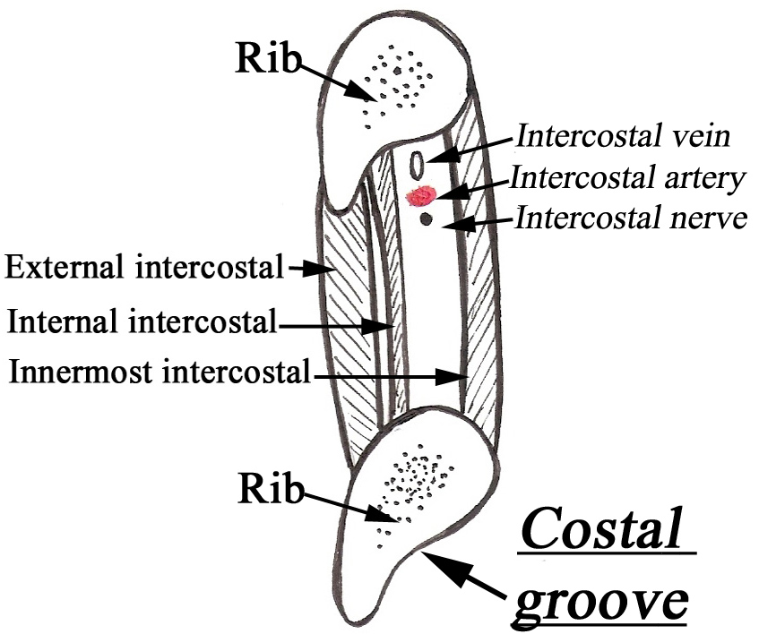
Arrangement of intercostal nerve and vessels in the costal groove

Slide 23
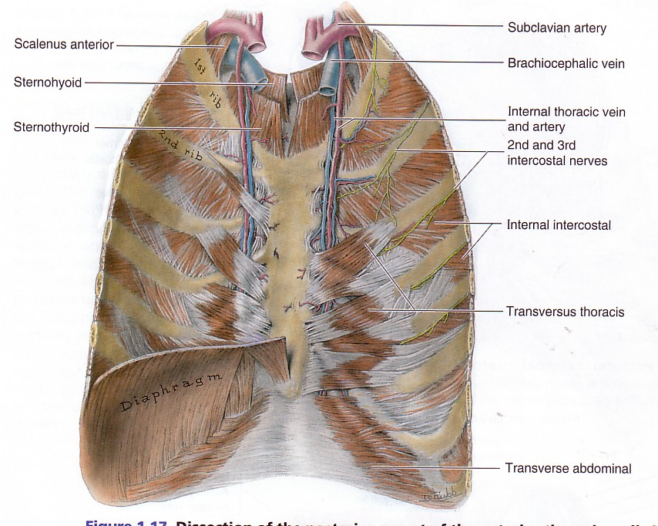
Sternocostalis
4 to 5 slips which arise from inner surface of lower part of body of sternum and costal cartilages
Inserted into inner surface of costal cartilages from 2 to 6.
Thin bands of muscle fibers.
Mainly in lower 6 spaces.
Only in post. part of spaces.
Origin: Inner surface & lower border of rib above.
Insertion: Upper border of 2nd or 3rd rib below.
Subcostalis muscle

Slide 24
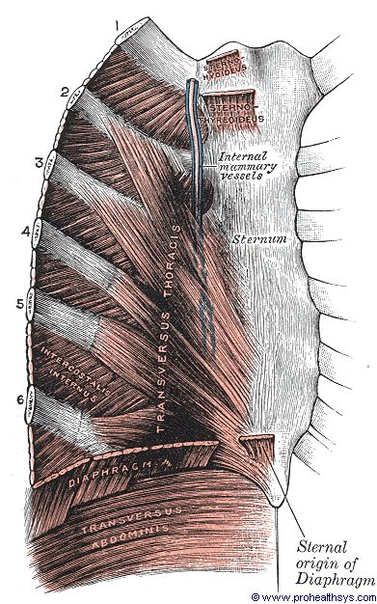

Slide 25
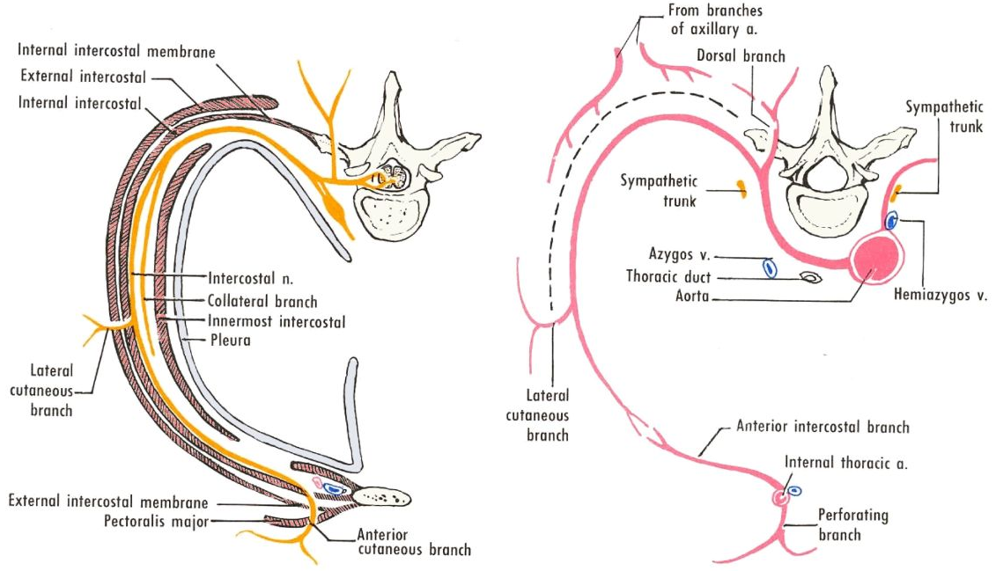
Intercostal Nerves

Slide 26
Intercostal Nerve
T1-T2: upper limb
T7-T11: Abdomen
T3-T6: true intercostal Nerves
T12: subcostal nerve

Slide 27
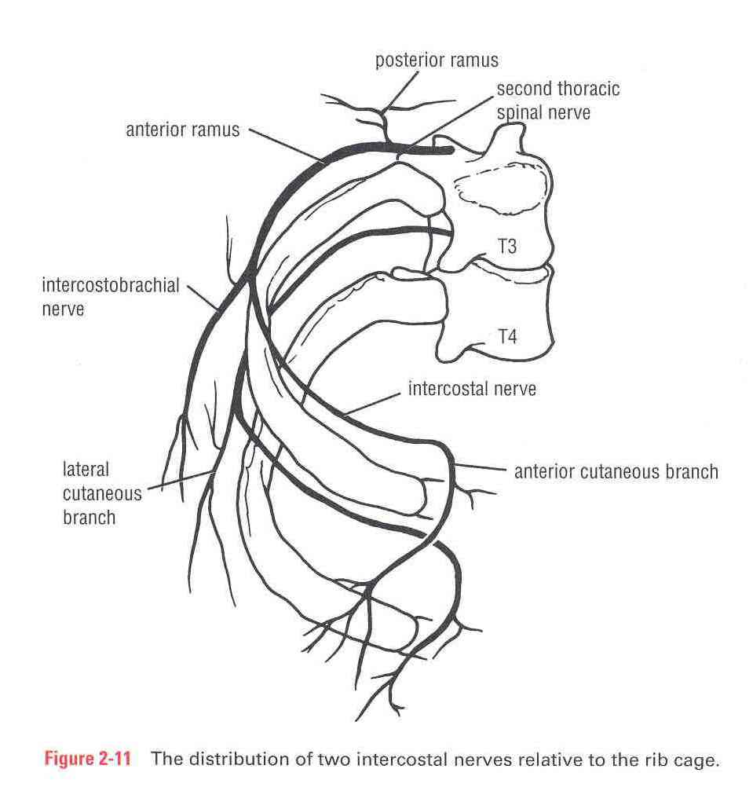
Intercostal Nerves
Twelve pairs
Are the anterior primary rami of the thoracic spinal nerves.
1-6 distributed in the intercostal spaces, 7-11th supply the anterior abdominal wall
Anterior ramus of 12th nerve runs forward in the abdomen as the subcostal nerve

Slide 28
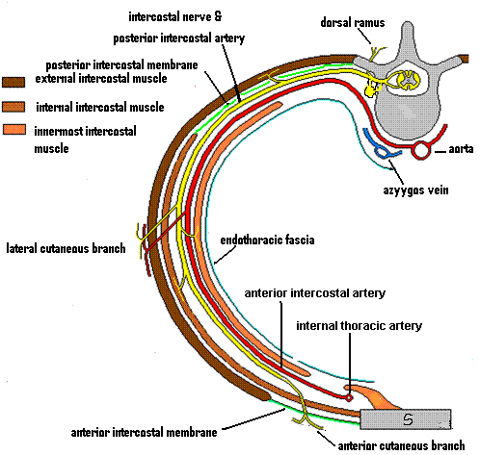

Slide 29
Atypical Intercostal Nerves
First thoracic nerve:
  Has no anterior cutaneous branch
  Is joined to the brachial plexus by a large branch that corresponds to the lateral cutaneous branch
Second thoracic nerve :
  Is joined to the medial cutaneous nerve of the arm by brachial plexus by a branch called the intercostobrachial nerve that corresponds to the lateral cutaneous branch

Slide 30
Intercostal Arteries
Each intercostal space contains:
  A single posterior &
  Two anterior intercostal arteries
Each artery gives off branches to the muscles, skin, parietal pleura (& breast)

Slide 31
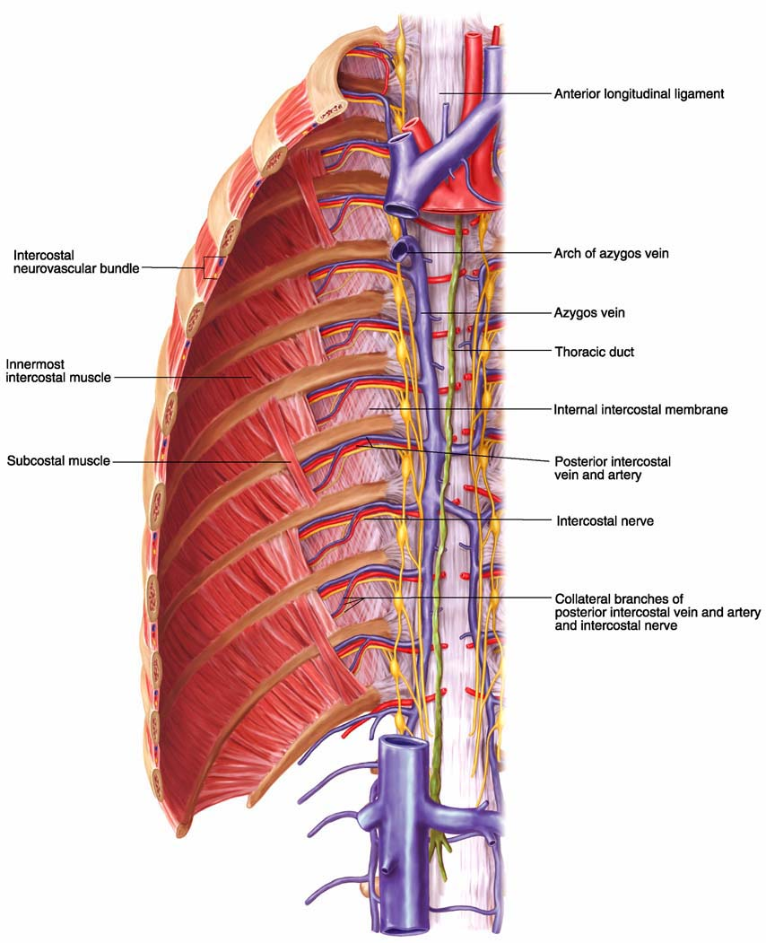
Posterior Intercostal Arteries
In the upper two spaces, arise from the superior intercostal artery (a branch of costocervical trunk of the subclavian artery)
In the lower nine spaces, arise from the branches of thoracic aorta
The course and branching of the intercostal arteries follow the intercostal nerves

Slide 32
Anterior Intercostal Arteries
In the upper six spaces, arise from the internal thoracic artery
In the lower five spaces arise from the musculophrenic artery (one of the terminal branch of internal thoracic)
Form anastomosis with the posterior intercostal arteries

Slide 33
Intercostal Veins
Accompany intercostal arteries and nerves
Each space has posterior & anterior intercostal veins
Eleven posterior intercostal and one subcostal vein
Lie deepest in the costal grooves
Contain valves which direct the blood posteriorly

Slide 34
Posterior Intercostal Veins
On right side:
  The first space drains into the right brachiocephalic vein
  Rest of the intercostal spaces drain into the azygos vein
On left side:
  The upper three spaces drain into the left brachiocephalic vein.
  Rest of the intercostal spaces drain into the hemiazygos and accessory hemiazygos veins, which drain into the azygos vein

Slide 35
Anterior Intercostal Veins
The lower five spaces drain into the musculophrenic vein (one of the tributary of internal thoracic vein)
The upper six spaces drain into the internal thoracic vein
The internal thoracic vein drains into the subclavian vein.

Slide 36
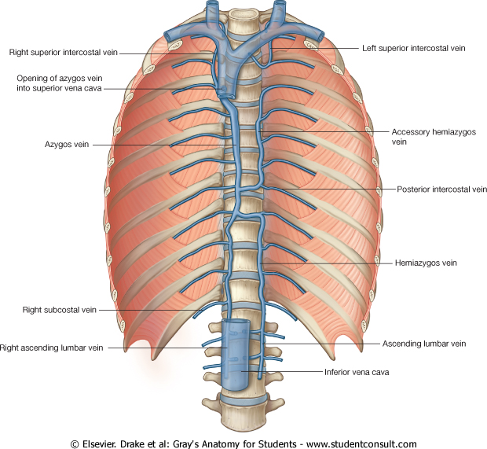
II. Posterior Intercostal Veins
Right side:
1st +2nd + 3rd post. intercostal veins unite to form the right superior intercostal vein → azygos vein.
-4th - 11th post. intercostal veins → azygos vein
-Subcostal vein→ Azygos Vein

Slide 37
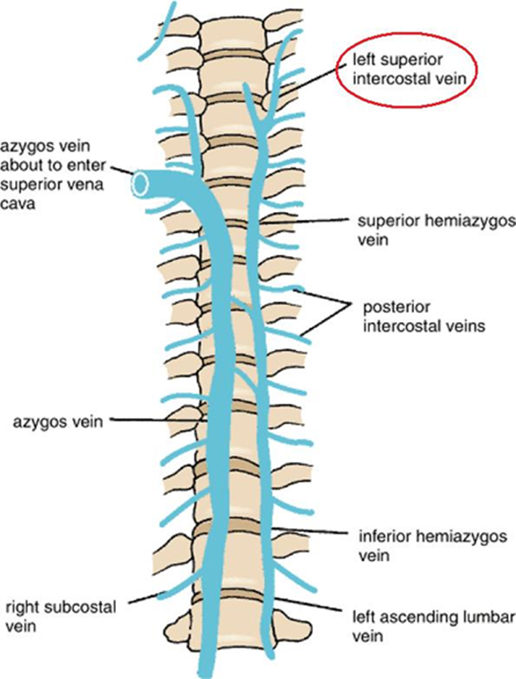
II. Posterior Intercostal Veins
Left side:
- 1stpost. intercostal vein→ left innominate vein.
2nd + 3rd post. intercostal veins unite to form the superior intercostal vein
- 4th – 8th post. intercostal veins→ superior hemiazygos.
- 9th – 11th post. intercostal vein→ inferior hemiazygos vein.
- Subcostal vein→ inferior
hemiazygos vein.

Slide 38
Lymphatics
Lymph vessels of the intercostal space conform to the general rule, that deep lymphatics follow arteries
  Anteriorly drain into anterior intercostal nodes that lie along the internal thoracic artery
  Posterioly drain into posterior intercostal nodes that lie in the posterior mediastinum

Slide 39
Applied Anatomy
Sternum:
  used for marrow biopsy
  May be split to make surgical access to heart, great vessels and thymus
Sternal angle as an important landmark for counting ribs, costal cartilages and intercostal spaces
Thoracic outlet syndrome: Compression of nerves /vessels at the superior aperture of thorax
Cervical rib
Referred pain: Disease in the thorax may reveal pain in the anterior abdominal wall… Why?

Slide 40
Applied Anatomy cont’d
Traumatic injuries to the thorax:
  Fracture of rib is extremely painful condition as periosteum of the rib is supplied by the intercostal nerves above & below the rib
  Fractured rib may penetrate the lung (and produce pneumothorax) or may damage the upper abdominal organs
  Injuries involving multiple ribs result in flail chest. The flail segment is sucked in during inspiration and pushed out during expiration

Slide 41
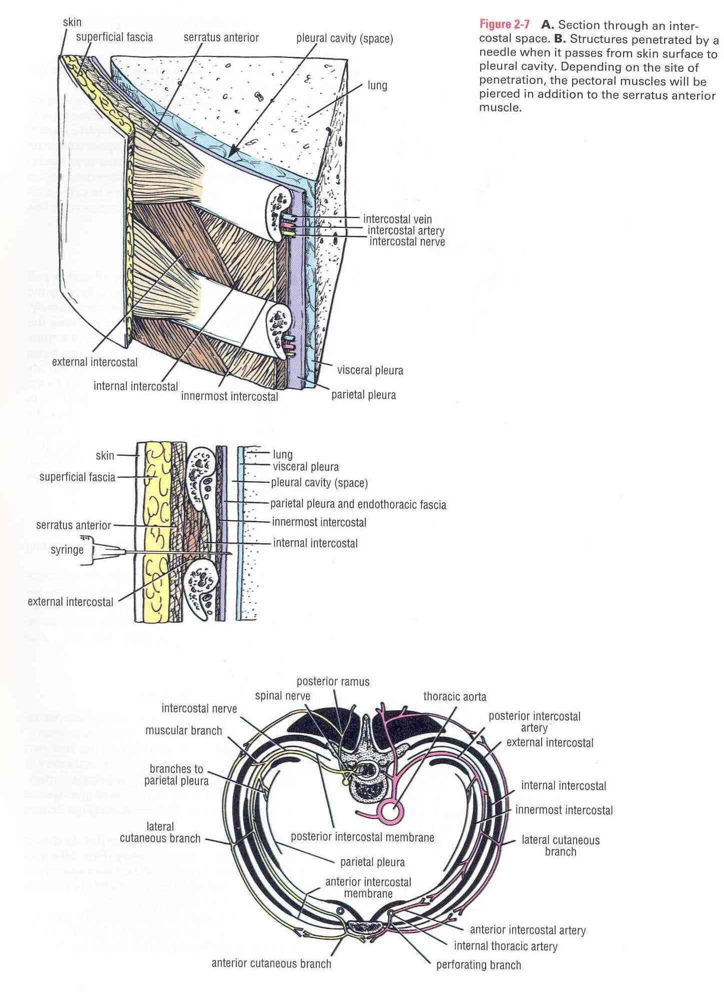
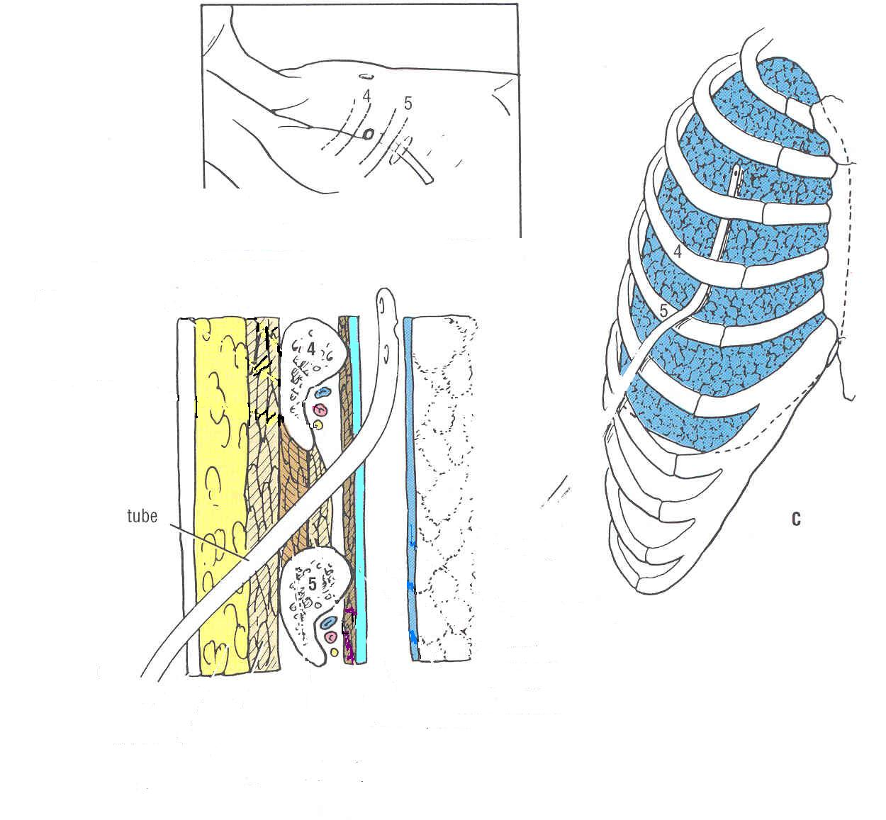
Applied Anatomy cont’d
The intercostal spaces are important access points for:
Surgical procedures, e.g. resection of (part of) the lung
Percussion and auscultation of underlying structures e.g. heart & lung
To obtain a sample of pleural fluid or drain pus/blood from the pleural cavity. The needle/drain is passed through the intercostal space just above the upper border of the rib to avoid the neurovascular bundle .

Slide 42
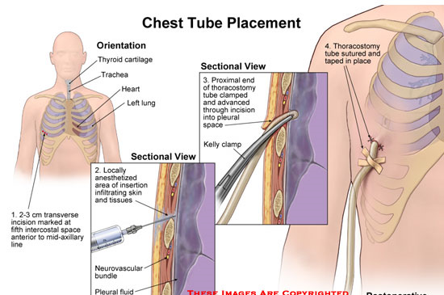
Intercostal drainage

Slide 43
RESPIRATORY MOVEMENTS
Series of cycles of inspiration & expiration
Inspiration - active process - 1 sec
Expiration – mostly passive – 3 sec
Rate of respiration(per minute):
Adults – 16 to 20
Children – 25 to 30
Infants – 30 to 40

Slide 44
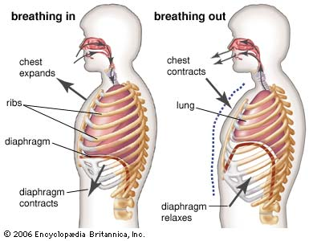

Slide 45
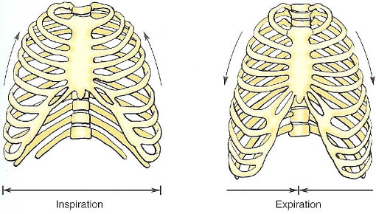

Slide 46
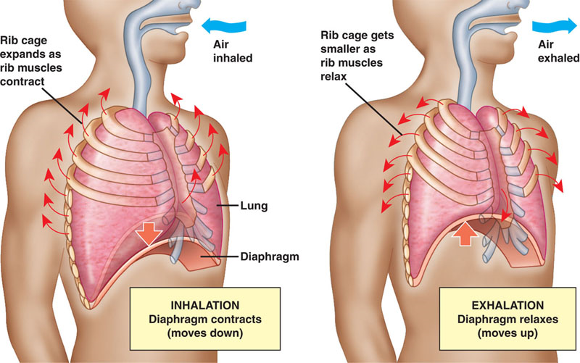

Slide 47
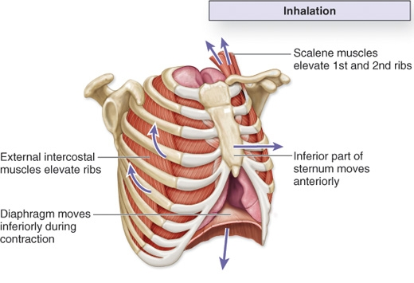

Slide 48
Muscles of Expiration
Mostly passive – elastic recoil of lungs & thoracic walls
Forced expiration – anterior abdominal wall muscles, lattisimus dorsi

Slide 49
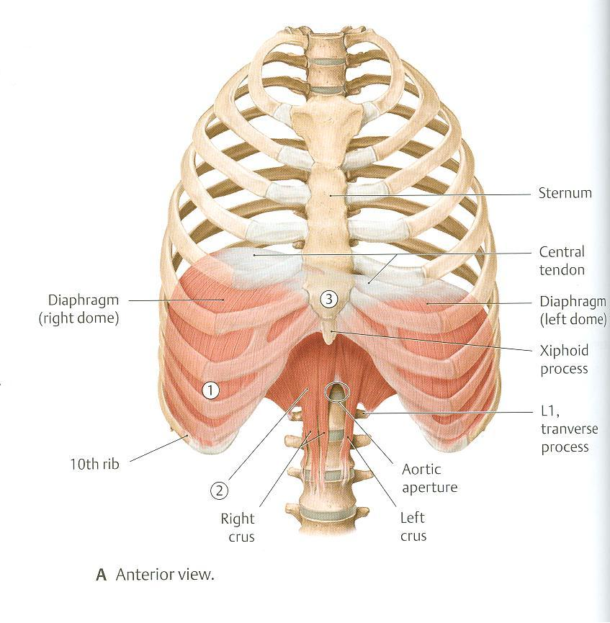
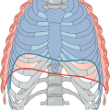
Respiratory Movements
A- Movements of Diaphragm
Inspiration
Contraction (descent) of diaphragm
Increase of vertical diameter
of thoracic cavity
Expiration
Relaxation (ascent)
of diaphragm)

Slide 50
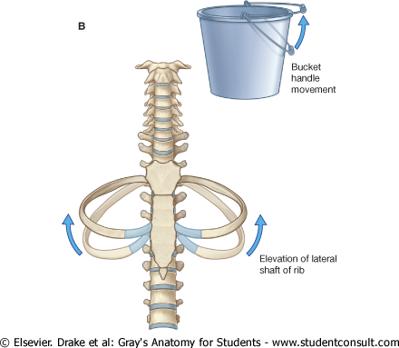
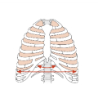
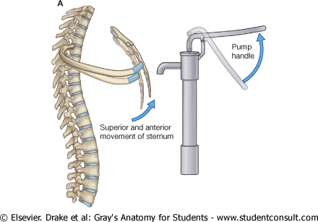
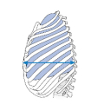
Respiratory Movements
B- Movements of Ribs
PUMP HANDLE MOVEMENT
Elevation of ribs
Increase in antero-posterior diameter of thoracic cavity
BUCKET HANDLE MOVEMENT
Elevation of ribs
Increase in lateral diameter of thoracic cavity

Slide 51
THANK YOU

