Slide 1
Biomechanics of
ELBOW COMPLEX
Dr. Parthkumar Devmurari, P.T.

Slide 2
OBJECTIVES
Student at the end of this lecture will be able to:
Brief an anatomy of elbow joint complex
Describe Osteokinematics & arthrokinematics of elbow joint
Enlist Ligaments of elbow joint
Enlist Muscle at elbow joint
Brief Pathomechanics of elbow joint complex

Slide 3
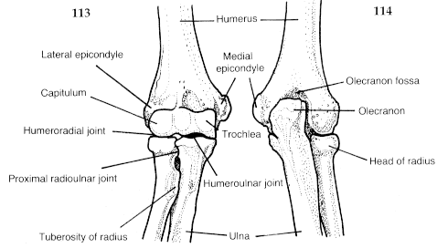

Slide 4
INTRODUCITON
The elbow complex includes the elbow joint (humeroulnar and humeroradial joints) and Mainly the proximal radioulnar joints. The elbow joint is considered to be a compound joint that functions as a modified or loose hinge joint.
Design of elbow & forearm adds to mobility of hand in space by shortening & lengthening Upper Extremity & by rotating forearm.

Slide 5
Muscles provide control & stability to region as hand is used for various activities, from eating, dressing, & grooming; to pushing, pulling, turning, lifting, throwing, catching, & reaching for objects; to coordinated use of equipment, tools, & machines
Tasks such as drinking & eating primarily require elbow flexion, whereas a task such as reaching to tie shoelaces requires substantial elbow extension

Slide 6
One degree of freedom is possible at elbow, permitting motions of flexion & extension, which occurs in sagittal plane around a coronal axis
A slight bit of axial rotation and side-to-side motion of the ulna occurs during flexion and extension, and that is why the elbow is considered to be a modified or loose hinge joint rather than a pure hinge joint.

Slide 7
STRUCTURE: ELBOW JOINT
Distal end of humerus has 2 articular surfaces
Trochlea Capitulum
Ulna Head of the radius

Slide 8
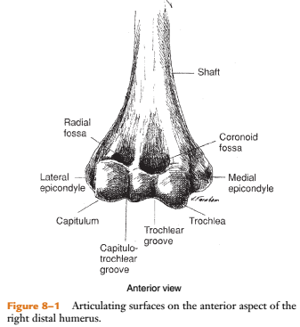

Slide 9
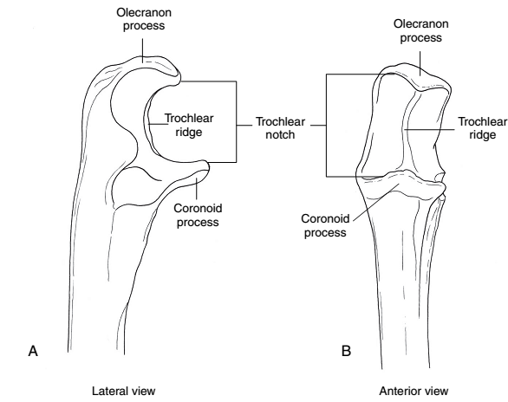

Slide 10
Radius also articulates with radial notch on ulna & is called proximal radioulnar joint
Participates in pronation & supination along with distal radioulnar joint

Slide 11
Capsule of elbow encloses humeroulnar, humeroradial, & proximal radioulnar articulations
Distal radioulnar joint is structurally separate from elbow complex even though its function is directly related to proximal radioulnar joint

Slide 12
JOINTS OF ELBOW & FOREARM
4 joints are involved in elbow & forearm function:
Humeroulnar
Humeroradial
Proximal radioulnar &
Distal radio-ulnar joint

Slide 13
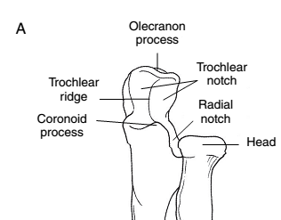
Proximal radio-ulnar joint

Slide 14
Elbow Joint Characteristics
Elbow is a compound hinge joint supported by 2 major ligaments
Medial (ulnar) & lateral (radial) collateral—which provide medial and lateral stability, respectively

Slide 15
HUMEROULNAR ARTICULATION
Characteristics
Humeroulnar (HU) articulation is a modified hinge joint
It is an articulation between trochlea at distal end of humerus which is convex, & concave trochlear fossa, on proximal ulna
Primary motion at this articulation is flexion & extension

Slide 16
Arthrokinematics
During elbow flexion trochlear fossa slides around trochlea in an anterior & distal direction
With elbow extension, trochlear fossa slides in a posterior & proximal direction
There is also slight medial & lateral sliding of ulna, allowing for full elbow range of motion (ROM)
It results in valgus angulation of joint with elbow extension & a varus angulation with elbow flexion

Slide 17
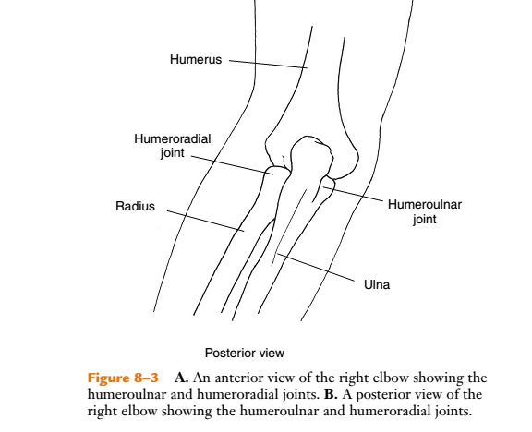
Joints

Slide 18
HUMERORADIAL ARTICULATION
Characteristics
Humeroradial (HR) articulation is a hinge-pivot joint between capitulum & head of radius
Flexion/extension & pronation/supination occur at this articulation

Slide 19
Arthrokinematics
As elbow flexes & extends, concave radial head slides in same direction as bone motion
During elbow flexion, concave head slides anteriorly & with elbow extension it slides posteriorly
With pronation & supination of forearm, the radial head spins on the capitulum

Slide 20
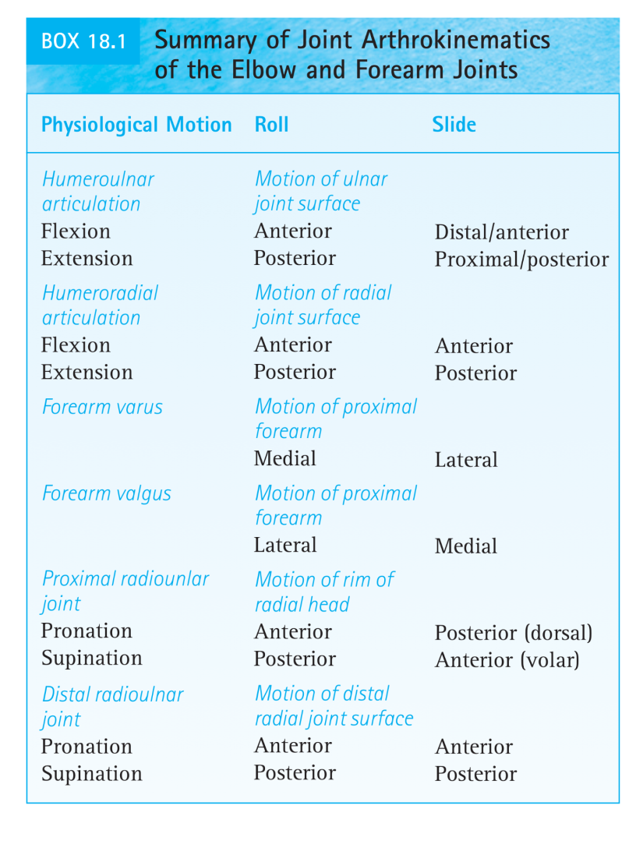

Slide 21
LIGAMENTS

Slide 22
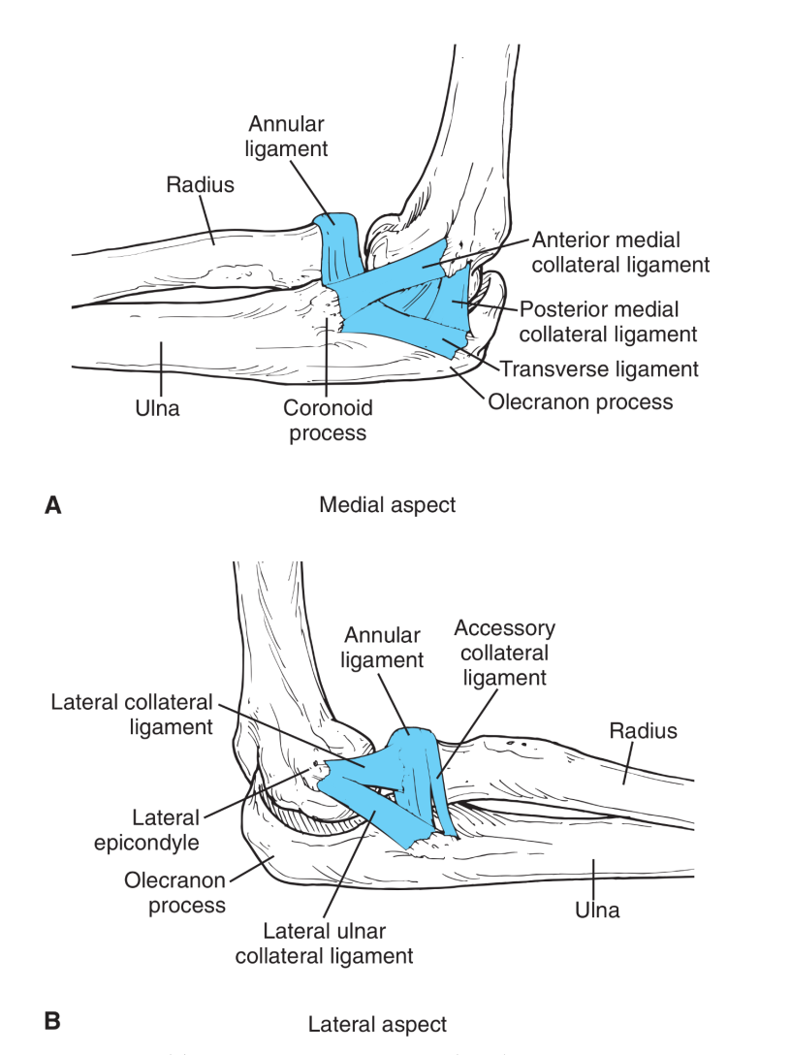

Slide 23
carrying angle or cubitus valgus
Long Axes of Humerus & Forearm
When UE is in anatomic position, long axis of humerus & long axis of forearm form an acute angle medially when they meet at elbow
Angulation in frontal plane is caused by configuration of articulating surfaces at humeroulnar joint

Slide 24
Medial aspect of trochlea extends more distally than does lateral aspect, which shifts medial aspect of ulna trochlear notch more distally & results in a lateral deviation (or valgus angulation) of ulna in relation to humerus
This normal valgus angulation is called carrying angle or cubitus valgus

Slide 25
Average angle in full elbow extension is about 15 degrees
An increase in carrying angle beyond average is considered to be abnormal, especially if it occurs unilaterally
A varus angulation at elbow is referred to as cubitus varus & is usually abnormal
Normally, carrying angle disappears when forearm is pronated & elbow is in full extension & when supinated forearm is flexed against humerus in full elbow flexion

Slide 27
MUSCLE FUNCTION AT ELBOW
Elbow Flexion:
Brachialis
Biceps brachii
Brachioradialis

Slide 28
Brachialis

Slide 29
Elbow Flexion
Brachialis: It arises from anterior surface of lower portion of humeral shaft & attaches to ulnar tuberosity & coronoid process
It is a one-joint muscle that inserts close to axis of motion on ulna, so it is unaffected by position of forearm or shoulder
It participates in all flexion activities of elbow
Brachialis is considered to be a mobility muscle because its insertion is close to elbow joint axis

Slide 30
Its MA is greatest at slightly more than 100⁰ of elbow flexion, at which its ability to produce torque is greatest
It works in flexion of elbow in all positions of the forearm, with & without resistance
It also is active in all types of contractions (isometric, concentric, and eccentric) during slow and fast motions

Slide 31
Biceps brachiI
Biceps brachii has two heads
short head arises from coracoid process of scapula, & long head from scapula’s supraglenoid tubercle & insert on tuberosity of radius
Biceps is a two-joint muscle that crosses both shoulder & elbow & inserts close to axis of motion on radius, so it also acts as a supinator of forearm

Slide 32
Functions most effectively as a flexor of elbow between 80⁰ & 100⁰ of flexion (greater MA) & is capable of producing its greatest torque in this range
If full flexion of elbow is attempted with shoulder in full flexion, especially when forearm is supinated, muscle’s ability to generate torque is diminished

Slide 33
For optimal length–tension relationship, shoulder extends to lengthen muscle when it contracts forcefully for elbow & forearm function
Considered to be a mobility muscle because of its insertion close to elbow joint axis

Slide 34
Biceps brachii is active during unresisted elbow flexion with forearm supinated & when forearm is midway between supination and pronation in both concentric and eccentric contractions
Tends not to be active when forearm is pronated
However, when magnitude of resistance increases much beyond limb weight, biceps is active in all positions of forearm

Slide 36
Brachioradialis
It arises from lateral supracondylar ridge of humerus & inserts just proximal to radial styloid process
It is inserted at a distance from joint axis, & therefore largest component of muscle force goes toward compression of joint surfaces & hence toward stability
However, it also participates as speed of flexion motion increases & load is applied with forearm from mid-supination to full pronation
Peak MA for brachioradialis occurs between 100⁰ & 120⁰ of elbow flexion

Slide 37
Brachioradialis does not cross shoulder & therefore is unaffected by position of shoulder
It shows no activity during slow, unresisted, concentric elbow flexion
When speed of motion is increased, it shows moderate activity if a load is applied & forearm is either in a position midway between supination & pronation or in full pronation

Slide 38
Elbow Extension
Triceps brachii
Long head arises from infraglenoid tubercle of scapula, medial head from posterior surface of humerus, lateral head arises from a narrow ridge on posterior humeral surface
All 3 heads insert via a common tendon into olecranon process
Long head of triceps brachii crosses both shoulder & elbow & other two heads are uniaxial

Slide 39
Effectiveness of triceps as a whole is affected by changes in position of elbow but not by changes in position of forearm, because triceps attaches to ulna & not radius
Long head’s ability to produce torque may diminish when full elbow extension is attempted with the shoulder in hyperextension. In this instance, the muscle is shortened over both the elbow and shoulder simultaneously

Slide 40
Medial & lateral heads of triceps, being one-joint muscles, are not affected by position of shoulder
Medial head is active in unresisted active elbow extension, but all three heads are active when heavy resistance is given to extension or when quick extension of elbow is attempted in gravity assisted position

Slide 41
Maximum isometric torque generation is at a position of 90 degree of elbow flexion
Long head functions most effectively as an elbow extensor if shoulder simultaneously flexes. This maintains an optimal length–tension relationship in muscle

Slide 43
Anconeus
It arises from posterior surface of lateral epicondyle of humerus & extends medially to attach to lateral aspect of olecranon process
It stabilizes elbow during supination & pronation & assists in elbow extension

Slide 44
RADIOULNAR ARTICULATION

Slide 45
Radioulnar Articulation
Proximal & distal radioulnar joints are uniaxial pivot joints & are mechanically linked, therefore, motion at one joint is always accompanied by motion at other joint
Pronation of forearm occurs as a result of radius crossing over ulna at superior radioulnar joint
During pronation & supination, rim of head of radius spins within enclosure formed by radial notch & annular ligament

Slide 46
LIGAMENTS
Annular ligament is a strong band that forms 4/5^{ths} of a ring that encircles radial head
Inner surface of ligament is covered with cartilage & serves as a joint surface

Slide 47
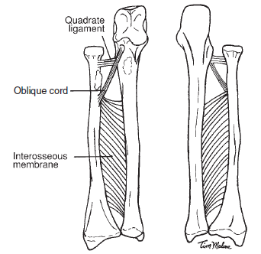

Slide 48
Quadrate ligament extends from ulna’s radial notch to insert in neck of radius
Interosseous membrane (IOM), which is located between radius & ulna, maintains space between radius & ulna during forearm rotation, provides stability for both superior & inferior radio-ulnar joints

Slide 49
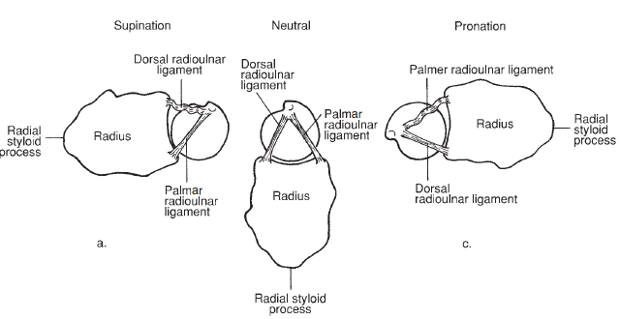

Slide 50
PROXIMAL (SUPERIOR) RADIOULNAR ARTICULATION
Characteristics
Convex rim of radial head articulates with concave radial notch on ulna & annular ligament
This ligament encircles rim of radial head & stabilizes it against ulna
Primary motion is pronation/supination

Slide 51
ARTHROKINEMATICS
As forearm rotates into pronation & supination, convex rim of radial head slides opposite bone motion
With pronation head slides posteriorly (dorsally) on radial notch & with supination it slides anteriorly (volarly)
It also slides in annular ligament & proximal surface spins on capitulum

Slide 52
FUNCTION: RADIOULNAR JOINTS
Axis of Motion
In supination, radius & ulna lie parallel to one another, whereas in pronation, radius crosses over ulna
There is very little motion of ulna during pronation & supination

Slide 53
Range of Motion
ROM of pronation & supination is assessed with elbow in 90⁰ of flexion
This position of elbow stabilizes humerus so that radioulnar joint rotation may be distinguished from rotation that is occurring at shoulder joint
When elbow is fully extended, active supination & pronation occur in conjunction with shoulder rotation

Slide 54
Forearm Supination
Supinator
Proximal attachment of supinator at annular & lateral collateral ligaments may function to stabilize lateral aspect of elbow
Its effectiveness as a supinator is not affected by elbow position as is the biceps brachii

Slide 55
Biceps brachii
Biceps acts as a supinator if elbow simultaneously flexes or if resistance is given to supination when elbow is in extension

Slide 56
Forearm Pronation
Pronator teres
It pronates as well as stabilizes proximal radioulnar joint & helps approximate humeroradial articulation
Pronator quadratus
It is a one-joint muscle & is active during all pronation activities & is unaffected by changing positions at elbow
It produces pronation by exerting pull on radius
It is a one-joint muscle It is active in unresisted & resisted pronation & in slow or fast pronation

Slide 58
PATHOMECHANICS

Slide 59
EFFECTS OF INJURY ON ELBOW

Slide 60
Compression Injuries
Distraction Injuries
Varus/Valgus Injuries

Slide 61
COMPRESSION INJURIES
Resistance to longitudinal compression forces at elbow is provided for mainly by contact of bony components; therefore, excessive compression forces at elbow often result in bony failure
Falling on hand when elbow is in a close-packed (extended) position may result in transmission of forces through bones of forearm to elbow

Slide 62
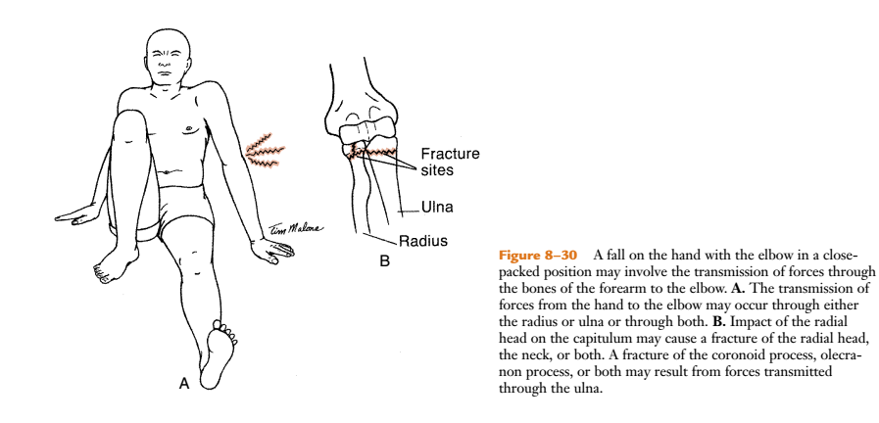

Slide 63
Muscle contractions also may cause high compression forces at elbow. For example, during acceleration & deceleration phases of baseball pitching, compression forces at elbow can attain 90% of body weight
Nerve compression, bony fracture, or dislocation may also result from muscle contractions
Repetitive forceful contractions of flexor carpi ulnaris muscle may compress ulnar nerve as it passes through cubital tunnel between medial epicondyle of humerus & olecranon process of ulna

Slide 64
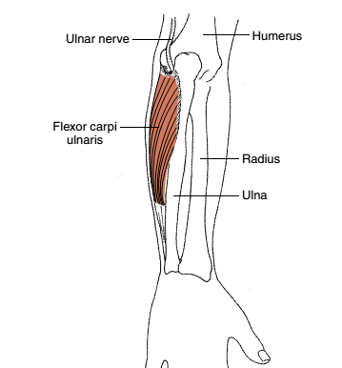

Slide 65
Distraction Injuries
Ligaments & muscles provide resistance of joints of elbow complex to longitudinal traction
A tensile force of sufficient magnitude exerted on a pronated & extended forearm may cause radius to be pulled inferiorly out of annular ligament

Slide 66
This injury is common in young children younger than 5 years & rare in adults
Lifting a small child up into air by one or both hands or yanking a child by one hand is usual causative mechanism, & therefore injury is referred to as either nursemaid’s elbow or “pulled elbow”

Slide 67
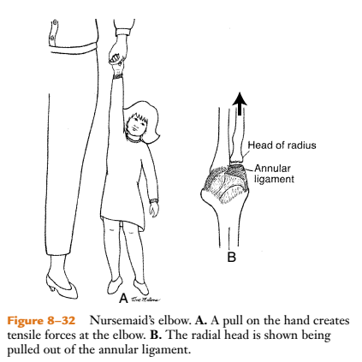

Slide 68
Varus/Valgus Injuries
If one side of joint is subjected to abnormal tensile stresses, other side is subjected to abnormal compressive forces
For example, MCL is subjected to tensile stress during backswing portion of throwing a ball
If stress on MCL is repetitive, such as in baseball pitching, ligament may become lax & unable to reinforce medial aspect of joint

Slide 69
Resulting medial instability may cause an increase in normal carrying angle & excessive compression on lateral aspect of joint so radial head impacts on capitulum
Other conditions that may occur in throwing elbow include ulnar neuritis, flexor-pronator muscle strain or tendinitis, & medial epicondylitis

Slide 70
Medial epicondylitis (Golfer’s elbbow) may be caused by forceful repetitive contractions of pronator teres, flexor carpi radialis, & occasionally, flexor carpi ulnaris
These muscles are involved in tennis serve when combined motion of elbow extension, pronation, & wrist flexion is used

Slide 71
Classic tennis elbow (epicondylitis of lateral
epicondyle) appears to be caused by repeated forceful
contractions of wrist extensors, primarily ECRB
Tensile stress created at origin of ECRB may cause microscopic tears that lead to inflammation of the lateral epicondyle

Slide 72
Title: A randomized controlled trial of exercises versus wait-list in chronic tennis elbow (lateral epicondylitis)
Type of study | RCT
Year of publication | 2011
Level of evidence | 1b
Authors | M Peterson et al
Citation | Upsala Journal of Medical Sciences. 2011; 116, 269-279
Aim | To see the effect of exercises versus wait-list on pain, muscle strength, function & QOL in patients with long standing tennis elbow
Method | 81 patients with tennis elbow lasting > 3 months were randomly allocated to an exercise & reference group. Exercise group performed daily exercise with weekly load increase for 3 months. Other group wait-listed. Cozen’s test & modified empty can test, strength, DASH & QOL were outcome measures.
Results | Exercise group had faster & greater regression of pain
Conclusion | Exercise appears to be superior to expectation in regarding in reducing pain in tennis elbow

Slide 73
PICO
P: Chronic tennis elbow patients
I: strength training
C: controls were in wait list
O: Cozen’s test & modified empty can test, strength, DASH & QOL

Slide 74

MULTIPLE CHOICE QUESTIONS (MCQs)

Slide 75
1. Normal carrying angle?
a. 15 degrees
b. 25 degrees
c. 35 degrees
d. None of the above
2. Which ligament forms 4/5^{ths} of a ring that encircles radial head
a. Quadrate ligament
b. Annular ligament
c. Medial collateral ligament
d. Lateral collateral ligament

Slide 76
3. Which of the following articulations are included in elbow complex
a. Humeroulnar
b. Humeroradial
c. Proximal radioulnar
d. All the above
4. Which muscle functions most effectively as a flexor of elbow between 80⁰ & 100⁰ of flexion
a. Brachioradialis
b. Brachialis
c. Biceps brachii
d. None of these

Slide 77
5. Carrying angle is called cubitus valgus
a. True
b. False

Slide 78
Answers
1-a
2-b
3-d
4-c
5-b

Slide 79
THANK YOU

