Slide 1
ZINC OXIDE EUGENOL PASTE

Slide 2
Definition
A negative imprint of an oral structure used to produce a positive replica of the structure to be used as a permanent record or in the production of a dental restoration or prosthesis.

Slide 3
Classification:
Impression material
Elastic Nonelastic
Hydrocolloid Rubber
ZOE Imp. Compound
Agar Alginate
Polysulphide Polyether Silicone
Condensation Addition

Slide 4
INTRODUCTION
The reaction between Zinc Oxide and Eugenol under proper conditions yields a relatively hard mass that holds many mechanical benefits as well as medicinal advantages in certain dental operations.

Slide 5
Classification
According to ADA specification no.16
Depending on hardness
Type I or hard set
Type II or soft set
Depending on eugenol content
Eugenol containing impression paste
Non-eugenol paste

Slide 6
APPLICATIONS
Impression material
Cementing medium
Bite registration paste
Surgical dressing
Root canal filling material
Temporary filling material

Slide 7
ZINC OXIDE EUGENOL IMPRESSION MATERIAL
It is a rigid, inelastic and irreversible impression material that hardens by a chemical reaction
Two types:
1.Type I or Hard : Bite registration paste
2.Type II or soft : Final impression material

Slide 8
COMPOSITION
Mostly dispensed in the paste form in two separate tubes:
1.Base paste.
2.Accelerator paste

Slide 9
COMPOSITION
Tube No. 1(Base)
Zinc oxide 87
Fixed Vegetable or mineral oil 13
Tube No. 2(Accelerator)
Oil of clove or eugenol 12
Gum or polymerized rosin 50
Filler(silica type) 20
Lanolin 3
Resinous balsam 10
Accelerator solution and color 5

Slide 10


Component | Function
Eugenol/Oil of clove | Reactive ingredient. Oil of clove contains 70-85% of eugenol.
Gum or Polymerised rosin | Gives body & coherence to mixed material. Imparts thermoplastic property to set impression. Facilitates speed of reaction and more homogenous product
Filler | Inert material to form paste with suitable consisitency.
Resinous balsam Lanolin | Increases flow and improve mixing properties.
Accelerator, moisture | Accelerators like zinc acetate, glacial acetic acid, metallic salts of hydrochloric and nitric acids, primary alcohols.

Slide 11
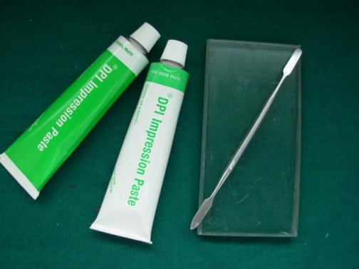
Setting reaction:
Chelation reaction:
    Acid-base reaction to form a chelate.
    Product is called zinc eugenolate.
Autocayalytic reaction:
    Water is needed to initiate the reaction and is also the by-product of the reaction.

Slide 12
ZnO
H₂O
Zn (OH) ₂
Zn(OH)₂
2HE
ZnE₂
2H₂O
Base Acid Salt
(Zn Eugenolate)

Slide 13
MANIPULATION
Mixing done on oil impervious paper or glass slab
Flexible stainless steel spatula with 8-10 cm long blade is used
Equal proportion of two pastes used
Mixing continued till one minute till uniform color and consistency is obtained

Slide 14
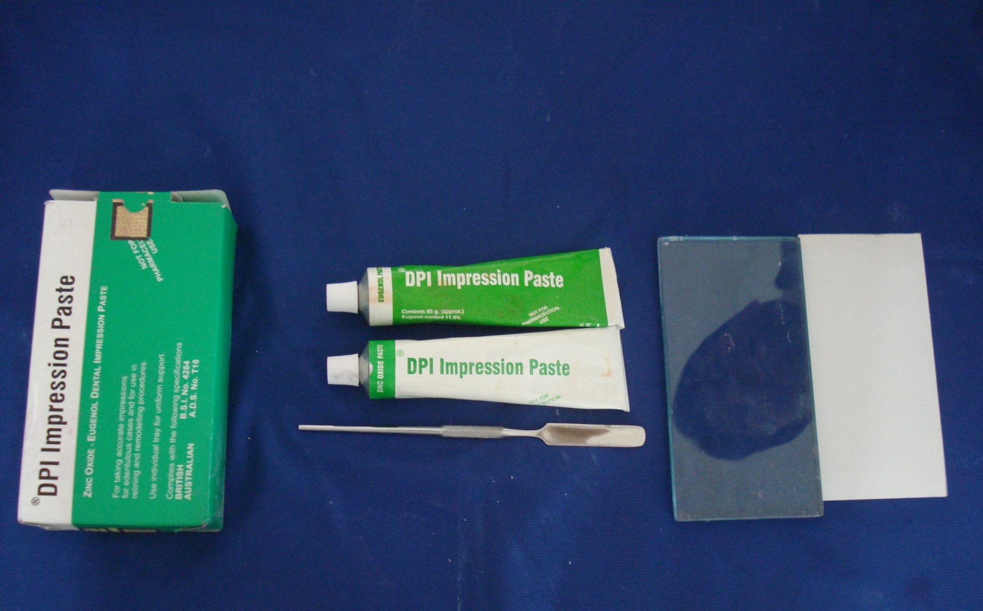

Slide 15
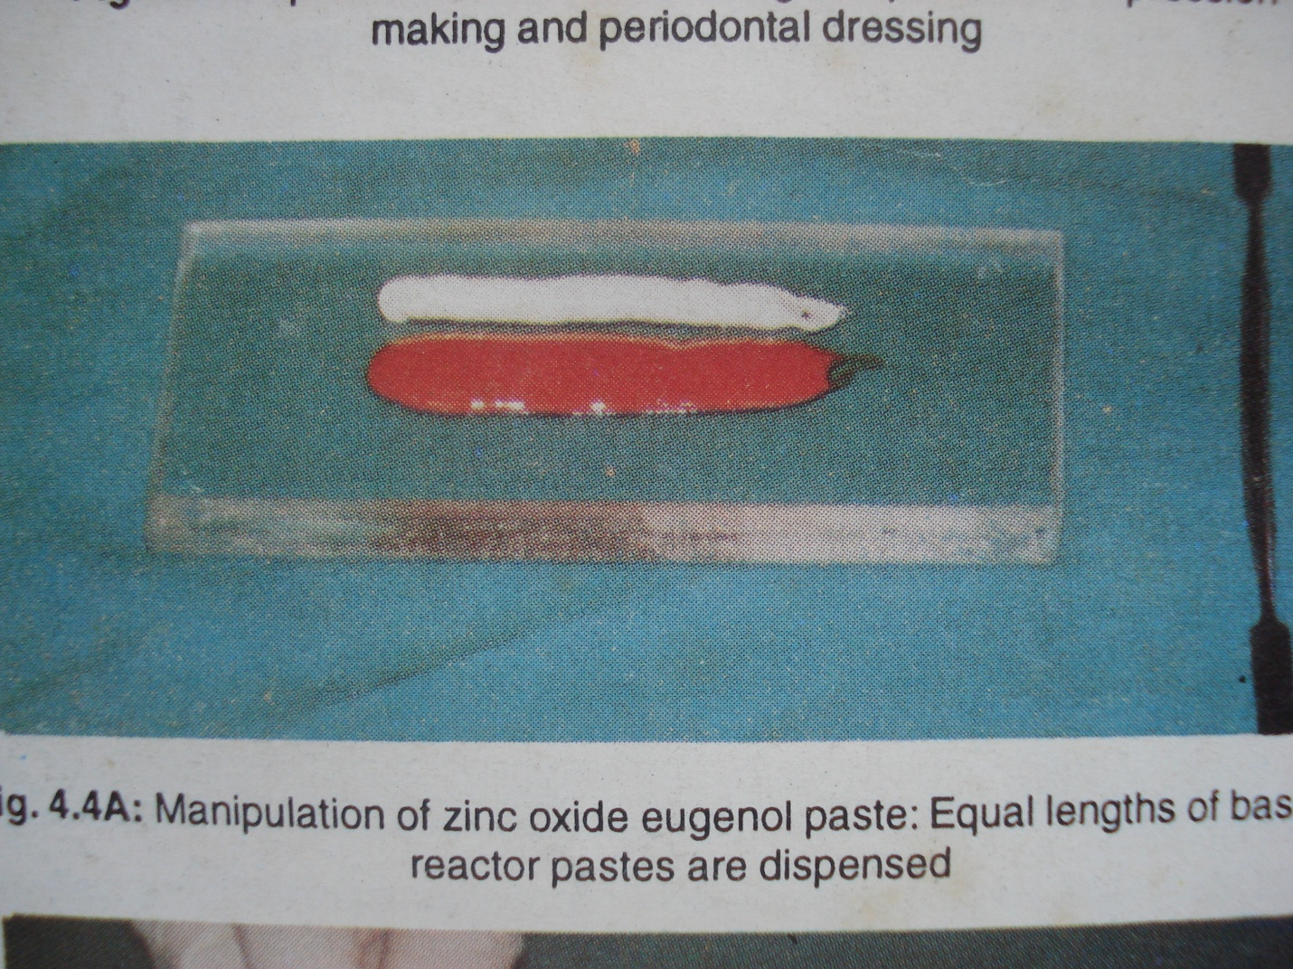

Slide 16
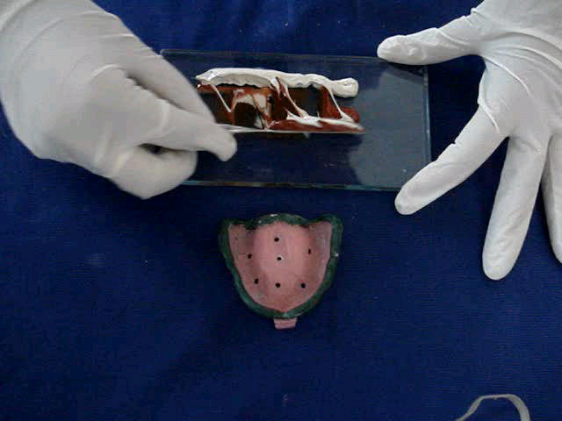

Slide 17
SETTING TIME
According to ADA specification no 16 for dental impression pastes
Setting time :
Type I pastes : 10 minutes
Type II pastes: 15 minutes

Slide 18
FACTORS AFFECTING SETTING TIME
TEMPERATURE
MIXING TIME
CHEMICAL MODIFIERS
HUMIDITY

Slide 19
Control of the Setting Time
Decreased setting time:
Addition of zinc acetate or other accelerators.
Mixing a small drop of water before blending the two pastes.
Increased setting time:
Cooling the spatula and mixing slab.
Addition of inert oils and waxes during the mixing (olive oil, mineral oil, and petrolatum).
By changing the ratio of ZnO paste to eugenol paste, retardation or acceleration obtained will depend upon which paste contains the accelerator.

Slide 20
DISINFECTION
2% Alkaline Glutaraldehyde is preferred for disinfection of the impression.
Bite Registration: Spraying is preferred

Slide 21
DIMENSIONAL STABILITY: -
The dimensional stability of impression pastes is quite satisfactory. A negligible shrinkage (<0.1%) may occur during hardening

Slide 22
SURGICAL PASTES:
1.They are less brittle.
2.Material is weaker after hardening.
3.It takes a longer time for setting.
4.It should be capable of being formed into a rope for dressing.
5.Material contains more eugenol.

Slide 23
NON EUGENOL PASTES: -
One of the chief disadvantages of zinc oxide eugenol pastes is the possible stinging or burning sensation caused by eugenol when it contacts soft tissues. Moreover ZoE reaction is never completed with the result that the eugenol may leach out. Some patients find the taste of eugenol extremely disagreeable, and in patients who wear surgical pastes for a long time may develop gastric disturbances.

Slide 24
Zinc oxide reacts with carboxylic acid
Most commonly used carboxylic acid is ortho ethoxy benzoic acid.
It is not greatly affected by temperature or humidity.
Bactericides and other medicaments can be incorporated without interfering with the reaction.

Slide 25

THANK YOU

