Slide 1
BIOMECHANICS Of KNEE JOINT
Dr. Jay Soni
Assistant Professor

Slide 2
Open pack position -25degree flexion
Close pack position –full extention
Capsuler pattern –Either flxion or extention

Slide 3
The knee is a complex joint with three bones (femur, tibia, and patella),
two degrees of freedom of motion, and
three articulating surfaces: the medial tibiofemoral, lateral tibiofemoral, and patellofemoral articulations, which are enclosed by a common joint capsule.
The knee plays a primary role in lowering and elevating body weight during sitting, squatting and climbing.

Slide 4
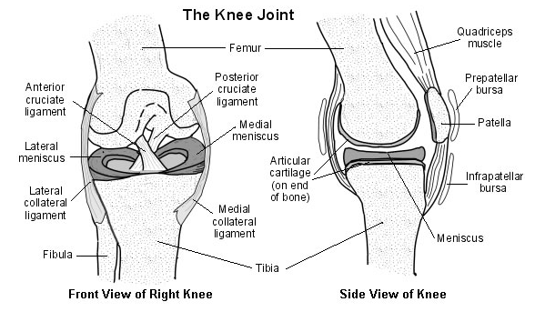

Slide 5
Bones
The three bones comprising the knee include the femur, tibia, and patella.

Slide 6
Femur
The distal femur forms the proximal end of the knee joint.
Distal femur contains two condyle ,medial and lateral.
The anterosuperior aspect of the condyles forms a groove between them known as the intercondylar groove or trochlear groove.
This is where the posterior patella articulates with the femur.
An intercondylar fossa separates the two condyles at their most inferior aspects and posteriorly.
In this fossa, cruciate ligaments passes traversly.

Slide 7
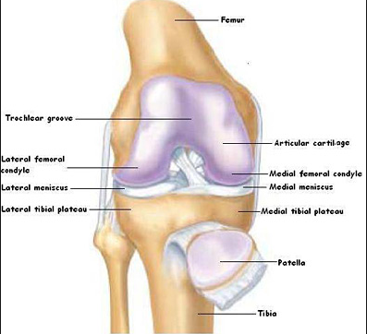

Slide 8
Tibia
The tibia flares at its proximal end as it meets the femur to form the distal portion of the tibiofemoral joint.
The articular surfaces of the tibia are significantly smaller than counterparts of the femur.
The tibia has two slightly concave condyles.
Medial is larger than Lateral condyle corresponding to the medial and lateral femoral condyles.
This is an important anatomical design since the medial knee bears more pressure in standing, so having a greater surface area reduces the amount of stress applied to it.

Slide 9
Anteriorly on the tibia and inferior to the tibial condyles is a large roughened area, the tibial tuberosity, which serves as the distal attachment for the quadriceps muscle’s tendon.
The shaft of the tibia is triangular in its cross-sectional shape. The sharp crest of the tibia.

Slide 10
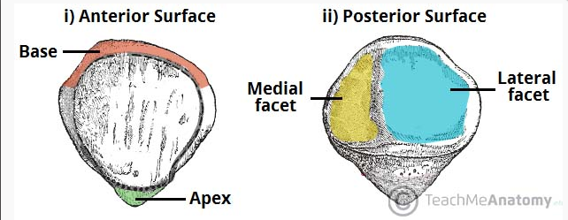
Patella
The patella begins its ossification process by the third to fifth year to ultimately become the largest sesamoid bone in the body. patellar ligament connects two bones, the patella and tibia.

Slide 11
FUNCTIONS
1. Improve the efficiency and increase torque of the knee extensors throughout the knee’s range of motion;
2. Centralize the forces of the four quadriceps muscles into one concentrated direction of pull;
3. Provide a smooth gliding mechanism for the quadriceps muscle and tendon to reduce compression and friction forces during activities such as deep knee bends;
4. Contribute to the overall stability of the knee; and
5. Provide bony protection from direct trauma to the femoral condyles when the knee is flexed.

Slide 12
02

Slide 13
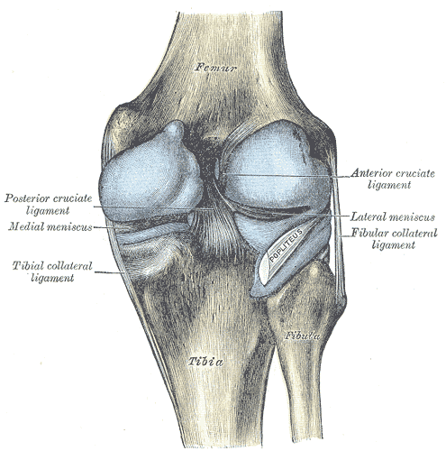
JOINTS
Two Joints
The Tibiofemoral Joint
surrounded by one capsule.
The Patellofemoral
Tibiofibular doesn’t lie with in the joint capsule so
Technically it is not the part of Knee complex

Slide 14
Tibiofemoral Joint
Made from the two longest bones of the body
Femoral condyles articulate with the two smaller tibial condyles, which have only a slight concavity; hence, they are commonly referred to as plateaus
The congruity of the articulations is increased slightly by
1.the intercondylar eminence of the tibia
2.the wedge-shaped medial and lateral menisci (semilunar cartilages), which form an incomplete ring, or crescent, on each tibial condyle.

Slide 15
The motions of knee flexion and extension cannot be pure rolling or hinge motions.
The longitudinal articulating surface of the femoral condyles is approximately twice the length of the surface of the tibial condyles.
The condyles execute both rolling and sliding movements, with the ratio of sliding and gliding changes throughout the range of motion.
Rolling is predominant at the initiation of flexion, and sliding occurs more at the end of flexion.
Because the length of the articular surface the movements of the two condylar surfaces differ.

Slide 16
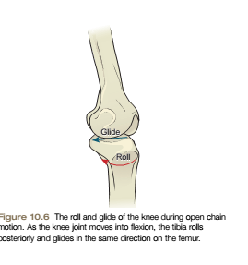
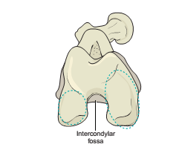

Slide 17
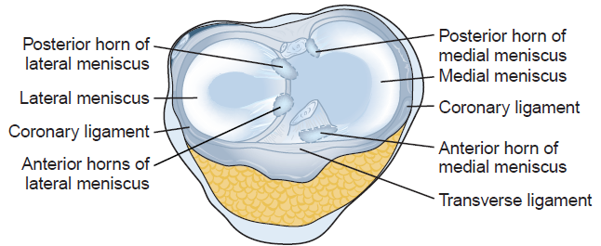
Menisci
. Fibrocartilaginous menisci are attached to the tibia.

Slide 18
Attachment:
Each meniscus is attached to the tibia at its anterior and posterior ends, or poles.
Each meniscus is anchored along its lateral rim to the tibia and joint capsule by a loose coronary ligament / Meniscotibial ligaments
Shape:
The lateral meniscus’s configuration is nearly a circle whereas the medial meniscus is more of a C-shape.

Slide 19
The menisci are attached to the tibia, their movement is controlled by knee movement, both passively and actively.
Menisci are pushed anteriorly by the femur as the knee extends and Conversely, the menisci move posteriorly with knee flexion.

Slide 20
Functions of Menisci
1. The menisci deepen the knee joint and thereby add stability to it.
2. The menisci absorb and distribute forces of impact by increasing the surface contact area and congruency of the joint.
4.The menisci promote joint lubrication by spreading a film of synovial fluid over the articular surfaces.
5. The menisci prevent the joint capsule to thrust into the joint space.
6. Although the ligaments provide most of the protection against knee hyperextension, the menisci provide partial protection to this excessive movement.

Slide 21
Surgical removal of the menisci decreases the surface area and causes pressure to increase on the femoral and tibial condyles, which may lead to later osteoarthritis.

Slide 22
Ligaments and Capsule
Collateral ligaments
1. Medial Collateral Ligament(MCL)
2. Lateral Collateral Ligament(LCL)
Cruciate Ligament
3. Anterior Cruciate Ligament(ACL)
4.Posterior Cruciate Ligament(PCL)

Slide 23
Attachment
Ligament | Proximal Attachment | Distal Attachment | Function
MCL | Medial epicondyle of femur | Posterior Section: medial epicondyle of femur Anterior Section: middle and superior aspect of medial tibia | Protect against Valgus force
LCL | Lateral epicondyle of femur | Lateral aspect of Head of fibula | Protect against Varus force
ACL | Intercondylar tibial fossa | Posteromedial aspect of lateral femoral condyle | Prevents Anterior translation of tibia on femur
PCL | Posterior tibial spine | Anterolateral surface of medial femoral condyle | Prevents Posterior translation of tibia on femur

Slide 24
Kinematics
Tibiofemoral Joint
Two degrees of freedom:
Flexion-Extension and Axial Rotation.
Flexion -0 to 125, End feel –soft
Extension -125 to 0 ,End feel –firm
The amount of degree varies from 120 to 150 degree because of muscles bulk of calf comes in contact with the posterior thigh.

Slide 25
The large articular surface of the femur and the relatively small tibial condyle create a potential problem as the femur begins to flex on the fixed tibia.
If the femoral condyles were permitted to roll posteriorly on the tibial plateau, the femur would run out of tibia.
For the femoral condyles to continue to roll as flexion increases without leaving the tibial plateau, the femoral condyles must simultaneously glide anteriorly.

Slide 26
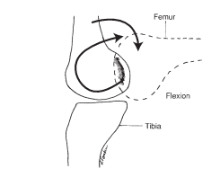

Slide 27
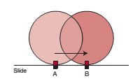
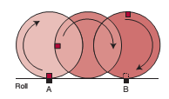

Slide 28
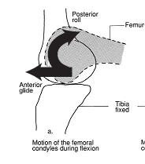
Closed chain…… for e.g. while Sitting on/Rising from chair
During Flexion……
The initiation of knee flexion occurs
primarily as Posterior Rolling of the femoral
condyles on the tibia.
As flexion continues, the rolling of
the femoral condyles is accompanied
by a simultaneous Anterior Glide.

Slide 29
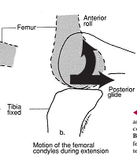
During Extension……
Extension of the knee from flexion is a reversal of flexion.
During Tibiofemoral extension, initially
anterior rolling of the femoral condyles
on the tibial plateau.
So femoral condyles displaces
back to a neutral position on the tibial plateau.
then the femoral condyles glide posteriorly
just to continue extension of the femur
on the tibial plateau.

Slide 30
open chain position…… for e.g. High Sitting Flexion and Extension
The movements would be somewhat different.
When the tibia is flexing on a fixed femur, the tibia both rolls and glides posteriorly
on the relatively fixed femoral condyles.
Extension of the tibia on a fixed femur, the tibia both rolls and glides on the fixed femoral condyles.

Slide 31
To Summarize…..
Close Chain
 | Femoral condyles Rolls | Femoral condyles Glides
During Flexion | Posterior | Anterior
During Extension | Anterior | Posterior
Open Chain
 | Tibial condyle Rolls | Tibial condyle Glides
During Flexion | Posterior | Posterior
During Extension | Anterior | Anterior

Slide 32
Axial Rotation
Axial rotation occurs in the transverse plane when the knee is flexed. When the knee is fully extended, the medial and lateral collateral ligaments are relatively tense, contributing to the stability of the joint

Slide 33
Terminal Rotation of the Knee
Screw Home Mechanism
Definition:
Normally, when the knee moves into extension, the tibia laterally rotates about 20°on the fixed femur. This motion occurs in the last 15°of knee extension and is called terminal rotation of the knee, or the screw home mechanism.
It is purely occurs with both passive and active knee extension and cannot be prevented voluntarily.

Slide 34
Medial tibial rotation occurs with knee flexion and lateral tibial rotation occurs with knee extension in the open chain.
In closed chain motion such as rising from a chair, terminal rotation occurs as medial rotation of the femur on the fixed tibia, whereas lateral femoral rotation
occurs when returning to the chair as the knee moves
from extension to flexion.

Slide 35
open chain
As the tibial condyles move on the femoral condyles during Open Chain Knee Extension, the motion on the shorter lateral femoral condyle is completed before the motion on the medial femoral condyle is completed.
So the available surface area of the lateral femoral condyle is used before movement on the medial femoral condyle is finished,
pivoting of the tibia on the femur occurs between the lateral condyles to allow the medial aspect of the knee to complete its motion. This pivoting produces passive lateral rotation of the tibia on the femur in the last 15° of extension
Reverse occurs while performing Open Chain Knee Flexion

Slide 36
Close chain
When the knee extends during closed chain extension the femur rotates medially on its lateral condyle to allow full terminal extension to occur at the knee.
During Close chain Flexion, the femur rotates laterally on its lateral condyle to Unlock the knee

Slide 37
To Summarize…..
Close Chain(Tibia is fixed)
 | Terminal Rotation
During Flexion | Femur Lateral Rotation
During Extension | Femur Medial Rotation
Open Chain(Femur is fixed)
 | Terminal Rotation
During Flexion | Tibial Medial Rotation
During Extension | Tibial Lateral Rotation

Slide 38
Arthrokinematics of the Tibiofemoral Joint
when the tibia moves on the femur(concave moves on convex) during open kinetic chain activity , the concave tibial surface slides or glides in the same direction as the roll, or joint motion.
Therefore, when the tibia rolls forward on the femur into extension, it also glides forward; likewise, when the tibia rolls backward as the knee moves into flexion, the tibia glides posteriorly.
During closed chain motions(convex moves on concave), knee moves in extension the roll of the femur is anterior and the glide is posterior.
During flexion: the roll of the femur is posterior and the glide is anterior.

Slide 39
Patellofemoral Joint
Close pack position –knee Extension
Open pack position –knee Flexion (25 degree)

Slide 40
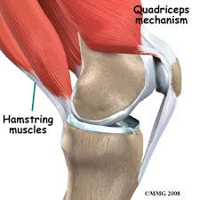
The patella lies within the common tendon of the quadriceps.
common tendon of the quadriceps which extends above and
on the sides of the patella as well as attaching to it.
From the apex of the patella, the patellar ligament is the continuation of the quadriceps tendon and extends to the tibial tuberosity

Slide 41
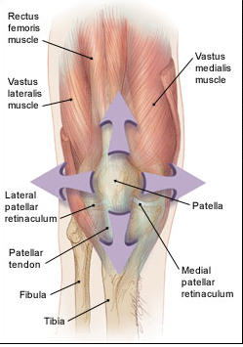
When the knee is in full extension, patellar stability relies
primarily on soft tissues which surround it.
The extensor, or quadriceps, mechanism actively stabilizes
the patella on all four sides and guides the motion between the patella and the femur.
From 20° to 0°, the primary responsibility
of the vastus medialis oblique (VMO)
muscle is to serve
as a dynamic stabilizer of the patella

Slide 42
Stabilizers
Lateral | Patella is passively stabilized by superficial and deep retinacula, iliotibial band, vastus lateralis muscle
Medial | Medial aspect actively by the VMO, Passively by the forces of the patellofemoral ligament and the medial Meniscopatellar ligament.
superior | attachments of the rectus femoris and the vastus intermedius
Inferior | base of the patella stabilized by patellar ligament

Slide 43
When the knee flexes, the lateral structures move posteriorly and create lateral and tilting forces on the patella. Therefore, the patella is affected by both static
(fascia) and dynamic (muscle) forces.

Slide 44
Kinematics
Patellofemoral Joint
When the tibiofemoral joint moves, the patellofemoral joint must also move.
if restriction of either joint occurs, the other joint’s mobility is also affected.
Same way when there is weakness of muscles controlling the tibiofemoral joint also has an affect on the patellofemoral joint.
Essentially, both injury and health of one joint directly impacts the other joint.

Slide 45
Patellofemoral Contact
As the knee moves from extension into flexion, the patella and femur move relative to one another.
which moves depends on whether it is an open or closed chain motion.
During open chain activities (when the tibia is moving), the patella moves over the femoral condyles.
During closed chain activities(femur moves ), the femoral condyles glide along the patellar surface.

Slide 46
When the knee is fully extended, the patella sits at the proximal end of the intercondylar groove.
As the knee moves into flexion, it contacts the femur at about 25° of knee flexion.
The lower margin of the patella makes initial contact with the intercondylar groove’s superior aspect at this time.
as the knee continues to flex and the patella moves inferiorly and progressively increases the patellofemoral contact area until at about 90° of knee flexion,

Slide 47
A maximum contact area between the patella and femur occurs When the knee flexes to 115°, the patella makes contact with the medial and lateral femoral condyles at a point at which the intercondylar sulcus is present.
By the time the knee flexes to 135°, the odd facet and lateral facet of the posterior patella are the only areas in contact with the femoral condyles.

Slide 48
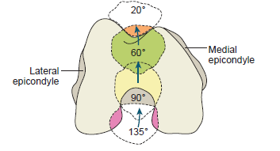

Slide 49
Patellofemoral
Static and Dynamic Alignment
When the tibiofemoral joint is in full extension, the patella rests at the proximal aspect of the intercondylar groove Because its position is maintained by the surrounding soft tissues.
if muscles are weak or tight, these dysfunctions will alter the patella’s position either at rest or during activity; such imbalances may lead to injury of the patellofemoral joint.

Slide 50
When the knee flexes and extends, the patella moves in several directions:
flexion-extension,
medial-lateral tilt,
medial-lateral shift,
medial-lateral rotation Of these motions,
the greatest excursion occurs in flexion and extension as it moves proximally and distal.
Its travelling distance of varies from 5 to 7 cms in the intercondylar groove

Slide 51
Patella Baja
Patella Alta.
Excessive lateral displacement of the patella as it tracks on the trochlear surfaces is normally prevented by the
-congruence of the joint surfaces,
- facet,
- soft tissues located medially
Imbalances such as tightness of the iliotibial band or weakness of the VMO cause the patella to track more laterally with muscle contraction of the quadriceps during knee movement and may lead to changes in joint contact areas and pressures with resulting pain and dysfunction.

Slide 52
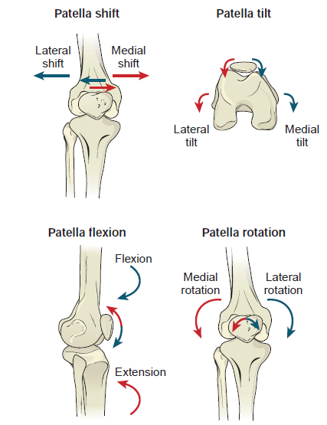

Slide 53
Arthrokinematics of the Patellofemoral Joint
Posterior patella Surface: Concave,
Femoral surface: Convex
The resting position of the patellofemoral joint is full extension and the close-packed position is flexion
As the knee flexes and extends, the patella glides within the intercondylar groove. As the knee moves into flexion, the patella glides inferiorly.
As the knee extends, the patella glides superiorly.
Patellar rotation, medial-lateral shifting, and medial-lateral tilting occur during knee flexion and extension.
The specific timing and occurrence of each of these motions is yet to achieve.

Slide 54
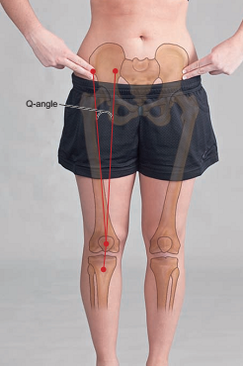
Q angle

Slide 55
Normal value Q angle
In male – about 10° to 14°
In female- about 15° to less than 23.
Reason of having increased Q angle in Female is : Wider Pelvis

Slide 56
An excessive Q angle is referred to as genu valgum, or knock knee.
if the Q angle is closer to 0° or the knee joint is convex laterally, the alignment is referred to as genu varum, or bowleg

Slide 57
Muscles of knee joint
Knee Extensors
Rectus Femoris, Vastus Lateralis, Vastus Medialis, and Vastus Intermedius.
The vastus medialis lies in a position medial to the rectus femoris.
The vastus medialis has two different fiber directions, and therefore, two different functions.

Slide 58
Proximal Fibers - Longitudinal Vastus Medialis Longus (VML) | Distal Oblique Fibers - Vastus Medialis Oblique (VMO)
work with the other quadriceps muscles in knee extension | patellar stabilization, especially during terminal extension. Works in terminal Knee extension

Slide 59
The medially directed forces of the VMO may also counteract the laterally directed forces of the vastus lateralis to prevent lateral displacement of the patella in the trochlear groove.

Slide 60
Knee flexors
The primary muscles are the hamstrings (biceps femoris, semitendinosus, and semimembranosus)
The hamstrings also serve to stabilize the knee by restricting an anterior glide of the tibia on the femur.
Gastrocnemius is more of a plantarflexor of the ankle, it also plays a role in knee flexion.
It also stabilizes the knee by preventing forward dislocation of the femur on the tibia

Slide 61
Tibial Rotators
Tibial Medial Rotators include the semitendinosus, semimembranosus, popliteus, gracilis, and sartorius. distal attachments of the tendons of the sartorius, gracilis, and semitendinosus are on the anterior medial surface of the tibia below the medial condyle, forming the pes anserinus .
The tibial lateral rotator is the biceps femoris which is possibly aided by the tensor fasciae latae. The biceps femoris is a strong lateral rotator.

Slide 62
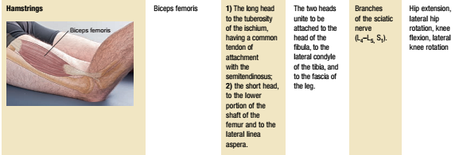
Lateral rotators

Slide 63
JOINT FORCES
TIBIO FRMAORAL
PATELLO FEMORAL

Slide 64
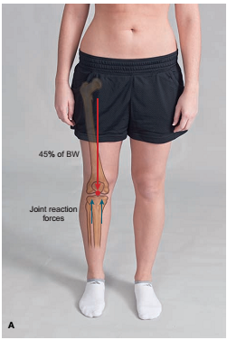
TIBIOFEMORAL JOINT FORCES
The body weight vector passes between the knees when
standing on both feet.
In unilateral stance, the compressive force increases to about twice the body weight.
These tibiofemoral compressive forces increase
with stair climbing, running, jumping, and squatting.

Slide 65
During normal walking, the majority of that force is borne by the medial compartment.
It may be for this reason that the medial tibial condyle has
about three times as much articular cartilage as its lateral counterpart.

Slide 66
As the weight gain increases, the individual can be seen to shift the trunk more and more laterally with each step in walking.
This decreases the force that the hip abductor muscles must generate to
balance the increased weight.
The tensor fascia lata is one of these hip abductor muscles, so its contributions
to counteracting the compressive forces on the knee are decreased.

Slide 67
In addition, the excessive lateral trunk shift causes the force of the body’s weight to
move from the medial side of the knee joint to the lateral side, with the joint reaction force moving laterally as well.
This produces asymmetric distribution of condylar pressures with excess pressure on the lateral condyles and a valgus thrust.
In time, these abnormal forces can lead to a knock-knee deformity, cartilaginous and meniscal thinning and destruction, and osteoarthritis

Slide 68
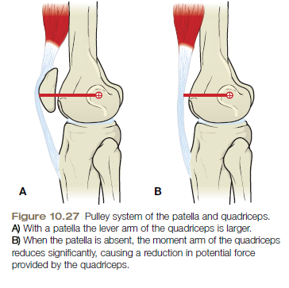
Patellofemoral Joint Forces
Function of Pulley: to change the direction or angle of a Force
The patella may be thought of as a pulley for the quadriceps since it does change the angle of force of the quadriceps.
If patella is removed (patellectomy),
there is 15 to 30% drop in the strength of
Quadriceps

Slide 69
Patella attaches to both the quadriceps tendon and the patellar ligament, it becomes tethered when the quadriceps contracts. These two forces pulling on the patella from opposite directions creates a compression of the patella against the femur .
With the knee extended, the resultant force is small because the forces of the tendon and the ligament are almost on a straight line.

Slide 70
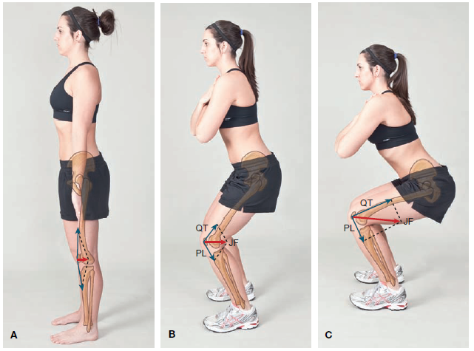
When the knee flexes, the resultant force becomes large and can easily exceed the force of the muscle.
As the knee flexion continues, angle of pull increases, the joint reaction force within the patellofemoral joint increases because the vector length becomes larger.

Slide 71
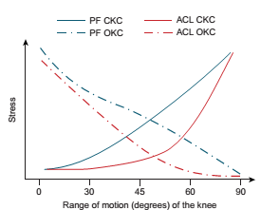
Patellofemoral compressive force in open kinetic chain activities is greatest at 0° and decreases as the knee moves to 90°
In a closed kinetic chain motion, patellofemoral stress is greatest at 90° and decreases as the knee moves into full extension

Slide 72
Patellofemoral joint reaction force in maximum isometric quadriceps contractions as 0.8 times body weight when the knee was in the 15° position. The force increased to 2.6 times body weight when the knee was at a 90° angle.
When doing a squat, the joint reaction force increases to 7 to 8 times body weight.

Slide 73
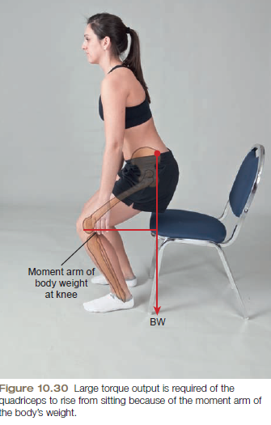
Functionally, the greater torque output of the quadriceps muscle at the 50° to 60° position.
Reason is that there is the need of large torques in elevation of the body, as in rising from a chair and climbing.
In these activities, a perpendicular line from the center of gravity of the body falls well posterior to the knee axis and, therefore, exerts a large resistance torque for the quadriceps.

Slide 74
Insufficiency
Muscles acting on knee joint
Only five of the muscles that act on the knee are one joint muscles:
the three vasti,
the popliteus, and
the short head of the biceps femoris.
The remaining muscles cross both the hip and knee (rectus femoris, sartorius, gracilis, semitendinosus, semimembranosus, long head of the biceps femoris, and the iliotibial tract of the tensor fasciae latae), or the knee and ankle (gastrocnemius).

Slide 75
Active insufficiency
Active insufficiency occurs when a multijoint muscle shortens but is unable to shorten sufficiently to allow full joint motion at all the joints it crosses;
Ex. Hip extension in standing with knee flexion(hamstring)

Slide 76
Passive insufficiency
Passive insufficiency occurs when a multijoint muscle is unable to stretch sufficiently to allow both joints it crosses to fully shorten;
Ex. Hip extension in standing with knee flexion (rectus femoris )
straight leg raise (SLR)(passive insufficiency of hamstring )

