Slide 1
SHOULDER COMPLEX
DR PURVI PATEL

Slide 2
Objectives
Student at the end of session should be able to:
Enumerate joints of shoulder complex
Describe the osteokinematics and arthrokinematics
Explain scapulohumeral rhythm
Explain muscle function at the shoulder joint

Slide 3
Shoulder complex consists of clavicle, scapula, and humerus
These three bones are joined by Sternoclavicular (SC) joint, Acromioclavicular (AC) joint, & Glenohumeral (GH) joint
Articulation between scapula & thorax is called as the scapulothoracic (ST) joint

Slide 4
scapulothoracic joint
ST “joint” is formed by articulation of scapula with thorax
It is not a true anatomic joint because it has none of usual joint characteristics (union by fibrous, cartilaginous, or synovial tissues)

Slide 5
Resting Position of Scapula
Normally, scapula rests at a position on posterior thorax approximately 2 inches from midline, between 2nd through 7th ribs
Scapula also is internally rotated 30⁰ to 45⁰ from coronal plane, is tipped anteriorly approximately 10⁰ to 20⁰ from vertical, & is upwardly rotated 10⁰ to 20⁰ from vertical

Slide 6
Motions of scapula from this resting position include 3 rotations:
upward/downward rotation, internal/external rotation, & anterior/posterior tipping
Translatory motions of scapula are elevation/depression & protraction/retraction

Slide 7
Motions of Scapula
Upward/Downward Rotation
Plays a significant role in increasing range of elevation of arm
Motion: upward & downward rotation is upward & downward movement of glenoid fossa, respectively
Range: 60⁰ of upward rotation of scapula on thorax

Slide 8
Elevation/Depression
Motion: scapula moves upward (cephalad) or downward (caudally) along rib cage from its resting position
Protraction/Retraction
Motion: Protraction & retraction of scapula on thorax are described as motion of scapula away from or towards vertebral column, respectively

Slide 9
Internal/External Rotation
IR of scapula on thorax results in prominence of vertebral border of scapula as a result of loss of contact with thorax
Often referred to clinically as SCAPULAR “WINGING”
Anterior/Posterior Tipping
Anterior tipping occurs at AC joint & results in prominence of inferior angle of scapula

Slide 10
Sternoclavicular (SC) Joint

Slide 11
SC joint is a plane synovial joint with 3 rotatory & 3 translatory degrees of freedom
It has synovial capsule, joint disk & 3 major ligaments
SC articulation consists of 2 saddle-shaped surfaces, which makes it incongruent
So, it has a fibrocartilage disk that increases congruence between joint surfaces

Slide 12
Sternoclavicular Motions
3 rotatory degrees of freedom at SC joint are elevation/depression, protraction/retraction, & anterior/posterior rotation of clavicle
These motions should be visualized by referencing movement of lateral end of clavicle
Clavicular anterior/posterior rotation are long axis rolling motions of entire clavicle

Slide 13
Elevation & Depression of Clavicle
AXIS: Anteroposterior (A-P) axis
MOTION: With elevation, lateral clavicle rotates upward, & with depression, lateral clavicle rotates downward

Slide 14
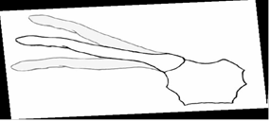
Elevation & Depression of Clavicle

Slide 15
Protraction & Retraction of Clavicle
AXIS: Vertical (superoinferior) Axis
MOTION: With protraction, lateral clavicle rotates anteriorly, & with retraction, lateral clavicle rotates posteriorly

Slide 16
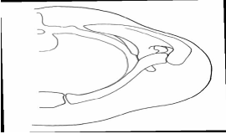
Protraction & Retraction of Clavicle

Slide 17
Anterior & Posterior Rotation of Clavicle
Anterior/posterior rotation of clavicle occurs as a spin
MOTION: clavicle rotates posteriorly from neutral, bringing inferior surface of clavicle to face anteriorly
Also known as backward or upward rotation

Slide 18
Sternoclavicular ligaments
sternoclavicular ligament
costoclavicular ligament
interclavicular ligament

Slide 19
Sternoclavicular ligament functions primarily to check anterior & posterior translatory movement of medial end of clavicle
Costo-clavicular ligament is found between clavicle & 1st rib. It checks elevation of lateral end of clavicle
Interclavicular ligament resists excessive depression of distal clavicle & superior glide of medial end of clavicle

Slide 20
Acromioclavicular Joint
It is a plane synovial joint with 3 degrees of freedom
It has a joint capsule & 2 major ligaments
Primary function of AC joint is to allow scapula additional range of rotation on thorax

Slide 21
Acromioclavicular Joint ligaments
Acromioclavicular & coracoclavicular ligaments are the 2 ligaments
Coracoclavicular ligament, is divided into a lateral portion, trapezoid ligament & medial portion, conoid ligament
Both portions of coracoclavicular ligament limit upward rotation of scapula at AC joint

Slide 22
Acromioclavicular Motions
Primary rotatory motions that take place at AC joint are
internal/external rotation
anterior/posterior tipping or tilting
upward/downward rotation

Slide 23
Internal & External Rotation
AXIS: vertical axis
MOTION: Internal & external rotation at AC joint brings glenoid fossa of scapula anteromedially & posterolaterally, respectively

Slide 24
Anterior & Posterior Tipping
AXIS: oblique “coronal” axis
MOTION: Anterior tipping will result in acromion tipping forward & inferior angle tipping backward
Posterior tipping will rotate acromion backward & inferior angle forward

Slide 25
Upward/Downward Rotation
AXIS: oblique “A-P” axis
MOTION: Upward rotation tilts glenoid fossa upward & downward rotation is opposite motion

Slide 26
GLENOHUMERAL JOINT
GH joint is a ball-and-socket synovial joint with 3 degrees of freedom. It has a capsule, several ligaments and bursae
Articulation is composed of large head of humerus & smaller glenoid fossa
Humeral head faces medially, superiorly, and posteriorly with regard to its shaft & condyles
An axis through humeral head & neck in relation to a longitudinal axis through shaft of humerus forms an angle of 130⁰ to 150⁰ in frontal plane. It is known as angle of inclination of humerus

Slide 27
In transverse plane, axis through humeral head & neck and axis through humeral condyles forms an angle which is usually 30⁰ posteriorly
This angle is known as angle of torsion. The normal posterior position of humeral head with regard to humeral condyles may be termed posterior torsion, or retrotorsion, of humerus

Slide 28
GH joint is surrounded by a large, loose capsule that is taut superiorly and slack inferiorly in resting position
When humerus is abducted & laterally rotated the capsule tightens, making abduction & lateral rotation the close-packed position for GH joint
Capsule is reinforced by the superior, middle, and inferior GH ligaments, as well as by coracohumeral ligament

Slide 29
Functions of ligaments of glenohumeral joint
Superior GH ligament contributes most to anterior & inferior stability when arm is at side (0⁰ abduction)
Middle GH ligament contributes primarily to anterior stability with arm is at the side & up to 45⁰ of abduction
With abduction beyond 45⁰ or with combined abduction and rotation, IGHLC prevents inferior humeral head translations

Slide 30
THE CORACOACROMIAL ARCH
Coracoacromial (or suprahumeral) arch is formed by coracoid process, acromion, & coracoacromial ligament that connects the two bones

Slide 31
BURSAE
Because of confined nature and closeness of structures in subacromial space, several bursae are present
Presence of bursae indicate possibility of frictional forces between structures
Most important are subacromial & subdeltoid bursae. These bursae separate supraspinatus tendon & head of humerus from acromion, coracoid process, coracoacromial ligament, & deltoid muscle

Slide 32
Glenohumeral Motions
OSTEOKINEMATICS
GH joint has 3 degrees of freedom: flexion/extension, abduction/adduction, and medial/lateral rotation
Flexion & extension occur about a coronal axis & sagittal plane
Medial & lateral rotation occur about a vertical axis & horizontal plane
Abduction/adduction of GH joint occur around a sagittal axis & frontal plane

Slide 33
Elevation in the plane of scapula (30⁰ to 45⁰ anterior to frontal plane) is called scapular abduction, or scaption

Slide 34
ARTHROKINEMATICS
According to convex-concave theory of joint motion with motions of humerus (physiological motions) convex head rolls in same direction & slides in opposite direction in glenoid fossa
Eg: With flexion, humeral head slides posteriorly & with abduction head slides inferiorly

Slide 35
Static Stabilization of the Glenohumeral Joint in the Dependent Arm
With arm is hanging at the side, gravity acts on humerus parallel to shaft in a downward direction
1. But passive tension in structures of rotator interval capsule (superior capsule, superior GH ligament, and coracohumeral ligament) results in compressing the humeral head into the lower portion of the glenoid fossa
2. Capsule has an airtight seal, which produces negative intra-articular pressure. This pressure creates a vacuum that resists inferior humeral translation because of gravity

Slide 36
3) Degree of glenoid inclination influences stability of GH joint. If there is a slight upward tilt of glenoid fossa either anatomically in structure of scapula or through scapular upward rotation, tilt of the fossa will produce a partial bony block against humeral inferior translation
When passive forces are inadequate for static stabilization, (eg. in heavily loaded arm, activity of supraspinatus is recruited

Slide 37
Dynamic Stabilization of the Glenohumeral Joint
Deltoid and Glenohumeral Stabilization
The deltoid muscle is a prime mover (along with the supraspinatus) for GH abduction
The anterior deltoid is also considered the prime mover in GH flexion

Slide 38
Large superiorly directed force of deltoid, if unopposed, would cause humeral head to impact coracoacromial arch before much abduction had occurred.
Inferior pull of gravity cannot offset the Fx component of deltoid, that is, deltoid cannot independently abduct (elevate) arm. Another force is required.

Slide 39
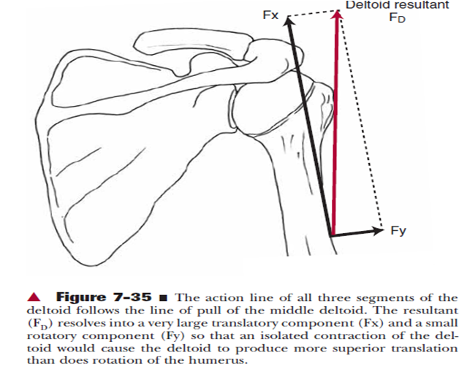
Action line of deltoid

Slide 40
Rotator Cuff and Glenohumeral Stabilization
Supraspinatus, infraspinatus, teres minor, & subscapularis muscles make up rotator or musculotendinous cuff
Also known as SITS muscles

Slide 41
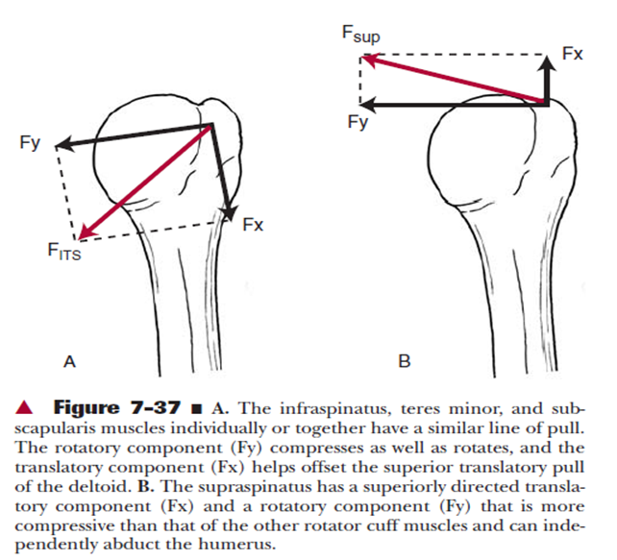
Action line of SITS MUSCLES

Slide 42
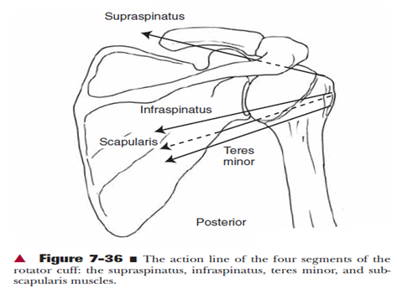

Slide 43
Long Head of the Biceps Brachii and Glenohumeral Stabilization
Biceps muscle is capable of contributing to the force of flexion & can, if humerus is laterally rotated, contribute to the force of abduction and anterior stabilization

Slide 44
Muscles of elevation
Deltoid
Deltoid is an effective primary mover for flexion & abduction & anterior deltoid is the prime mover for flexion

Slide 45
Supraspinatus
Supraspinatus is considered an abductor of humerus
When deltoid is paralyzed, supraspinatus alone can bring arm through most if not all of the GH range, but motion will be weaker

Slide 46
Secondary functions of supraspinatus are to compress GH joint & to assist in maintaining stability of dependent arm
With isolated & complete paralysis of supraspinatus, some loss of abduction force is evident, but most of its functions can be performed by remaining muscles

Slide 47
Infraspinatus, Teres Minor, & Subscapularis
Infraspinatus & Teres minor are external rotators of GH joint & subscapularis is an internal rotator
Lateral rotation is required during abduction to clear the greater tuberosity from under the coracoacromial arch.The medial rotatory function of the subscapularis muscle decreases with abduction.

Slide 48
Muscles of Depression
Latissimus Dorsi Function
When UE is free to move in space, it may produce adduction, extension, or medial rotation of humerus
When hand &/or forearm is fixed in weight-bearing, latissimus dorsi muscle will pull its inferior attachment on pelvis towards its superior attachment on scapula & humerus

Slide 49
This results in lifting the body up as in a seated pushup. During crutch walking, a contraction of latissimus dorsi will unweight feet as trunk rises beneath the fixed scapula, allowing legs to swing forward through crutches

Slide 50
Teres major muscle, like latissimus dorsi, adducts, medially rotates, and extends humerus
Rhomboid Muscle Function
Rhomboid major and minor muscles are active in elevation of arm, especially in abduction
These muscles serve function as stabilizing synergists to muscles that upwardly rotate scapula

Slide 51
Upward Rotators of Scapula
Upward rotation of scapula is produced by a balance between trapezius & serratus anterior muscles through their attachments on clavicle & scapula
Upper portion of trapezius contributes directly to initial elevation of clavicle

Slide 52
Serratus anterior contributes to combined clavicular & scapular motion
It plays a primary role in stabilizing scapula to thorax
Paralysis of serratus anterior muscle is classically characterized by scapular “winging”

Slide 53
Scapulothoracic Stability
Stability of scapula on thorax is provided by muscles that attach to both thorax & scapula & maintain contact between these surfaces by pulling or compressing scapula to thorax

Slide 54
Ultimate functions of scapular motion are to orient glenoid fossa for
  optimal contact with moving arm
  to add range to elevation of arm
  to provide a stable base for controlled motions between humeral head & glenoid fossa

Slide 55
Integrated Function of Shoulder Complex/ Scapulohumeral rhythm
Scapulothoracic & Glenohumeral Contributions
Scapula contributes to elevation (flexion & abduction) of humerus by upwardly rotating glenoid fossa 50⁰ to 60⁰ from its resting position

Slide 56
GH joint contributes 100⁰ to 120⁰ of flexion & 90⁰ to 120⁰ of abduction

Slide 57
Combination of scapular & humeral movement results in a maximum range of elevation of 150⁰ to 180⁰

Slide 58
Overall ratio of 2⁰ of GH to 1⁰ of ST motion during arm elevation & simultaneous GH & ST motion is called as “SCAPULOHUMERAL RHYTHM”
Ratio has variable consideration among individuals but is commonly accepted to be 2:1 (2⁰ of GH motion to 1⁰ of scapular rotation) overall motion

Slide 59
During setting phase (0⁰ to 30⁰ abduction, 0⁰ to 60⁰ flexion), motion is primarily at GH joint, whereas, scapula seeks a stable position
During mid-range of humeral motion, scapula has greater motion, approaching a 1:1 ratio with humerus
Later in range, GH joint again dominates motion

Slide 60
PATHOMECHANICS OF SHOULDER JOINT
Coracoacromial Arch
It protects structures beneath it from direct trauma from above
Such trauma can occur through even carrying a heavy bag over shoulder
contact of humeral head with undersurface of arch can simultaneously cause painful impingement or mechanical abrasion of structures lying in subacromial space

Slide 61
Supraspinatus is particularly vulnerable
When subacromial space is narrowed (can be due to anatomic factors such as changes in shape of acromion inferiorly, changes in slope of acromion, acromial bone spurs, AC joint osteophytes), impingement of rotator cuff tendons & subacromial bursa during elevation of arm increases

Slide 62
Subacromial bursa separates supraspinatus tendon & head of humerus from acromion, coracoid process, coracoacromial ligament, & deltoid muscle
It permits smooth gliding between humerus & supraspinatus tendon
Interruption or failure of this gliding mechanism is a common cause of pain & limitation of GH motion

Slide 63
MULTIPLE CHOICE QUESTIONS

Slide 64
Which of the following muscle helps effectively in crutch walking
Serratus anterior
Deltiod
Latissimus dorsi
Rhomboidus
2. Glenohumeral joint contributes 100⁰ to 120⁰ of flexion & 90⁰ to 120⁰ of abduction
True
False

Slide 65
3. Axis through humeral head & neck in relation to longitudinal axis through shaft of humerus forms an angle which is known as
a. Angle of torsion
b. Angle of inclination
4. Which of the following provide static stability to shoulder joint
Glenoidal inclination
Corecohumeral ligament
Rotator interval capsule
All the above

Slide 66
5. SC joint is a plane synovial joint
True
False

