Slide 1

BIOLOGICAL PRINCIPLES OF TOOTH PREPARATION

Slide 2
PRINCIPLES OF TOOTH PREPARATION
(According to Rosenstiel)
BIOLOGIC
Conservation of tooth structure
Avoidance of over contouring
Supra gingival margins
Harmonious occlusion
Protection against tooth fracture
MECHANICAL
Retention form
Resistance form
Deformation
ESTHETIC
Minimum display of metal
Maximum thickness of porcelain
Porcelain occlusal surfaces
Subgingival margins
Optimal restoration

Slide 3
Learning objectives
Prevention of damage during tooth preparation
Conservation of Tooth Structure
Various CONSIDERATIONS AFFECTING FUTURE DENTAL HEALTH
Classification of margins

Slide 4

Teeth do not possess regenerative property.
Once enamel or dentin is lost as a result of trauma, caries or wear restorative materials must be used to reestablish the form and function
Teeth require preparation to receive restoration
The current focus is on conservative tooth preparation that is noninvasive and that minimally involves dentin.

Slide 5
definition
Tooth preparation may be defined as the mechanical treatment of dental disease or injury to hard tissue that restores a tooth to the original form (Tylman).

Slide 6
OBJECTIVES OF TOOTH PREPARATION
Reduction of the tooth as minimum as possible.
Preservation of healthy tooth structure to secure resistance form.
Provision for acceptable finish line.
Performing précised axial tooth reduction to encourage favorable tissue responses.

Slide 7
PRINCIPLES OF TOOTH PREPARATION
According to Shillingburg, the design of a preparation for a cast restorations and the execution of that design are governed by five principles:
Preservation of tooth structure
Preservation of the periodontium.
Marginal integrity
Retention and resistance
Structural durability

Slide 8
Biologic Considerations
Tooth preparations affects the adjacent teeth, soft tissues and tooth pulp. This may lead to inadequate fit, crown contour and plaque control.
Prevention of damage during tooth preparation
Prevention of injury to the pulp
Conservation of tooth structure
Considerations affecting future dental health

Slide 9
Prevention of damage during tooth preparation:
Adjacent teeth:-
Iatrogenic damage to an adjacent tooth is a common error during tooth preparation.
The technique of tooth preparation must avoid damage to adjacent teeth because a damaged tooth even if reshaped and recontoured is always more susceptible to caries as,
  Less fluoride content than surface layer
  More plaque retention
This damage can be avoided by;
  Placing a matrix band interproximally
  Better method is by using a thin tapered diamond and by passing it interproximally leaving thin lip/ fin of enamel intact.

Slide 10
b) Soft tissues:
Includes the tongue, cheek, lip, soft tissues should be carefully retracted using an aspirator tip, mouth mirror and saliva ejector especially, the tongue while preparing lingual surfaces of mandibular molars.

Slide 11
c) Pulp:
Here, proper knowledge of the anatomy and morphology of the tooth is important.
Diagnostic radiographs for assessing the pulp size and its proximity to the outer surface.
Pulp affected by,
- Temperature
- Chemical agents
- Microorganisms

Slide 12
1. Temperature:
Heat generated due to friction between rotary instrument and surface being prepared. Excessive pressure, high speed, type, shape and condition of cutting alters the heat produced precautions.
Use of water spray, removes the debris and cools the tooth.

Slide 13
2. Chemical Action:
Cements, bases and luting agents are known pulpal irritants. Hence, the use of cavity varnish (forms barrier) recommended. Chemicals commonly used to clean and debride the preparation are contraindicated.
3. Bacteria:
Due to bacteria left behind after preparation or having gained access to dentin due to microleakage. Thus, removal of all carious dentin is essential before tooth preparation.

Slide 14
II. Conservation of Tooth Structure:
Thickness of remaining dentin is inversely proportional to the pulpal response. So the preparation should not extend very deep as this may damage the odontoblastic processes which will adversely affect the cell nucleus at dentin pulp interface (dowden).
Thus, special care has to be taken when preparing vital teeth for complete coverage.

Slide 15
Tooth structure conserved using following methods:-
Use of partial coverage instead of full coverage crowns.
Preparation of teeth with minimum possible axial taper (i.e. not more than 8⁰).
Preparation of occlusal surfaces so that reduction follows the anatomic planes to give uniform thickness.
Selection of a conservative margin.
Avoiding unnecessary apical extension of the restoration.

Slide 16
title | Author and journal | Materials | Conclusion | level
Tooth preparations for complete crowns: An art form based on scientific principles | Charles J. Goodacre, DDS, MSD,a Wayne V. Campagni, DMD,b and Steven A. Aquilino, DDS, MSc THE JOURNAL OF PROSTHETIC DENTISTRY 363 april 2001 | Literature covering 250 years of clinical practice was reviewed with emphasis on scientific data acquired during the last 50 years. Both a MEDLINE search and an extensive manual search were used to locate relevant articles written in English in the last 50 years. | Nine scientific principles have been developed that ensure mechanical, biologic, and esthetic success for tooth preparation of complete coverage restorations. | 5

Slide 17
CONSIDERATIONS AFFECTING FUTURE DENTAL HEALTH
Axial reduction:
Gingival inflammation is commonly associated with crowns and FPD abutments having excessive axial contours, as it is more difficult for the patient to maintain plaque control around the gingival margins. It is essential that a tooth preparation provide sufficient space for the development of good axial contours. This will enable the junction between the restoration and the tooth to be smooth and free of any ledges or abrupt changes in direction.

Slide 18
Unless a restoration is needed to correct a malformed or malpositioned tooth, a crown should duplicate the contours and profile of the original tooth. Sufficient tooth structure must be removed to allow the development of correctly formed axial contours, particularly in the interproximal and furcation areas, where periodontal disease often begins.

Slide 19
MARGIN PLACEMENT
Whenever possible, the margin of the preparation should be supragingival.
Subgingival margins of cemented restorations have been identified as a major factor in periodontal disease, particularly when they encroach on the epithelial attachment. Supragingival margins are easier to prepare accurately without trauma to the soft tissues.
Supragingival margins are usually located on enamel, whereas subgingival margins are either on dentin or on cementum.

Slide 20
CLASSIFICATION
Supragingival
Equigingival
Subgingival

Slide 21
SUPRAGINGIVAL MARGINS
Least traumatic to the soft tissues
Margin placement is easy and can be finished easily
Impressions are easily made
Most accessible for cleansing
Restorations can be easily evaluated

Slide 22
Advantages of supragingival margins :
They can be easily finished.
They are more easily kept clean.
Impressions are more easily made, with less potential for soft tissue damage.
Restoration can easily be evaluated at recall appointments.

Slide 23
Indication of subgingival margins :
Dental caries, cervical erosion, or restorations extending subgingivally and where crown lengthening procedures are not indicated.
Proximal contact area extending to the gingival crest.
Need for additional retention.
Masking of margin of a metal ceramic restoration
Root sensitivity that cannot be controlled by more conservative procedures.
Modification of the axial contour is indicated.

Slide 24
Disadvantages of subgingival margins
Plaque retention…
Margin placement…
Mechanical irritation…
Violation of biological width
Soft tissue injury…

Slide 25
Criteria for subgingival margin placement
Emergence profile
Margins are closed and properly finished
Adequate band of attached gingiva
Margin should not violate the biological width

Slide 26
The finish line is the peripheral extension of a tooth preparation
The most important consideration in selecting a cervical margin design is its ability to consistently and predictably provide excellent marginal integrity.
Knife edge
Chisel edge
Chamfer
Shoulder
Sloped shoulder
Shoulder with bevel
Radial shoulder
Heavy chamfer

Slide 27
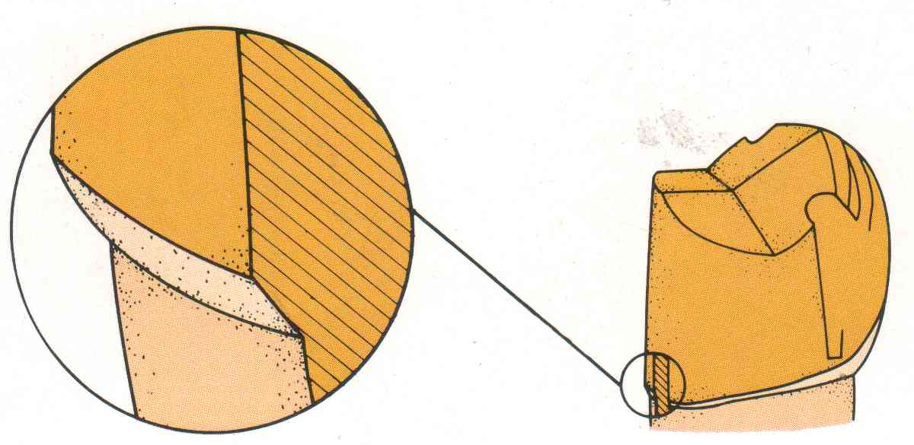
FEATHER EDGE/knife edge
Advantages
Conservation of the tooth structure
Permits an acute margin of the metal
Disadvantages:
The axial reduction may fade out
Thin margin may be difficult to accurately wax and cast
More susceptible to distortion
Results in overcontouring
Indications:
Not recommended

Slide 28
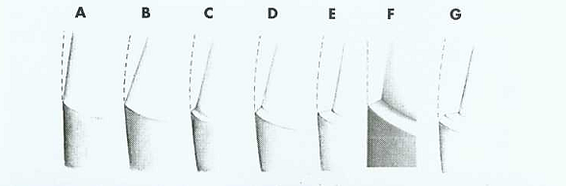
CHISEL EDGE
Variation of feather edge
Larger angle between the axial surface and unprepared tooth structure
Associated with excessively tapered preparation
Historic advantage-impression making with rigid impression compound in coper bands
Indications:
Lingual surface of mandibular posterior teeth
The surfaces towards which tooth has tilted
Cementum
BEVEL EDGE
Advantage
remove unsupported enamel, allows finishing of metal
Disadvantage
extends preparation into sulcus if used on apical margin
Indication
facial margin of maxillary partial coverage crowns

Slide 29
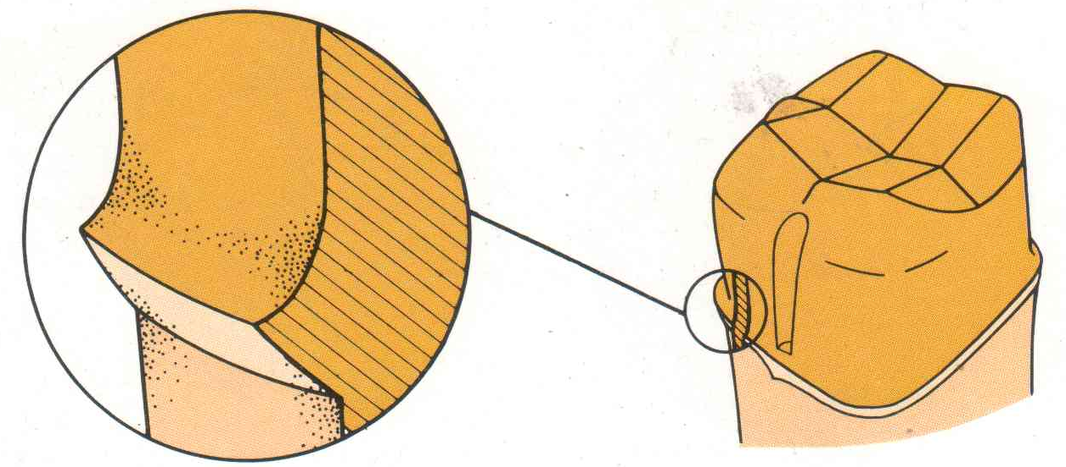
CHAMFER
It’s a finish line design for tooth preparation in which gingival aspect
meets the external axial surface at an obtuse angle
Advantages
It provides distinct margin
Adequate bulk to the restoration
Easier to control
Exhibits least stresses
Disadvantage -Care needed to avoid unsupported lip of enamel
Indications:
Cast metal restorations
Lingual margin of the metal ceramic crowns

Slide 30
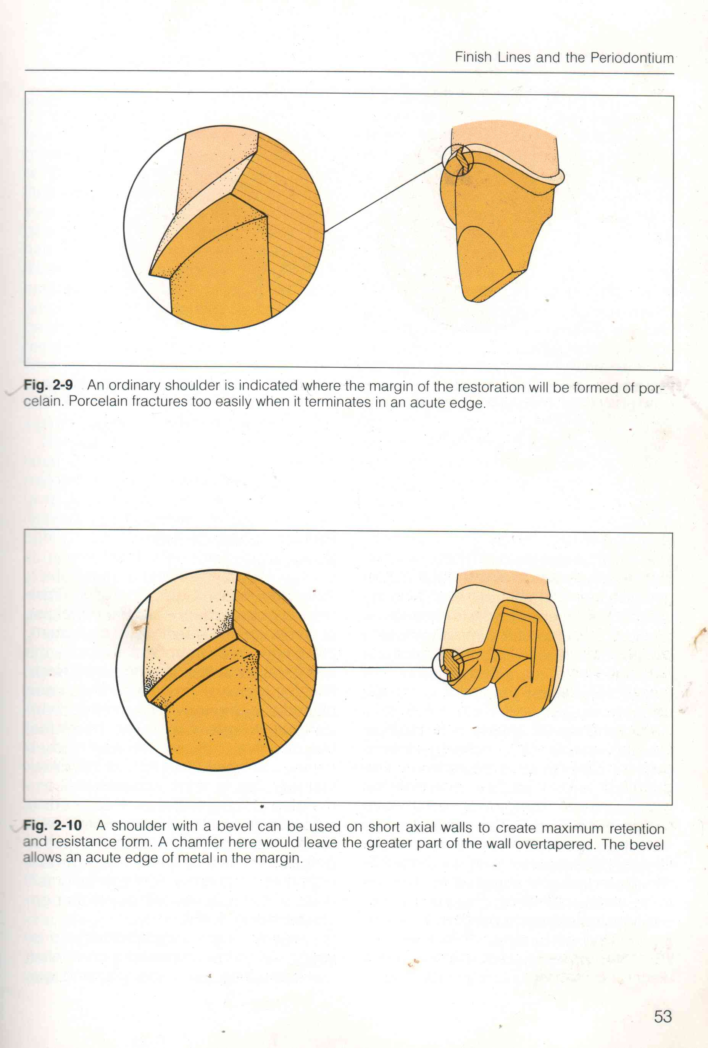
shoulder
Bulk of the restoration
Wide ledge provides resistance to occlusal forces
Provides space for healthy restorative contours
Maximum esthetics
It offers resistance against distortion during processing
Disadvantages:
Less conservative of tooth structure
The sharp 90⁰ internal line angle…
Indications:
All ceramic restorations
Facial magins of metal-ceramic crowns

Slide 31
SLOPED SHOULDER
Advantage
bulk of material, advantages of bevel
Disadvantage
less conservative
Indication
facial margin of metal ceramic crowns
Cavosurface margin - 120°
Reduces the possibility of leaving unsupported enamel and yet leaves sufficient bulk to allow thinning of the metal framework to a knife edge for acceptable aesthetics.

Slide 32
SHOULDER WITH BEVEL
Removes unsupported enamel, allows finishing of metal
Disadvantage – extends the preparation into the sulcus if used on apical margin
Indications –
-facial margins of maxillary partial coverage restorations
- Inlay and onlay margin
-Shoulder is already present because of destruction by caries or presence of previous restorations

Slide 33
RADIAL SHOULDER:
Shoulder with rounded internal line angle
Stress concentration is less in the tooth structure
HEAVY CHAMFER
Internal line angle is large radius rounded
Provides better support for a ceramic crown than chamfer, but it is not as good as shoulder
Easier to prepare than shoulder

Slide 34
OCCLUSAL CONSIDERATIONS :
A satisfactory tooth preparation should allow sufficient space for developing a functional occlusal scheme in the finished restoration. Sometimes a patient’s occlusion is disrupted by supraerupted or tilted teeth. When these teeth are prepared for restoration, the eventual occlusal plane must be carefully analyzed and the teeth reduced accordingly. Often considerable reduction is needed to compensate for the supraeruption of abutment tooth.

Slide 35
PREVENTING THE TOOTH FRACTURE
The likelihood that a restored tooth will fracture can be lessened if the tooth preparation be designed to minimize the potentially destructive stresses
Inlay- greater potential for fracture
Onlay – lessens the chance of fracture
Complete crown –greatest protection against fracture

Slide 36
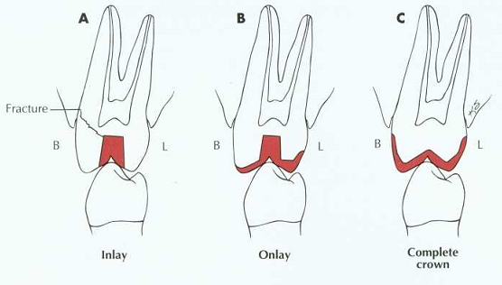
Protection against tooth fracture
The tooth preparation is designed should be designed in such a way that it minimizes potentially destructive stresses.

Slide 37
Title | JOURNAL & author | Material and method | Result | Conclusion | Level of evidence
Finish-line designs for ceramic crowns: A systematic review and meta-analysis | THE JOURNAL OF PROSTHETIC DENTISTRY-2018 | This report follows the Preferred Reporting Items for Systematic Reviews and Meta-Analyses (PRISMA) statement. The literature search was conducted in MEDLINE via the PubMed, Embase, and Web of Science databases with no publication year or language limits. In vitro studies comparing the marginal and internal adaptations of ceramic crowns with rounded shoulder and chamfer finish lines were included in the meta-analysis. | 16 studies were included in the qualitative synthesis and meta-analyses. Statistical analyses were conducted using the Review Manager Software. Meta-analyses were performed with random-effects models (a=.05). Ceramic crowns with rounded shoulders exhibited significantly better marginal adaptation than those with chamfers | The difference in marginal adaptation of ceramic crowns using 2 finish-line designs was small, and the clinical significance was low, whereas the results of internal adaptation favored the chamfer finish line. | 2a

Slide 38
TITLE | NAME OF JOURNAL | AUTHOR NAME | MATERIAL &METHODOLOGY | RESULT | LEVEL OF EVIDENCE
In in-vitro evaluation of effect of different finish lines on marginal adaptation in metal-ceramic restorations under thermo-mechanical loading | Indian J Dent Res.2011 Jul-Aug;22(4 | Riddhima gupta | the marginal gap in terms of cement film thickness associated with shoulder, shoulder with 45° bevel, shoulder with 30° bevel and chamfer, under thermo-mechanical loading. Forty human mandibular molars were prepared and restored with ceramo-metal crowns. Teeth were thermo-mechanically loaded and vertically sectioned to evaluate the cement film thickness. | finish line designs may influence the marginal adaptation of ceramo-metal restorations. Clinically, shoulder with 45° bevel design facilitate marginal adaptation in comparison to shoulder or chamfer design and may be preferred for this type of crown. | 5

Slide 39


