Slide 1
APPENDIX
Dr. Ashok
Assistant Professor
Department of Anatomy
S.B.K.S.M.I. & R.C.

Slide 2
APPENDIX
The vermiform appendix is narrow, hollow blind tube which is attached to the posteromedial aspect of the caecum about 2 cm from the ileocaecal opening
It is coiled on itself and is usually directed downward, it contains large amount of lymphoid tissues and is the remnant of the distal part of the embryonic caecum
It lies in the right iliac fossa

Slide 3
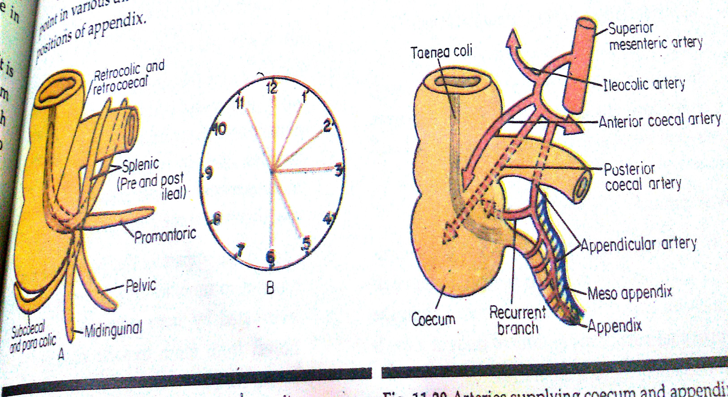

Slide 4
Its base is situated at the junction of lateral one third with the medial two thirds of a line joining the anterior superior iliac spine with the umbilicus ( McBurneys point)
Its length varies from 2 cm to 20 cm and its diameter is 5 mm. its wide lumen opens in the caecum and the opening is guarded by a semilunar valve. In children it is longer than in adult .
The three taeniae coli of the colon are continuous with the longitudinal muscle layer of appendix and begin from the base the appendix. To locate the base of appendix, follow the anterior taenia on the caecum.

Slide 5
Positions :
Retrocaecal or retrocolic (12 oc) : it lies behind the caecum in the retrocaecal recess or behind ascending colon. It is the commonest position
Pelvic type (4 oc) : lies over the pelvic brim or in the pelvic cavity. It may come in contact with the right ureter and in the female with the right uterine tube or ovary
Subcaecal (11 oc): it lies below the caecum
Splenic type( 2 oc) : the appendix is directed toward the spleen and passes in front or behind the terminal part of the ileum

Slide 6
Mid inguinal type (6 oc) : the appendix hangs vertically towards the inguinal ligament
Promotoric type (3 oc) : it is directed horizontally toward sacral promontory
Blood supply : appendicula artery brach of ileocolic artery and appendicual vein joins in the ileocolic vein
Lymphatic drainage : ileocolic nodes
Nerve supply : sympathetic fibers are from T10 segment of spinal cord through the coeliac plexus, the parasympathetic fibers are from the vagus.

Slide 7
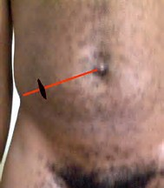
Mac Burney's Point

Slide 8
CLINICAL ANATOMY
Appendicitis
Mc Burney's point
Inflamed appendix
Appendicectomy
Perforation

Slide 9
TITLE | AUTHOR / JOURNAL | MATERIAL | RESULT | CONCLUSION
Appendicitis complications: Antibiotics v/s Surgery | Robert Preiedt Health Day Reporter WEBMD ARCHIEVES | A total of 1116 patients with mild appendicitis were reviewed | Rates of complications were similar | Early use of antibiotics reduces the complications by 92 % within first month of diagnosis

