Slide 1
PERINEUM
Dr. A. R. Gandotra
HOD and Professor
Department of Anatomy
S.B.K.S.M.I. & R.C.

Slide 2
PERINEUM
The perineum is the lowest region of the trunk below the pelvic diaphragm.
It includes all structures that fill the pelvic outlet. The perineum is traversed by urethra and anal canal in the male, and urethra, vagina, and anal canal in the female.

Slide 3
The surface features of the perineum in male are penis, scrotum, and anal orifice, whereas the surface features of the perineum in the female are vulva (female external genitalia) and anal orifice.
The median region between vaginal and anal orifices in female, containing perineal body is considered as gynecological perineum.

Slide 4
Superficial Boundaries
In lithotomy position, the perineum is diamond shaped and is bounded as follows
Anteriorly: by scrotum in male and mons pubis in female.
Posteriorly: by buttocks.
On each side: by the upper medial aspect of the thigh.

Slide 5
Deep Boundaries
The deep boundaries of the perineum correspond to the boundaries of the pelvic outlet as follows
Anteriorly: Inferior margin of the pubic symphysis
(actually arcuate pubic ligament).
Posteriorly: Tip of the coccyx
On each side:
– Anterolaterally: Conjoint ischiopubic ramus.
– Laterally: Ischial tuberosity.
– Posterolaterally: Sacrotuberous ligament.

Slide 6
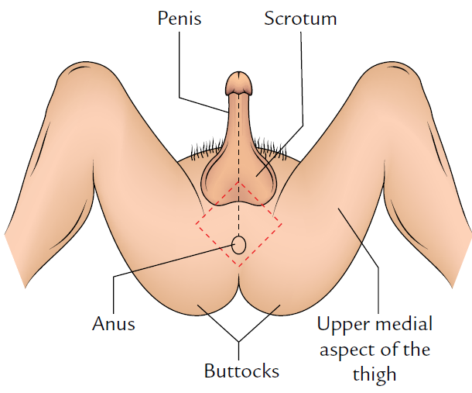

Slide 7
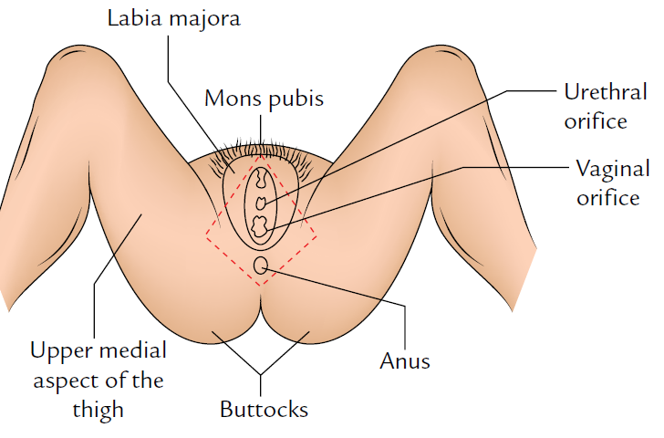

Slide 8
Urogenital Diaphragm
- The urogenital diaphragm is a triangular muscle sheet formed by the sphincter urethrae and deep transverse perineal muscles.
- On the deeper aspect it is covered by a thin layer of endopelvic fascia called superior fascia of the urogenital diaphragm, and on the superficial aspect it is covered by the perineal membrane called inferior fascia of the urogenital diaphragm.

Slide 9
-This triangular diaphragm occupies the urogenital triangle with its apex behind the pubic symphysis and its sides attached to the ischiopubic rami.
-It is pierced by the urethra in male and by the urethra and vagina in female, and contains bulbourethral glands within it in male.

Slide 10
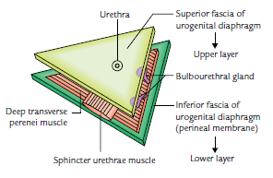

Slide 11
Perineal Membrane
It is a very strong triangular membrane (fascialsheet) that stretches across the urogenital triangle between the ischiopubic rami at the sides.
It intervenes between the superficial perineal pouch below and the deep perineal pouch above.

Slide 12
1. In front, it is thickened to form the transverse perineal ligament and is continuous with the superior fascia of the urogenital diaphragm.
2. Behind, it is fixed to the perineal body in the midline and splits in to two layers.
The upper layer is continuos with the superior fascia of the urogenital diaphragm; and the lower layer is continuous with Colles’ fascia.

Slide 13
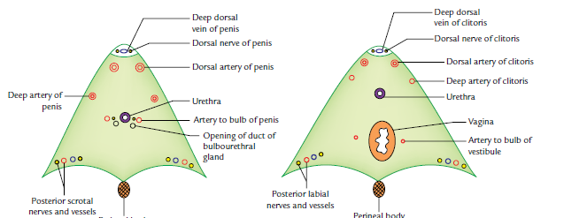
Structures piercing perineal membrane.

Slide 14
Structures Piercing the Perineal Membrane
1. Posterior scrotal or labial, nerves and vessels on each
side at the base.
2. Deep artery of penis or clitoris near the middle of its
attached margin.
3. Dorsal artery of penis or clitoris near the anterior part
of its attached margin.
4. Urethra in the midline.
5. Ducts of the bulbourethral glands.
6. Artery to the bulb of penis or bulb of vestibule of vagina
on each side of the urethra.
7. Vagina (in female) behind the urethra.

Slide 15
Perineal Body
The perineal body is a wedge-shaped mass of fibromuscular tissue situated in midline at the junction of urogenital triangle (anterior perineum) and anal triangle (posterior perineum) between the lower ends of vagina and anal canal.
It lies about 1/2 inch (1.25 cm) in front of the anal margin close to the bulb of penis in male and the posterior wall of the vestibule of vagina in female.

Slide 16
The 10 muscles of the perineum converge and interlace in the perineal body.
These are as follows:
1. Two superficial transverse perineal muscles.
2. Two deep transverse perineal muscles.
3. Two bulbospongiosus muscles.
4. Two levator ani muscles.
5. One sphincter ani externus.
6. One longitudinal muscle coat of anal canal.

Slide 17
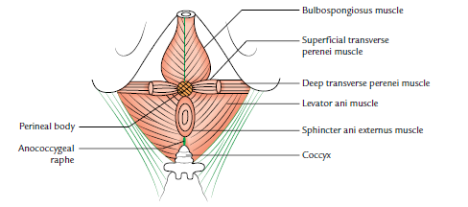

Slide 18
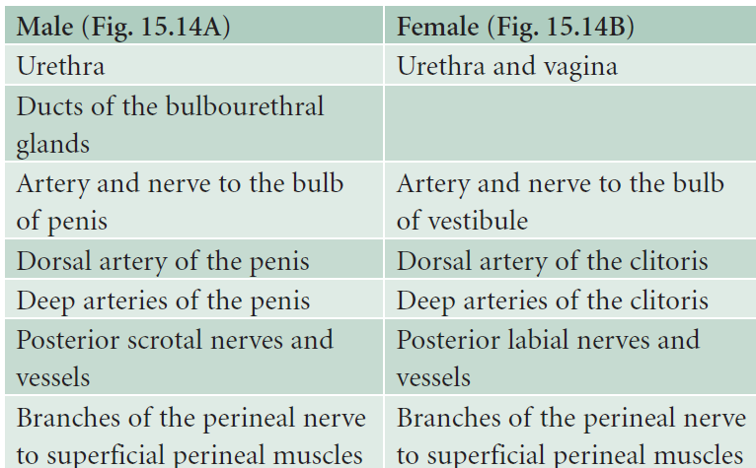

Slide 19
ANAL TRIANGLE (POSTERIOR PERINEUM)
It is a triangular area bounded in front by a horizontal line joining the anterior ends of ischial tuberosities, laterally by the ischial tuberosities, inferolaterally by the sacrotuberous ligaments, and posteriorly by the coccyx.
It contains the anal canal in the middle and ischiorectal fossae one on each side of the anal canal

Slide 20
Superficial and Deep Perineal Pouches
A triangular tough fascial sheet called the perineal membrane stretches across this triangle and is attached to its sides.
The posterior margin of the perineal membrane is fused centrally to the perineal body.
The anterior margin of the perineal membrane thickens to form a transverse perineal ligament.
A small gap between this ligament and the arcuate pubic ligament provides passage to the deep dorsal vein of the penis

Slide 21
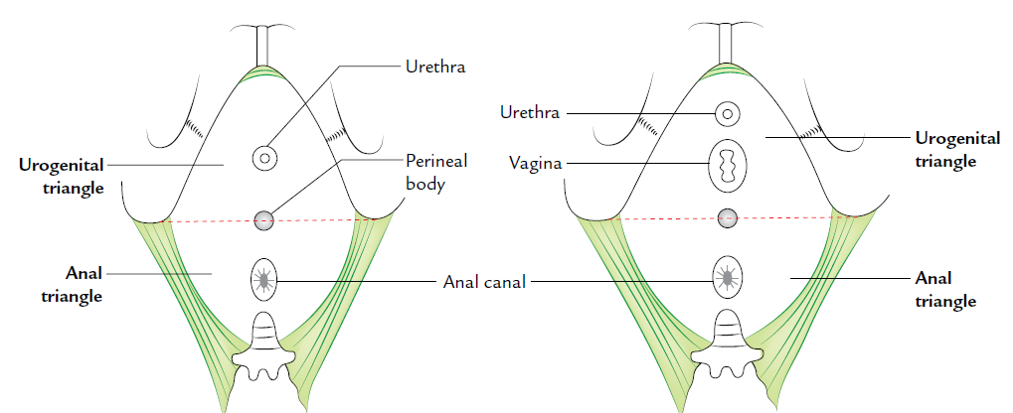

Slide 22
The perineal membrane is pierced by the urethra in male and by the urethra and vagina in female.
Above the perineal membrane the urethra is surrounded by a voluntary, sphincter urethrae muscle (superficial urethral sphincter).
In the female, the superficial urethral sphincter is also pierced by the vagina

Slide 23
The deep aspect of the external sphincter is covered by a thin fascia which is continuous with the posterior edge of the perineal membrane and is attached at the sides to the ischiopubic rami. Thus, sphincter urethrae is in fact contained within a fascial capsule which is termed deep perineal pouch .
This pouch also contains the deeptransverse perineal muscles and in male two bulbourethralglands (glands of Cooper) whose ducts pass forward piercing the perineal membrane to open into the bulbous urethra

Slide 24
The membranous layer of the superficial fascia of abdomen (Scarpa’s fascia) surrounds the penis as far as its neck, to form a tube-like fascia of penis, the scrotum, and finally in the perineum it fuses with the posterior edge of the perineal membrane.

Slide 25
The perineal part of this fascia is called Colles’ fascia. Thus, superficial perineal pouch is formed between the perineal membrane and Colles’ fascia
It contains the root of penis and some muscles, viz., bulbospongiosus covering the bulb of penis, the ischiocavernosus muscle on each side covering the crus of penis, and the superficial transverse perineal muscle on each side running transversely from the perineal body to the ischial ramus

Slide 26
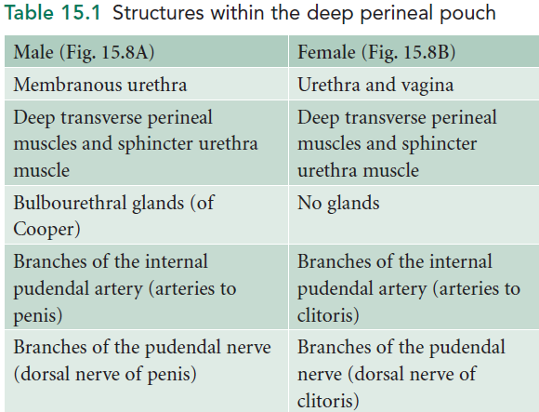

Slide 27
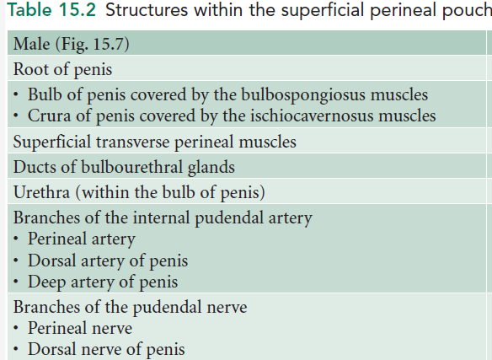

Slide 28
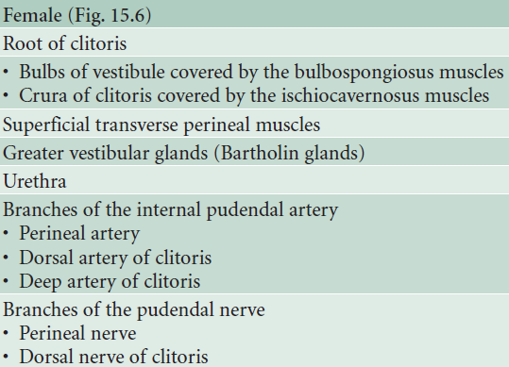

Slide 29
Title | Author/ Journal | Material | Results | Conclusions
The relationship between the pubo-urethral ligaments and the urogenital diaphragm in the human female | Paul Milley David Nicols The anatomical Record | The connective tissue supports of the human female urethra have been investigated in 14 cadavers and 20 fetuses. | In all cases the urethra was found to be suspended from the pubic bone by bilaterally symmetrical anterior, posterior and intermediate pubo-urethral ligaments. The anterior and posterior ligaments were formed by reflections of the inferior and superior fascial layers of the urogenital diaphragm. The intermediate ligament represented a fusion of these fascial layers and no transverse perineal ligament was found. | Pubovesical ligament is analogous to the puboprostatic ligament of the male. An anatomical defect in the pubo-urethral ligaments might be a contributing factor to urinary stress incontinence in the female.

