Slide 1
FAMILY PLANNING METHODS
Mr. K.M.Parmar
Assistant Professor
Department of Anatomy
S.B.K.S.M.I. & R.C.

Slide 2
FAMILY PLANNING
The goal of family planning is to enable couples and individuals to freely Choose how many children to have and when to have them

Slide 3
Methods of Contraception
Temporary methods
Permanent methods
Emergency contraception

Slide 4
Temporary methods
Natural regulation of fertility
Barrier methods
Hormonal contraception
Intra uterine contraceptive devices
Emergency (Post coital ) contraception

Slide 5
Permanent methods
Sterilization
Female sterilization: Tubal ligation
Male sterilization: Vasectomy (No-scalpel vasectomy - NSV)

Slide 6
Natural regulation of fertility
Symptom based methods: BBT, Billing’s method
Calendar method

Slide 7
Basal Body Temperature
Slight fall in baseline temp just before ovulation
F/b sharp rise in temp for 2-3 days

Slide 8
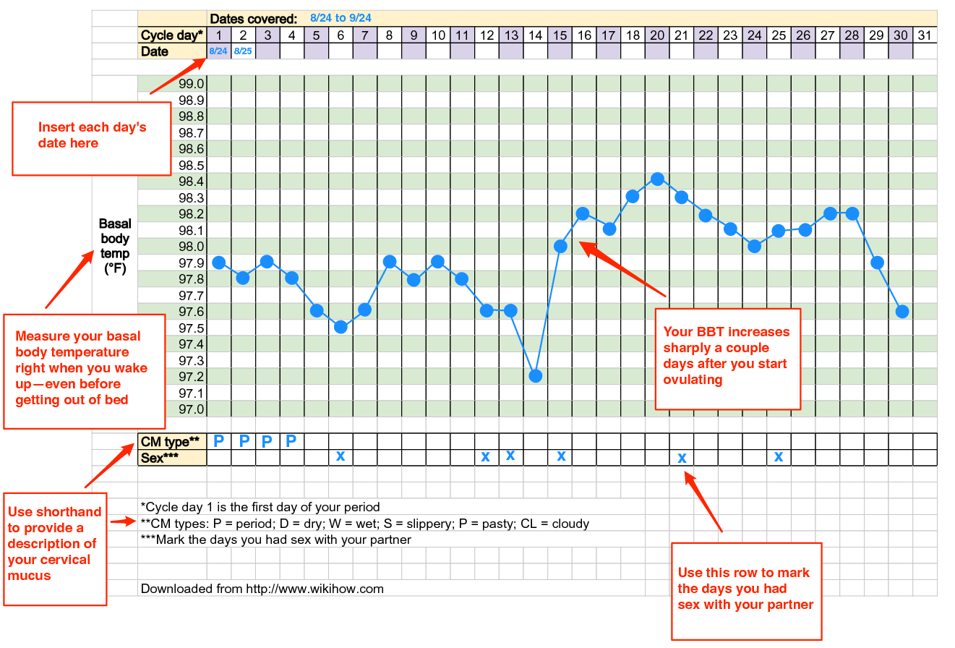

Slide 9
Billing’s method/ Cervical mucus method
Change in quality of cervical mucus before ovulation (thin, clear & elastic)
After ovulation mucus becomes thick

Slide 10
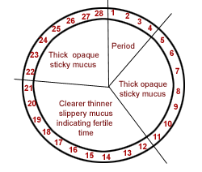

Slide 11
Rhythm Method(“safe Period”)
ovum survival- 24 hours
Sperms- 3 days
Coitus must be avoided from the 9th to the 18th day

Slide 12
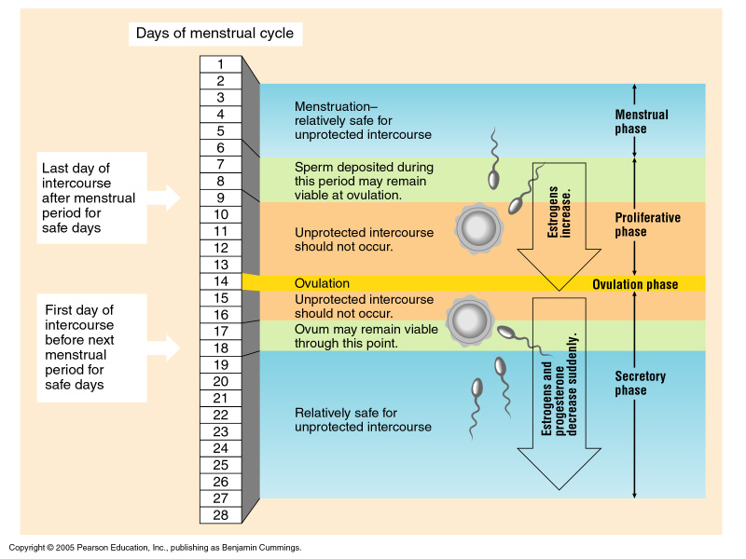
The Fertility Cycle
Figure 6.4

Slide 13
Barrier methods
Male: condom
Female: condom, cervical cap/ diaphragm

Slide 14
Male condom
A barrier method
Covers the erect penis
Readily available, cheap, Easy to use, easy to carry
Prevents STDs
No major side effect

Slide 15
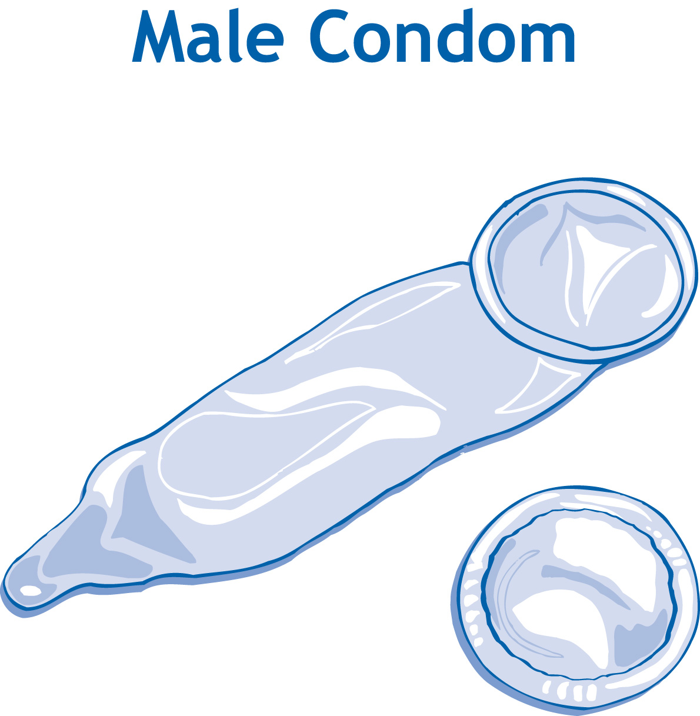

Slide 16
Barrier methods used by Females
Female condoms, cervical cap, diaphragm
Blocks the sperm from entering the uterus
Helps to prevent pregnancy and sexually transmitted diseases
Easy to use, readily available

Slide 17
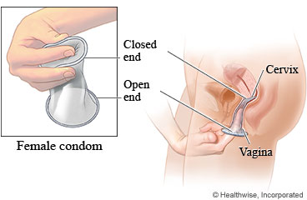

Slide 18
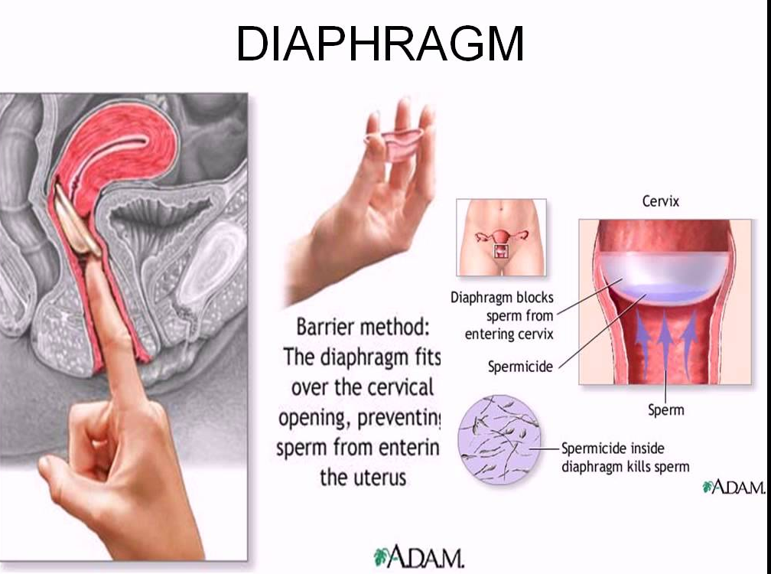

Slide 19
Oral Contraceptives
Hormonal pill
Combination of oestrogen & Progesterone
Prevents ovulation, thickens cervical mucus, makes the uterus hostile for implantation
Can be used as Emergency contraceptive
No protection against STDs
Daily consumption required

Slide 20
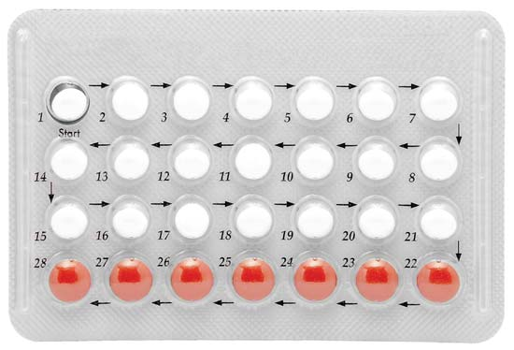

Slide 21
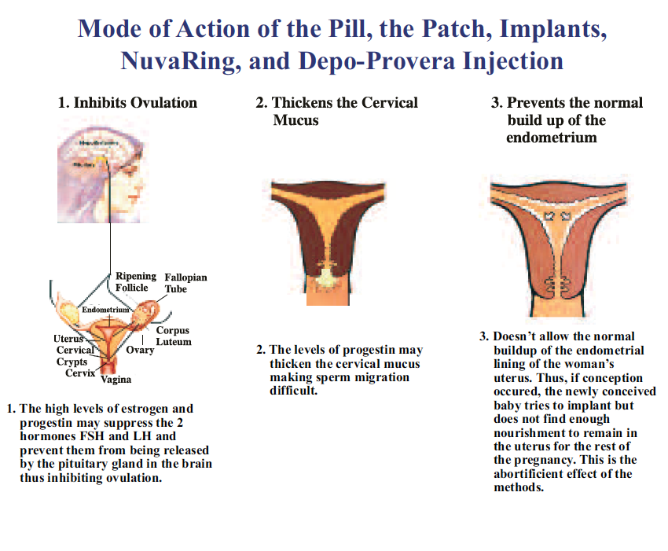

Slide 22
Intra-uterine devices (IUDs)
Small device put inside the uterus by a health care professional
Thickens mucus in cervix making it hard for sperm to enter the uterus
Foreign body reaction inside the uterus: hostile for implantation
Always stays in place, cannot move around

Slide 23
Intra Uterine Devices
Inert
Copper bearing
Progestogen releasing

Slide 24
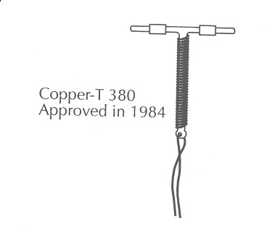
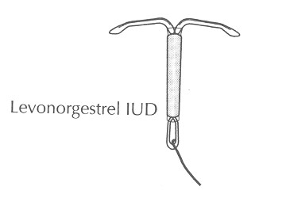
IUDs

Slide 25
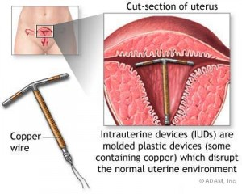

Slide 26
IUD Insertion Risks
Risks:
  Perforation of the uterus (rare)
  Infection (antibiotic prophylaxis not needed)
  May increase the chance of pelvic inflammatory disease (PID)
  increased menstrual bleeding

Slide 27
Permanent Methods of Family Planning
Vasectomy
Tubal ligation

Slide 28
Indications
Family size completed
Couple willing for sterilization

Slide 29
Male sterilization
No scalpel vasectomy (NSV)
Cutting & ligation of vas deferens under local anaesthesia
vasectomy is far safer and far less expensive than female tubal ligation
No change in hormonal levels
Semen examination after 6-10 wks to confirm absence of sperm
Recanalization: little success

Slide 30
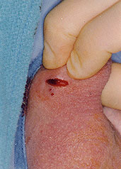

Slide 31
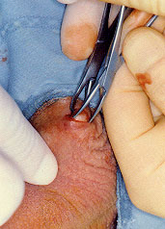

Slide 32
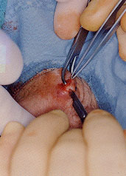

Slide 33
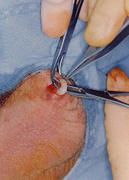

Slide 34
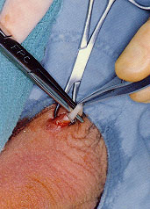

Slide 35
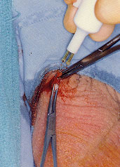

Slide 36
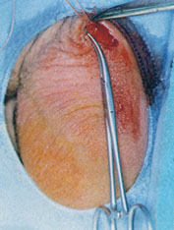

Slide 37
Tubal Sterilization
Surgery to block a woman's fallopian tubes.
Permanent form of birth control.
This procedure is also called tubal ligation or Tubectomy

Slide 38
Procedure
Spinal/Local anaesthesia
Traditional tubal ligation, the surgeon severs the tubes, and then ties (ligates) them off thereby preventing the travel of eggs to the uterus.
Other methods include using clips or rings to clamp them shut, or severing and cauterizing them.

Slide 39
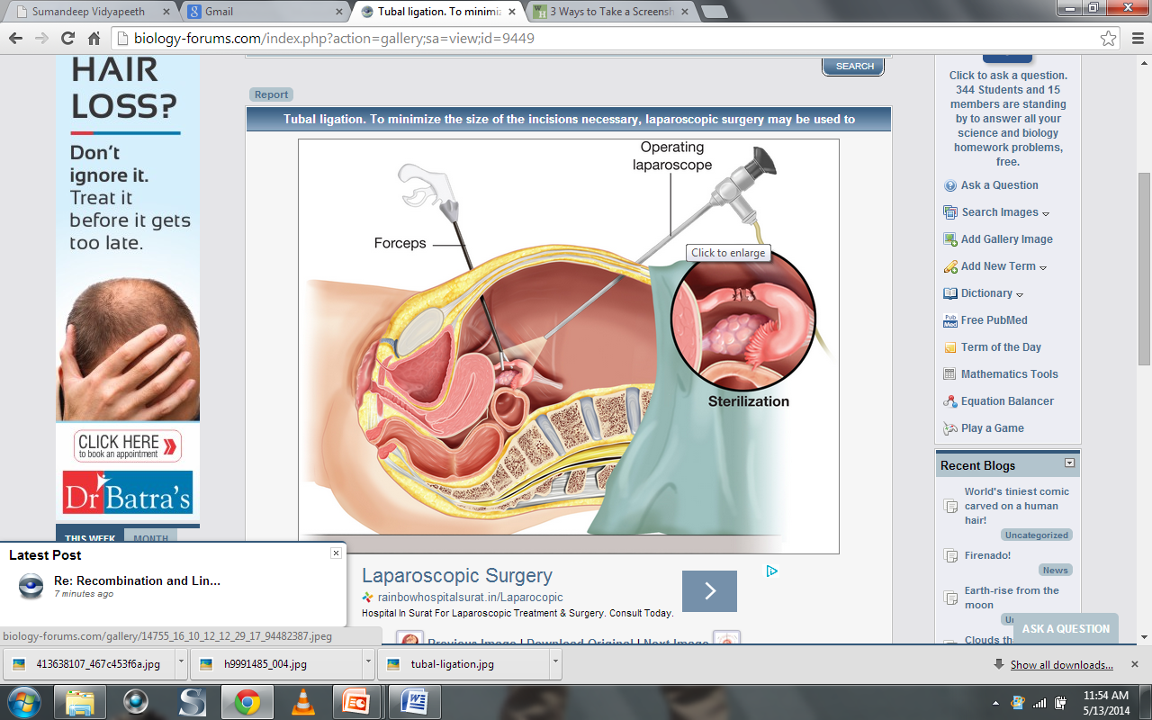

Slide 40
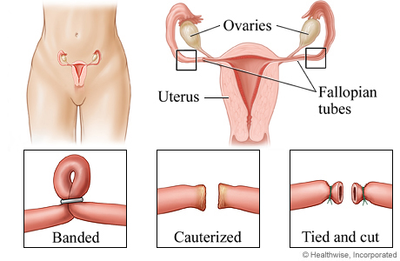

Slide 41
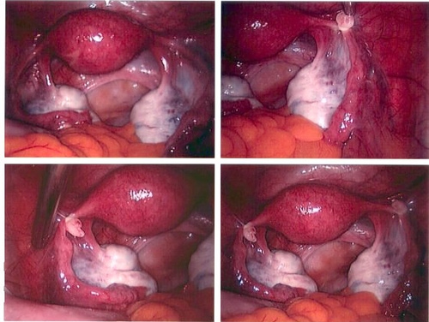

Slide 42
Tubal Ligation
99% effective
Chances of operative & Post op complications
Failure with Ectopic pregnancy may occur

Slide 43
Tubal reversal
The procedure that connects these separated parts of the fallopian tube is called tubal reversal or microsurgical tubotubal anastomosis.
Tubal reversal is microsurgery to repair the fallopian tube after a tubal ligation procedure.

Slide 44
In vitro fertilisation (IVF)
A process by which an egg is fertilised by sperm outside the body: in vitro.
IVF is a major treatment for infertility when other methods of assisted reproductive technology have failed.

Slide 45
In vitro fertilisation (IVF)
The process involves monitoring and stimulating a woman's ovulatory process, removing ovum or ova (egg or eggs) from the woman's ovaries and letting sperm fertilize them in a fluid medium in a laboratory.
The fertilised egg (zygote) is cultured for 2–6 days in a growth medium and is then transferred to the mother's uterus with the intention of establishing a successful pregnancy.

Slide 46
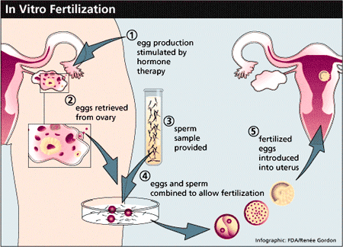

Slide 47
Surrogate Motherhood
A relationship in which one woman bears and gives birth to a child for a person or a couple who then adopts or takes legal custody of the child; also called mothering by proxy.

Slide 48
Surrogate Motherhood
Replacement Mother
Intended mother
Surrogacy arrangements are categorized as either commercial or altruistic

Slide 49
Q 1 Which of the following is false about barrier methods of contraception?
Easy to use
Very few side effects
No protection against STDs
Cheap

Slide 50
Q 2 Mechanism of action of Oral contraceptives is:
Prevents ovulation
Thickens cervical mucus
Makes uterus hostile for implanation
All of the above

Slide 51
Q 3 Major advantage of IUDs over OC pills
Safe & minimum side effects
Longer duration of action
more effective in preventing pregnancy
None of the above

Slide 52
Q4 Which of the following is permanent method of contraception?
Barrier
Oral contraceptives
NSV
IUD

Slide 53
Q 5 False about IVF is:
treatment for infertility when other methods of ART have failed
Sperms injected into uterus directly
Fertilization in a medium outside the body
Zygote cultured for 2–6 days in a growth medium before transferring to the mother's uterus

Slide 54
TITLE | AUTHOR / JOURNAL | MATERIAL | RESULT | CONCLUSION
In vitro fertilization, gamete intrafallopian transfer, and superovulation with intrauterine insemination: Efficacy and potential health hazards on babies delivered | M.Yusoff Dawood, American Journal of Obstetrics & Gynaecology April 1996Volume 174, Issue 4, Pages 1208–1217 | The purpose of this article was to review the efficacy and potential hazards of assisted conception. | The pregnancy per cycle is 19.8% and delivery per cycle is 16.0% for in vitro fertilization (all indications) and 29.5% and 19.8%, respectively, for gamete intrafallopian transfer. In limited prospective studies, in vitro fertilization, gamete intrafallopian transfer, and superovulation with intrauterine insemination have similar fecundity. Multiple births from in vitro fertilization and gamete intrafallopian transfer are increased, whereas preterm labor and low-birth-weight babies are significantly more common, even in singletons. | The efficacy or relative superiority of IVF, gamete intrafallopian transfer, and superovulation with intrauterine insemination in nontubal subfertility remains to be shown by properly designed, prospective, randomized, controlled, or comparative studies. Therefore less invasive and less expensive methods such as expectant management or superovulation with intrauterine insemination should be used before embarking on in vitro fertilization and gamete intrafallopian transfer.

