Slide 1
Wheel and Axle
DR PURVI PATEL

Slide 2
Wheel and axle device consists of a wheel attached to a central axle about which it revolves.
Force may be applied either to wheel at the rim or to axle.
Steering wheel is an example of a wheel and axle which magnifies force at the expense of speed and distance.
Larger the diameter of wheel, greater the magnification of force.

Slide 3
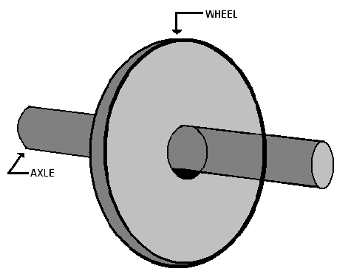

Slide 4
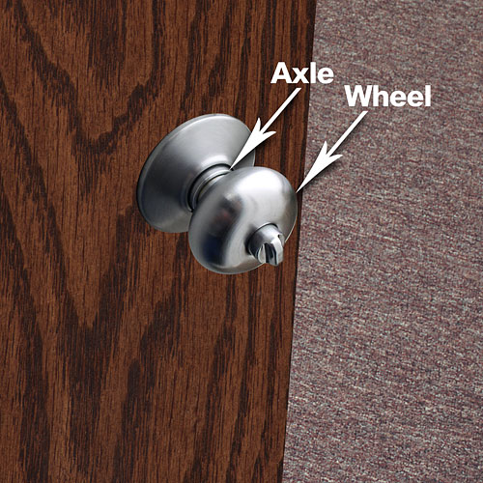

Slide 5
Turning effect of wheel is the product of force & radius.
Radius corresponds to force arm of lever.
Wheel & axle device is similar to lever, particularly when the wheel consists of a single spoke.
The type wheel & axle which is used to gain speed & distance at the expense of force is seen less commonly. Example: rear wheels of an automobile.

Slide 6
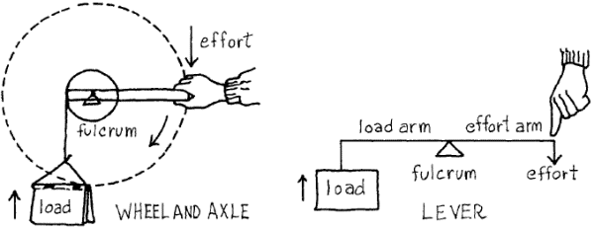

Slide 7
EXAMPLES OF WHEEL & AXLE IN HUMAN BODY
1. Cross section of upper trunk is a good example of wheel & axle. Multifidus, rotators & semispinalis act on “axle”-spinal column & oblique abdominal muscles & iliocostalis act on “wheel”- ribs

Slide 8
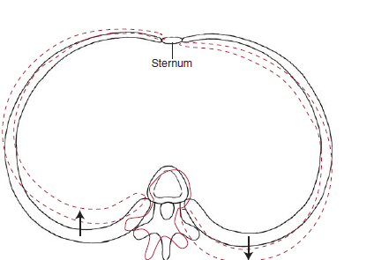

Slide 9
. Head & neck also act as wheel & axle mechanism, force being applied to periphery of wheel by sternocleidomastoid & splenius muscles & to axle by deep spinal muscles

Slide 10
ANATOMIC PULLEYS
When direction of pull of a muscle is altered, the bone or bony prominence causing deflection forms an anatomic pulley
Pulleys can change the direction without changing magnitude of applied force
Change in action line produced by an anatomic pulley (even without affecting force) will have implications for the ability of muscle to produce torque

Slide 11
Function of any pulley is to redirect a force to make a task easier
Task in human movement is to rotate a body segment
Anatomic pulleys (in majority of instances) make this task easier by deflecting action line of muscle away from joint axis, thus increasing MA of muscle force
By increasing MA for a muscle force, a force of same magnitude produces greater torque

Slide 12
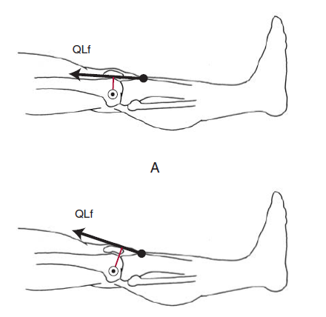
Patella is a classical example of anatomic pulley

Slide 13
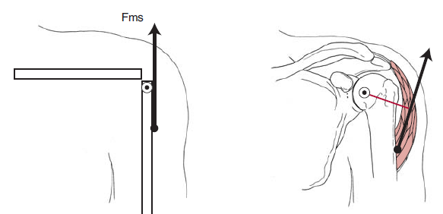
Example: Acromion process and head of humerus

