Slide 1
Pulmonary function testing
Spirometry

Slide 2
Objectives
What is PFT ?
Various Lung volumes & Capacities
Tests of gas flow rates
PEFR

Slide 3
Pulmonary Function Tests
Tests to assess Pulmonary function.
Provide objective and standardized measurements for assessing the presence and severity of respiratory dysfunction.

Slide 4
GOALS of PFT
To screen for the presence of obstruction or restriction.
To assess the severity of disease.
To assess the progression of disease.
To assess the response to treatment.
To assess the patient prior to surgery, to identify the risk for post operative complications.

Slide 5
INDICATIONS OF PFT IN PAC
Age > 70 yrs.
Morbid obesity
Thoracic or Upper abdominal surgery
Smoking history and cough
Any pulmonary disease
Undergoing anesthesia for lengthy period of time

Slide 6
Normal values - Variables
Normal values vary and depend on
  Height
  Age
  Gender
  Ethnicity/Race
Notes:
Height varies directly with VC
VC increases with age up to age 20 years then becomes inversely proportion to age
Women usually with lower VC than men

Slide 7
Tests of ventilatory function
There are four volume and capacities

Slide 8
Volumes | Capacities
TV 500 ml | VC
IRV 2500 ml | IC
ERV 1000 ml | FRC
RV 1500 ml | TLC

Slide 9
Spirometer
Two types
Traditional water seal type
Electrical computerized device
In either case, a graphic tracing is done – known as Spirogram.

Slide 10
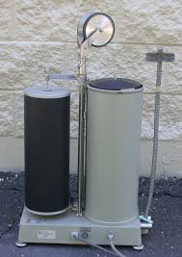

Slide 11
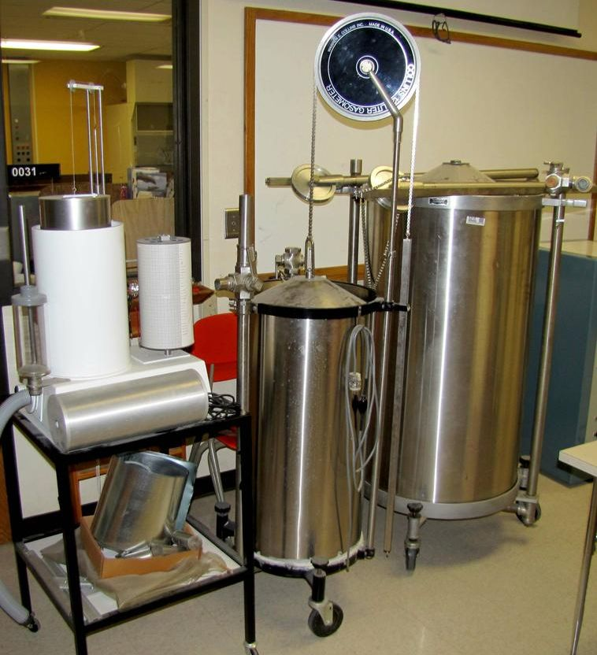

Slide 12
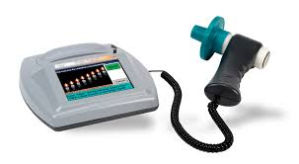

Slide 13
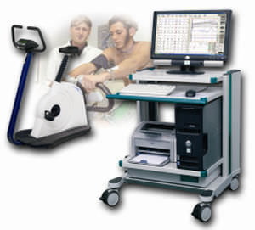

Slide 14
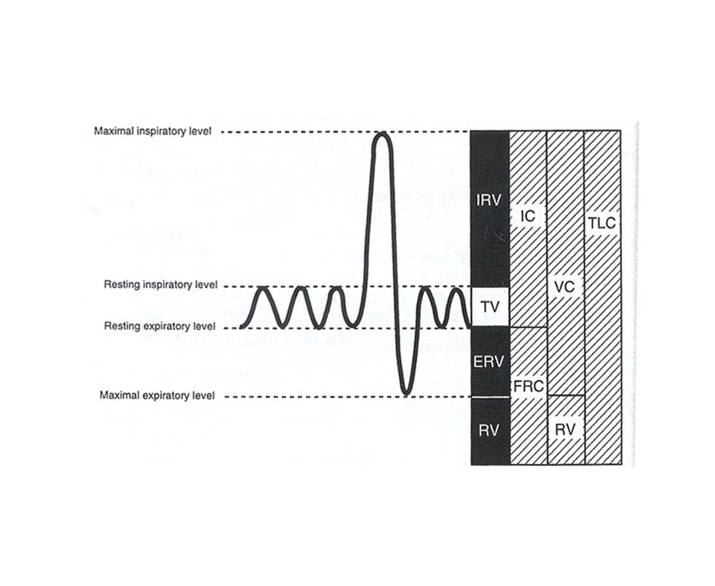
Spirogram

Slide 15
RV is not measured directly with the spirometer
So RV= FRC-ERV
Common method to measure these are
Nitrogen washout method.
Helium dilution method.
Total body plethysmography.

Slide 16
Tests of gas flow rates
Tests that measures air flow rates during forced breathing maneuvers.

Slide 17
FVC
Max volume of air expired after a max inspiration.
Imp for the diagnosis of obstructive & restrictive dz.
VC= TV+ERV+IRV
Normal- 3.1-4.8 Lit. OR 60-70 ml/kg

Slide 18
FEV1
FEV1%= FEV1
FVC
FEV3%
PEFR
FEF25-75 - Sensitive & important indicator of obstruction of small distal airways.

Slide 19
Peak Flow Meter
PEFR

Slide 20
Peak flow meter
Originally invented by wright for monitoring of asthma symptoms.
Known as wrights peak flow meter.
It is a small, inexpensive, portable and easy for most patients to use.

Slide 21
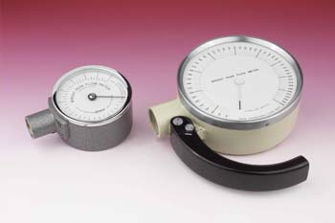
Original peak flow meter

Slide 22
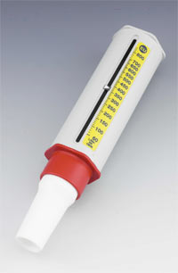
Updated peak flow meter

Slide 23
Indications
Regularly monitor lung function and response to treatment over the short- and long-term.
Determine the severity of an asthma attack.
Assess response to treatment during an attack.

Slide 24
PEFR
Peak expiratory flow rate is the measurement of how much the patient can blow out air of their lungs in one breath.

Slide 25
Peak Expiratory Flow Rate (PEFR) Technique
Connect a clean mouthpiece.
Ensure the marker is set to zero.
Stand up or sit upright.
Take as deep a breath in as you can and hold it.
Place the mouthpiece in your mouth and form as tight a seal as possible around it with your lips.
Breathe out as hard as you can.
Observe and record the reading.
Repeat the process 3-4 times and record the highest reading.
Note down the reading in a diary to allow comparison with readings on other days.

Slide 26
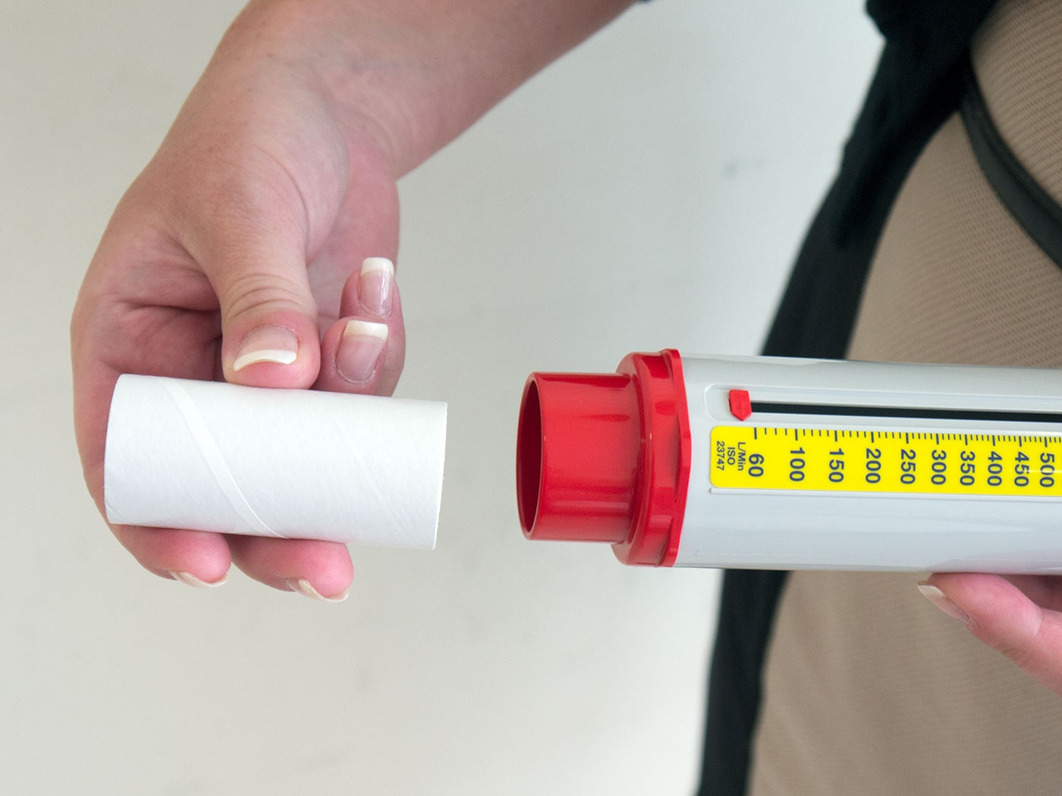

Slide 27
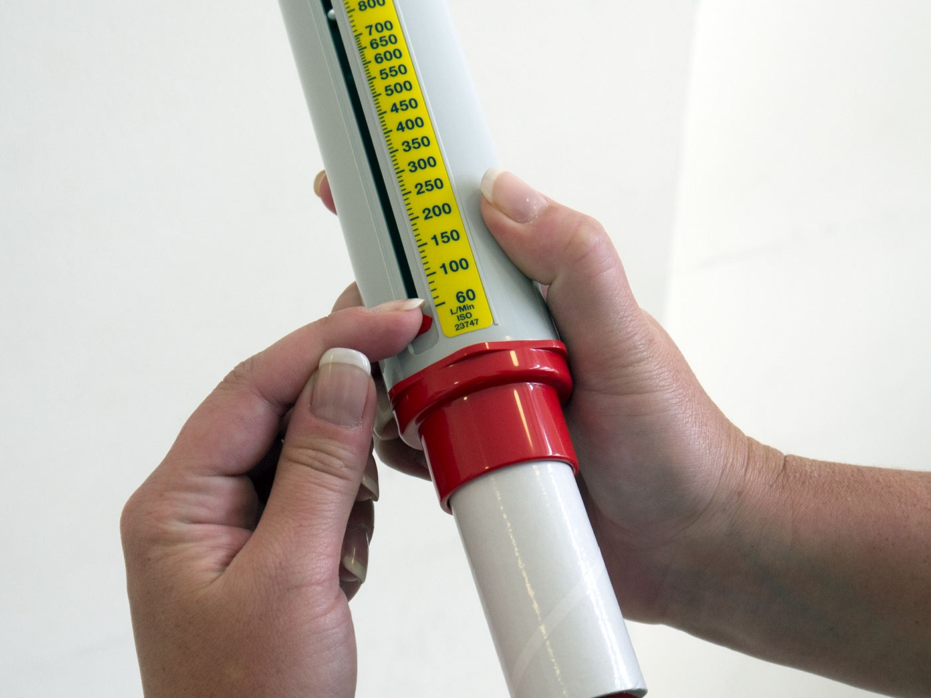

Slide 28
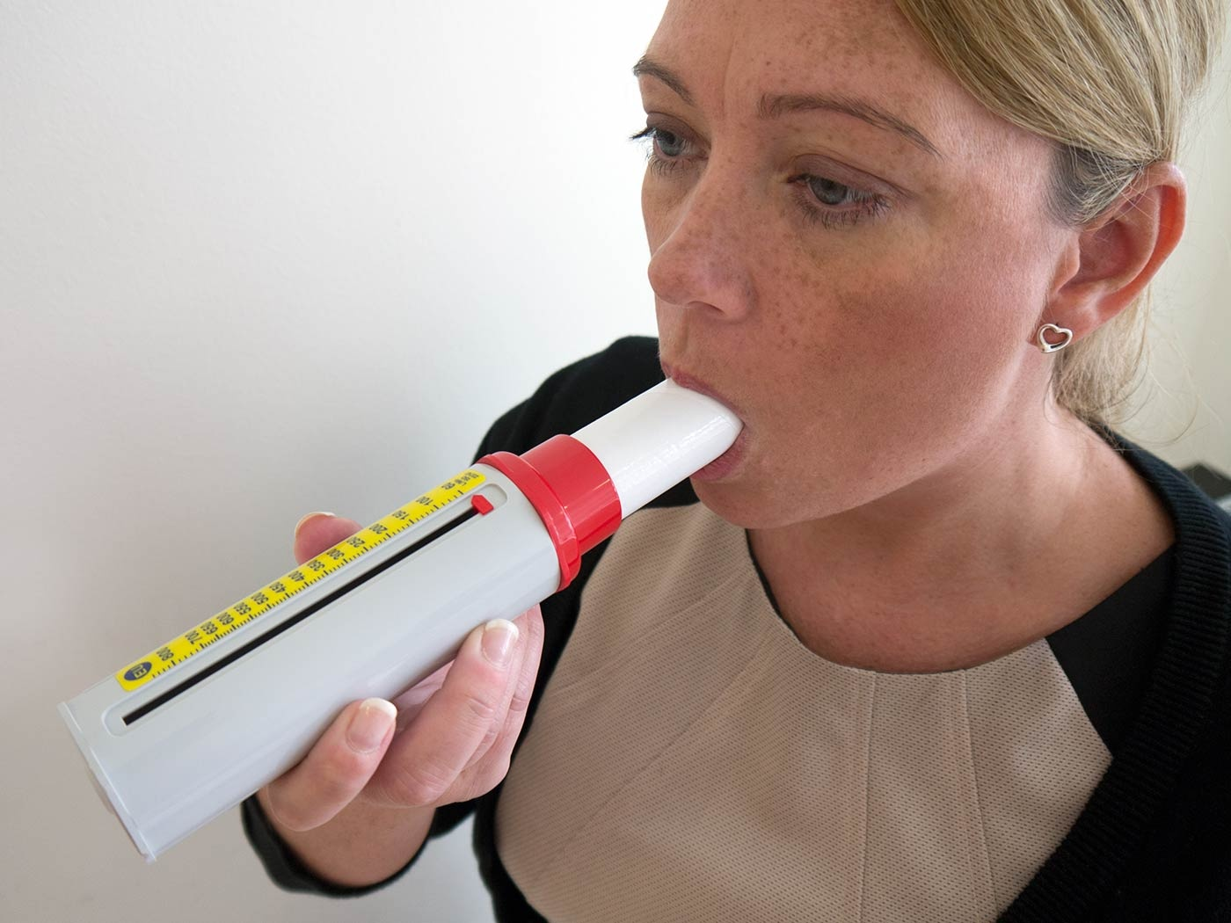

Slide 29
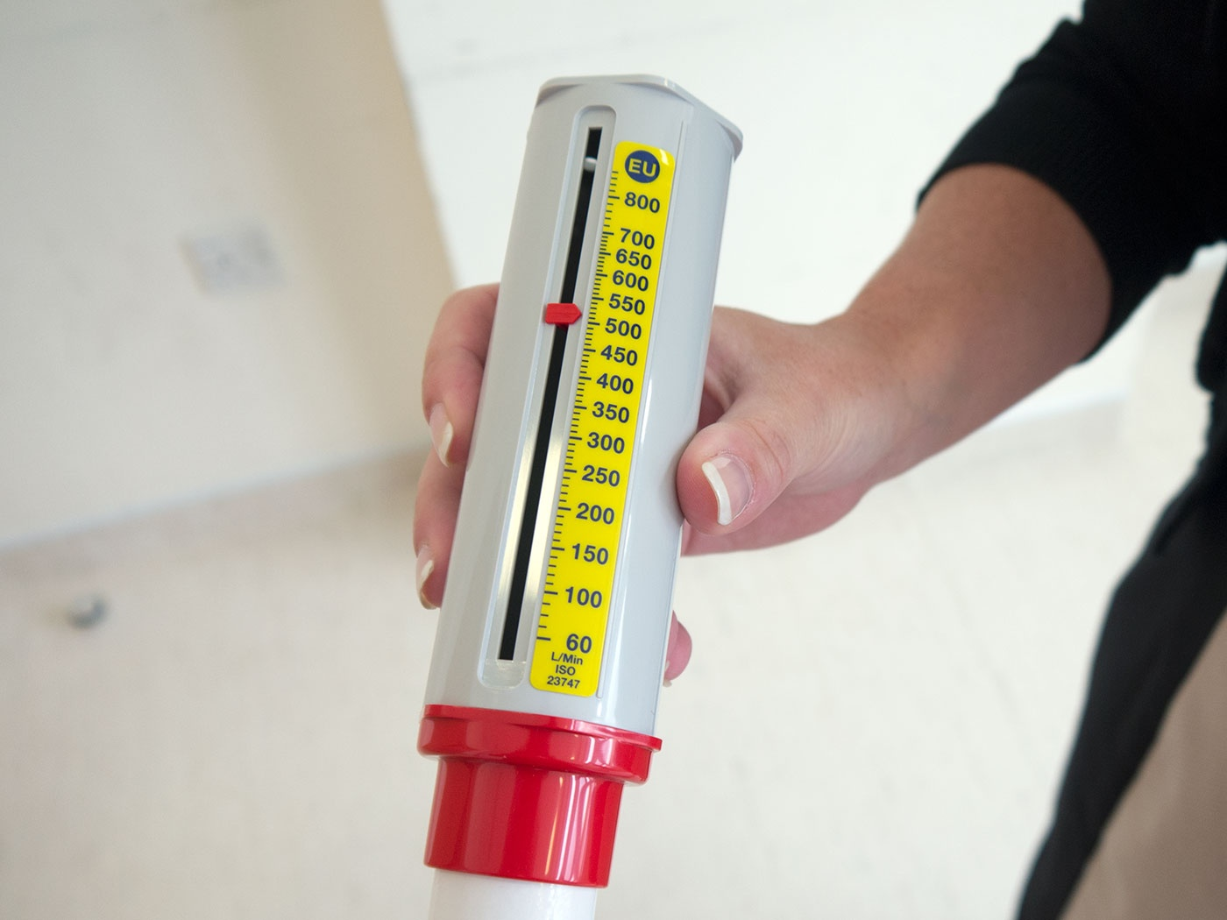
s

Slide 30
Normal values

Slide 31
Breath holding test

Slide 32
World record – 22 minutes
A test used as a rough index of cardio pulmonary reserve, measured by the length of time a person can hold his or her breath.
Diminished cardiac or pulmonary reserve is indicated if one's breath is held for less than 20 seconds.

Slide 33
Thank you

