Slide 1
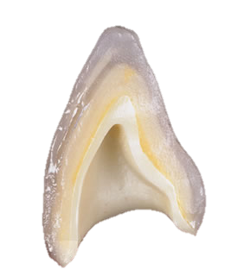

DENTAL CERAMICS
Dr. Namrata Shah Naidu

Slide 2
Lesson plan
Target audience – II BDS students
Duration – 40 minutes – lecture
- 10 minutes – discussion
- 10 minutes – Assessment using MCQs – for CCES

Slide 3


What will you learn from this lecture:
What are ceramics?
Difference between dental ceramics and porcelains
Characteristics of ceramics
Brief history of ceramics
Classification of ceramics

Slide 4
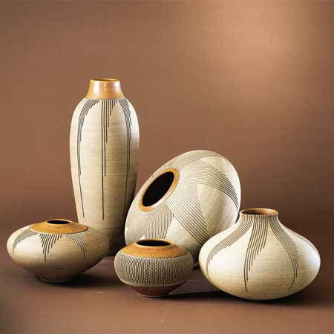
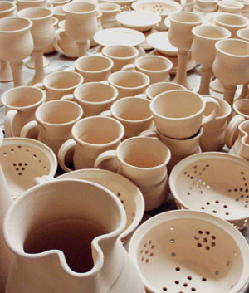
        CERAMICS
Derived from the Greek ‘ KERAMIKOS’
means ‘Earthen’

Slide 5
Ceramics \sa-ra˘m#iks\ n :
Compounds of one or more metals with a nonmetallic element, usually oxygen. They are formed of chemical and biochemical stable substances that are strong, hard, brittle, and inert nonconductors of thermal and electrical energy.
The art of making porcelain dental restorations.

Slide 6
DIFFERENCE BETWEEN CERAMICS AND PORCELAIN
Dental porcelains falls under the category of silicate ceramics.
It is characterized by an amorphous glass phase with a porous structure.
Main components are SiO₂ with small additions of crystalline Al₂O₃, MgO, ZrO₂, and/or other oxides.
Other ceramics are composed entirely of a crystalline oxides.

Slide 7
Charateristics of Ceramics
Refractory nature
Hardness
Chemical inertness
Biocompatibility
Matching appearance to natural teeth
Insulating property
Brittleness

Slide 8
EVOLUTION OF DENTAL CERAMICS

Slide 9
1728 – Pierre Fauchard, a French dentist first proposed the use of porcelain in dentistry.
1837 – John Murphy of London introduced the plantium foil technique.
1903 – Dr. Charles Land introduced first ceramic crowns using the platinum foil matrix technique.
1965 – McLean and Hughes used a dental aluminous core ceramic consisting of a glass matrix containing b/w 40-50wt% Al₂O₃ , which lead to significant improvement in fracture resistance of porcelain jacket crowns.

Slide 10
1983 - First dental CAD/CAM prototype was presented in France.
1984 – Adair and grossman demonstrated crystallization of a glass (DICOR)
1985 – Hobo & Kyocera (Biocream group ) developed a castable glass-ceramic which melts at 1460⁰C and flows like molten glass.

Slide 11
1986 – The first generation CEREC 1 (Siemens) CAD/CAM system was introduced.
Early 1990’s – Pressable glass ceramics (IPS Empress) containing 34vol% leucite was introduced.

Slide 12
CLASSIFICATION OF
DENTAL CERAMICS

Slide 13
1. According to type:
feldspathic porcelain
leucite-enriched porcelain,
aluminous porcelain,
glass-ceramics,
specialized core ceramics (alumina, glass-infiltrated alumina, magnesia, and spinel), and
CAD-CAM ceramics

Slide 14
2. According to the firing temperatures:
a. High fusing – 1300⁰C
b. Medium fusing – 1101⁰ - 1300⁰c
c. Low fusing – 850⁰ – 1100⁰C
d. Ultra-low fusing < 850⁰C

Slide 15
3. According to micro-structure:
a. Non-crystalline ceramics
eg. Feldspathic porcelain
b. Crystalline ceramics
eg. Aluminous porcelain,
Glass ceramics

Slide 16
4. According to Method of Firing:
a. Air-fired
b. Vacuum-fired

Slide 17
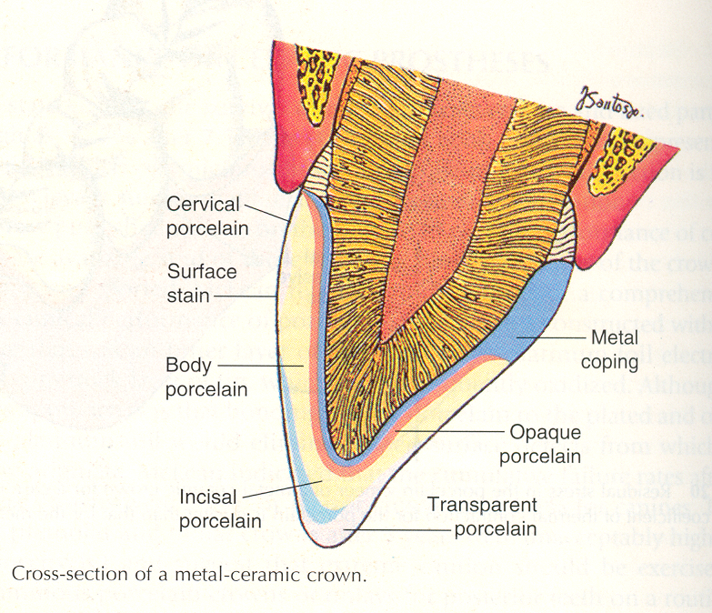
5. According to application:
a. Core porcelain
b. Body porcelain
c. Enamel porcelain

Slide 18
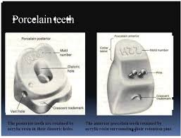
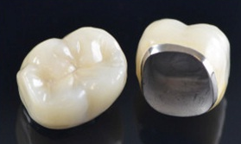
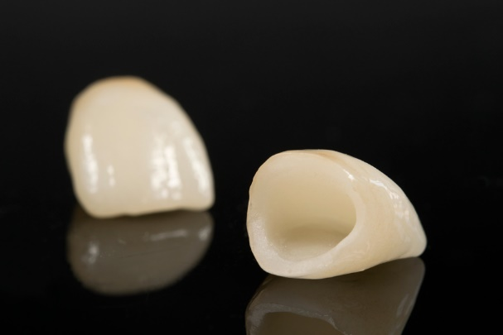
6. According to use:
a. For porcelain teeth
b. For ceramo-metal restorations (Metal-Ceramic systems)
c. For All-ceramic restoration (All-ceramic system)
Crowns & Bridges

Slide 19
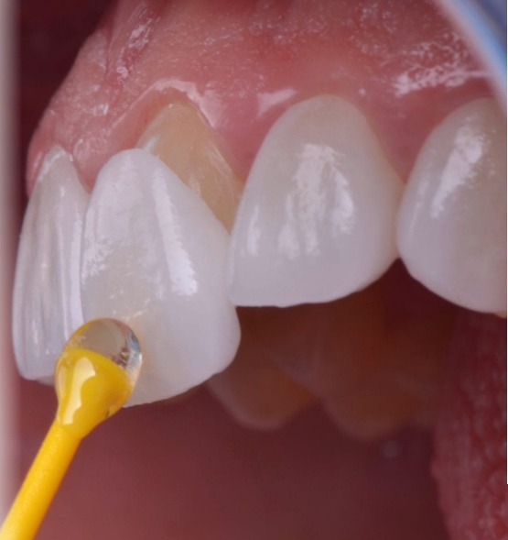
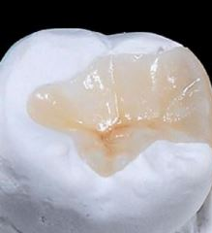
Veneers:
Inlays:

Slide 20
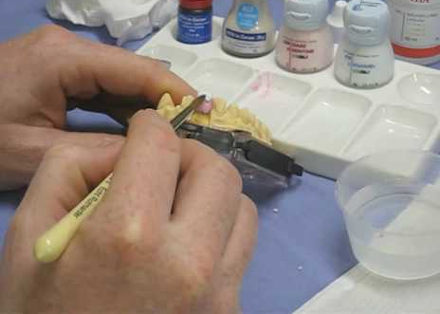
7. According to method of fabrication: a. Conventional powder & slurry ceramics: (Using casting & ceramming)

Slide 21
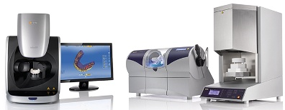
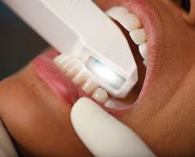
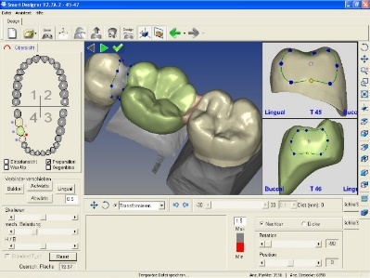
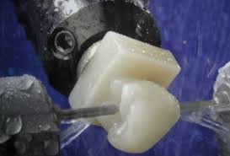
b. Castable ceramics : eg. DICOR ceramics c.Machinable ceramics :

Slide 22
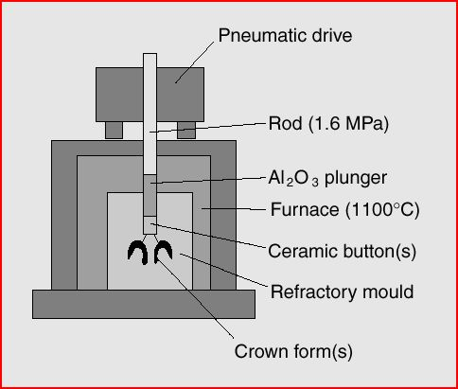
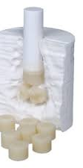
d. Pressable ceramics :
By pressure molding & sintering
1. Shrink-Free Alumina Reinforced Ceramic (Injection Molded)
eg. Cerestore / Alceram
2. Leucite Reinforced Ceramic (Heat- Transfer Molded)
eg. IPS Empress, IPS Empress2 & Optec OPC

Slide 23
e. Infiltrated ceramics :
By slip casting, sintering & glass infiltration
1. Alumina based eg. In-Ceram Alumina
2. Spinel based eg. In-Ceram Spinel
3. Zirconia based eg. In-Ceram Zirconia

Slide 24
THANK YOU

