Slide 1
LASER
Light Amplification by Stimulated Emission of Radiations
Dr.Nalina Gupta

Slide 2
“LASER”
“Light Amplification by Stimulated Emission of Radiations”
Lasers are electromagnetic wave amplifiers which can produce pencil-like beams of electro-magnetic waves with special properties.
German Physicist “Max Planck” in 1900
Einstein (1917)- Quantum theory
In 1960s and 1970s- high powered lasers

Slide 3
The laser beam is produced when the atoms of certain elements are excited by electro-magnetic radiations → produce electromagnetic radiation of a particular wavelength themselves.

Slide 4
How Laser radiations differ from ordinary light- Laser light Properties
Monochromaticity
Coherence
Collimation

Slide 5
Monochromaticity
Lasers are of a single specific frequency and hence have a definite wavelength.
Laser Type | Wavelength (nm) | Radiation
Ruby | 694.3 | Red light
Helium-Neon | 632.8 | Red light
Gallium/aluminium arsenide | 630 to 1550 | Red to Infrared
Carbon dioxide | 10,600 | Infrared

Slide 6
Coherence (united)
Temporal Coherence: Peaks and troughs of the electric and magnetic fields all occur at the same time. (laser radiations are in same phase)
Spatial Coherence: They are all travelling in the same direction
Coherence length: The distance over which the wave-lengths stay in phase. It can vary from thousands of metres to a fraction of milli-metre in biological tissues.

Slide 7
Collimation
Lasers remain in a parallel beam (lack of beam divergence) as a consequence of spatial coherence.
Since the radiation does not diverge, the energy is propagated over very long distances.

Slide 8
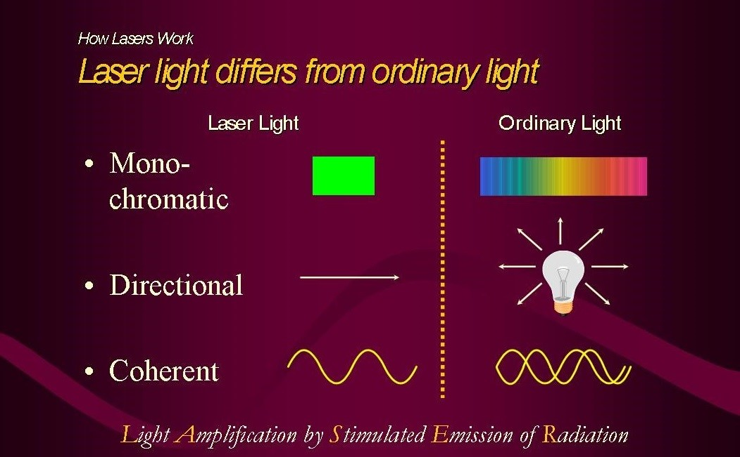

Slide 9
How Laser Works
Laser Principles
The electrons in an atom or a molecule exist in a very specific energy level called states.
Each atom possesses electrons that are specific to the characteristic element or a combination of elements (molecules).
The transition of an atom or a molecule from one state to another is called Quantum Transition.
Quantum transitions may be induced by various causes

Slide 10
They occur once an atom interacts with optical radiations, in particular.
If an atom in the upper state makes a transition to lower state, then energy can be emitted as a photon of electromagnetic radiation.
If an atom in the lower state makes a transition to upper state, then energy must be absorbed.
The excited state is less stable as compared to lower or ground state.

Slide 11
Electrons tend to give energy equal to the energy difference between the two states and return to the lower state.
This emission occurs after a period of time called life time of spontaneous emission
Emission of photons can occur in two ways: spontaneous and stimulated
Spontaneous emission: without stimulus
Stimulated emission: (with stimulus) same incident photon can be a trigger

Slide 12
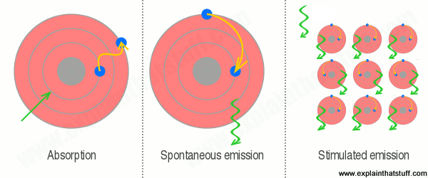

Slide 13
If large number of matching – energy photons come past an excited state, there is a high probability that this process occurs.
In that case, life time of stimulated emission can be much less than that of spontaneous emission.
This is called “Amplification”
Amplification is the critical process that makes a laser possible.

Slide 14
In order to obtain a laser action, more atoms in the lasing medium must be in the excited state as compared to lower state
This condition is called “Population Inversion”
Pumping energy into the lasing medium can create this condition.

Slide 15
Elements of Laser Devices
Three basic conditions must be satisfied in order to operate laser devices:
Active medium: This is a collection of atoms, molecules or ions that can be solid, liquid, gas or in plasma state. The composition of lasing medium determines wavelength output and name of a particular laser.
Pumping source
Optical resonator

Slide 16
Active medium: This is a collection of atoms, molecules or ions that can be solid, liquid, gas or in plasma state. The composition of lasing medium determines wavelength output and name of a particular laser.
Pumping source: This is the source of energy to pump the laser medium. When the laser medium in the optical cavity is pumped, laser beam is generated that leaves the cavity through the partially transmitive mirror.

Slide 17
Optical Resonator: This consists of two mirrors. The laser medium is placed in the optical cavity. One mirror is fully reflective for the operation of wavelength of a laser and one is partially transmitive.

Slide 18
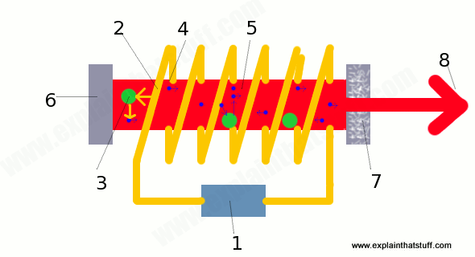
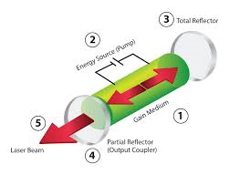

Slide 19
Laser Parameters
Energy density: The amount of energy falling on a surface is expressed in Joules per square meter or joules per square centimetre.
Power: The rate at which energy is produced or absorbed is measured in joules per second i.e. watts and called power.
Power density: The average power per unit area, watts per square centimetre.

Slide 20
Once radiation interacts with matter, properties are similar to that of electromagnetic waves- Reflection, Refraction and Absorption
Collimation will be diminished
Coherence will be lost,
Depends on nature and density of matter
passes unaffected in space
Slightly altered in air
Markedly altered in tissues
(in fraction of a mm, coherence will be lost in biological tissue but it will still be mono-chromatic

Slide 21
Effects of LASER Radiation on the Tissues
Like all radiation, laser may
be reflected from the surface
Penetrate the tissues in proportions that depend on the wavelength, nature of the tissue surface and angle of incidence

Slide 22
Having entered the tissues, laser radiation is diffused, scattered and spread by:
Divergence
Reflection
Refraction
Attenuated by Absorption

Slide 23
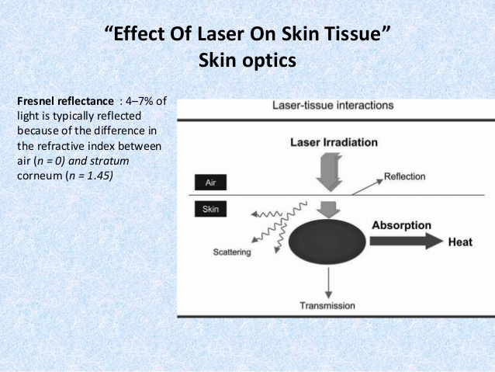

Slide 24
Laser Interaction Mechanisms
Wavelength dependent mechanisms
Photothermal Interaction mechanisms
The most frequently used mechanism is heating
Heating of irradiated sample occurs with all methods of heating such as coagulation, vaporisation and cutting etc.
The external energy from the laser photons is deposited on the target material by transitional, rotational and vibrational movements of the target molecules

Slide 25
This is the criteria of kinetic energy of the target molecules
The extracted energy from incident light is most efficient if the frequency of incident photons is close to the characteristic frequency of these modes (resonance absorption).
When laser energy is converted into heat, thermal diffusion begins
This diffusion depends on the thermal properties of irradiated tissues.

Slide 26
Thermal Effect of Laser Radiation
Temperature | Biological Effect
37 <43 43-45 50 60 70-80 80 100 >150 >300 | Normal Biostimulation Hyperthermia Reduction in enzyme activity Protein denaturation (coagulation0 Welding Permeabilization of cell membranes Vaporisation Carbonization Rapid cutting and ablation

Slide 27
2. Photodynamic Therapy:
It is mediated by exogenous chromospheres
At low light intensities, laser energy is absorbed by exogenous chromosphere molecules called photosensitizers (photo acceptors).
In this case, light is used for activation of molecules or drugs by a specific wavelength of laser light.
The absorbing molecule can transfer the energy to another molecule

Slide 28
This activated molecule then cause chemical reaction in the surrounding tissues.
This molecule can transform into toxic compound, often involving oxygen free radical that cause cellular death through DNA destruction. E.g. photodynamic therapy of tumour
Basis for low power laser effect

Slide 29
3. Biostimulation
This process is also known as low energy, low light, soft, cold laser, low intensity, low power therapy is the application of mono-chromatic red light energy close to infra-red wave-lengths to stimulate growth factor cells and improve wound/soft tissue healing.
Low intensity light energy can promote and upgrade metabolic processes that result in tissue repair and pain relief.

Slide 30
Low intensity lasers promote the repair process of skin, tendon, ligaments, bones and cartilage.

Slide 31
4. Photo-ablation Therapy
First discovered by Srinivasan and Mayne-Banton in the year 1982.
Material is decomposed when exposed to high intense laser irradiation.
It occurs when the energetic photons of laser light decomposes the molecules by breaking the chemical bonds.
e.g. dental enamel etching process

Slide 32
Wave length independent mechanisms
Plasma formation
Photo-disruption
Photo-ablation

Slide 33
Types of Lasers
Pulsed
Focused
Ruby
Helium-Neon
Gallium/aluminium arsenide
Carbon-dioxide
Superluminous diodes (SLDs)
Cluster probes

Slide 34
1. Gas lasers (Helium-Neon)
2. Solid lasers (Ruby)
3. Liquid lasers (organic dyes)
4. Semi Conductor lasers (junction diodes)

Slide 35
Power laser: used for destructive or surgical purposes
Soft lasers: have a very superficial effect and are used principally for treating the skin
Mid-lasers: are the types used by physiotherapists as their depth of penetration is sufficient to produce a biological effect on deeper tissues without damaging them.

Slide 36
Classification of Laser
Class | Power | Effect | Usage
1 | Low | None on eye or skin | Laser pointer Barcode reader
2 | Low up to 1mW | Safe on skin. Eyes protected by aversion response | Therapeutic Laser pointer
3A | Low-Medium up to 5mW | Viewing with optical aids may be hazardous | Therapeutic Laser pointer
3B | Medium up to 500mW | Viewing may be hazardous | Therapeutic
4 & 5 | High over 500mW | Hazardous to skin and eye | Destructive-surgical

Slide 37
Therapeutic Uses of Lasers
The types used clinically to promote healing are low level laser therapy and include different type of lasers from classes 1 to 3B.
Two major uses are:
Tissue healing
Pain control

Slide 38
1. Tissue healing
2. Musculo-skeletal pain
3. Trigger/acupuncture points
4. Oedema
5. Carpal Tunnel syndrome
6. Lympho-edema
7. Raynaud’s phenomenon
8. Tuberculosis

Slide 39
Tissue healing
Effect of Laser on venous ulcers
Cochrane review (4 RCTs)
Two studies used He-Ne Laser with dosage 4Jcm⁻², one a GaAs laser at 2Jcm⁻² and one provided no detail
Each study used a Sham or another form of phototherapy as a control
The results do not indicate any evidence of benefit on venous ulcers
(Flemming & Cullum, 2004)

Slide 40
2. Effect of low level laser therapy on wound healing (Review)
Andrade et al, Rev.Col.Bras.Cir. 2014, 41(2)
Low level laser therapy , when applied to skin wounds, is able to produce major physiological effects, such as anti-inflammatory resolution, neoangiogenesis, epithelial and fibroblast proliferation, collagen synthesis, and deposition, revascularisation and wound contraction.

Slide 41
Doses of 3-6 J/cm² appears to be more effective
Doses above 10J/cm² are associated with deleterious effects
The wave-lengths between 632.8 and 1000nm remain as those having more satisfactory results in the wound healing process.

Slide 42
3. Low level laser therapy facilitates superficial wound healing in humans: A triple blind, sham-controlled study
Hopkins, McLoda, Seegmiller & Baxter. J Athl Train. 2004;39(3):223-229
22 subjects- Laser and Sham group
Two standardised 1.27cm⁻² abrasions were induced on the anterior fore-arm.
LLLT (8J/cm²; treatment time=2minutes, 5 seconds; pulse rate=700Hz)

Slide 43
At days 6, 8 and 10, follow up testing revealed that the laser group had smaller wounds than the Sham group
LLLT is an effective modality to facilitate wound contraction of partial thickness wounds.

Slide 44
Musculo-skeletal Pain
Bjordal et al, 2003: Eleven trials of laser directly over the joint and the findings suggest that low level laser does reduce pain and improve health status of patients.
Sytematic reviews and cochrane reviews raise the need to standardize dosage factor of Laser.
Brosseau et al, 2004: Laser reduced pain by 70% and morning stiffness by 27.5 minutes in five placebo-controlled trials with a total of 204 subjects.

Slide 45
Gur et al, 2003: Patients with painful osteo-arthritis of knee treated with Laser improved more than that in Sham treatment group.
Laser also appears to reduce pain and increase function in patients with cervical osteo-arthritis, and chronic low back pain. (Ozdemir et al, 2001; Soriano & Rios, 1998; Basford, 1999).
Less pain and swelling after dental extraction in those treated with laser. (Ong and Ho, 2001)

Slide 46
Unidentified differences in pain in cases of ankle sprains, ischaemic arm pain, DOMS, and lateral epicondylitis have been observed.

Slide 47
Carpal Tunnel Syndrome
Laser irradiation over the median nerve of normal subjects increases nerve conduction latencies. (Baxter et al, 1991)

Slide 48
Oedema and Lymphedema
Oedema reduction in acute stage in 47 soccer players (laser 820nm, 7.5Jcm⁻²)
Significant differences in volume were apparent at 24, 48 and 72 hours after treatment in the laser group.
(Stergiolas, 2004)
Treatment with 904nm laser and 1.5Jcm⁻² reduced the volume of lymphoedema affected limbs and softened the tissues only after two cycles of nine treatments (three per week for three weeks). (Carati et al, 2003)

Slide 49
Raynaud’s phenomenon
Laser (670nm) decreases the severity of the symptom of Raynaud’s phenomenon.
Laser was applied to the palms of hands and soles of feet in 10 sessions over a 5-week period.
Effects were evident three months after the treatment
(Al-Awami et al, 2004)

Slide 50
Principles of Application
Most low- or medium laser sources are applied to the skin by one of three methods:
Probe
Cluster probe
Scanning system

Slide 51
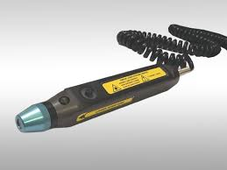
Probe
It is a hand held applicator, the size of a larger marker pen
It has one laser diode, close to the tip, which is a small lens
This is used in direct contact with the skin
This can treat only a small area, less than 1 square mm
But its area of effect is usually accepted as being larger, upto 0.5 square centimeter.

Slide 52
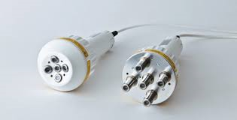
2. Cluster Probe
It is a collection of individual laser diodes which all emit at different wave-lengths.
It can be used to treat a larger area, approximately 25 square centimeter.

Slide 53
3. Scanning system
A laser applicator is attached to a stand upto 30 cm away from the skin.
The applicator can have several sources of laser output
It is moved either mechanically or manually in a systematic path over the area to be treated.

Slide 54
Technique of Application
Explanation to the patient : nature of treatment, wavelength specific goggles
Positioning of the apparatus
Preparation of the part: Clean the surface of the skin to be treated, support the part being treated (Patient must be comfortable throughout the session)
Application:

Slide 55
Application
Turning a key as well as switching on the power
Application of laser applicator to the skin surface
Switching on the output
Laser applicator is kept in contact with the tissues and held so that beam is applied at right angles to achieve maximal penetration
There is also a switch in the timer so that the output ceases once the preset time is reached

Slide 56
If contact is not desirable, it may be held just above the surface or covered with transparent non-reflective film.
The position of the probe is maintained for the selected time
The actual methods of application are:
Single point or spotting
Gridding
Scanning

Slide 57
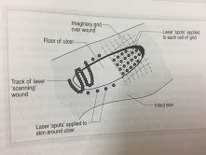

Slide 58
For single point of spotting method, the single or cluster probe is held on or immediately over the site. e.g. edges of a wound, directly over a wound, over an acupuncture point, over a joint or an area of pain
Gridding is done systematically to cover a larger area
A grid is marked , or visualised, on the skin or on a transparent cover used over a wound.

Slide 59
The distance between grid spots may vary but is usually no more than 1 cm for a single probe, depending on the size of the probe tip.
Scanning is used for larger area, such as anterior surface of limb. The laser applicator is moved systematically to cover the surface of the limb.
5. Switch the device off

Slide 60
Dosage
Variables contribute to laser dosage are:
The wavelength
The size of the area of application

Slide 61
Wavelength
Wavelength affects depth of penetration
GaAlAs (Gallium/aluminium arsenide) lasers are used more commonly because of their greater depth of penetration (810-940nm, 3-4 mm) than He-Ne lasers (632.8nm, 1-2 mm)

Slide 62
2. Energy density
The treatment dose is usually given in Jcm⁻² or mJcm⁻² and called energy density or sometimes radiant exposure.
The recommended dosages typically range from 1 to 10 Jcm⁻²
Suggested principles are:
Initial treatment/acute lesion: <4Jcm⁻² and adjust in next session based on patients’ response

Slide 63
Chronic lesion: between 4 and 50 Jcm⁻²
Deeper structures: use a higher dose

Slide 64
3. Pulsed output
Acute conditions: low pulse frequency and long pulse duration
Chronic conditions: higher pulse repetition rates and short pulse durations

Slide 65
4. Area of treatment
Discrete lesions: directly by applying laser over them
For wounds and larger areas: the part is divided into grid and each area is separately stimulated or a scanning technique is used where the laser is moved continuously over the wound surface
Healthy skin at the edge of wound can be stimulated with spotting at usually 1 cm distance

Slide 66
For the treatment of open wounds, it is held just above the wound or on a sterile clear plastic wrap over the wound.
For painful areas: directly over the tender points or painful spots
5. Progression of treatment
No response after first treatment: dose should be increases
No response after 2-3 treatments: alternative method

Slide 67
Dangers
Risk of damage if the beam is applied directly into the eye
Therapeutic lasers have no thermal effect but if it passes the cornea and lens of the eye, the beam can get focussed on a very small area and can cause local intense heating and even total loss of vision of that eye.
Though the risk is small by therapeutic lasers, still shining a laser into the eye or looking directly into the laser beam must be avoided strictly.

Slide 68
Reasonable precautions
Eye protection
Use laser devices in specially designated areas
Avoid reflecting the laser beam from shiny surfaces
Switch the laser on only when the applicator is in contact with the skin
Wear appropriate protective glasses or goggles
(for class 2, 3A and 3B)
5. Display outside when laser is in use, however
unusual below class 4.

Slide 69
Tumours: Avoid treatment
Infection: clean the contact area

Slide 70
Contra-indications
Tumours
Recently irradiated areas
Pregnant uterus

Slide 71
Thank You

