Slide 1
SPINAL CORD LESIONS
Dr. A.R. Gandotra
HOD and Professor
Department of Anatomy
S.B.K.S.M.I. & R.C.

Slide 2
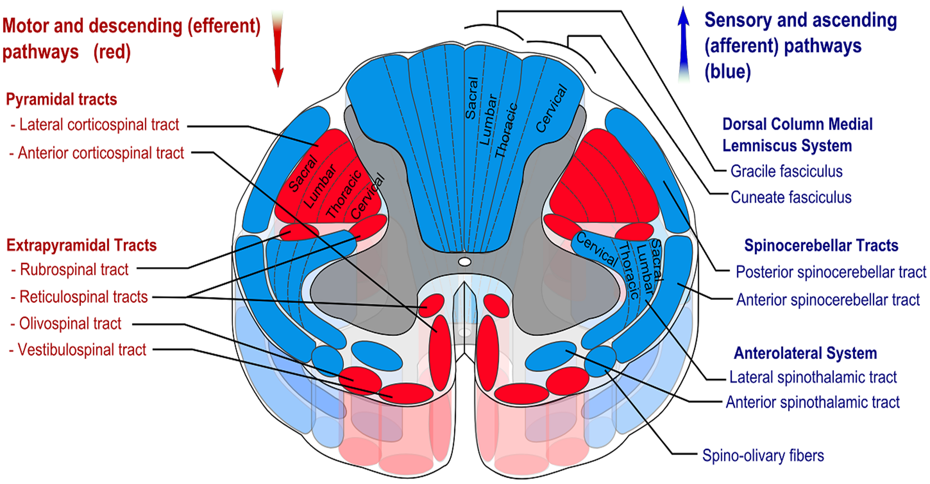

Slide 3
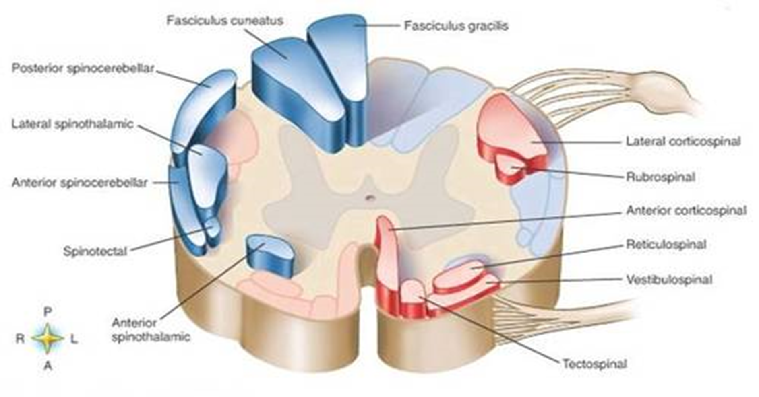

Slide 4
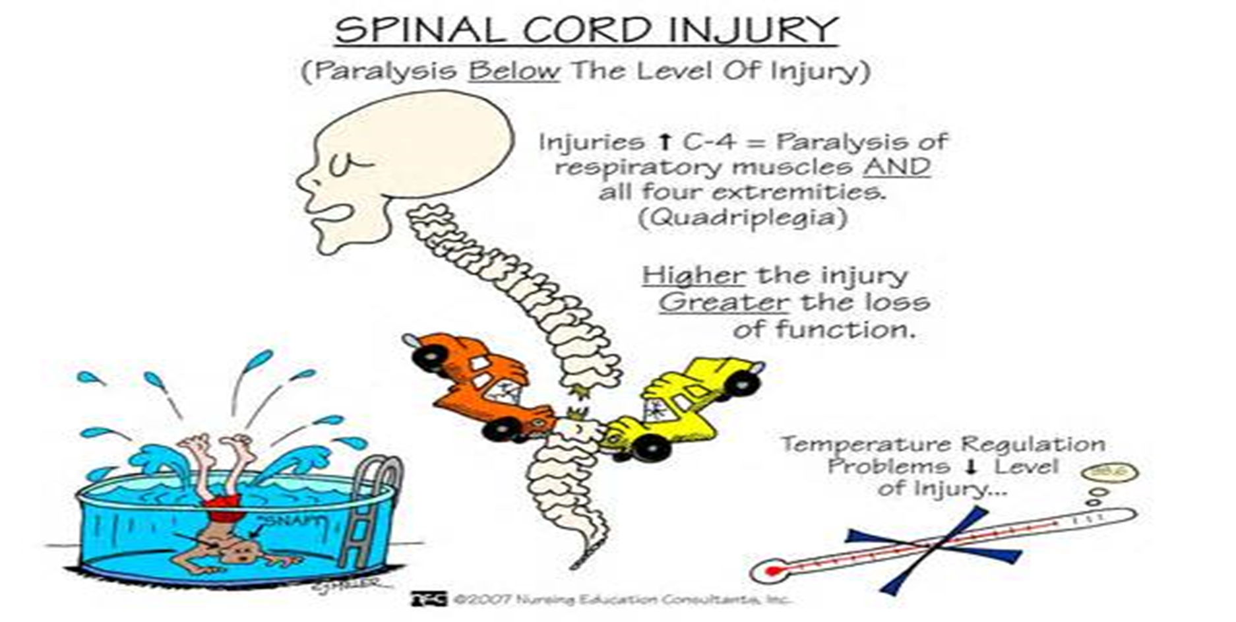

Slide 5
LESIONS AFFECTING AFFERENT SYSTEM
A) DORSAL NERVE ROOTS:
: SLIPPED DISC
B) DORSAL ROOT GANGLIA:
: TABES DORSALIS, HERPES ZOSTER
LOSS OF EXTROCEPTIVE SENSES
ANAESTHESIA, ANALGESIA
ATAXIA(LOSS OF MUSCLE SENSE)
HYPOTONIA/ATONIA(STRETCH)
LOSS OF VISCERAL SENSE
AREFLEXIA

Slide 6
C) POSTERIOR WHITE FUNICULUS:
: TABES DORSALIS INVOLVES ESPECIALLY FASCICULUS GRACILIS
CAUSES: LOSS OF POSITION, VIBRATION, MOVEMENT, PRESSURE AND DISCRIMINATIVE TOUCH.
LEADS TO: LOCOMOTOR ATAXIA.
: BROAD BASE SLAPPING WALK
: MAY BE CORRECTED BY VISION

Slide 7
D) SPINOTHALAMIC TRACT
LATERAL SPINOTHALAMIC TRACT:
: LOSS OF PAIN/TEMPERATURE ON OPPOSITE SIDE BELOW THE LEVEL OF LESION
ANTERIOR SPINOTHALAMIC TRACT:
: THERE WILL BE NO LOSS OF TOUCH AND PRESSURE
BECAUSE THESE ARE CONVEYED BY UNCROSSED FIBERS ALSO

Slide 8
SYRINGOMYELIA
: CAUSES CAVITATION OF CENTRAL CANAL USUALLY CERVICAL ENLARGEMENT
: THERE IS BILATERAL AND SEGMENTAL LOSS OF PAIN AND TEMPERATURE IN BOTH UPPER LIMBS DUE TO INVOLVEMENT OF DECUSSATING LATERAL SPINOTHALAMIC FIBERS IN ANTERIOR WHITE COMMISSURE.
: THE TOUCH SENSATION ESCAPES

Slide 9
LESION OF EFFERENT SYSTEMS
LOWER MOTOR NEURON LESION(FLACCID PARALYSIS)
A COMPLETE DEGENERATION OF MOTOR NEURONS OF SPINAL CORD AND BRAIN STEM

Slide 10
MANIFESTATIONS
SEGMENTAL PARALYSIS- VOLUNTARY AND REFLEX- COMPLETE OR PARTIAL
b) ATONIA OR HYPOTONIA- STRETCH REFLEX – MUSCLES FLACCID
c) AREFLEXIA- DEEP TENDON REFLEXES ARE LOST
d) WITHIN 2-3 WEEKS MUSCLES CONTRACT SPONTANEOUSLY FORMING FIBRILATIONS AND FASCICULATIONS

Slide 11
FIBRILLATION- WHEN SINGLE MUSCLE FIBER CONTRACTS.
        - USUALLY VISIBLE IN TONGUE
FASCICULATION- GROUP OF MUSCLE FIBERS UNDERGO TWITCHING
- SEEN UNDER THE SKIN
-HYPERSENSITIVITY OF MUSCLES TO CIRCULATING CHEMICAL MEDIATORS
e) ATROPHY AFTER FIBRILLATION AND FASCICULATION-

Slide 12
f) PRE GANGLIONIC FIBERS- DRY CYNOTIC SKIN
– BRITTLE FINGER NAILS - LOSS OF HAIR
– LYSIS OF BONES AND JOINTS
POST GANGLIONIC FIBERS OF S 2,3,4 CAUSES DYSFUNCTION OF URINARY BLADDER AND RECTUM

Slide 13
LESION OF SYMPATHETIC POST GANGLIONIC FIBERS IN THE VENTRAL ROOT OF T 1,2 –
HORNER’S SYNDROME ON AFFECTED SIDE:
PIN POINT FIXED PUPIL,
PTOSIS UPPER EYE LID,
ENOPHTHALMOS,
WARM AND DRY SKIN

Slide 14
UPPER MOTOR NEURON LESION
(SPASTIC PARALYSIS)
INTERRUPTION OF PYRAMIDAL AND OTHER SUPRA SPINAL TRACTS
SITE OF LESION: ABOVE PYRAMIDAL DECUSSION- CONTRALATERAL PARALYSIS
: BELOW PYRAMIDAL DECUSSION-
IPSILATERAL PARALYSIS

Slide 15
AFTER THE LESION THE AFFECTED MUSCLES BECOME FLACCID AND DEEP TENDON REFLEXES ARE LOST
AFTER A FEW WEEKS FOLLOWING MANIFESTATIONS ARE OBSERVED:
a) HEMIPLEGIA, QUADRIPLEGIA, MONOPLEGIA, PARAPLEGIA. LOSS OF VOLUNTARY MOVEMENT

Slide 16
b) MUSCLES BECOME SPASTIC, INCREASED MUSCLE TONE, EXAGGERATED TENDON REFLEXES
c) MUSCULAR RESISTANCE TO PASSIVE MOVEMENT IS INCREASED AND GIVES WAY SUDDENLY – CLASP KNIFE MOVEMENT

Slide 17
d) SUSTAINED SERIES OF SUSTAINED JERKS WHEN A QUICK STRETCH IS APPLIED TO A TENDON – CLONUS (ANKLE CLONUS)
e) LOSS OF SUPERFICIAL REFLEXES
f) BABINSKI SIGN POSITIVE- WHEN LATERAL ASPECT OF SOLE IS SCRATCHED THE GREAT TOE IS DORSIFLEXED AND OTHER TOES SPREAD FAN-WISE.

Slide 18
HEMISECTION OF CORD
(BROWN SEQUARD SYNDROME)
ON THE SIDE OF THE LESION:
: LOSS OF POSTERIOR FUNICULAR FUNCTIONS
: SPASTIC PARALYSIS, ↑ TENDON REFLEXES, + BABINSKI (PYRAMIDAL TRACT)
ON THE OPPOSITE SIDE:
: LOSS OF PAIN AND TEMPERATURE
(LATERAL SPINOTHALAMIC TRACT)

Slide 19
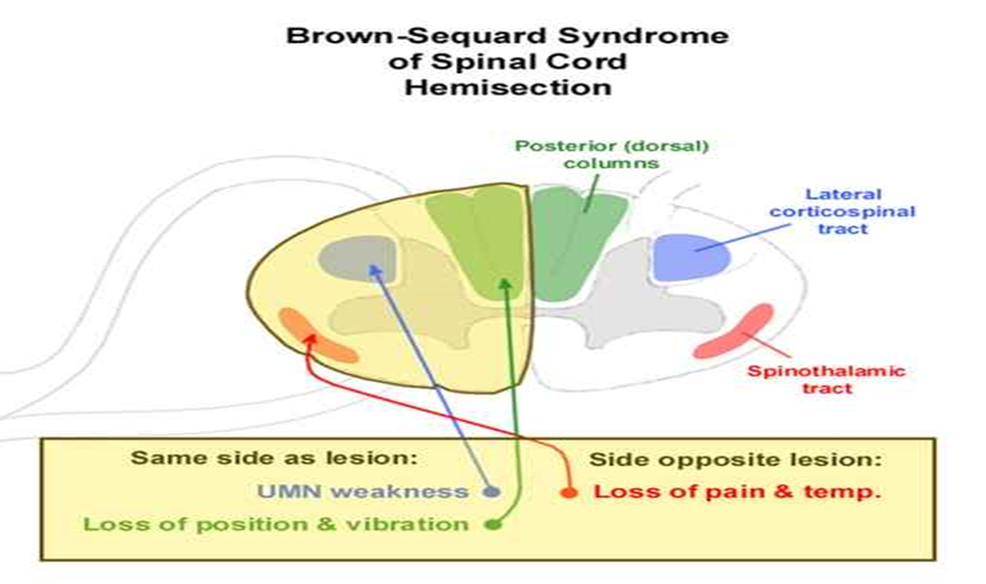

Slide 20
TRANSECTION OF CORD
IF ABOVE C 5- PHRENIC NERVE INVOLVED- PATIENT DIES.
IF BELOW C 5- QUADRIPLEGIA
IF BETWEEN CERVICAL AND LUMBO-SACRAL ENLARGEMENTS – PARAPLEGIA
: PARAPLEGIA IN EXTENSION – INCOMPLETE TRANSECTION
: PARAPLEGIA IN FLEXION – COMPLETE TRANSECTION

Slide 21
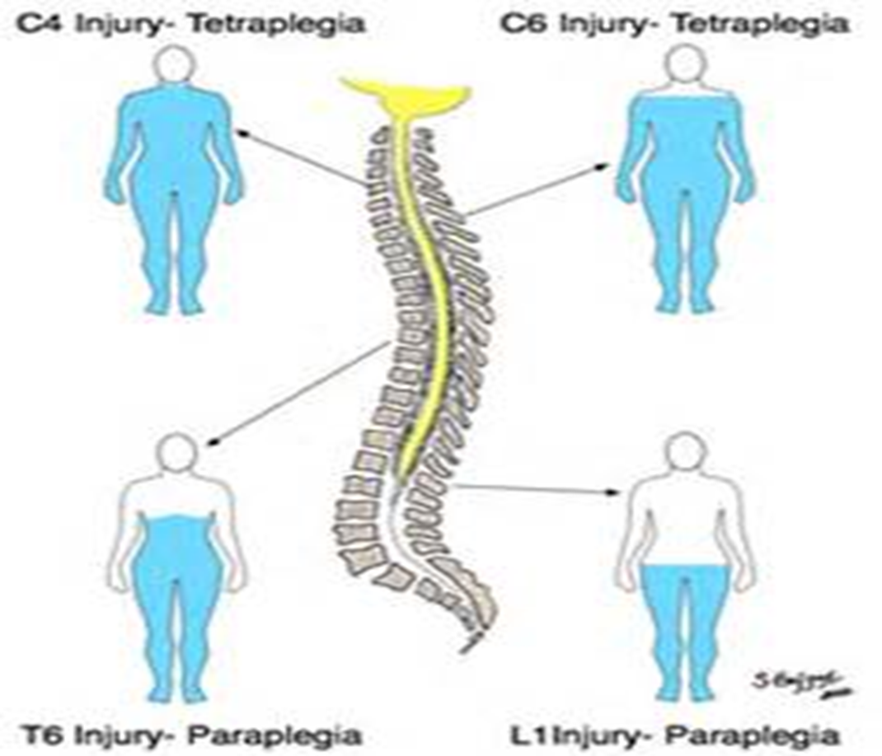

Slide 22
Title | Author/Journal | Material | Result | Conclusion
Event-related beta EEG-changes during passive and attempted foot movements in paraplegic patients | Gernot R. Müller-Putz, , Doris Zimmermann, Bernhard Graimann, Kurt Nestinger, Gerd Korisek, Gert Pfurtscheller Brain Research Volume 1137, 16 March 2007, Pages 84–91 | The present study compares ERD/ERS patterns in paraplegic patients (suffering from a complete spinal cord injury) and healthy subjects during attempted (active) and passive foot movements | The results showed midcentral-focused beta ERD/ERS patterns during passive, active, and imagined foot movements in healthy subjects. | This is in contrast to a diffuse and broad distributed ERD/ERS pattern during attempted foot movements in patients.

Slide 23
MCQ
Q. 1 DORSAL ROOT GANGLIA COMPRESSION CAUSES ALL EXCEPT
CONTRALATERAL PARALYSIS
ANAESTHESIA
ATONIA
AREFLEXIA

Slide 24
MCQ
Q. 2 LESION OF LATERAL SPINOTHALAMIC TRACT CAUSES LOSS OF
VIBRATION
PAIN & TEMPERATURE
SENSE OF POSITION
SENSE OF MOVEMENT

Slide 25
MCQ
Q. 3 ALL IS TRUE ABOUT LOWER MOTOR NEURON LISION EXCEPT
HORNER’S SYNDROME
AREFLEXIA
ATONIA
SPASTIC PARALYSIS

Slide 26
MCQ
Q. 4 CLASP KNIFE MOVEMENT OCCURS IN
UPPER MOTOR NEURON LESION
SYRINGOMYELIA
LOWER MOTOR NEURON LESION
TABES DORSALIS

Slide 27
MCQ
Q. 5 IF THE SPINAL CORD IS INJURED BETWEEN CERVICAL AND LUMBOSACRAL ENLARGEMENT IT CAUSES
PARAPLEGIA
MONOPLEGIA
QUADRIPLEGIA
HEMIPLEGIA

Slide 28
MCQ - KEY
1. a
2. b
3. d
4. c
5. a

