Slide 1
  Shoulder joint (Glenohumeral joint)
Dr. Kinjal Jethva
Assistant Professor
Department of Anatomy
S.B.K.S.M.I. & R.C.

Slide 2
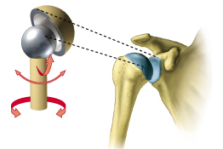
Type of joint
Ball and scoket type of synovial joint
www.slideworld.org/.../shoulder-joint-exam-ppt-2844836

Slide 3
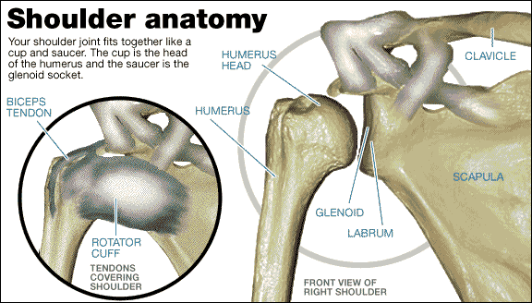
Formation of shoulder joint
Glenoid cavity of scapula
Head of the humerus
www.slideworld.org/.../shoulder-joint-exam-ppt-2844836

Slide 4
Stability of the joint maintained by:
Coracoacromial arch
Musculotendinous cuff or rotator cuff
Glenoidal labrum
Muscles surroundings the joint
Atmospheric pressure

Slide 5
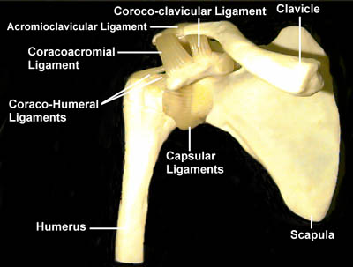
Ligaments
    Fibrous capsule
    Glenohumeral ligaments
    Coracohumeral ligament
    Transverse humeral ligament
    Glenoidal labrum
instruct.uwo.ca/kinesiology

Slide 6
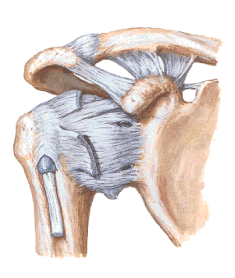
Coracoclavicular
Acromioclavicular
Coraco-acromial Lig.
Superior, Middle and Inferior Glenohumeral Ligament
instruct.uwo.ca/kinesiology

Slide 7
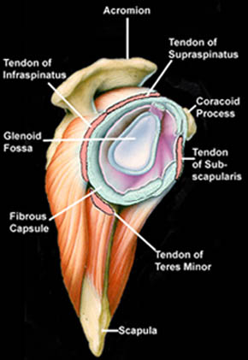
LABRUM
Cartilage ring around the glenoid. Deepens the socket of the G-H Joint.
instruct.uwo.ca/kinesiology

Slide 8
Blood supply
Anterior circumflex humeral vessels
Posterior circumflex humeral vessels
Suprascapular vessels
Subscapular vessels

Slide 9
Nerve supply
Axillary nerve
Musculocutaneous nerve
Suprascapular nerve

Slide 10
Movement of joint
Flexors
  pectoralis major, anterior deltoid, coracobrachialis
Extensors
  Posterior deltoid, latissimus dorsi, teres major, teres minor subscapularis
Abductors
  Anterior and middle deltoid, supraspinatus
Adductors
  latissimus dorsi, teres major, teres minor
medial rotators
  subscapularis, pectoralis major, latissimus dorsi, anterior deltoid
lateral rotators
  Teres minor, infraspinatus, posterior deltoid
instruct.uwo.ca/kinesiology

Slide 11
Applied anatomy
Dislocation of the joint
Shoulder tip pain- irritation of the diaphragm
Frozen shoulder
Arthroplasty on the shoulder joint
Arthroscopy on the shoulder joint

Slide 12
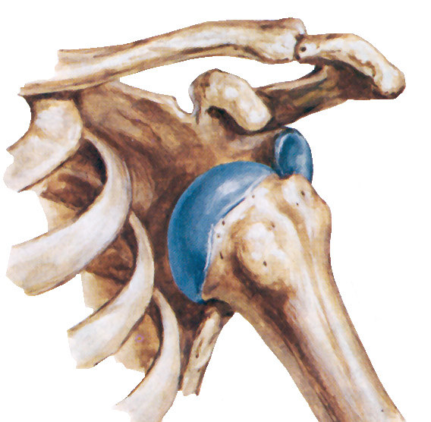
www.similima.com

Slide 13
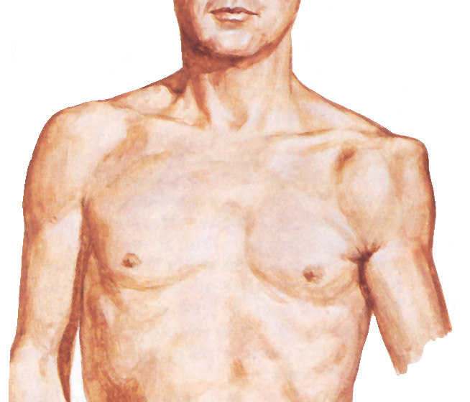
Subcoracoid Dislocation
www.similima.com

Slide 14
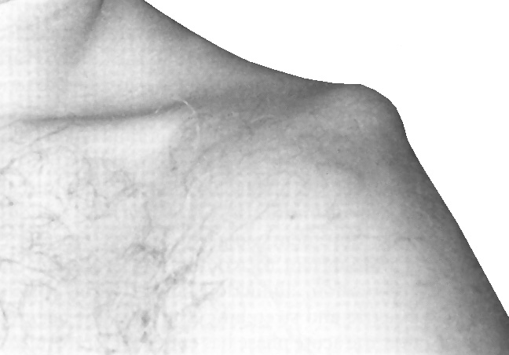
Anterior Dislocation
www.similima.com

Slide 15
Evidence on the applied of shoulder joint

Slide 16
Angela Cadogan1*, Mark Laslett1,2, Wayne A Hing1, Peter J McNair1 and Mark H Coates3, Cadogan et al. BMC Musculoskeletal Disorders 2011, 12:119
Angela Cadogan1*, Mark Laslett1,2, Wayne A Hing1, Peter J McNair1 and Mark H Coates3 | A prospective study of shoulder pain in primary care: Prevalence of imaged pathology and response to guided diagnostic blocks | Consecutive patients with shoulder pain recruited from primary care underwent standardised x-ray, diagnostic ultrasound scan and diagnostic injections of local anaesthetic into the SAB and ACJ. Subjects who reported less than 80% reduction in pain following either of these injections were referred for a magnetic resonance arthrogram (MRA) and GHJ diagnostic block. | Ultrasound evidence of a biceps tendon sheath effusion (OR 8.0; p < 0.01) and an intact rotator cuff (OR 1.3; p < 0.05) were associated with PAR to GHJ injection. No imaging findings were strongly associated with PAR to ACJ injection (p ≤ 0.05). | Rotator cuff and SAB pathology were the most common findings on ultrasound and MRA. Evidence of a full thickness supraspinatus tear was associated with symptoms arising from the subacromial region, and a biceps tendon sheath effusion and an intact rotator cuff were associated with an intra-articular GHJ pain source. When combined with clinical information, these results may help guide diagnostic decision making in primary care.

Slide 17
Shah N, Bartsokas T, Wagner R, The Journal Of Family Practice [J Fam Pract], ISSN: 1533-7294, 2012 Jan; Vol. 61 (1), pp. 16-22; PMID: 22220291
Nilesh Shah. MD; Tom Bartsokas, MD; Ryan Wagner, MD | Shoulder pain: 3 cases to test your diagnostic skills | The 3 cases* that follow, and the takeaway message incorporated in each, will give you an opportunity to test—and to hone— your shoulder pain diagnostic skill. | Rotator cuff tear was suspected because Robert had positive elements of the "rotator cuff triad"—supraspinatus weakness (as indicated by a positive empty can test), external rotation weakness (revealed by the French horn test), and a positive Hawkins impingement test. | all 3 are positive, there is a 98% chance of a rotator cuff tear; if 2 tests are positive and the patient is older than 60 years, the findings are suggestive of a tear; and if all 3 tests (plus the drop arm test) are negative, there is less than a 5% chance of a major rotator cuff tear."*

Slide 18
Brett D. Owens, MD, Jonathan F. Dickens, MD, Kelly G. Kilcoyne, MD, John-Paul H. Rue, MD, The Journal Of The American Academy Of Orthopaedic Surgeons [J Am Acad Orthop Surg], ISSN: 1067-151X, 2012 Aug; Vol. 20 (8), pp. 518-26; PMID: 22855854
Brett D. Owens, MD Jonathan F. Dickens, MD Kelly G. Kilcoyne, MD John-Paul H. Rue, MD | Management of Mid-season Traumatic Anterior Shoulder Instability in Athletes Lower level of evidence | Shoulder dislocation and subluxation injuries are common in young athletes and most frequently occur during the competitive season. Controversy exists regarding optimal treatment of an athlete with an in-season shoulder dislocation, and limited data are available to guide treatment. | Surgical management of shoulder dislocation or subluxation with arthroscopic or open Bankart repair reduces the rate of recurrence; however, the athlete is unable to participate in sport for the remainder of the competitive season. | Although some athletes with an initial instability injury and primary soft-tissue pathology may be able to return to sport within 3 weeks, motion-restricting braces may be helpful in preventing recurrence.

Slide 19
Summary: Shoulder Joint
Bones: Humerus, Scapula (Glenoid Fossa)
  glenohumeral joint
Muscles
  Rotator Cuff
    supraspinatus, infraspinatus, teres minor, subscapularis
  deltoid, coracobrachialis, teres major, latissimus dorsi, pectoralis major
Stability is sacrificed for flexibility
    Ligaments:Fibrous capsule, Glenohumeral ligaments, Coracohumeral ligament, Transverse humeral ligament, Glenoidal labrum

Slide 20


