Slide 1
Ultra-violet Radiation
Dr.Nalina Gupta

Slide 2
Invisible radiation beyond the violet end of the visible spectrum was termed “ultravioletten” by Johann Ritter in 1801.
Ultra-violet radiation is electro-magnetic energy which is invisible to human eye, with wave-lengths between 10nm and 400nm.
It lies between visible light and X-rays in the electro-magnetic spectrum.

Slide 3
Classification of UVR
Region | Wavelength (nm) | Other names
Biotic UVA UVB Abiotic UVC | 400-315 315-280 280-100 | Long UV, blacklight MediumUV, erythemal UV Short UV, germicidal UV

Slide 4
Production of UVR
For the therapeutic purpose, ultraviolet generators are used which take the form of lamps.
They employ either a high or a low pressure tube across which a current is passed.

Slide 5
Production of UVR
High pressure mercury vapour burner
The Kromayer lamp
Fluorescent tubes

Slide 6
High Pressure Mercury-vapour Burner
U-shaped burner
The burner is made of quartz (can withstand very high temperature and has a fairly low coefficient of expansion)
Quartz allows the passage of UVR
Argon gas is enclosed in the tube at low pressure
A small quantity of mercury is also enclosed in the tube
Electrodes are sealed at either end

Slide 7
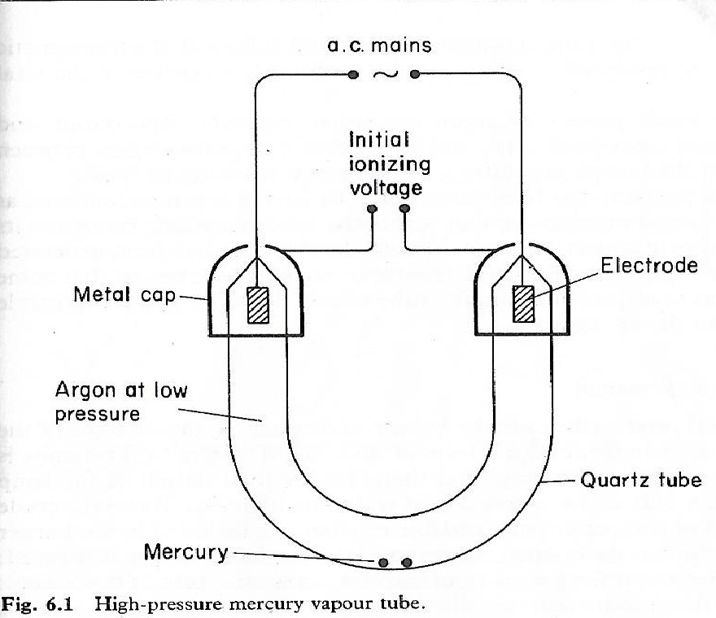

Slide 8
Two metal caps are surrounding the ends across which a high potential difference is applied.
Argon is normally extremely stable and inert
In order to pass a current through the tube, the argon atoms must be ionized
Applying very high potential difference (400 volts) across the tube for a fraction of a second → ionize the argon

Slide 9
Start button---- auto-transformer---- step up to 400 volts ----- once the argon gas is ionized----- normal mains voltage
Electrons move towards positive terminal and then around the circuit
Positive ions move towards the negative terminal and collect an electron
Exactly the same number of electrons leave the burner at the positive terminal as enter the negative

Slide 10
Two way movement of charged particles causes further ionization so that there is continuous generation of ionized particles to sustain the current flow across the tube
Eventually sufficient heat is produced to vaporise the liquid mercury inside the tube, and this mercury vapour itself becomes ionized.

Slide 11
UVR is produced
Partly as energy released by the re-combination of electrons and positive mercury ions
Partly by photons released when excited electrons return from a higher energy quantum shell to their normal shell within the mercury atoms
UVR forms only a portion of the total output as visible and Infra-red waves are also produced.

Slide 12
The whole process of argon ionization, mercury vaporization and ionization takes some time, thus, a period of 5 minutes elapses between starting the burner and UVR emission reaching its peak.
Similarly, once the lamp is turned off, ions of argon and mercury re-combine, thus some time has to be elapsed, allowing the tube to cool down.

Slide 13
Heat produced inside the burner unfortunately causes some of the quartz to change to another form of silica called tridymite
Tridymite is opaque to UVR
As a very crude method of compensation, a variable resistance is included in the burner circuit
Burning time is recorded
After 1000 hours of burning, whole burner tube needs to be replaced

Slide 14
The photochemical action of UVR shorter than 250nm in wavelength on atmosphere oxygen is to form ozone.
Ozone is a toxic gas
It could be detected by smell at extremely low levels (0.1 parts per million)

Slide 15
The Kromayer Lamp
It is a water-cooled mercury vapour lamp
It eliminates the danger of an IR burn
It can be used in contact with the tissues, or with a suitable applicator to irradiate inside a sinus or body cavity
Working is same as for the air-cooled lamp
High pressure mercury vapour burner is completely enclosed in a jacket of circulating distilled water, the purpose of which is to absorb the infra-red.

Slide 16
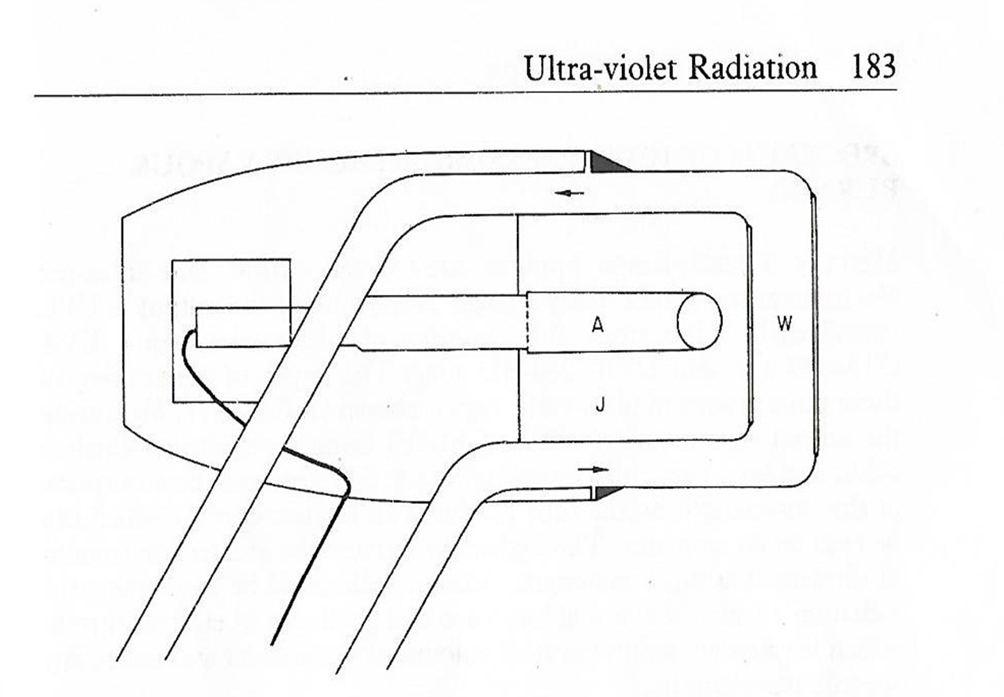
Kromayer lamp

Slide 17
A pump and cooling fan are incorporated into the body of the kromayer lamp in order to cool the water.
After use, water circulation should be continued for five minutes after the burner is switched off in order to cool the lamp.
Water circulates between two quartz windows which allow the ultra-violet to emerge.
Applicators for the treatment of sinus

Slide 18
Mercury vapour lamps produce UVR, IRR and visible electro-magnetic waves
Only a small proportion is of UVC
Majority is of UVA and UVB

Slide 19
Fluorescent Tubes
Major problem with mercury lamps is that it produces a certain proportion of short ultra-violet rays
The spectrum of each tube depends on the type of phosphor coating
Each tube is about 120cm long and made of a type of glass which allows long wave ultra-violet to pass
The inside of the tube is coated with a special phosphor

Slide 20
A low pressure arc is set up inside the tube between its ends by a process of ionization similar to that described for the mercury vapour tube.
Short UVR is produces but it is absorbed by the phosphor and re-emitted at a longer wavelength

Slide 21
Theraktin tunnel
It is a semi-cylindrical frame in which are mounted four fluorescent tubes.
Each tube is mounted in its own reflector in such a way that an even irradiation of the patient is produces, allowing treatment of the whole body in two halves.
Spectrum of 280-400nm are used.

Slide 22
PUVA apparatus
Irradiation only with UVA with special fluorescent tubes
It may be mounted in a vertical battery on a wall, or on four sides of a box totally surrounding the patient
It is usually given two hours after the patient has taken a photoactive drug such as psoralen: hence the term PUVA (psoralen UVA)

Slide 23
Physiological effects of Ultra-violet
Acute effects of UVR
Sun-burn
Classic signs of inflammation- pain, swelling, redness and warmth
The severity depends on the skin type and dosage
Depletion of Langerhans cells and, consequently, immuno-suppression

Slide 24
Erythema or reddening (uniform, not mottled), appears immediately after or within hours of an application (latent period), increases and then fades
Oedema, irritation and desquamation (peeling) if UVR is sufficiently intense
Next time, less strong reaction due to the pigmentation and skin thickening

Slide 25
Degree of Erythema | Approximate latent period | Appearance | Approximate duration | Skin discomfort | Desquamation | Relation to E1 | Other features
E1 | 6-12 h | Mildly pink | <24 h | None | None | X 1
E2 | 6 h | Definite pink- red | 2 days | Slight soreness | Powdery | X 2.5 | Blanches on compression
E3 | 3 h | Very red | 3-5 days | Hot and painful | In thin sheets | X 5 | Does not blanch on compression
E4 | <2 h | “angry” red | 1 week | Very painful | In thick sheets | X 10 | Blistering

Slide 26
Longer-term effects of UVR
Initiation of tanning or melanogenesis
Pigmentation changes
Immuno-suppression
Increased skin growth or hyperplasia of the dermis, epidermis and stratum corneum
Increased keratinocyte cell turnover- 20 to 40% increase in the number of cell layers in stratum corneum

Slide 27
Both protective effects (pigmentation and hyperplasia) fades over 4-6 weeks if no further application of UVR
Cumulative longer term effect, especially to UVB, is Photoageing- skin becomes dry, wrinkled, inelastic and leathery with collagen fibrils degrading and becoming disorganised.
Production of Vitamin-D requires minimal amount of regular exposure

Slide 28
DNA Damage and Skin Cancer
Repeated exposure can lead to the development of actinic keratosis, which may in turn, become squamous cell carcinoma.
Cutaneous melanoma
Recent evidence suggests UVA poses the greatest malignancy risk.

Slide 29
Effect of UVR on the Eye
Strong doses of UVB and UVC can cause conjunctivitis and photokeratitis
These produce watering, a feeling of grit in the eye and photophobia
Severe cases, intense pain and spasm of eye-lid
Most damaging wave-length- 270nm
High doses of UVA has been implicated in the formation of cataracts

Slide 30
Acute Effects (On Skin) | Acute Effects (On Eyes) | Chronic Effects (On Skin)
Erythema Pigmentation Thickening (hyperplasia) Vitamin D production Cell DNA damage Immunosuppression | Conjunctivitis Photokeratitis | Photoageing Tumour initiation and promotion

Slide 31
Therapeutic Uses and Indications
Principal therapeutic use is to treat skin diseases
Psoriasis
Vitiligo
Other uses
Mild deficiency of Vitamin D
PUVA- miscellaneous dermatoses, cutaneous T cell lymphomas, atopic dermatitis, lichen planus, cutaneous mastocytosis
UVB- atopic dermatitis, photodermatoses, scleroderma, urticaria pigmentosa and seborrhoeic dermtaitis

Slide 32
Chronic uses
To control surface bacterial infections
Infected open wounds such as pressure sores with high doses of UVR
Historical uses
Acne vulgaris, eczema

Slide 33
The extent of biological response to UVR depends on three main factors:
Skin type
Skin sensitivity
Recent exposure of skin to UVR

Slide 34
Skin Type | Response to UVR exposure
Type I Type II Type III Type IV Type V Type VI | White skin, always burn, never tans White skin, always burn, tans slightly White skin, sometimes burns, always tans Olive skin, rarely burns, always tans Brown skin, never burns, always tans Black skin, never burns, always tans

Slide 35
Treatment Principles using UVR
Requirements:
Knowledge of the condition
Skin response to UVR
While planning to use UVR, a therapist must be aware of
Grades of erythema
Erythema testing
Skin photosensitizers
Progression of treatment

Slide 36
Grades of Erythema
Four grades (E1, E2, E3, E4)
“First degree erythema (E1) and “minimal erythemal dose (MED)” refer to the response used to define a dose and a subsequent doses
MED- Minimal erythemal dose
MPD- minimal perceptible dose or minimal phototoxic dose
MPE- minimal perceptible erythema

Slide 37
Check for any contra-indications for using UVR
Check and record any use of photo-sensitizers- topical applications or systemic applications
Check skin is freshly washed
Explain the test carefully
Get patients’ consent
Include a warning that 2-3 red marks may be visible for a day or two and for those who tan readily, a slight pigmented mark for a week or so

Slide 38
Provide patient with a UVR protected goggles
UVR source
Turn the lamp 5 minutes prior
While estimating the time to produce the erythema at the intended distance with a given lamp, following factors are used:
The skin classification
Extent of recent exposure
Specific lamp characteristics

Slide 39
If not known, with the alpine sunlamp, an E1 typically takes about 30-90s at 50cm from the burner and a typical Theraktin 4-5 minutes at 50cm. (just a rough guideline)
Distance (usually 50cm)
Any topical application or systemic medication

Slide 40
Template
Decide which test area to use (anterior forearm, or an area of body not exposed to sunlight)
Make a template to cover this area
Use a piece of lint or other blocking material
Cut (three or four or five) separate holes of at least 2cm² and at least 1cm² in the template.
The area chosen must be visible to the patient.

Slide 41
Fix the template firmly to the skin so that only deliberately exposed holes will be irradiated and none are over a joint line.
Applying the test dose
Therapist and patient put on their goggles
Cover the exposed areas
50cm distance
Radiation at right angle to the test area

Slide 42
Uncover the UVR source
Time the exposure to each hole
Usually the first hole is exposed for the entire time, the second for one time less, the third for two time periods less etc.
Post-test
Advise the patient to check their skin at 4 to 6 h intervals for any signs of reddening, pain or swelling and provide them with a card to help them record their observations

Slide 43
Ask the patient to return after 24 hours to check the area
E1 or MED is the hole that appeared last and disappeared first, i.e. the least visible (minimally perceptible) response
Repeat Tests
If the patients’ medications are changed or a topical sensitizer or a new lamp has to be used.

Slide 44
Skin Photosensitizers
Skin develops a increased sensitivity to UVR following the ingestion or topical applications
Prior to erythema testing, the therapist must record all current medications and clean the skin of any topical substances not required for the test or treatment
Care needs to be exercised if patients’ drug regimen has been changed

Slide 45
Progression of ultra-violet dosage
There is increased tolerance of UVR
Dose has to be increased each time to achieve the same erythemal effect
The increased dose needed is only an approximate guide as it depends on skin pigmentation and thickening
These figures only apply if the erythema has faded completely before a further dose of UVR is given

Slide 46
Initial Dose | Earliest time at which the dose can be repeated | Increase (%)
E0 (suberythemal) E1 (MED dose) E2 E3 | 24h 1 or 2 days 3-4 days 7-10 days | 12.5 20 to 25 50 75

Slide 47
Repeat doses are not normally given before the erythema disappears as the skin response is too unpredictable
Advise on the increases used to repeat suberythemal doses varies: 10, 12.5 and 15% of the E1
There is no reason for ever applying an E4 dose to the skin. E4 dose is used only to treat the floor and walls of an open wound.

Slide 48
Proportion of body surface irradiated
Level of erythema | Size of area treated
E0 E1 E2 E3 E4 | Whole body Half or whole body 20 to 25% of body surface 4% of body surface Area in wound only

Slide 49
Test Dose
Air cooled lamp:
Suitable area of skin
Three differently shaped holes
Middle hole is 2cm by 2cm, with the hole on one side larger and the other smaller
Every lamp has its average E1 time and distance

Slide 50
Given the average E1 of the lamp, durations for E2, E3 and E4 doses are calculated as
E2 time= E1 time X 2.5
E3 time= E1 time X 5
E4 time= E1 time X 10
Inverse square law: half the distance requires a quarter the time for the same effect
Patients’ card

Slide 51
Theraktin tunnel
Larger holes (4cm X 4cm)
Abdomen
Kromayer lamp
1. Small holes (0.25 cm X 0.25 cm)

Slide 52
Indications
Acne
Psoriasis
Skin wounds
Intact skin
Counter-irritation

Slide 53
Contra-indications
Hypersensitivity to light
Deep X-ray therapy
Erythema
Skin conditions

Slide 54
PUVA
PUVA means Psoralen and UVA
Psoralens are UV sensitizers which can be applied topically or systematically
Rationale is that UVA dose can be reduced while producing the same therapeutic effect
Treatment is provided in a PUVA unit or cabinet. Some are like the theraktin tunnel and others are in vertical cabinets
PUVA erythema differs from that produced by sunburn or UVB alone.

Slide 55
The effect takes 24 to 36 hours to appear and they peak at 72 to 96 hours or later.
The treatment dose is usually at the E1.
To maintain this level, treatment needs to be systematically increased.
Treatment is typically given twice a week, progressively increasing the dose at weekly intervals for several weeks
The UVA dosage is measured in Jcm⁻²

Slide 56
Dose increases 0.5-1 Jcm⁻²
Topical Psoralen applications
For a small area of psoriasis or a resistant area, a topical preparation of 8-methoxypsoralen is applied
The UVR dose required is less as using a topical application produces a higher local concentration of the drug in the skin than a systematic application
PUVA bath can also be used

Slide 57
Systemic psoralens
Patients are given 8-methoxypsoralen Usome 1-3h before exposure to the UVR
They are given grey or green glasses to wear while sensitized i.e. from the time of taking the tablets until 8h afterwards
They are also warned not to expose themselves to the sun for atleast 8 h from ingestion

Slide 58
Re-PUVA (Retinoid PUVA)
This has been shown to clear those plaques not cleared with either PUVA or retinoids alone at normal dosages

Slide 59
Dangers of PUVA
Increased risk of melanoma with long term repeated use
Marked pigmentation (after 2 or 3 weeks of PUVA treatment)

Slide 60
Thank you

