Slide 1
TRAINING, DEVELOPMENT & CAREER MANAGEMENT
Dr. Subhasish Chatterjee

Slide 2
CONTEXT
NATURE
INPUTS
TRAINING PROCESS
CAREER DEVELOPMENT
SUMMARY

Slide 3
Nature of training & development
Training & Development refer to the imparting of specific skills, abilities & knowledge to an employee.
Training & Development may be understood as any attempt to improve current or future employee perfomance by increasing an employee’s ability to perform through learning,usually by changing employee’s attitude or increasing his or her skills & knowledge.
Training & Development need= Std perfomance – Actual perfomance

Slide 4
Training
It is process of increase the technical skills of employee.
Development
Learning opportunities designed to help employees grow.
Education
It is theoretical learning in classrooms.

Slide 5
Inputs in training & Development
There are some inputs for participants.
1.SKILLS: A worker needs skills to operate machines, and use other equipment with least damage & scrap. This is a basic skill without which the operator will not be able to function.
2.EDUCATION: The purpose of education is to teach theoretical concepts & develop a sense of reasoning & judgement. That any training & development programme must contain an element of education is well understood by HR specialists.
3.DEVELOPMENT:Another component of a training programme is development which is less skill oriented but stresses on knowlegde.

Slide 6
Cont..
An organisation expects the following from its managers when they are deputed to attend any training & development programme.
I. How do we make our managers self starters?
II. How do we make them result oriented?
III. How do we make them sensitive to the environment in which they function ?
IV. How do we make them aware of themselves-their potential & their limitations?
V. How do we teach them communicate without filters, to see & feel points of view different from their own?

Slide 7
Cont
4.ETHICS: There is need for imparting greater ethical oreientation to a training & development programme. There is no denial of the fact that ethics are largely ignored in business. Ethics are important because government & law cannot always protect the society, but ethics can.
5.ATTITUDINAL CHANGES: It represents feelings & beliefs of individual toward others. Attitude affect motivation, satisfaction & job commitment. Negative attitudes need to be converted into positive attitudes. Changing negative attitudes is difficult .

Slide 8
Training & development as source of competitive advantage
Training & Development offer competitive advantage to a firm by removing perfomance defficiencies; making employees stay long; minimising accidents, scrap & damage; meeting future employee needs.
There is greater stability, flexibility & capacity for growth in an organisation.
Training contributes to employee stability in at least two ways. Employees become efficient after undergoing training. Efficient employees contribute to the growth of the firm. Growth renders stability to work force. Further trained employees tend to stay with the company.

Slide 9
Benefits of employee training
Training leads to improved profitability & more positive attitudes toward profit orientation.
It improves the job knowledge & skills at all levels of the organisation.
It helps people identify with organisational goals.
It improves relationship between boss & subordinate.
It helps to prepare guidelines for work.
It helps to provide information for future needs in all areas of the organisation.
It aids in improving organisational communication.

Slide 10
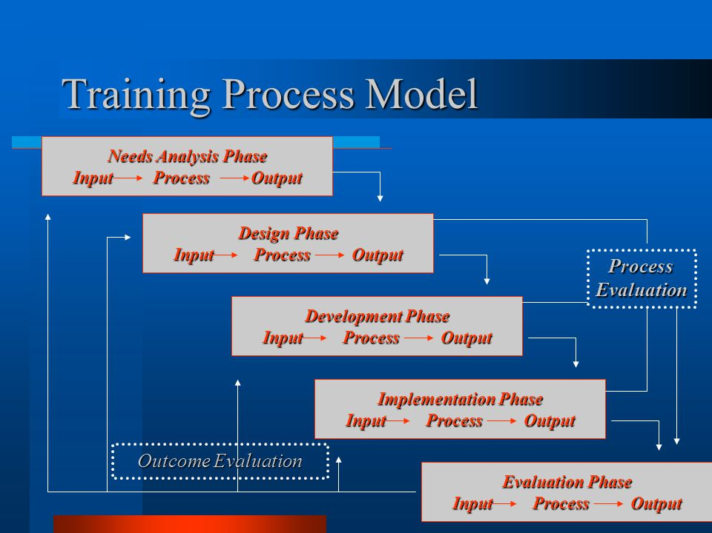
training process model

Slide 11
1. needs assessment
Needs assessment diagnoses present problems & future challenges to be met through training and development. Organisations spend vast sums of money on training & development. Before committing such huge resources, organisation would do well to assess the training needs of their employees.
Need assessment occurs at 2 levels: Group & Individual.An individually obviously needs training when his or her perfomance falls short of expectations.

Slide 12
Cont..
Assessment of training needs must also focus on anticipated skills of an employee. Technology changes fast & new technology demand new skills. It is necessary that the employee be trained to acquire new skills. This will help him or her to progress in his or her career path. Training & Development is essential to prepare the employee to handle more challenging tasks. Individual may also require new skills because of possible job transfers.

Slide 13
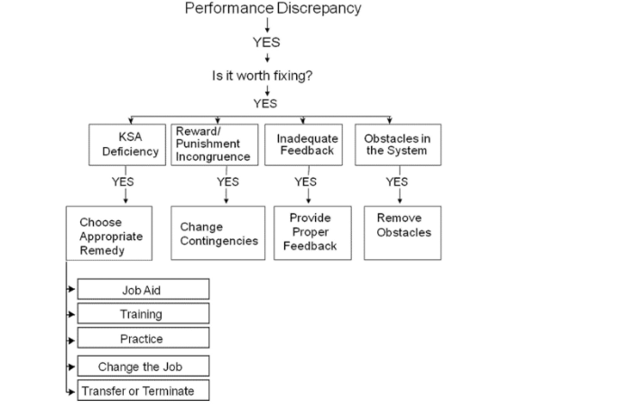
model for initiatives when perfomance discrepancy is identified

Slide 14
Issues in needs assessment
ORGANISATIONAL SUPPORT: When need assessment is carefully designed & supported by firm, disruption is minimised & co operation is much more likely to occur.
TASK & KSA ANALYSIS:In addition to obtaining organisational support & making organisational analysis, it is necessary to assess & identify what tasks are needed on each job & which knowledge, skills & abilities(KSA) are necessary to perform these tasks.
PERSON ANALYSIS: This analysis obviously targets individual employees. Important aspect of person analysis is to determine which necessary KSAs have already been learnt by the prospective trainee so that precious training time is not wasted repeating what has already been acquired.

Slide 15
Benefits of needs assessment
Trainer may be informed about the broader needs of the trainees.
Trainer are able to pitch their course inputs closer to the specific needs of the trainees.
Assessment makes training department more accountable & more clearly linked to other human resource activities, which may make the training programme easier to sell to line managers..

Slide 16
Consequences of absence of training needs assessment
Loss of business
Constraints on business development
Higher labour turnover
Poorer quality applicants
Increased overtime working
Undermining career paths & structures
Higher training costs
Need for job redesign & revision of job specification

Slide 17
2. deriving instructional objectives
Instructional objectives provide the input for designing the training programme as well as for the measures of success that would help assess effectiveness of the training programme.
Below are some sample instructional objectives for a training programme with sales people:
After training, the employees will be able to smile at all customers even when exhausted or ill, unless the customer is irate.
After training, the employees will be able to accurately calculate mark down on all sales merchandise.

Slide 18
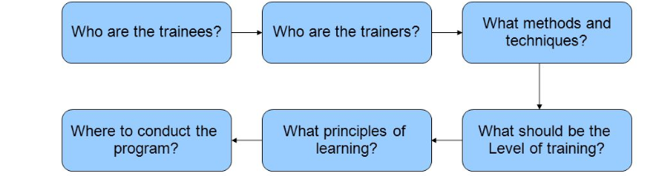
3.designing & training development programme

Slide 19
Who are the trainee?
Trainee should be selected on the basis of self nomination, recommendations of supervisiors by the HR department itself. whatever is the basis, it is advisable to have two or more target audience. Bringing several target audience together can also facilitate group process such as problem solving & decision making.

Slide 20
Who are the trainers?
Training & development programmes may be conducted by several people, include the following:
Immediate supervisors.
Co workers, as in buddy system.
Members of HR staff.
Specialists in other part of company,
Outside consultants.
Industry association
Faculty members at university.

Slide 21
What method for training ?
LECTURES: It is a verbal presentation of information by an instructor to a large audience. A virtue of this method is that is can be used for very large groups & hence the cost per trainee is low.
CASE STUDY: It is a written description of an actual situation in business which provokes, in the reader, the need to decide what is going on, what the situation really is or what the problems are & what can & should be done. Trainees study the cases to determine problems, analyse causes, develop alternative solutions, select the best one & implement it.

Slide 22
Cont..
SENSITIVITY TRAINING: The objective of this training is to provide the participants with increased awareness of their own behaviour & how others percieve them-greater sensitivity to the behaviour of others & increased understanding of group process.
PROGRAMMED INSTRUCTION(PI):This is a method where training is offered without the intervention of a trainer. Information is provided to trainee in blocks, either in a book form of through a teaching machine.

Slide 23
what should be the level of training?
At lowest level, employee must acquire fundamental knowledge.
Goal of next level is skills development, or acquiring the ability to perform in a particular skill area.
The highest level aims at increased operational proficiency. This involves obtaining additional experience & improving skills that have already been developed.

Slide 24
what is learning principles ?
Training & development programmes are more likely to be effective when they incorporate the following principles of learning:
Employee motivation
Recognition of individual differences
Practice opportunities
Reinforcement
Knowledge of results(feedback)
Goals
Schedules of learning
Transfer of learning

Slide 25
Where to conduct programme?
A final consideration is where the training & development programme is to be conducted. Decision comes down to the following choices.
At the job itself(basic skills)
On site but not the job-for example, in a training room in the company(basic grammar)
Off the site, such as in a university or college classroom, hotel, a resort, or a conference centre(Interpersonal & conceptual skills)

Slide 26
4.Implementation of training
Implementation is beset with certain problems. In the first place, most managers are action oreineted & frequently say they are too busy to engage in training efforts. Second one is availability of trainers is a problem.
Programme implementation involve action on the following lines:
Deciding the location & organising training & other facilities.
Scheduling the training programme.
Conducting the programme.
Monitoring the progress of trainees.

Slide 27
5. Evaluation of the programme
Evaluation helps to determine the results of the training & development programme.
NEED FOR EVALUATION:Is to ensure that any changes in trainee capabilities are due to the training programme & not due to any other conditions.
PRINCIPLES OF EVALUATION:
1. Evaluation must be continuous.
2. Evaluation must be specific.
3. Evaluation must be based on objective methods & standards.

Slide 28
how to make training effective ?
Ensure that training contributes to competitive strategy of the firm. Different strategies need different HR skills for implementation.
Ensure that comprehensive & systematic approach to training exists, & training & retraining are done at all levels on a continuous & ongoing basis.
Ensure that there is proper linkage among organisational, operational & individual training needs

Slide 29
CAREER DEVELOPMENT
CAREER is progress or general course of action of a person in some profession or in an organisation.
CAREER PLANNING is a process whereby an individual sets career goals and identifies the means to achieve them.
CAREER DEVELOPMENT refers to a formal approach used by the firm to ensure that people with proper qualifications & experiences are available when needed.

Slide 30
CAREER DEVELOPMENT INITIAVTIVES
CAREER COUNSELLING: It helps employee to discuss their career goals in one to one counseling sessions.Along with goals, other variables identified are capabilities, interest & current job activities & perfomance.
CAREER PLANNING WORKSHOPS: These workshops are designed to guide individuals to figure out their strengths & weakness, job & career opportunity, & necessary steps for reaching their goals.

Slide 31
Cont..
MENTORING: It involves coaching, advising,& encouraging employees of usually lessor ranks.It is also valuable for improving the job involvement & satisfaction of the mentor.
SABBATICALS:These are temporary levels of absence from an organisation, usually at reduced amount of pay.
PERSONAL DEVELOPMENT PLANS(PDP):In these, employees write their own personal development plans. Such development plans include development needs & action plans to achieve them.

Slide 32
Cont..
CAREER WORKBOOKS: These consist of question & exercises designed to guide individuals to figure out their strengths & weakness, job & career opportunities, & necessary steps for reaching their goals. Many workbooks are tailor-made for a particular firm & can be completed in several sessions.

Slide 33
summary
Skills, education, development, ethics, attitudinal changes & decision making skills must go into any programme of Training & Development. A programme of training & development is important as it lends stability & flexibility to an organisation.
There are several initiatives for career planning & career development, but it is not just organisations alone, even the employees themselves have a role in shaping their careers.

Slide 34


